Slide 1
SDC PDS Review KEM Encounter Data: 2018-08-14 to 2022-04-09
A.R. Poppe
U.C. Berkeley
October 17, 2022

Slide 2
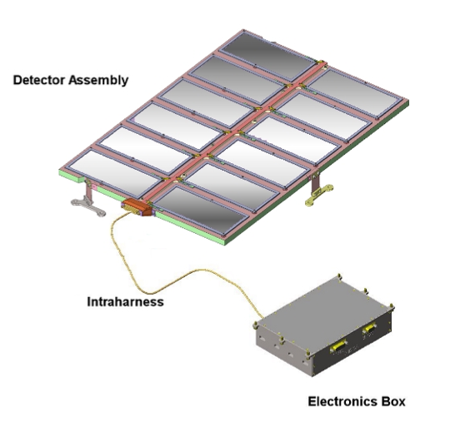
SDC Instrument
SDC instrument:
- 14 detectors: 12 science (with 1 defunct), 2 reference
- electronics box for signal processing, telemetry/commands

Slide 3
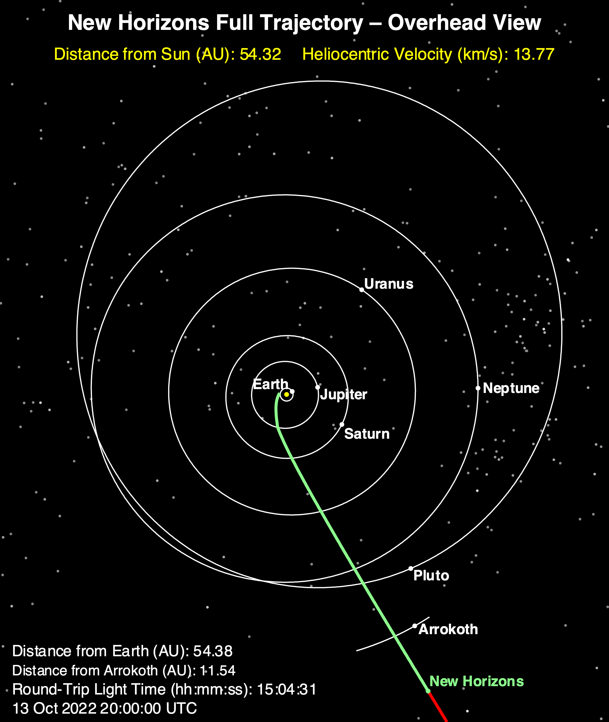
Current Release
Current dataset:
KEM Encounter + Cruise
Aug 2018 to Apr 2022

Slide 4
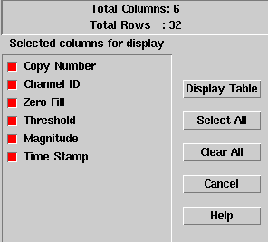
KEM Encounter: SDC Raw Data
Includes SDC raw scientific data, SDC housekeeping (engineering telemetry), New Horizons spacecraft housekeeping (0x004, 0x00D, 0x00A), and New Horizons thruster firing fata
The SDC raw scientific data includes channel (detector) number, data threshold, data magnitude, and time stamp

Slide 5
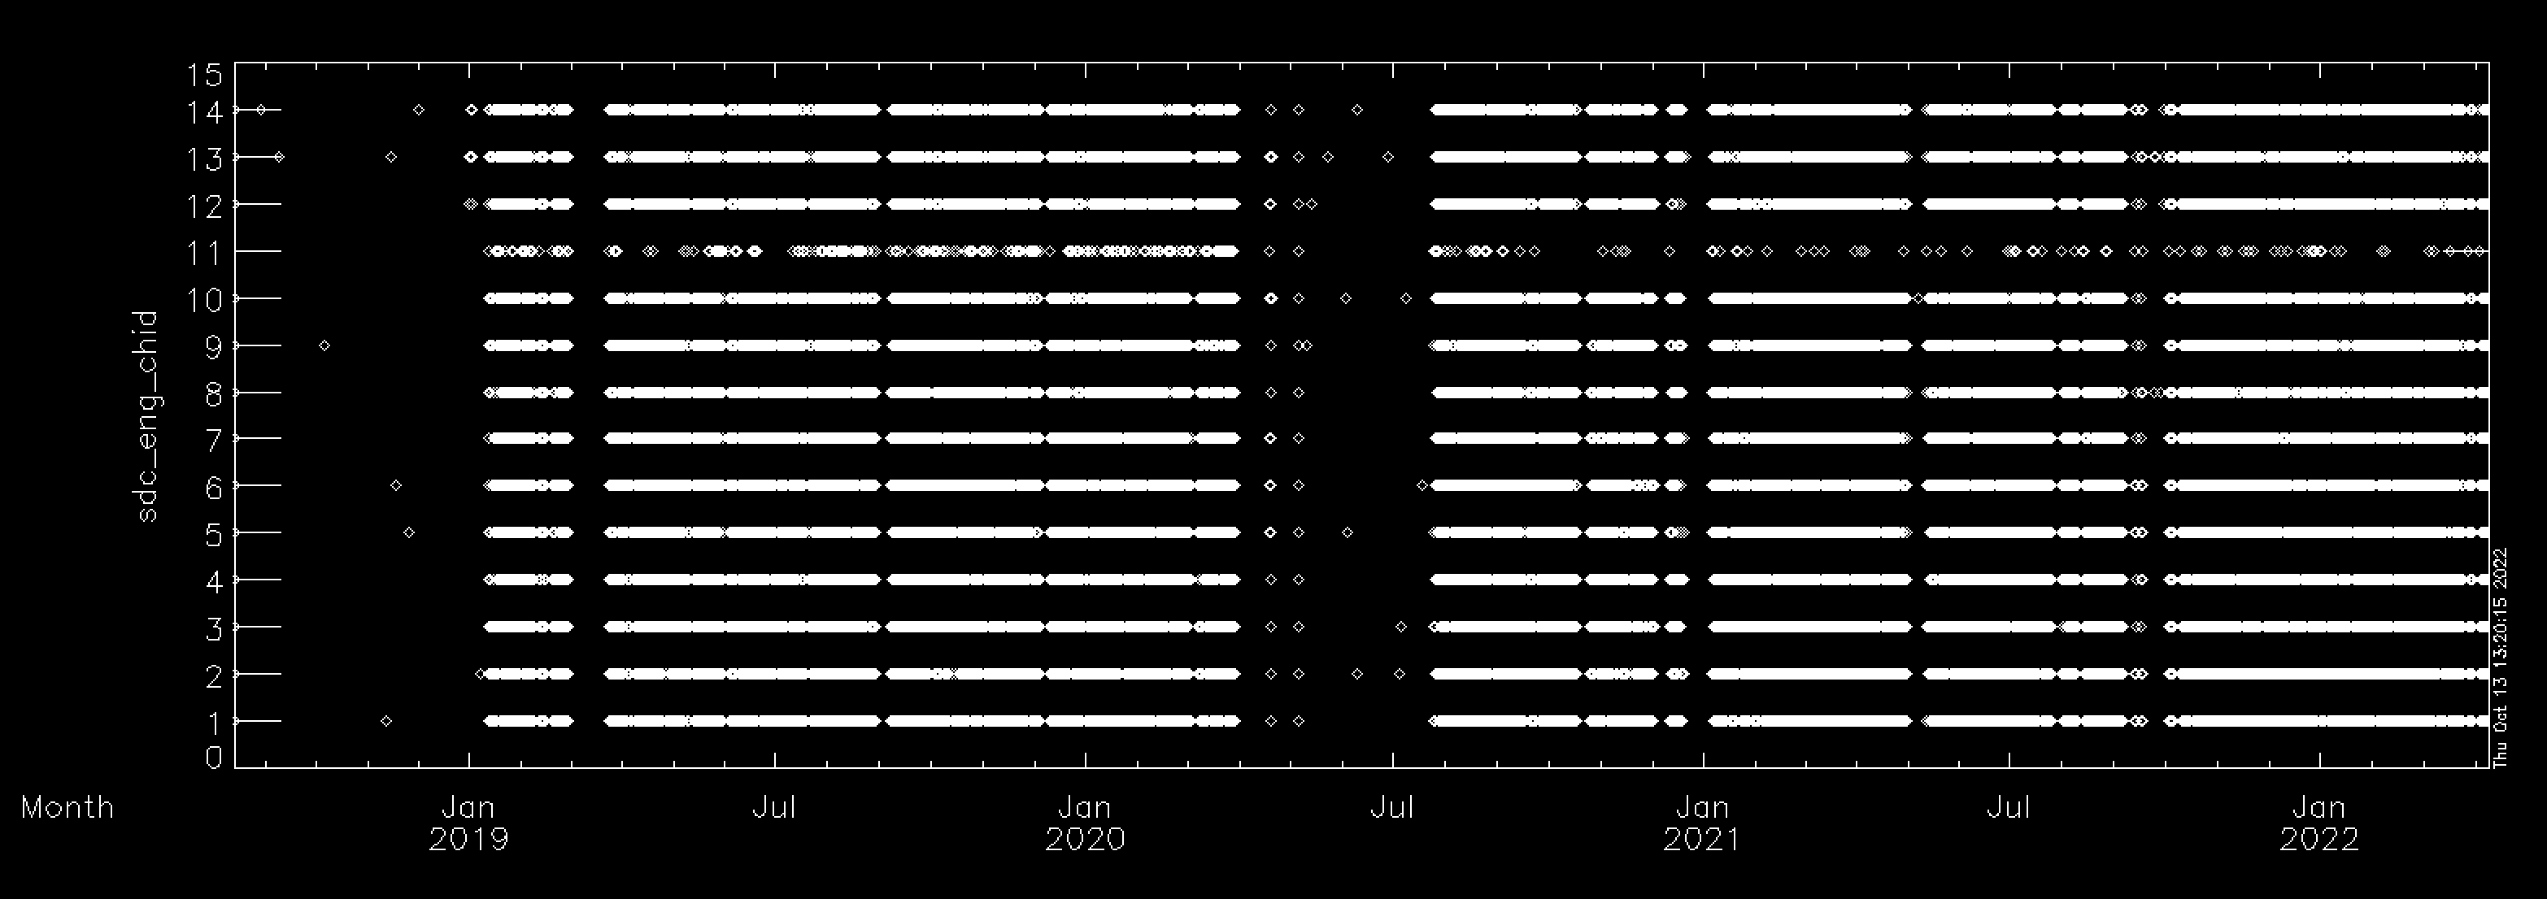
KEM Encounter: SDC Raw Data
Channel ID# versus Time looks good
Very few hits leading up to Jan 1 encounter as expected from high thresholds
Continued periodic cruise measurements with ACO breaks in counts (Apr-Jul 2020)
Total number of events: 62,010
Time period covers: Aug 15, 2018 – April 9, 2022

Slide 6
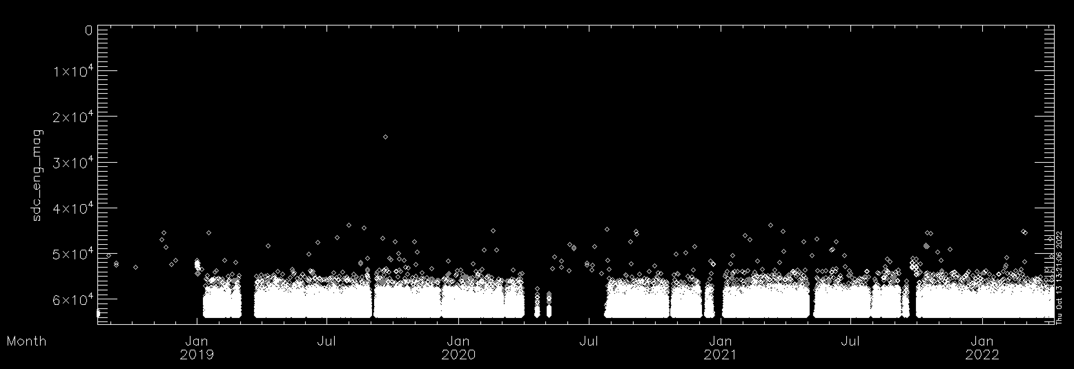
KEM Encounter: SDC Raw Data
Magnitude versus Time looks good
Very few hits leading up to Jan 1 encounter as expected from high thresholds
Continued periodic cruise measurements with ACO breaks in counts (e.g., Apr-Jul 2020)
Total number of events: 62,010
Time period covers: Aug 15, 2018 – April 9, 2022

Slide 7
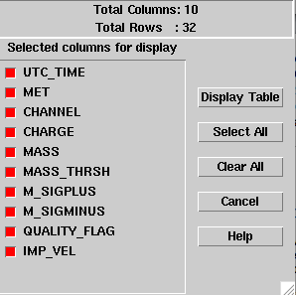
KEM Encounter: SDC Calibrated Data
Includes SDC calibrated scientific data
The SDC calibrated scientific data includes time, channel, charge, mass, mass threshold, error bars, quality flag, and theoretical SDC-dust relative impact velocity

Slide 8
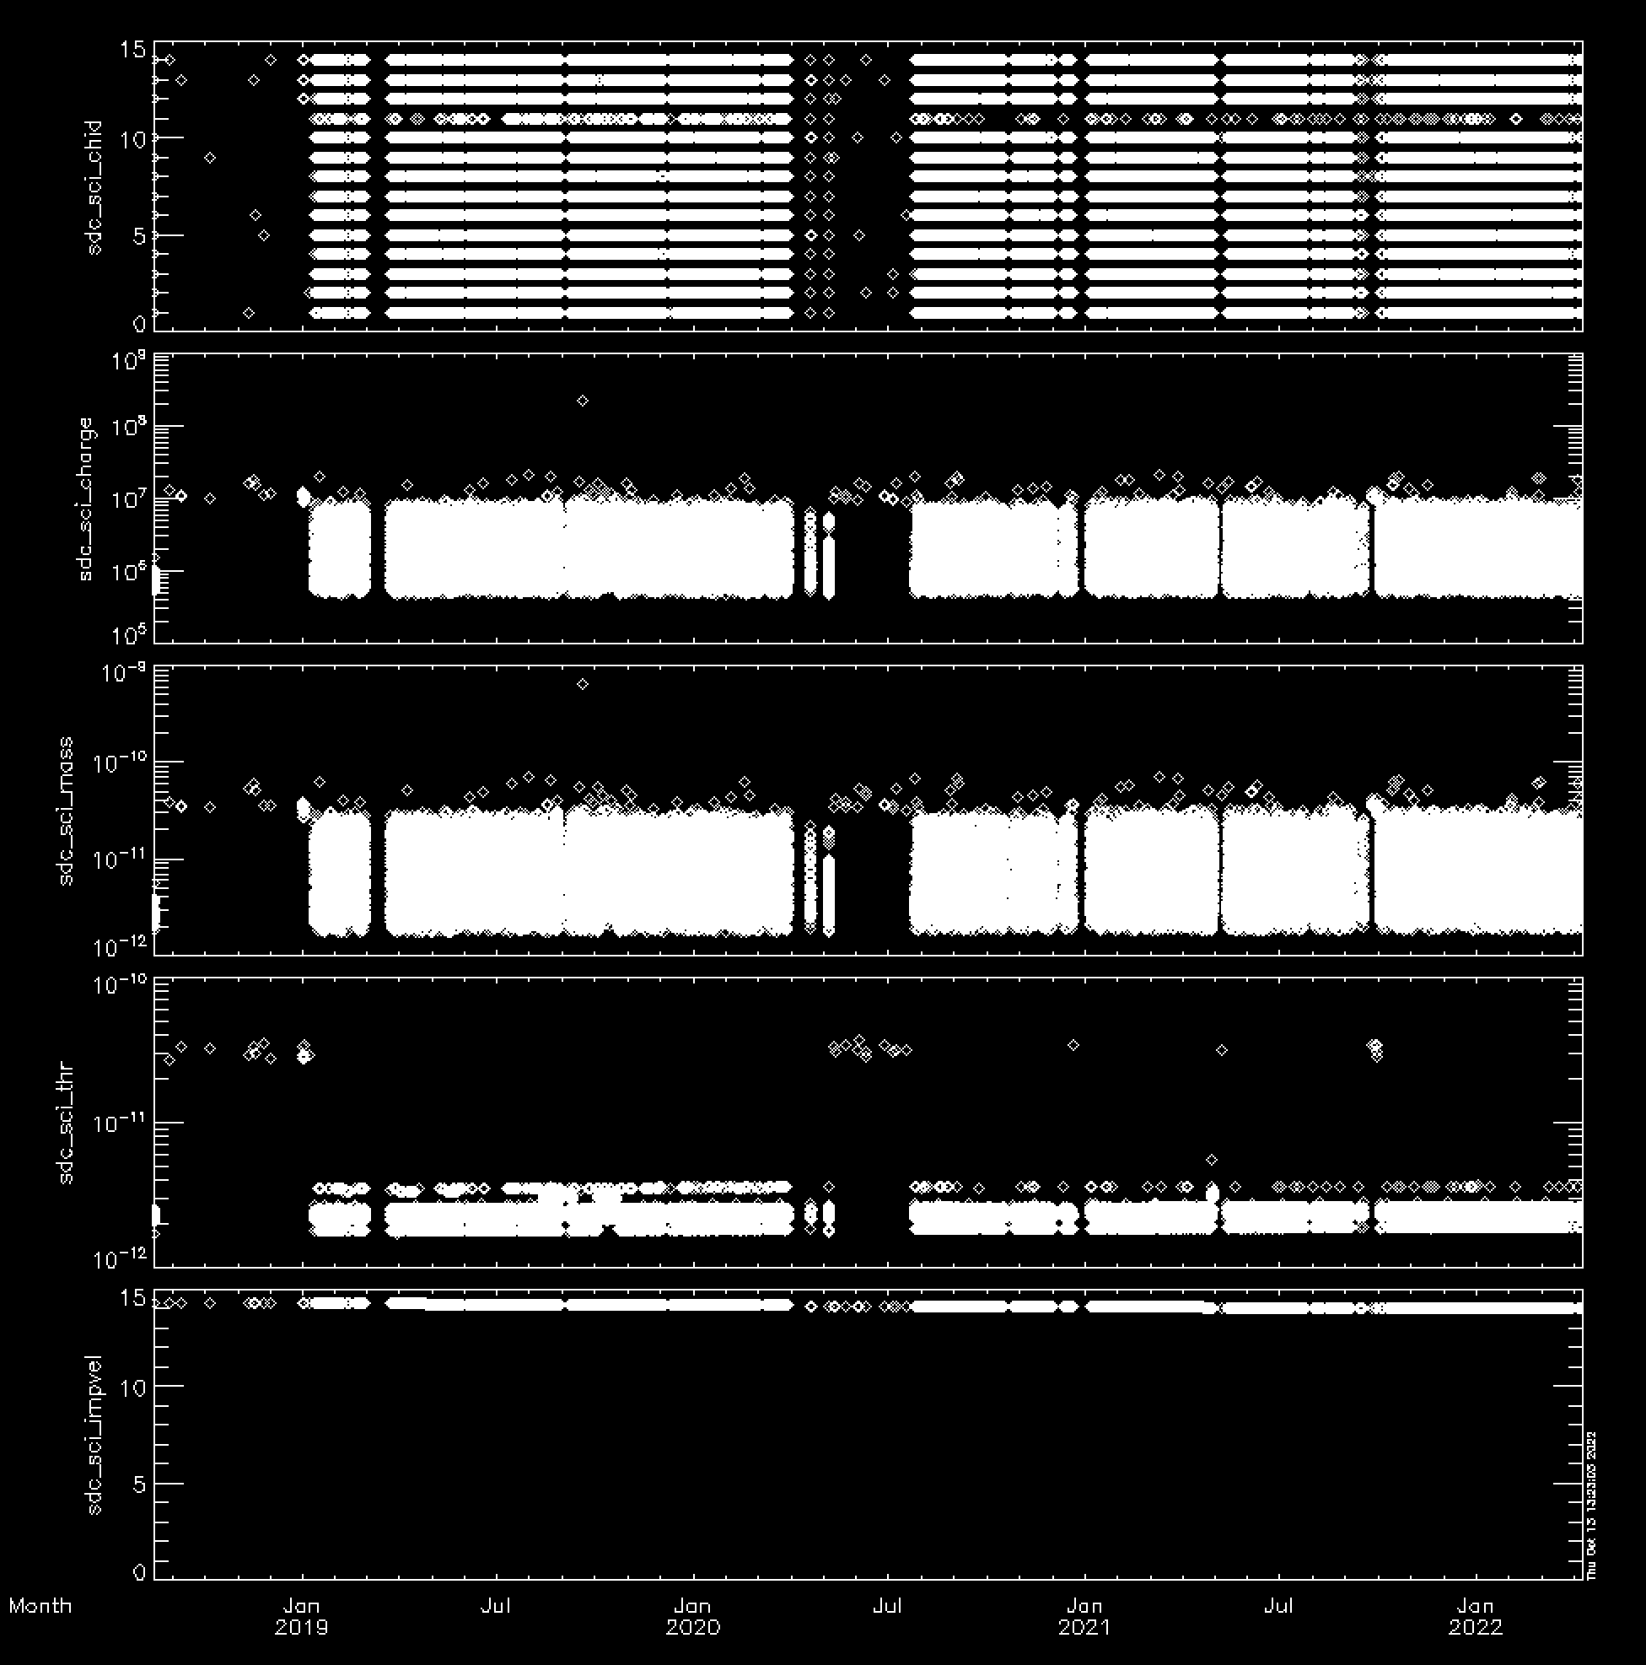
KEM Encounter: SDC Calibrated Data

Slide 9
Completeness:
The delivered dataset has a complete set of files and documentation
Adequate completeness of each data record (i.e., one dust hit)
Intelligibility:
Documentation is adequate and straightforward
SDC data are intelligibly formatted through FITS files, both raw and calibrated
Metadata are straightforward through ASCII implementation
Interpretability:
Given the relatively simple nature of SDC operations, the data are straightforwardly interpretable; no issues noted here

