Slide 1
DART/DRACO Data Review
Jian-Yang Li
Planetary Science Institute
February 28, 2023

Slide 2
Overview
DART/DRACO data bundle
Three data collections
Raw data (raw)
Calibrated data (cal)
Documentation
Contain all images collected by DRACO throughout the DART mission
From commissioning to the last partial image in the final phase
Calibration data are also included in the cal data collection
Document collection includes three files: SIS v2, calibration pipeline description v2, and Dimorphos coordinate system v1
Review summary: No major problems found, one very minor issue about geometry to be discussed, and some typos
GREAT JOB DRACO TEAM!

Slide 3
Review Process
Documentation
Compare with the previous version for the SIS and Calibration Pipeline Description
Read through the coordinate system documentation
Data
Only reviewed data from three phases: approach, terminal, and final
Extracted and checked the values of many keywords for all raw and cal images based on SIS and Calibration pipeline description, to search for any conflicts, inconsistencies, or if the values make sense
Checked the orientation of a few images using multiple software
Compared raw and cal images for the consistency of keywords
Calculate some basic geometric parameters using SPICE and compare with the values in image headers
Didn’t do
Check data from commissioning and cruise phases
Try to calibrate the data from raw to cal following the calibration document

Slide 4
Results
No inconsistency in keyword values and descriptions is identified
Image can be opened and displayed correctly with python module `astropy.io.fits`, DS9, and PDS4_viewer, all with consistent orientation as described in SIS, PDS labels (.xml), and the PNG thumbnails
Discrepancies in the geometric parameters, details next slide
Some typos listed in next page

Slide 5
Geometry keyword values
Calculated seven geometric keywords: heliocentric distance, s/c range, phase angle, sub-s/c lat lon and sub-solar lat lon, all w/r to Dimorphos, and compare with the values in the FITS headers
Use meta kernel dart_v01.tm, and all the kernels downloaded from NAIF from the link on PDS review page
didymos_system.tf has a version v002, but xml label has v001. But this doesn’t matter because this is just the definition of various NAIF names, the difference is the addition of dsk names
Keyword values extracted from FITS headers: SHDIST, SSCRNG, SSPHASE, SSUBLAT, SSUBLON, SSSOLLAT, SSSOLLON
SHDIST precision is 0.01, which is quite low
SSCRNG has 5 significant digits, which is fine
All angles have a precision of 0.01, which is fine, too

Slide 6
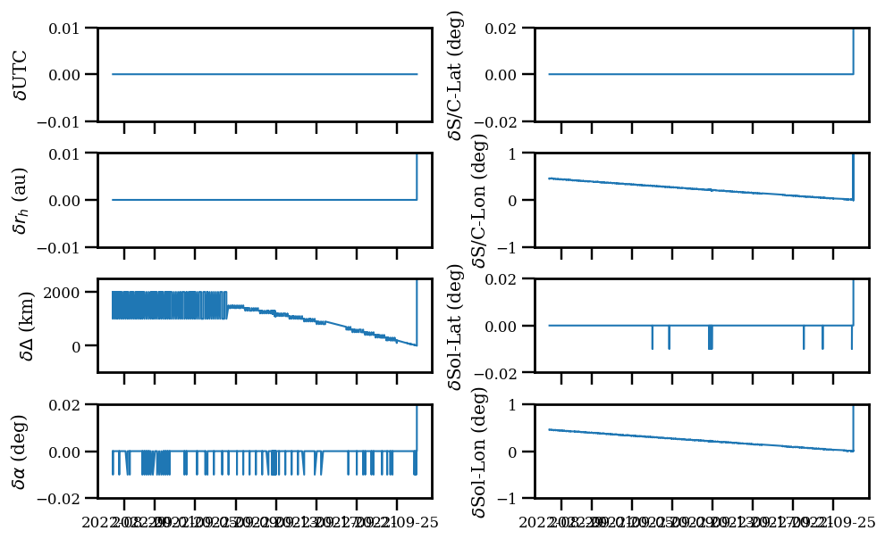
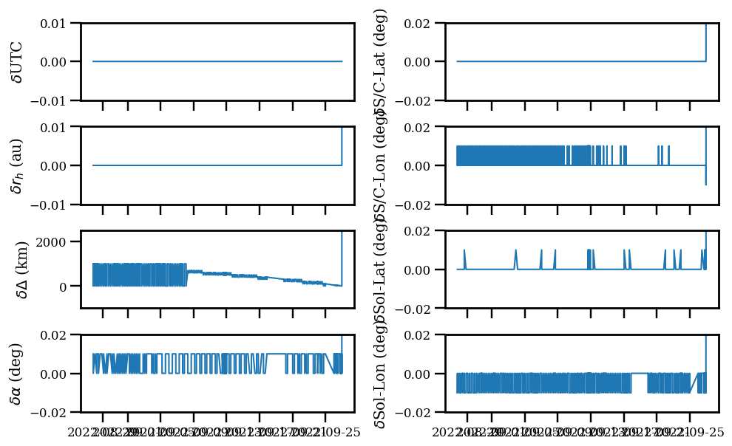
Geometry keyword values
Agreement is good for rh, phase angle, and latitudes to within the precision given in the header key values, but some systematic trend for range and longitude
If turn off light time correction, then all agrees within the precision in the header
Small discrepancy that should not affect the use of data, but better sort out the reason
With light time correction
Without light time correction

Slide 7
Typos and other questions
SIS document
Fig. 8 caption for panel B: The image is mirror flipped across the y-axis instead of x-axis as stated?
Section 7.4 DRACO Imaging Sequence table: What’s the difference between the shaded rows and unshaded rows?
Calibration document
Section 3.2.5: 25-int = 2186.675 µm, different from previous version of 2186.75 µm. Is there a typo or is this an updated (and better) value to use?

Slide 8
Conclusion
Excellent dataset!
Certifiable

