Slide 1
Pluto Albedo Map
Jian-Yang Li
Planetary Science Institute
February 28, 2023

Slide 2
Overview
Pluto bolometric albedo map
Two data collections
One FITS file that stores the albedo map of Pluto
One pdf file in the documentation
Review summary: Insufficient documentation, no problem found for the data

Slide 3
Document
Summary of the current document
The data collection information is provided in three places: abstract, overview.txt, and one pdf file in the document collection
The pdf file in the document collection is a preprint of a paper by Hofgartner et al. presenting the production of the albedo map of Pluto
The overview.txt an excerpt from Section 4 of the paper
Without much context, the overview.txt is hard to follow
The abstract is an excerpt from the abstract of the paper
No information is given for the map, such as the range and direction of coordinates, projection type, special values.
Recommendations
Rewrite abstract to briefly summarize what is in the dataset
Rewrite overview.txt: The overview needs to be brief and specifically for this dataset, rather than simply copying the relevant text from the reference paper. Please include sufficient context, such as what is in the dataset, how is it presented in the dataset (point to the fits file), and what is your quality assessment of the dataset, and a pointer to the preprint of the paper included in the document. There is no need to include the details how the map is produced here
Add a dataset description: An additional dataset description should be added to describe the map, such as the coordinates, resolution, display orientation, projection, special values, etc. You can also include some details to explain what a bolometric hemispherical albedo map is here. You can point to the pdf paper preprint for the technical details

Slide 4
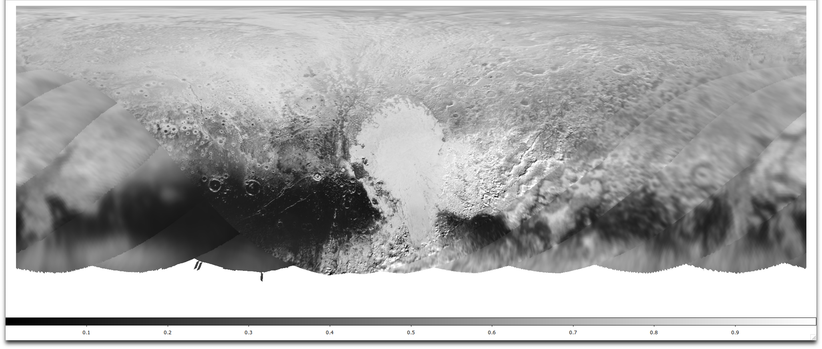
Data
No problem found for the data file itself
Display orientation is defined in the PDS4 labels
Can be opened and correctly displayed with python, DS9, and PDS4_viewer as long as the orientation is set correctly
Suggest to include a PNG or whatever image format to show the map

Slide 5
Conclusion
The documentation needs to be re-done
No problem found for the data
Certified?

