Slide 1
L’LORRI DART Data
Jian-Yang Li
Planetary Science Institute
May 30, 2023

Slide 2
Overview
Lucy L’LORRI observations of Didymos during the DART impact
Three data collections (or two, or one?)
data/uncalibrated/ (raw data)
data/calibrated/ (calibrated data)
calibration/ (calibration data)
Contain all 1549 images collected by L’LORRI during the observations of DART impact
One documentation file included: LLORRI_Users_Guide.pdf
Review summary: Many minor issues, data collection organization to be discussed, possible wrong unit of calibrated data

Slide 3
Review Process
Documentation
Read through the LLORRI_Users_Guide.pdf
Quick scan of some .xml PDS4 label files
Data
Compare raw and calibrated data
Load and display in various software facilities
Check format and display orientation against documentation
Didn’t do
Replicate calibration process
Calculate geometry (only boresight RA and Dec provided in the header)

Slide 4
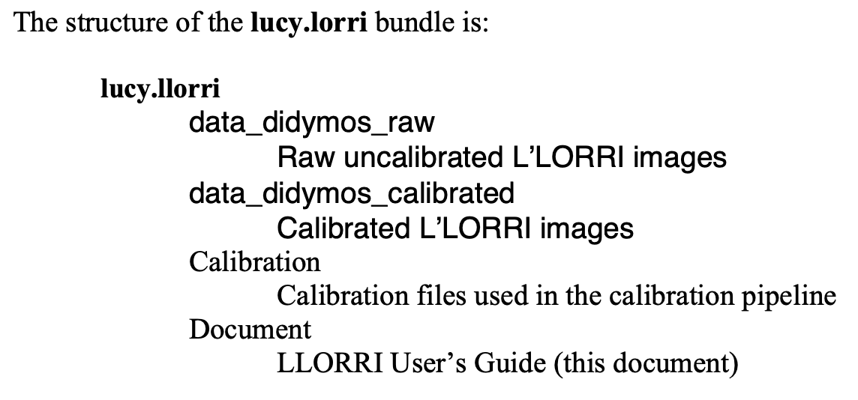
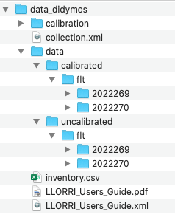
Data collection organization
LORRI_Users_Guide.pdf
Page 4: The structure of the lucy.lorri bundle described here is inconsistent with the actual structure
Page 5, Section 4: data collection path lucy.llorri:data_didymos_calibrated is inconsistent with the path in the PDS4 label in .xml (lucy.llorri:data_didymos).
From inventory.csv, all data are organized into one single data collection lucy.llorri:data_didymos, including the document, calibration data, and all raw and calibrated images. Should they be separated into different collections, as indicated in LLORRI_Users_Guide.pdf (e.g., page 5)?

Slide 5
LLORRI_Users_Guide.pdf
Very useful document, especially appreciate the observation plan included in page 12
Page 4: description of the PDS4 xml label: <observation_identifier> metadata attribute should be <observation_id>
Page 5, Section 3: No description to explain the FITS extensions in raw data. Needs to briefly describe them, or refer to other documents
Page 5, Section 3: raw image size (1028x1024) or (258x256) is inconsistent with the instrument description in page 3 Section 1.1 (1024x1024). This is explained later in Section 6.2 in page 7, but would be good to mention the dark columns earlier, e.g., in Section 1.1
Page 9, Section 6.4: Three sets of calibration constants are provided to convert DN/s to physical units for different colors of targets. The values for Trojans are unnecessary here, given that this document is specifically for the DART data. Also, conversion to I/F is unnecessary here, but it’ll be useful to provide the value of F_dot
Page 11: the time of impact paragraph should use consistent format for date/time

Slide 6
Image Data
All header information is consistent between raw and calibrated data
WCS is included in the header, which is great
Calibrated data appears to be in units of DNs, but not DN/s as indicated by the users guide and SIS (from sample dataset)
Can be loaded and displayed with PDS4_viewer, astropy.io.fits in python, and DS9 with correct orientation
Error array and data quality array are all set to 0 for all images – are they place holders to be updated later?
Calibrated data all look normal – didn’t try to extract photometry and compare with other measurements
Why there is a flt subdirectory in the image file path?

Slide 7
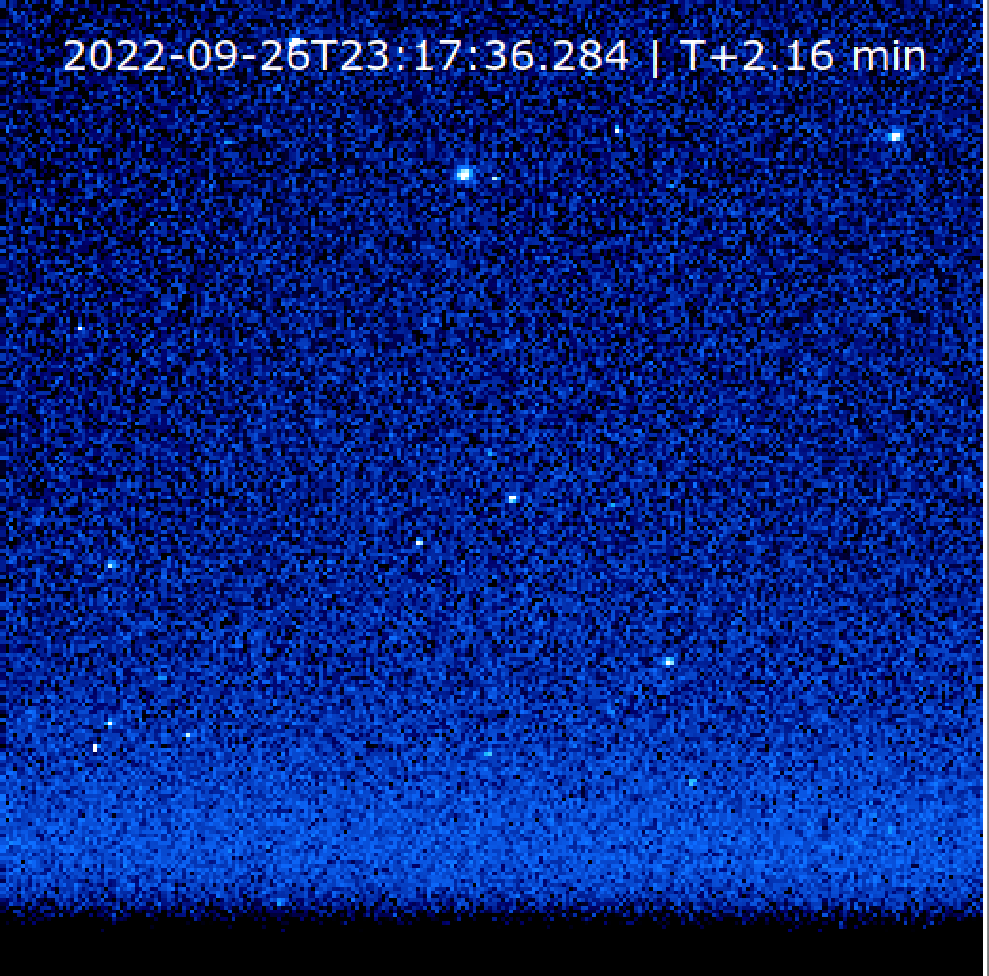
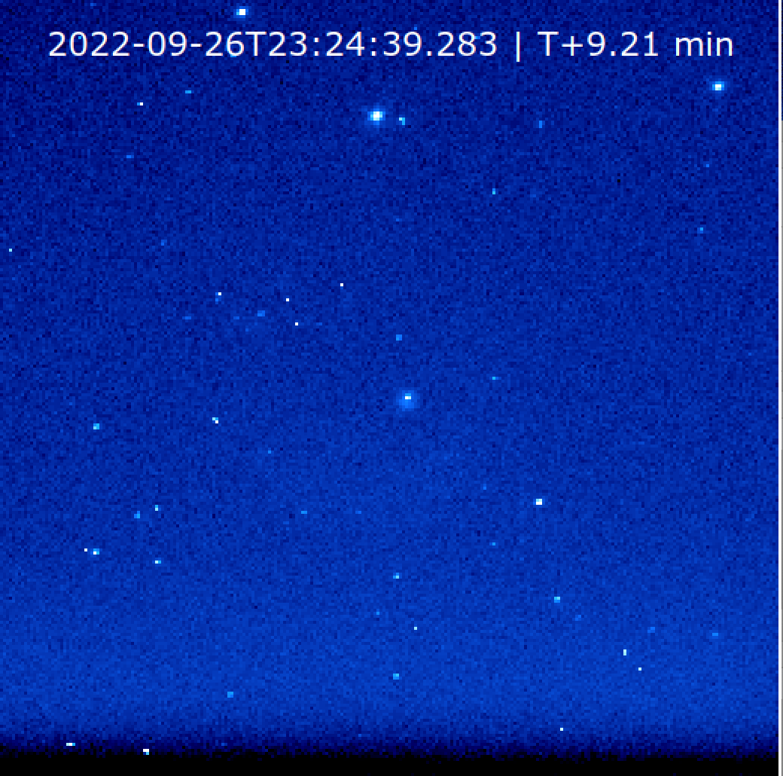
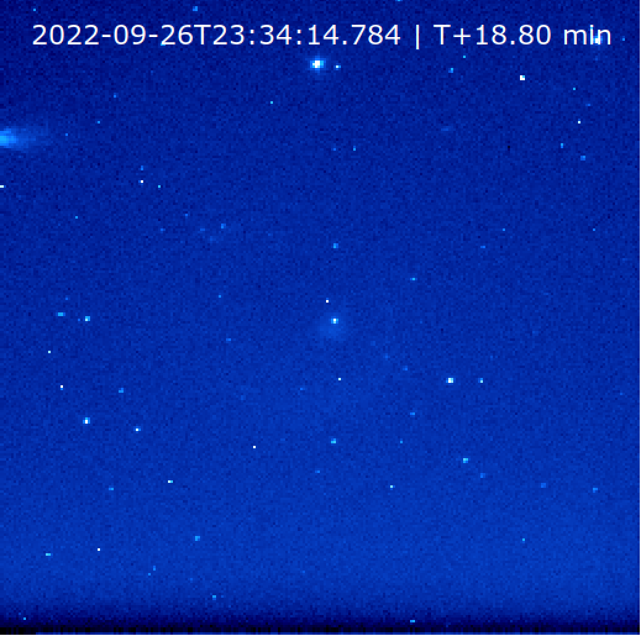
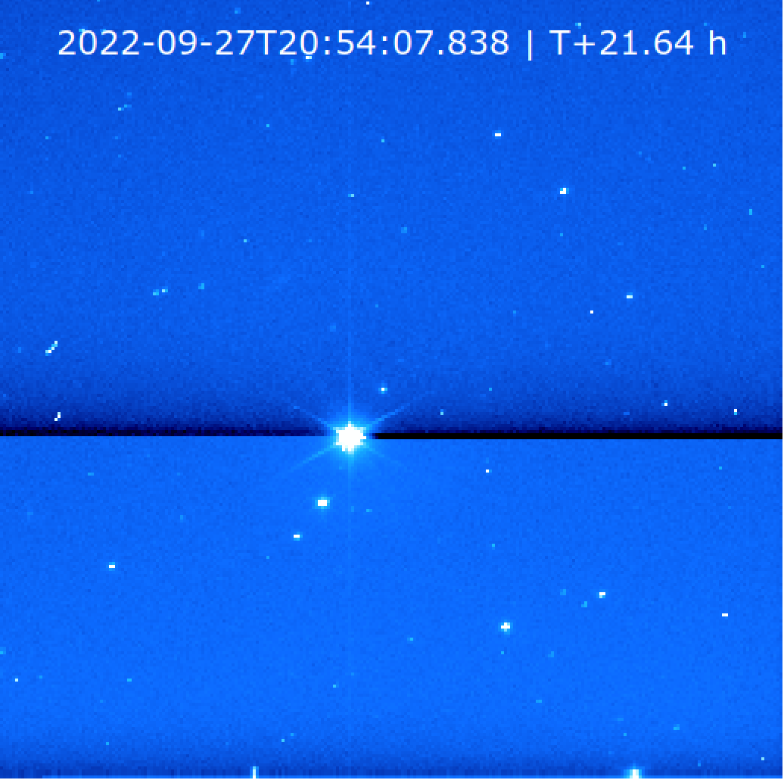
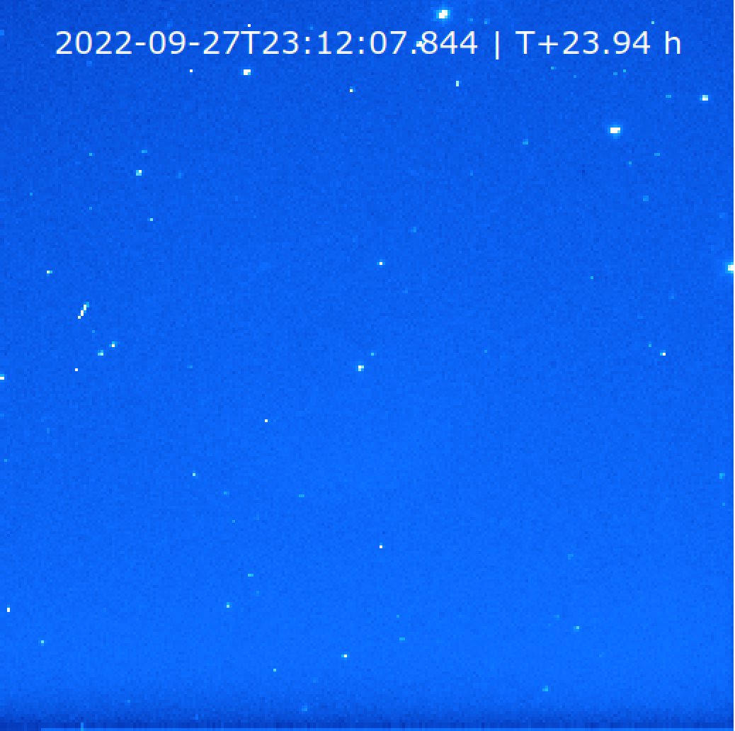
Sample calibrated images
0.9 s
4.9 s
9.9 s
9.9 s
Sample images from phase 3, 4, 5, 8
Why the dark strips near the bottom, which seems to depend on exposure time and source brightness?
Looks like this is from calibration?
9.9 s

Slide 8
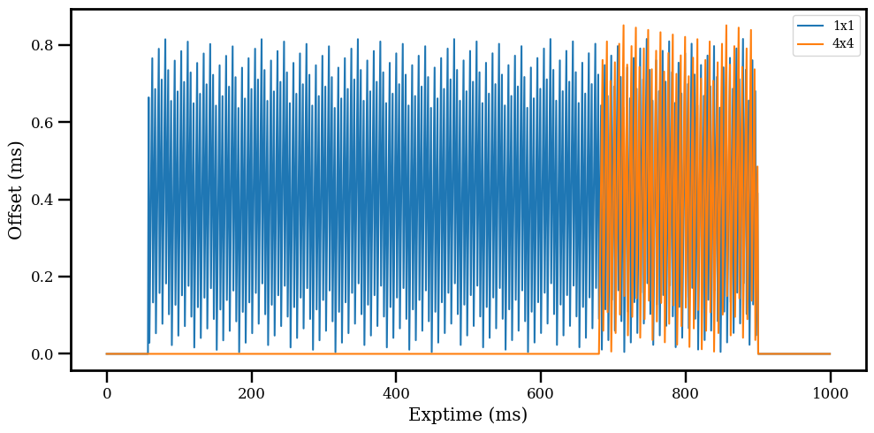
Calibration data
All appears to be reasonable, although I didn’t replicate the calibration pipeline to calibrate the raw data
1x1
4x4
Bias
t-offset
Flat

Slide 9
Typos and others
collection.xml
<Product_Collection>:<Identification_Area>:<Citation_Information>:<description>: instrumnet → instrument
LLORRI_Users_Guide.pdf
Page 5: Delete duplicate “be found”
Page 5: two Lucy L’LORRI specific documentations are cited here, but neither has been written – need to be updated later
Page 6, top paragraph: Metadata attached to the *raw* L’LORRI images… should be calibrated

Slide 10
Conclusion
No major problems with the dataset
Many minor issues, mostly with the documentation
Possible unit problem with the calibrated data (DN vs. DN/s)
Probably not to be certified if the units of calibrated images needs to be corrected

