Slide 1
Lucy L’LORRI Sample Data
Jian-Yang Li
Planetary Science Institute
May 30, 2023

Slide 2
Overview
Lucy L’LORRI sample dataset
Three data collections
data_cruise1_raw/lor_0705960615_02254_00002_eng_01
data_cruise1_calibrated/lor_0705960615_02254_00002_sci_01
document
One image in each of the raw and calibrated data collection
One document file 22668.07-LLORRI-SIS-01 R0 C0 draft 2021-08-02.docx
Review summary: Need to add more details to the SIS documentation, no issue seen in the (single) sample image

Slide 3
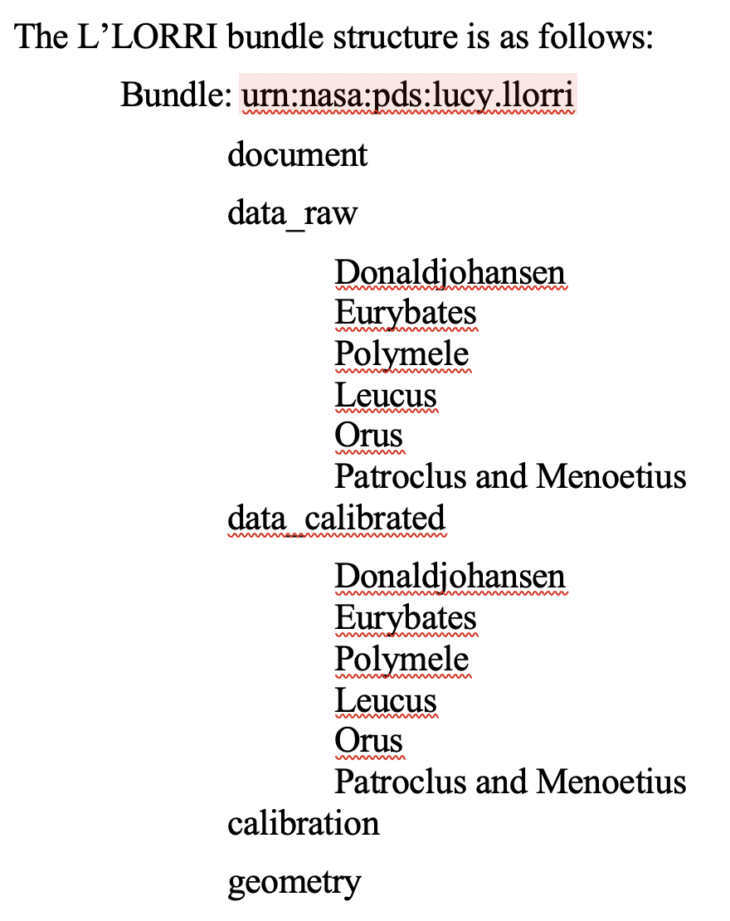
Data bundle organization
SIS Page 12: Data products organization described in 3.1 is inconsistent with the actual directory structure
calibration and geometry directories missing
cruise1 mission phase is at the same level as data processing level
Suggest adding various cruise phases to the structure

Slide 4
SIS document
Pages 13 - 15: More detail about data format is needed
What are the histogram, image header, image description data stored in raw fits extensions?
What are data quality flags definitions?

Slide 5
Typos and others
Page 3: “a SNR” should be “an SNR”
Page 3: "I/F = 0:0014 148" should be "I/F = 0.00148”
Page 3: Therefore, the Lucy mission set the *182º* phase angle …?
Page 3: "I=F = 0:40" should be "I/F = 0.40”
Page 4: Fig. 1 missing
Page 5: Bullet 2 in Section 2.2 seems to be copied from bullet 1. Needs to be updated
Page 5: First sentence in 2.3, something missing after "located”
Page 5: Section 2.3.1, reference to Table 2-3 should be Table 2-2
Page 7: many empty sections need to be completed
Page 9: Table 2-3 needs to be populated
Page 11: 2.4.2 is not completed

Slide 6
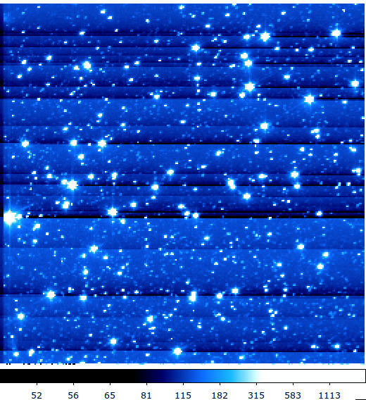
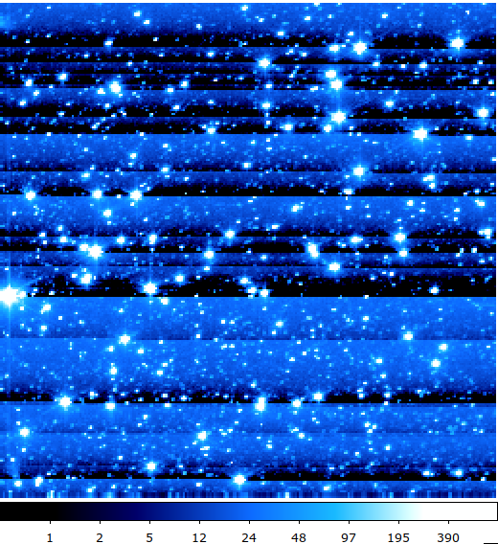
Sample Data
Consider adding thumbnails of all images in popular image format (e.g., jpg)
Error and quality arrays in the calibrated data are all 0 now – needs to be updated to more meaning values for a more complete review
raw
cal

Slide 7
Conclusion
Many minor issues and typos with the documentation
More details needed in the SIS to describe the data product
Need to make the directory organization compatible with the dataset organization described in the SIS

