Slide 1
Lucy MVIC and TTCam Sample Data
Jian-Yang Li
Planetary Science Institute
May 30, 2023

Slide 2
Overview
Lucy MVIC and TTCam sample datasets
Three data collections
data_raw/one-raw-image
data_calibrated/one-calibrated-image
document (SIS)
One image in each of the raw and calibrated data collection
One document file each dataset: SIS draft
Review summary:

Slide 3
MVIC SIS document
Page 11 - 12: Hierarchical description of Product_Observational is not consistent with the actual xml:
In xml but not in description: Citation_Information, Reference_List
In description but not in xml: File_Area_Supplemental
In both but using different names (?): Discipline_Dictionaries vs. Discipline_Area
FITS keys listed in Table 3-1 are not entirely consistent with the actual keys in FITS headers (see later)

Slide 4
MVIC SIS typos and others
The PDS4 .xml label is missing for this document
Page 9: SPOC?
Page 9, section 2.3.2.2: What is "space data"? This section is hard to follow. Need more context
Page 10, table 2-4: Mission phases listed here may not be complete, e.g., multiple cruise phases are not included
Page 12, section 2.4.2 not complete
Page 13 – 14: Section 3.1 is incomplete (or mostly empty), more details needed for the data products structure and organization
Will calibration data be included?

Slide 5
MVIC sample data
An extra label file mvi_acqtime_obsid_2 in the calibrated data collection
Missing keys listed in SIS Table 3-1: OBJECT, BORERA, BOREDEC, CLKANG, INSTRU (actual in header is INSTRUME), DATE-OBS (vs. DATE), LRSTART, LREND, GRT, ARCHDATE, ...
Subtracted background array in calibrated data are all 4500. Calibration coefficients have a distribution of non-zero values. Are they correct or just place holders for now? Needs to be explained somewhere

Slide 6
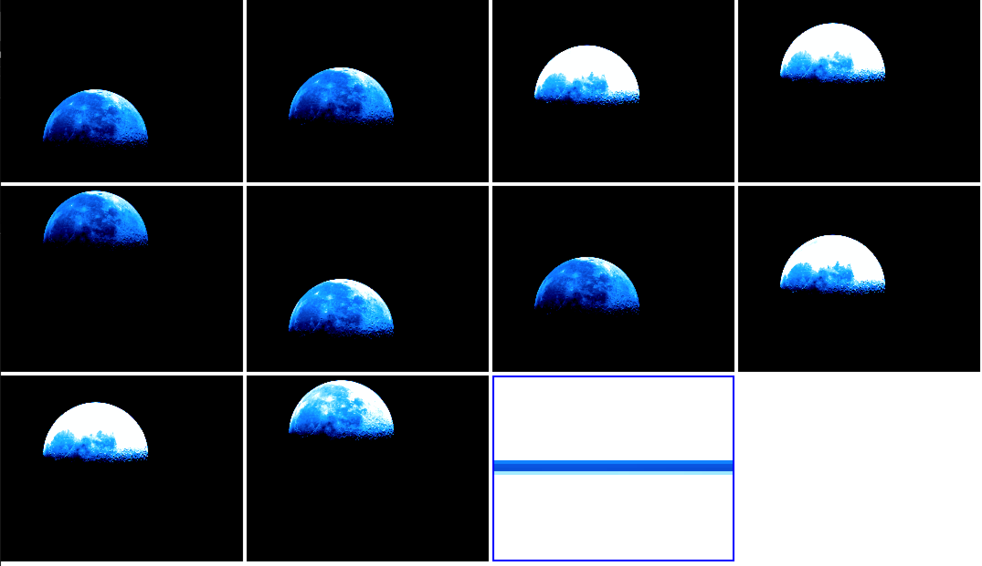
MVIC sample data
Looks reasonable
Loadable with PDS4_viewer and astropy.io.fits
Error array and data quality array should be provided?

Slide 7
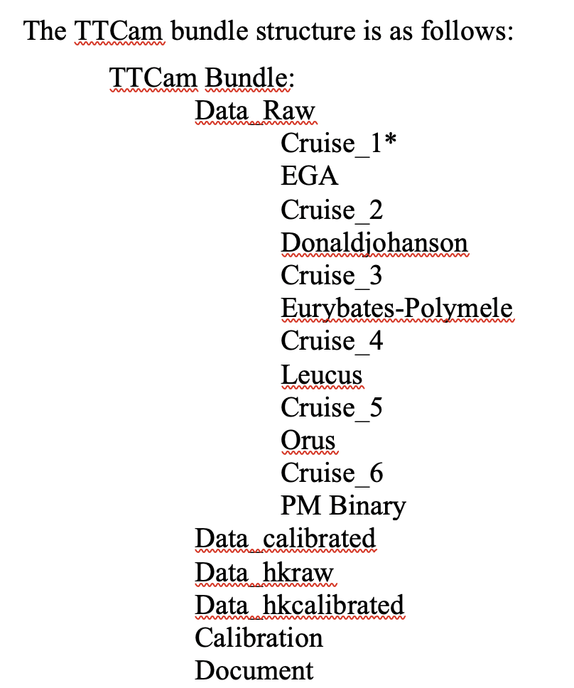
TTCam SIS
Page 12: Hierarchical description of Product_Observational is not consistent with the actual xml (same as for MVIC sample data):
In xml but not in description: Citation_Information, Reference_List
In description but not in xml: File_Area_Supplemental
In both but using different names (?): Discipline_Dictionaries vs. Discipline_Area
Page 15: Data bundle structure described here is inconsistent with the actual directory structure
data_hkraw and data_hkcalibrated missing
Subdirectories should be created in data_raw/ and data_calibrated/
Should SIS include description of those files, as well as calibration data?

Slide 8
TTCam SIS typos and others
The PDS4 .xml label is missing for this document
Page 6: "Primary Terminal Tracking Images are .... Other images may be ...", what are primary terminal tracking images and what are other images?
Page 6: From Section 2.2, the units of calibrated data are either radiance or I/F. How does the pipeline decide which unit to use?
Page 6: Section 2.3 says that the size of calibrated image is ~3x that of raw. Is this correct, given raw is 8-bit, and calibrated has one 16-bit image and four 8-bit image extensions?
Page 8: Usage of the word “companding” is not precise. 12-bit to 8-bit is compressing, 8-bit back to 12-bit is expanding, and the whole process is called companding. It's confusing to say companding and de-companding.
Page 9, section 2.3.2.2.1: extrta should be extra
Page 9 - 10, section 2.3.2.2: All subsections cite Bell et al. (2021). Can be cited once in the overview part.
Page 10: Do you need to provide different radiance conversion factors for targets of different colors like for L’LORRI images, given the wide bandpass?
Page 13: Naming convention uses ttc, but sample image is tt2

Slide 9
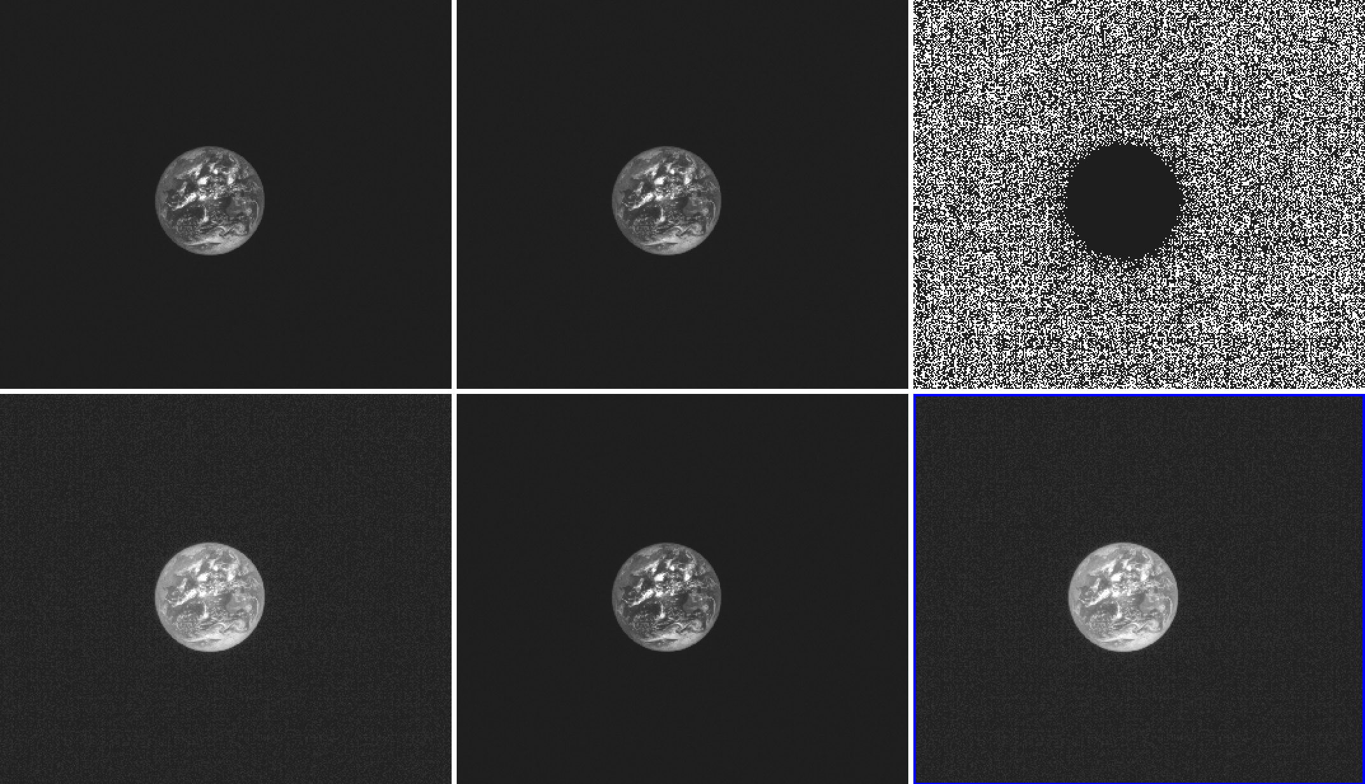
TTCam sample data
raw
cal
Bad pixel map
radiance err
I/F
I/F err
Bad pixel map has values of 0 and 4. What does 4 mean? Distribution seems to correlate with signal level?

Slide 10
Conclusion
[both] SIS document needs to be more completed and better consistent with the data
[both] Sample data look reasonable
[TTCam] dataset organization should be consistent with the description in SIS

