Slide 1
L’Ralph LEISA PDS Review
Adam McKay

Slide 2
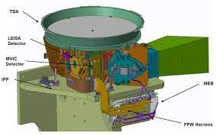
L’Ralph/LEISA Overview
Successor to similar instruments on New Horizons and OSIRIS-REx
“Push-broom” Imaging IR spectrometer, covering 0.95-4 microns
Scans across target to obtain image cube with spectral information

Slide 3
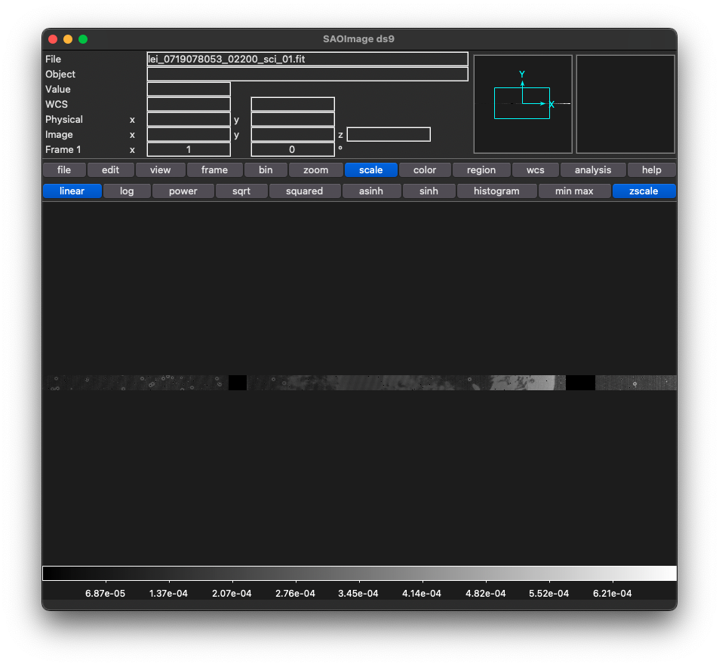
Data at this time
One test observation of Earth, engineering and science calibrated data
Everything looks OK! Headers informative and well organized
Delivery also includes XML files for both engineering and science calibrated data, look OK
Minor Note: The target name in FITS headers is blank, but included in XML files

Slide 4
Documentation
Includes Word document with additional documentation, still seems to be somewhat a work in progress (some information labeled as TBD or TBR like estimated size of data files, Word track changes comments still included)
Looks good, though I think in text shown below the highlighted should be L’Ralph/LEISA, not L’Ralph/MVIC?
Lastly, some of the FITS header field names in Table 3-1 don’t seem to match what is actually used in the files- e.g. INSTRU should be INSTRUME (already noted in a comment), LRSTART should be STRTSCLK? What do color-text entries like that for OBJECT or BORERA mean?

Slide 5
Conclusions
Data is certifiable, a few fixes and updates may be needed in documentation

