Slide 1
DART/DRACO Data Review
Jian-Yang Li
Planetary Science Institute
September 15, 2023

Slide 2
Overview
DART/DRACO data bundle
Four data collections
Raw data (raw)
Calibrated data (cal)
Derived data product (ddp)
Documentation
Contain all images collected by DRACO throughout the DART mission
From commissioning to the last partial image in the final phase
Calibration data are also included in the cal data collection
Document collection includes four files
SIS v3 (updated from previous v2)
Calibration pipeline description v2 (same as before)
Dimorphos coordinate system v2 (updated from v1)
Didymos coordinate system v1 (new)
Review summary: No major problems found, one very minor issue about geometry to be discussed, and some typos
GREAT JOB DRACO TEAM!

Slide 3
Comparative review process
Documentation
Compare with the previous version for the SIS and Dimorphos coordinate system
Read through the Didymos coordinate system documentation
Skip the calibration document
Data
Check all data, focusing on three phases: approach, terminal, and final
Extracted and checked the values of many keywords for all raw and cal images based on SIS and calibration pipeline description, to search for any conflicts, inconsistencies, or if the values make sense
Check the orientation of a few images using multiple software
Compare raw and cal images for the consistency of keywords
Compare with previous version for changes and consistency
Calculate some basic geometric parameters using SPICE and compare with the values in image headers
Didn’t do
Try to calibrate the data from raw to cal following the calibration document
Check the correctness of calibration

Slide 4
Results
No inconsistency in keyword values and descriptions is identified
All data appears to be nominal
I/F data plane in the ddp product needs to be updated to be consistent with the current data bundle
Some small discrepancies in the geometric parameters, details follow
Some typos listed separately

Slide 5
Data review summary
Image can be opened and displayed correctly with `astropy.io.fits`, DS9, and PDS4_viewer, all with consistent orientation as described in SIS, PDS labels (.xml), and the PNG thumbnails
Compared to the previous version (approach, terminal, and final phases)
All raw data are identical. The only changes are in the headers and labels
15354 out of the 56054 cal data files changed, and others remain identical. This is due to the change of the LUT for global 1x mode, but not rolling, 30x mode – Thanks to Carolyn and Terik for sorting this out for me
Calibration data contain one new bad pixel map and 7 updated LUT files
Bad pixel map identical with the previous version – no bad pixels identified
Radiometric cal LUTs for all rolling modes and the global 30x mode appear to be identical, other global modes changed
Backplane data
I/F plane contains v2 I/F data, which should be updated to v3 to be consistent with this data bundle
Everything else looks good

Slide 6
Document typos
Dimorphos coordinate system document
Figure 1 caption: remove the o following )
Figure 2 caption: remove "to the" after "anchor rock”
Didymos coordinate system document
4th paragraph, p4, remove "via" or "by”
Figure 2 caption incomplete
SIS document
The whole pdf document contains track-changes. Should use a clean version
Update version number in the footnote

Slide 7
Geometry keyword values
Calculated seven geometric keywords: heliocentric distance, s/c range, phase angle, sub-s/c lat lon and sub-solar lat lon, all w/r to Dimorphos, and compare with the values in the FITS headers
Use meta kernel dart_v02.tm, kernels provided by Ray
Keyword values extracted from FITS headers: SHDIST, SSCRNG, SSPHASE, SSUBLAT, SSUBLON, SSSOLLAT, SSSOLLON
SHDIST precision is 0.01, which is quite low
SSCRNG has 5 significant digits, which is fine
All angles have a precision of 0.01, which is fine, too

Slide 8
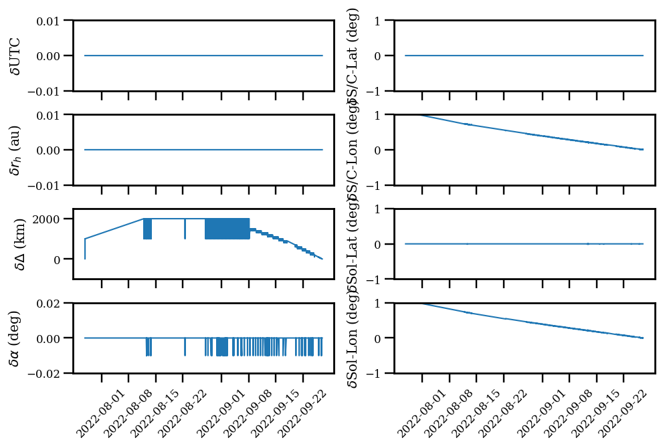
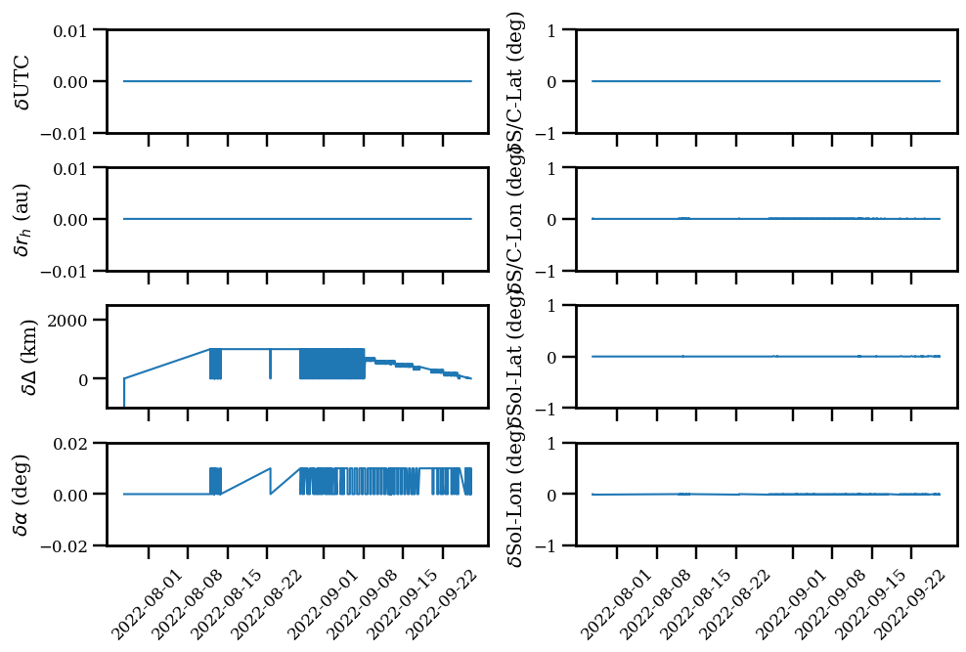
Geometry keyword values
Overall agreement as the previous version, but small discrepancy in longitudes
Turning off light time correction will remove the discrepancy
Discussed with Hari, who did the calculation in his code in an identical way as what I do in my code
Small discrepancy that should not affect the use of data, but curious why
With light time correction
Without light time correction

Slide 9
Conclusion
Excellent dataset!
Recommend to certify (but maybe not the ddp?)
Thank you DRACO team!

