Slide 1
LICIACube LEIA/LUKE Data Review
Jian-Yang Li
Planetary Science Institute
September 15, 2023

Slide 2
Overview
LICIACube data bundle
Five data collections
Documentation
Two cameras (LEIA and LUKE) with each having two calibration levels (raw and calibrated)
Calibration data are placed inside the calibration collections for both cameras
Contain all images collected by LICIACube after its deployment from DART to the end of mission
Two mission phases: approach and final
Document collection includes three pdf files and five txt files
Camera data SIS
Camera data calibration pipeline description for both cameras
Radio science SIS
Five text files listing the TCMs
Review summary: Many problems, including image orientation, geometry, and some issues in the documentations, likely not certifiable

Slide 3
Review Process
Documentation
Read through all documentation, check against data
Radio science data SIS is not reviewed here
Data
Extracted and checked keywords for all raw and cal images based on SIS and calibration pipeline description to search for any conflicts, inconsistencies, or if the values make sense
Compare the data in two calibration levels for each camera for consistency of keywords
Checked the orientation of a few images using multiple software tools
Calculate some basic geometric parameters using SPICE and compare with the values in image headers
Didn’t do
Try to calibrate the data from raw to cal following the calibration document
Check the correctness of image calibration

Slide 4
Results
355 LEIA images in raw, 305 calibrated
All 30 uncalibrated images are windowed, 25 of which from approach, the other five from final – consistent with SIS
274 LUKE images in raw, 267 calibrated.
All 7 uncalibrated images are windowed from approach, consistent with SIS
No inconsistency in keyword values and descriptions is identified
Image can be opened and displayed correctly with python module `astropy.io.fits`, DS9, and PDS4_viewer, except for some LUKE raw images in approach phase, details follow
Problems with image orientation, details follow
Large discrepancies in the geometric parameters, details follow
Some places in the documentation not clear

Slide 5
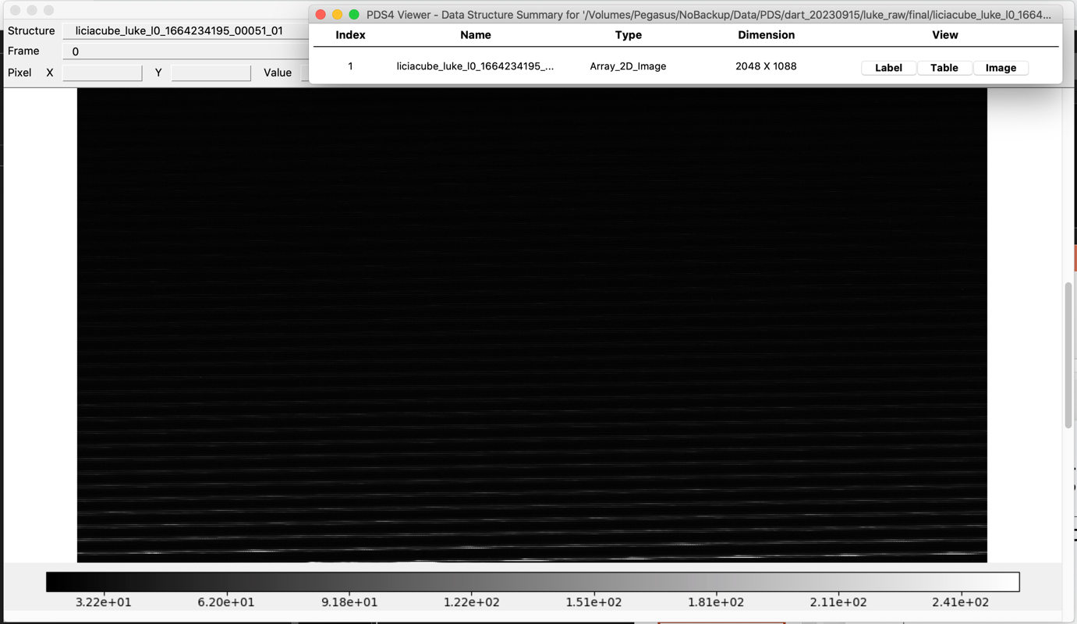
LUKE raw PDS4_viewer problem
PDS4_Viewer cannot view raw images
Seems the problem is only for final phase images, approach images are probably fine

Slide 6
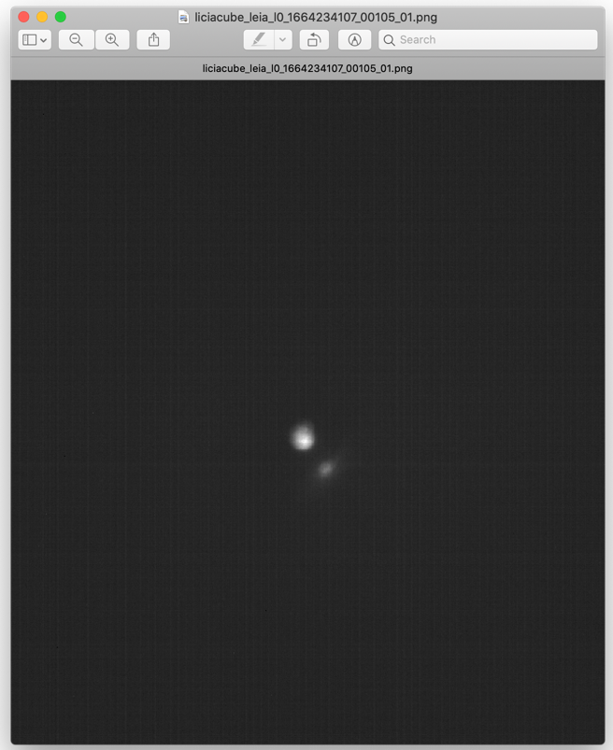
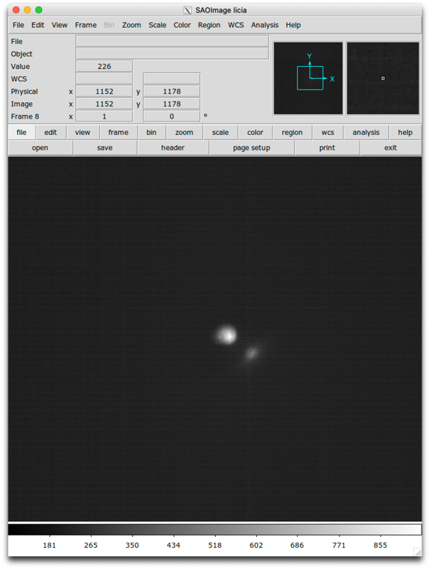
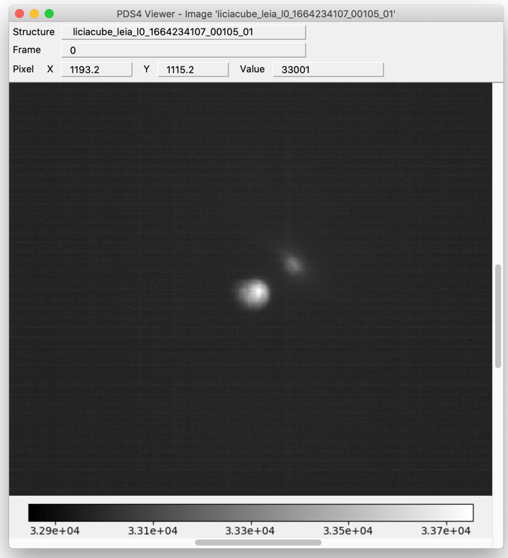
Orientation – LEIA raw
xlm labels:
Sample: Left to right
Line: Top to bottom
1664234107_00105

Slide 7
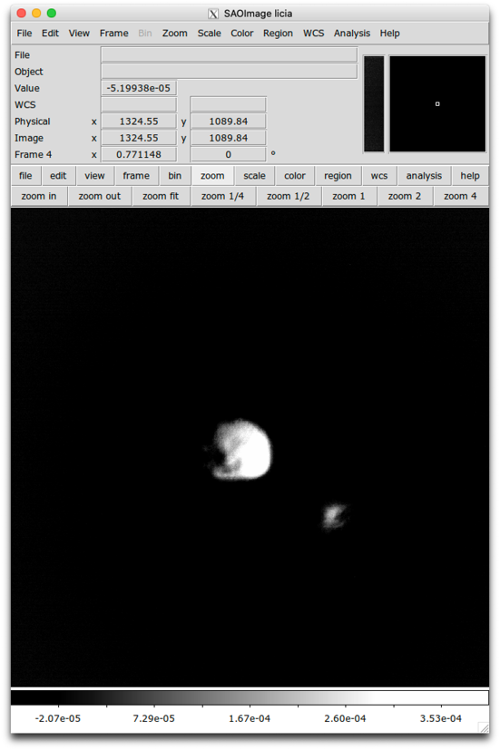
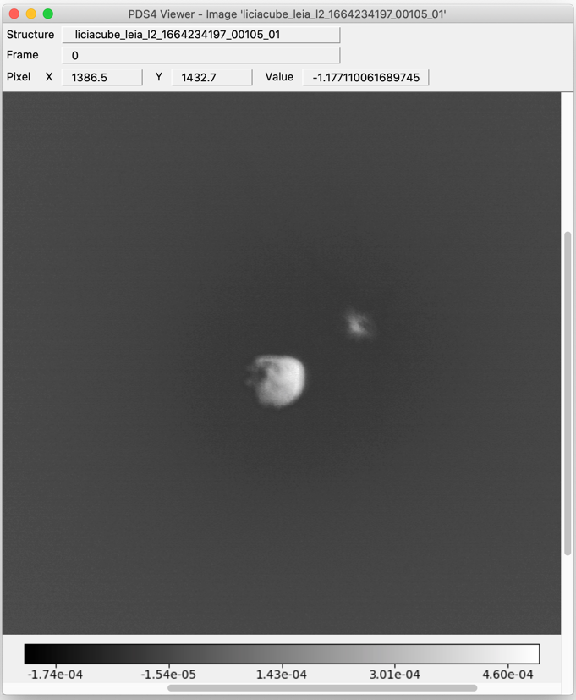
Orientation – LEIA calibrated
xlm labels:
Sample: Left to right
Line: Top to bottom
1664234197_00105

Slide 8
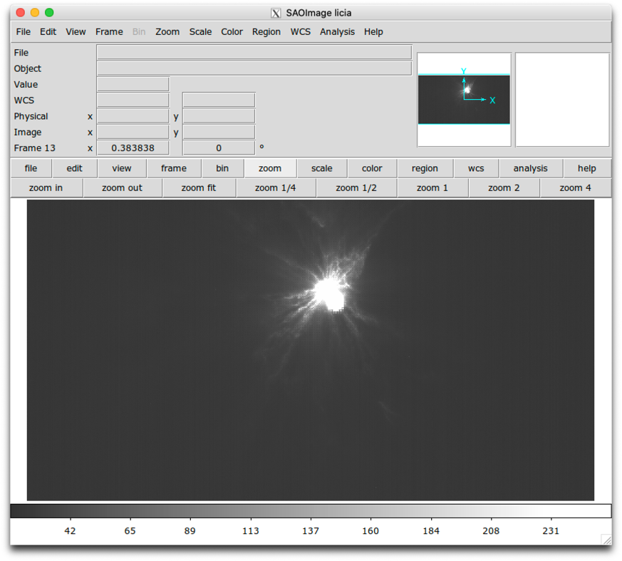
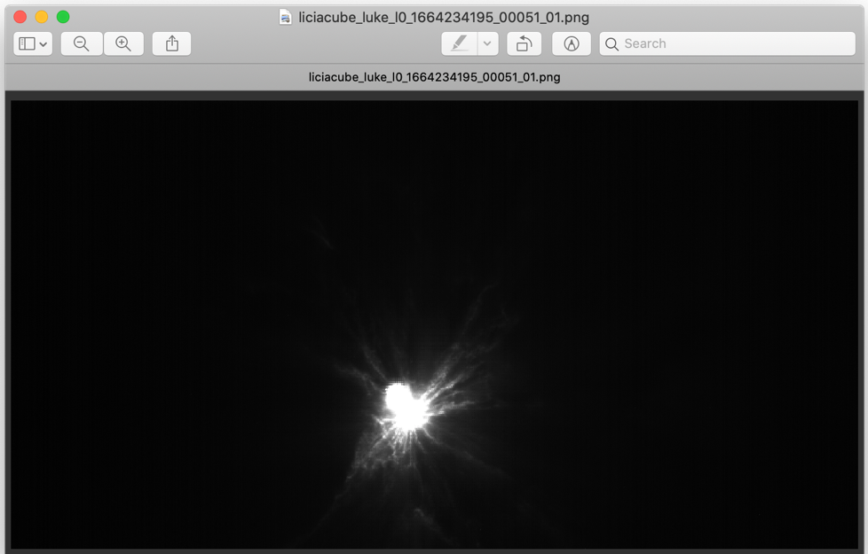
Orientation – LUKE raw
xlm labels:
Sample: Left to right
Line: Top to bottom
1664234195_00051

Slide 9
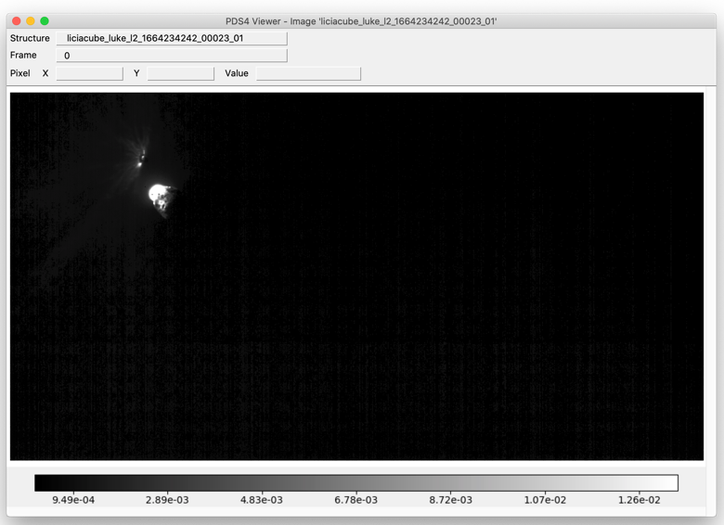
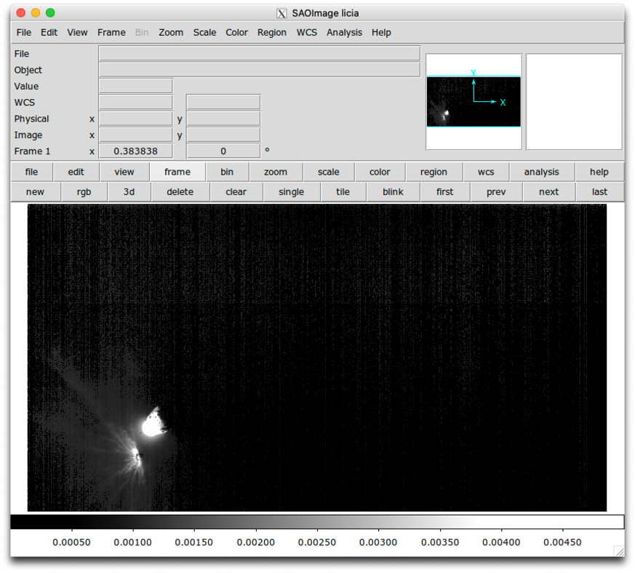
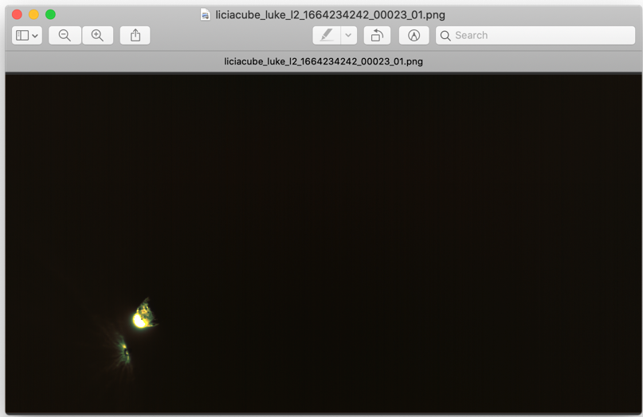
Orientation – LUKE calibrated
xlm labels:
Sample: Left to right
Line: Top to bottom
1664234242_00023

Slide 10
Geometry keyword values
Calculated seven geometric keywords: heliocentric distance, s/c range, phase angle, sub-s/c lat lon and sub-solar lat lon, all w/r to Dimorphos, and compare with the values in the FITS headers
Tried meta kernel dart_v02.tm with and without the kernels listed in the xml labels
Keyword values extracted from FITS headers: shdist, sscrng, ssphase, ssublat, ssublon, sssollat, sssollon

Slide 11
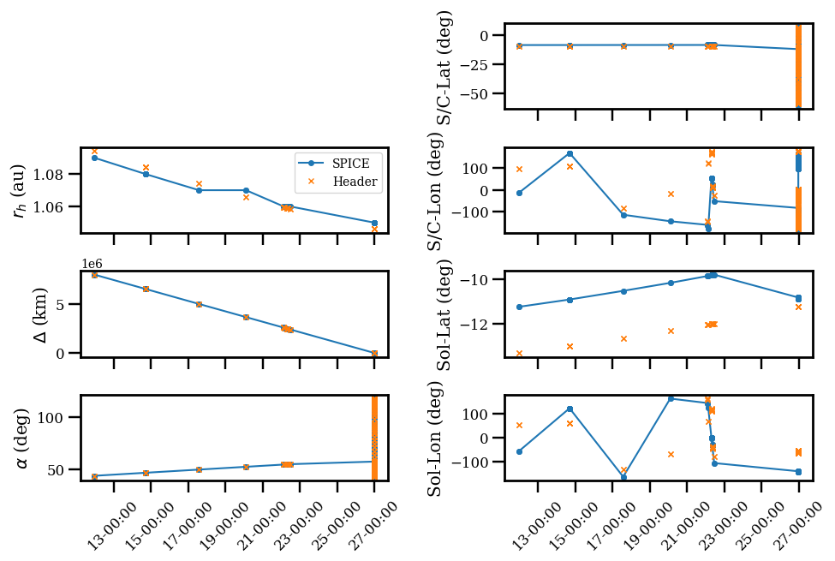
Geometry – LUKE raw

Slide 12
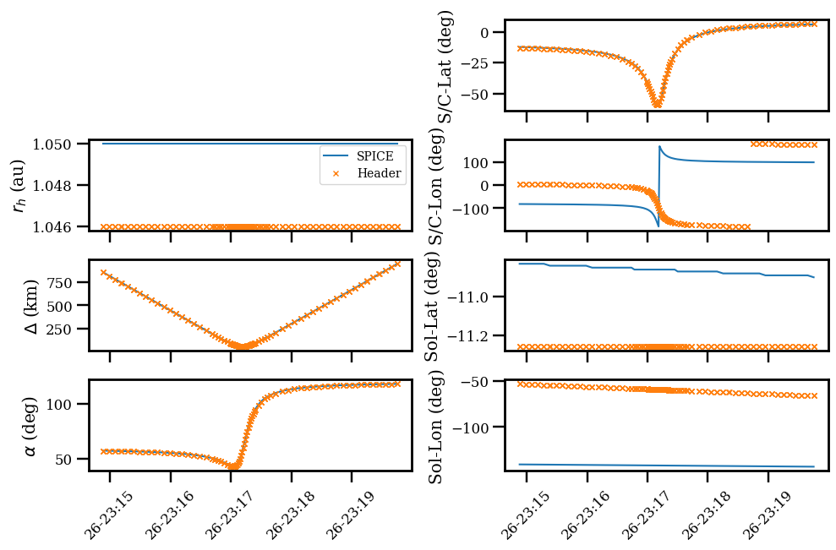
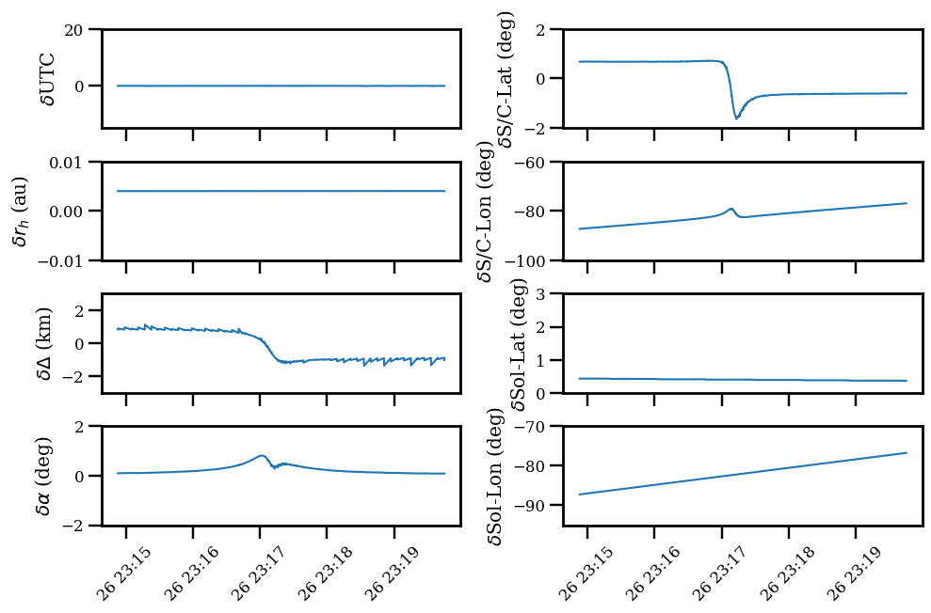
Geometry – LUKE near C/A
Small difference for SPK related quantities
Small difference in latitude, large difference in longitude – PCK problem?
Why the discrepancy for target heliocentric distance?

Slide 13
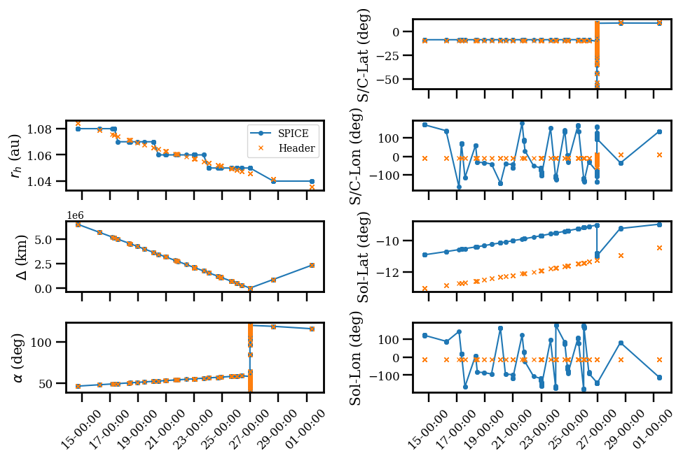
Geometry – LEIA raw

Slide 14
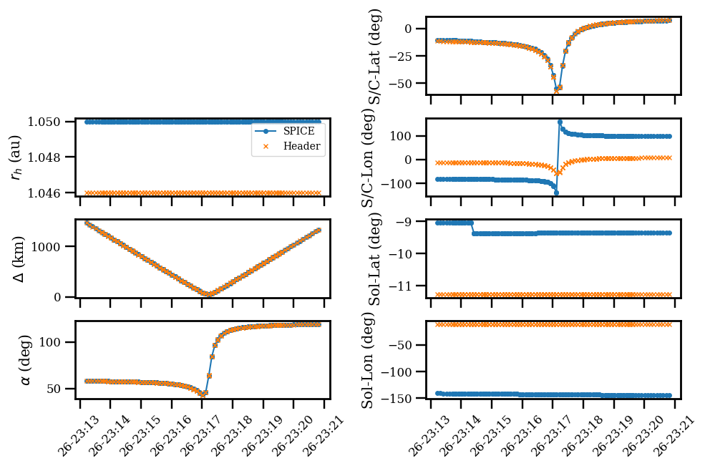
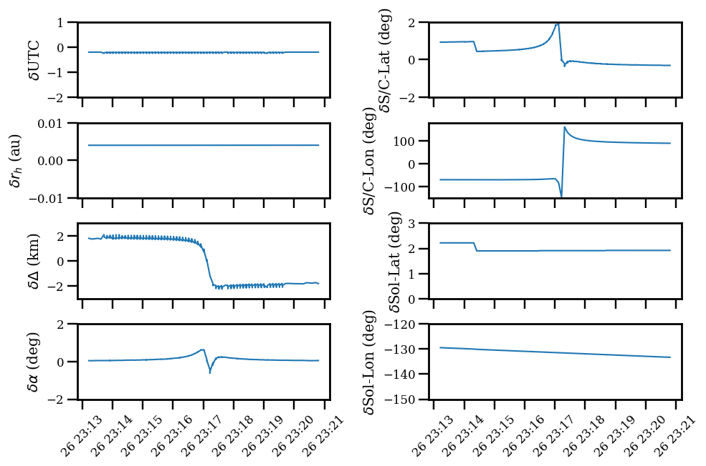
Geometry – LEIA near C/A
Small difference for SPK related quantities
Small difference in latitude, large difference in longitude – PCK problem?
Why the discrepancy for target heliocentric distance?

Slide 15
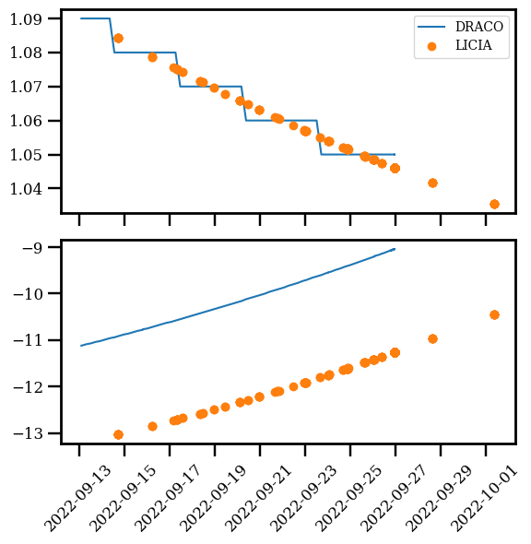
Geometry – Compare with DRACO
Systematic difference in sub-solar latitude compared to the values in DRACO image headers
Possibly from PCK?

Slide 16
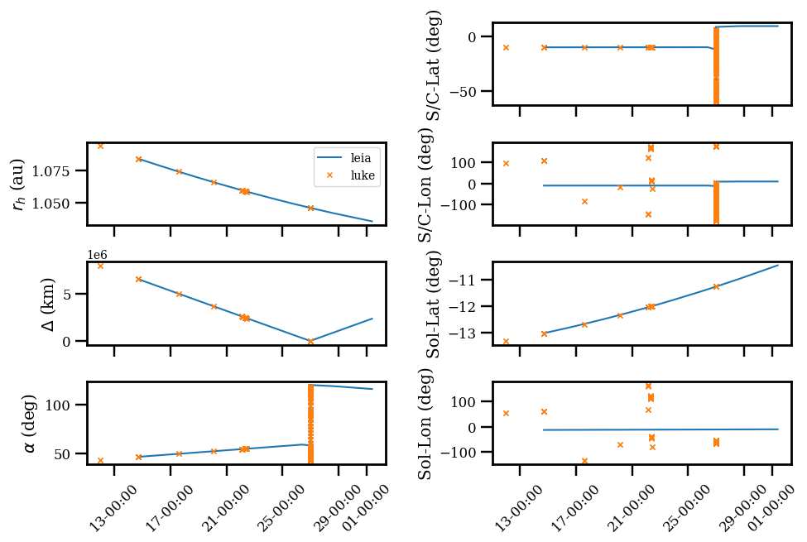
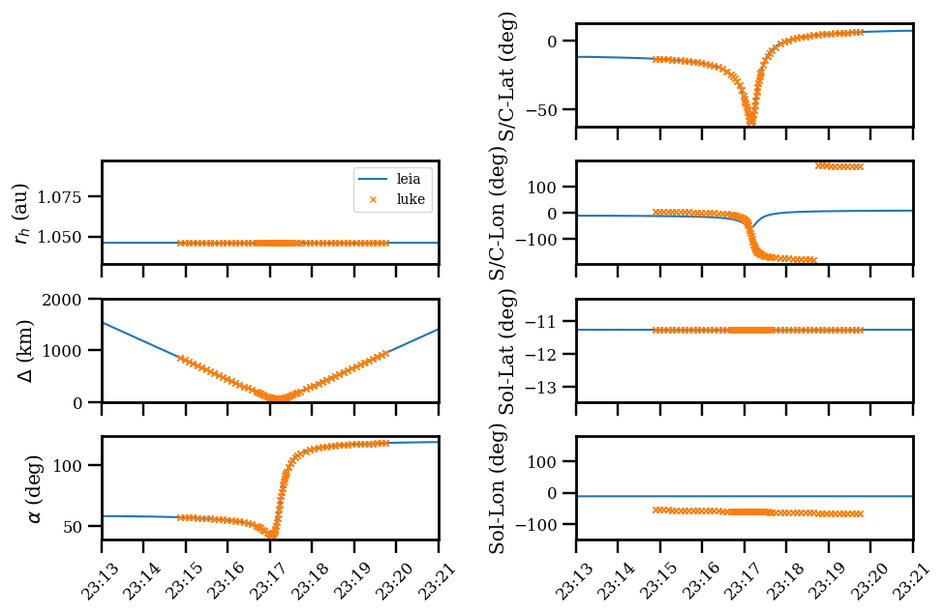
Geometry – Compare LEIA and LUKE
rh, delta, phase angle, and latitudes agree with each other
Large discrepancies in longitudes – different PCK used for LEIA and LUKE?

Slide 17
Documents
SIS
P8, 4.1.1: Description of windowing is missing in this section
P9, last paragraph: The description of setting bit 1 is not clear to me. What does it mean?
P10, first full paragraph is hard to understand
P12, 4.2.1: LUKE data products also listed here, and should not be
P15, Fig. 5: flatfield is missing in the diagram, based on the calibration document
Calibration document
P6, first full paragraph: It says “SIS takes precedence in case of conflict”. But in SIS P5, it says the calibration pipeline document takes precedence
P6, 3.3.2, last sentence: I can’t understand this sentence
P11, first half page: the description about PchiInterpolator is very detailed and I couldn’t understand. Needs to be rephrased, or just remove this technical detail?
P11 second half: Impossible to follow this section. I don’t understand what these scaling factors are and how they are derived
TCM parameter files: Why not summarize them in a single file?

Slide 18
Document typos
SIS
P8, 4.1.1: 2 *bytes*; …reducing the picture dimension by a factor of *2* (or reducing the picture *area* by a factor of 4)
P9, 4.1.2.2, 2nd paragraph: what is ”optical inch”?
P16, 4.4.2.2: word docx reference error message
P16, 4.4.2.3: last line in the first paragraph, remove *in the*
Calibration document
P7, table 1: “evaluation” missing “n”
P11, paragraph starting “the values coming from …”: “furtherly” should be “further”

Slide 19
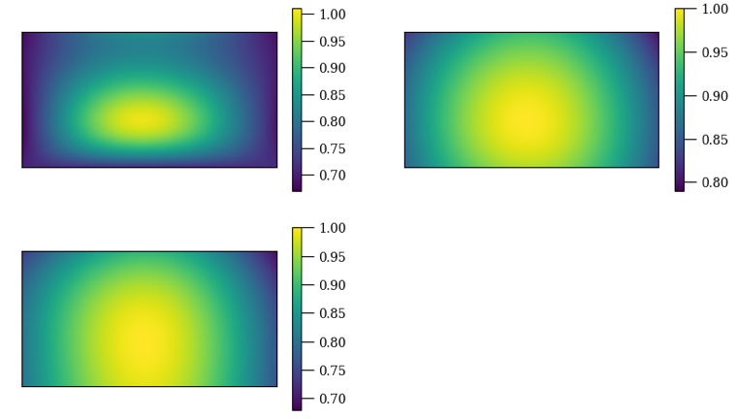
Calibration data
About flat field
P10, 4.3.3 says flatfield is to correct for vignetting; flatfield data have values decreasing from center outward; but the formula in 4.3.3 is to multiply the flat array. Doesn’t seem to be right
LUKE bad pixel map shows bad pixels, but calibration document P6, 3.3.1 states “no bad pixels have been flagged”
No information found in SIS, calibration document, or fits headers concerning the radiometric calibration parameters in the *_cal_col_001.fits files
What are they?
How are they derived?
How to use them?
Otherwise calibration data appear nominal
LUKE flats

Slide 20
Conclusion
Many places need to be checked for correctness and consistency
Cannot recommend a certification until at least the three issues below are addressed
Display orientation are confirmed, and inconsistency sorted out
PDS4_viewer display problem for LUKE raw images are resolved
Geometry parameters are corrected

