Slide 1
DART dart_shapemodel bundle review
Navigation and Ancillary Information Facility
Alyssa Bailey
NAIF / Jet Propulsion Laboratory, California Institute of Technology
Virtual Meeting
September 15, 2023
The research described in this publication was carried out at the Jet Propulsion Laboratory, California Institute of Technology, under a contract with the National Aeronautics and Space Administration.
© 2023 California Institute of Technology. Government sponsorship acknowledged.

Slide 2
Index
Overview
Opening Remarks
PDS Validate Tool
Miscellaneous PDS4 Issues
Product Validation (Minimal)
Documents
Shape Models
Conclusion

Slide 3
Overview
The collections within this bundle contain a number of shape models and derived physical properties of these shape models along with the adequate documentation
The documentation is provided as PDF and text files whereas the shape models are provided as OBJ and FITS files. There are two kinds of FITS files:
Image Cubes
Binary Tables -also called Ancillary files
Image Cubes should contain all the information of the Binary Tables as different layers that can be overlayed in the shape model

Slide 4
Opening Remarks
Only the data and documentation in accordance to NAIF's area of expertise have been reviewed. This mainly excludes the validation of the physical properties from the FITS Image Cubes and/or Binary Tables.
Items that are considered liens, and therefore required to be addressed to pass the review from NAIF side are marked with [LIEN], any other items are --strong-- suggestions.

Slide 5
PDS Validate Tool
PDS Validate tool (v3.2.0)
Context products are missing. --skip-context-validation was used for bundle, collection, and product validation.
Bundle
% validate -t dart202309/ -R pds4.bundle --skip-context-validation -r validate_bundle.txt
“ERROR: Validation run terminated due to an excessive amount of errors.”
data_derived_dimorphos_model_v003 Collection
% validate -t dart202309/data_derived_dimorphos_model_v003/ -R pds4.collection --skip-context-validation -r validate_data_derived_dimorphos_model_v003.txt
20 (of 79) products failed validation
data_derived_dimorphos_model_v004 Collection
% validate -t dart202309/data_derived_dimorphos_model_v004/ -R pds4.collection --skip-context-validation -r validate_data_derived_dimorphos_model_v004.txt
16 (of 79) products failed validation
data_derived_didymos_model_v003 Collection
% validate -t dart202309/data_derived_didymos_model_v003/ -R pds4.collection --skip-context-validation -r validate_data_derived_didymos_model_v003.txt
“ERROR: Validation run terminated due to an excessive amount of errors.”
Document Collection
% validate -t dart202309/document/ -R pds4.collection --skip-context-validation -r validate_document.txt
Document collection passes ☺
Validation reports are included in the review material
Notes:
PDS Validate Tool
-------------------------
Running the PDS Validate Tool is the first step to validate a PDS4 product,
collection or bundle.
It would be appropriate to provide the context products of the bundles
or collections in order to be able run the PDS Validate Tool at its full
capacity. Because it is not available, we have to use the –skip-context-validation flag
Because the bundle had so many errors I broke down my validation runs by collection.
Why are there so many errors?

Slide 6
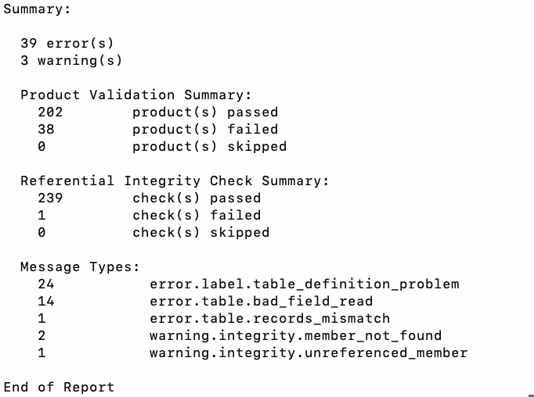
PDS Validate Tool
Ran validate with the –skip-product-validation flag to “Execute bundle validation but only check bundle/collection validity and ignore the products”
% validate -t dart202309/ -R pds4.bundle --skip-product-validation -r validate_bundle_skip_product_validation.txt
Bundle Validation with –skip-product-validation Produced
39 ERRORS
3 WARNINGS
Notes:
Additionally, given all of the PDS4 Validation errors I have run it with
--skip-product-validation which according to the PDS4 Validate Tool
documentation will "Execute bundle validation but only check bundle/collection
validity and ignore the product"

Slide 7
PDS Validate Tool
[LIEN] [1 Error] ERROR [error.table.records_mismatch] Number of records read is not equal to the defined number of records in the collection (expected 77, got 76).
data_derived_didymos_model_v003/collection_data_derived_didymos_model_v003.xml
[LIEN] [24 Errors] ERROR [error.label.table_definition_problem] - Number of fields for binary tables in the following labels are incorrect :
data_derived_didymos_model_v003/gravity/didymos*spc_grv*v003.xml
data_derived_dimorphos_model_v003/gravity/dimorphos*spc_grv*v003.xml
data_derived_dimorphos_model_v004/gravity/dimorphos*spc_grv*v004.xml
data_derived_didymos_model_v003/tilt/didymos*spc_nvf*v003.xml
data_derived_dimorphos_model_v003/tilt/dimorphos*spc_nvf*v003.xml
data_derived_dimorphos_model_v004/tilt/dimorphos*spc_nvf*v004.xml
In the label: <Record_Binary> -- <fields>6</fields> … but there are 10 fields.
[LIEN] [14 Errors] ERROR [error.table.bad_field_read] line 0: Data Object #0 (): Cannot invoke "java.math.BigInteger.multiply(java.math.BigInteger)" because the return value of "gov.nasa.arc.pds.xml.generated.TableCharacter.getRecords()" is null
data_derived_didymos_model_v003/shape/didymos_g_*spc_obj*v003.xml
data_derived_dimorphos_model_v003/shape/dimorphos_g_*spc_obj*v003.xml
data_derived_dimorphos_model_v004/shape/dimorphos_g_*spc_obj*v004.xml
data_derived_dimorphos_model_v003/local/dimorphos_l_00050mm_spc_obj_0884s26430_v003.xml
data_derived_dimorphos_model_v004/local/dimorphos_l_0050mm_spc_obj_0896s25122_v004.xml
Notes:
Wildcards are used where all files of this type have the error

Slide 8
Miscellaneous PDS4 Issues
Readme.txt is missing [LIEN]
ERROR [error.label.missing_file]
URI reference does not exist: file: ... readme.txt
Document collection is not in the bundle xml [LIEN]
collection_data_derived_didymos_model_v003.csv – has 4 files that have truncated filenames [LIEN]
Notes:
Readme is referenced in the bundle xml but is missing from the bundle
The derived didymos model v3 data collection csv has 4 truncated files

Slide 9
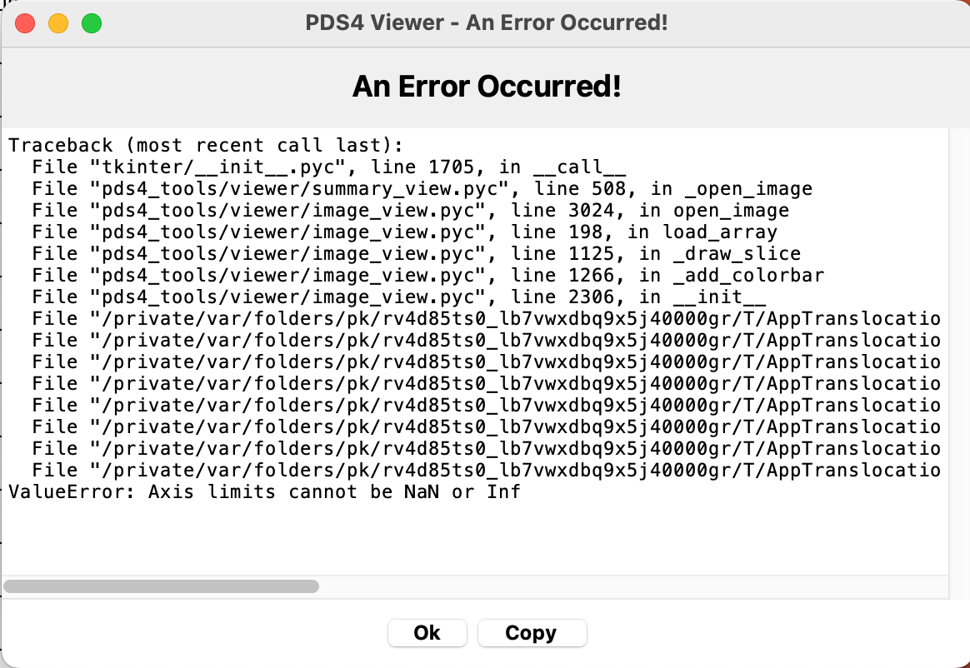
Product Validation (Minimal)
OBJ file labels & headers have been reviewed
The header described in the SIS (5.2.2) does not match the files [LIEN]
The xml <description> of all files is identical [LIEN]
Resolution in description does not match the file
Dimorphos is used for all Didymos shape models
Checked binary table & image cube FITS files with PDS4 Viewer
data_derived_didymos_model_v003
1 file of each type ie Tilt/*spc_fdi*.xml was opened
Most of the Global DTM data was not viewable via image and table [LIEN]
data_derived_dimorphos_model_v003
1 file of each type ie Tilt/*spc_fdi*.xml was opened
Some of the Local and Global DTM data was not viewable via image and table [LIEN]
data_derived_dimorphos_model_v004
1 file of each type ie Tilt/*spc_fdi*.xml was opened
More details are included in the review material
Notes:
Error produced when the image was not viewable in PDS4 Viewer

Slide 10
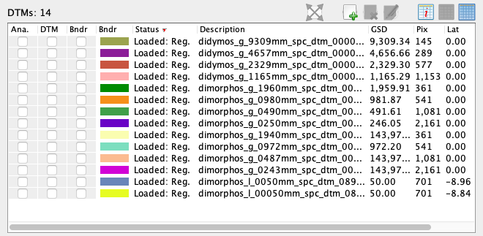
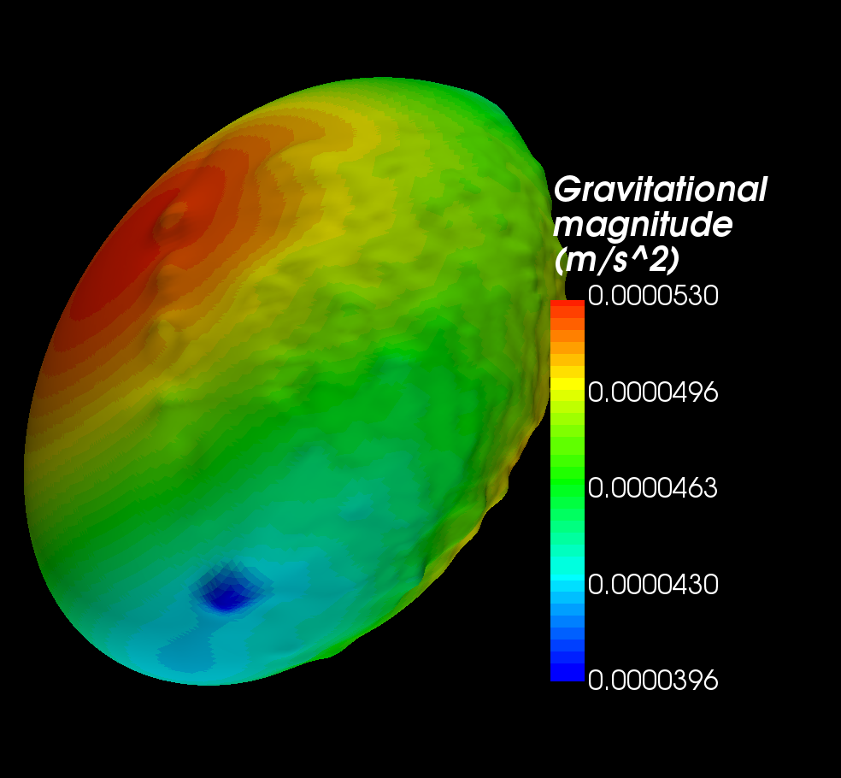
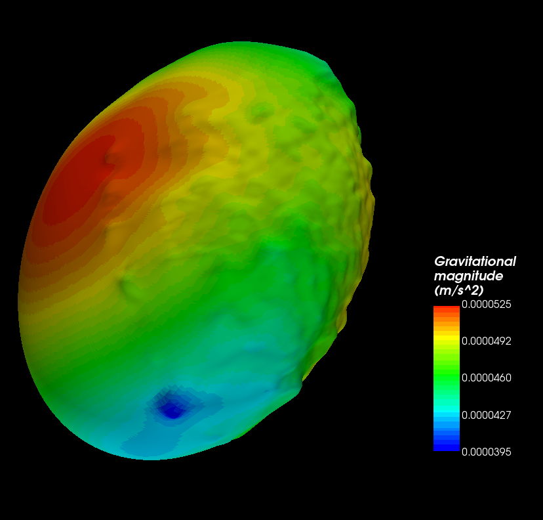
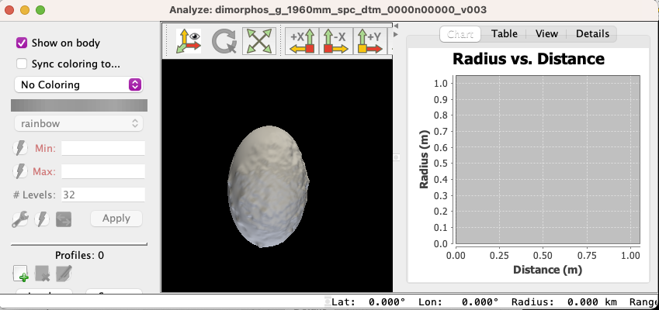
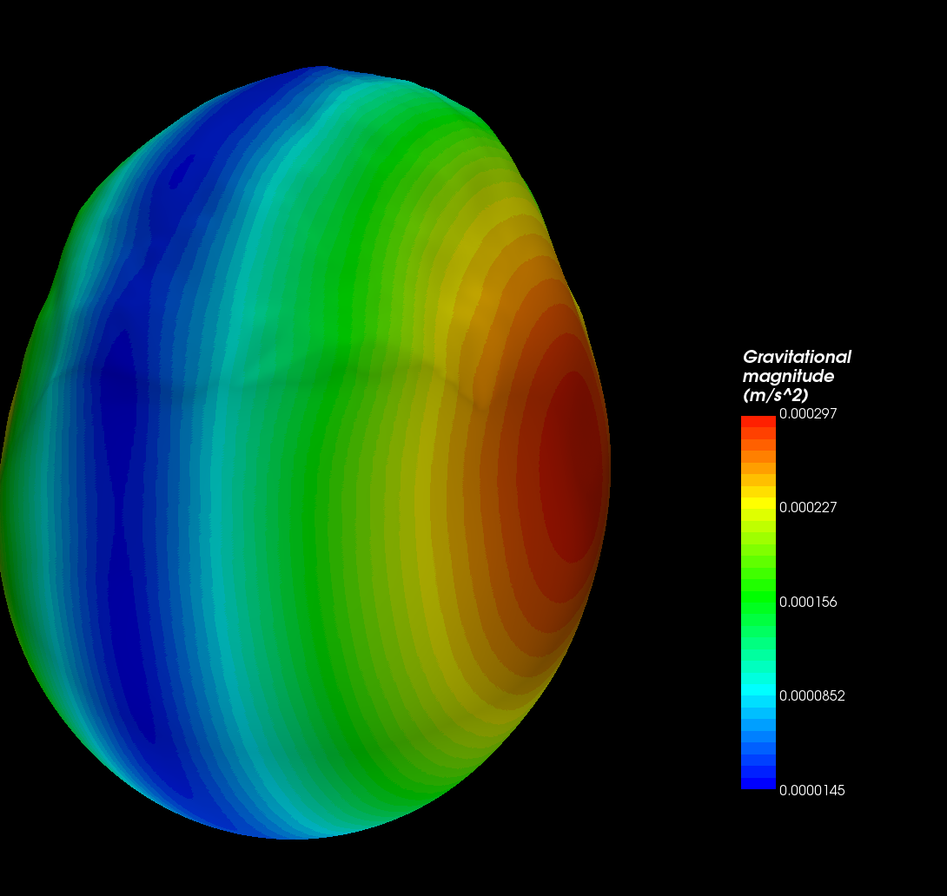
Product Validation (Minimal)
Image Cube DTM FITS files have been tested with SBMT
All 14 DTM files open and display in SBMT
Shape models overlayed with quantities
1
2
3
1 - dimorphos_g_1960mm_spc_dtm_0000n00000_v003
2 - dimorphos_g_1940mm_spc_dtm_0000n00000_v004
3 - didymos_g_1165mm_spc_dtm_0000n00000_v003

Slide 11
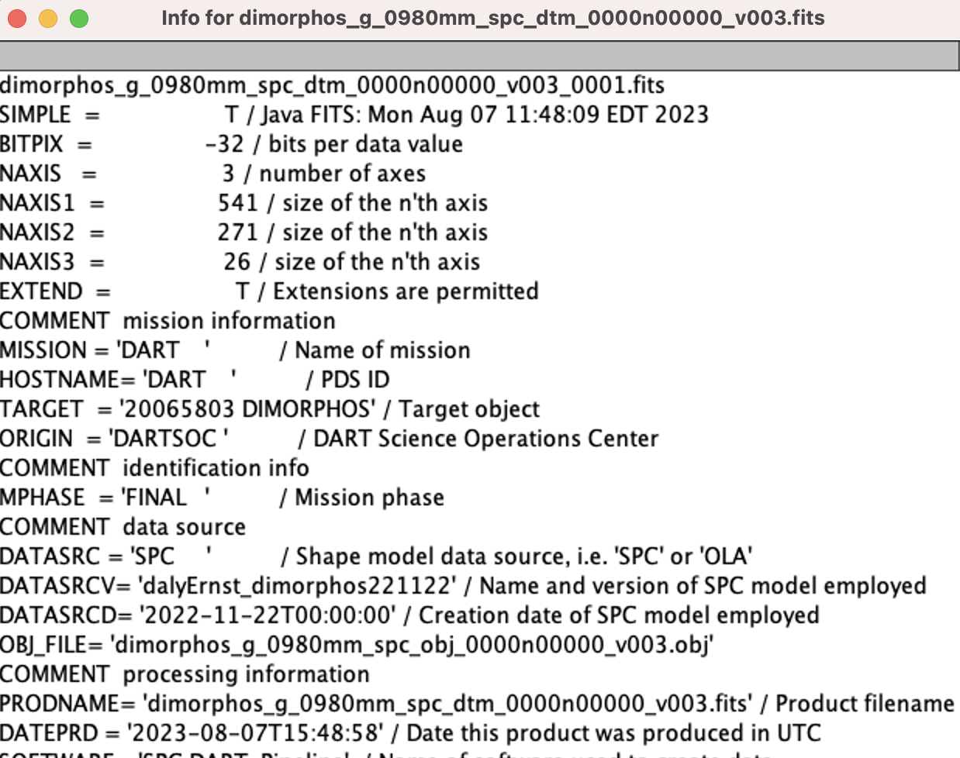
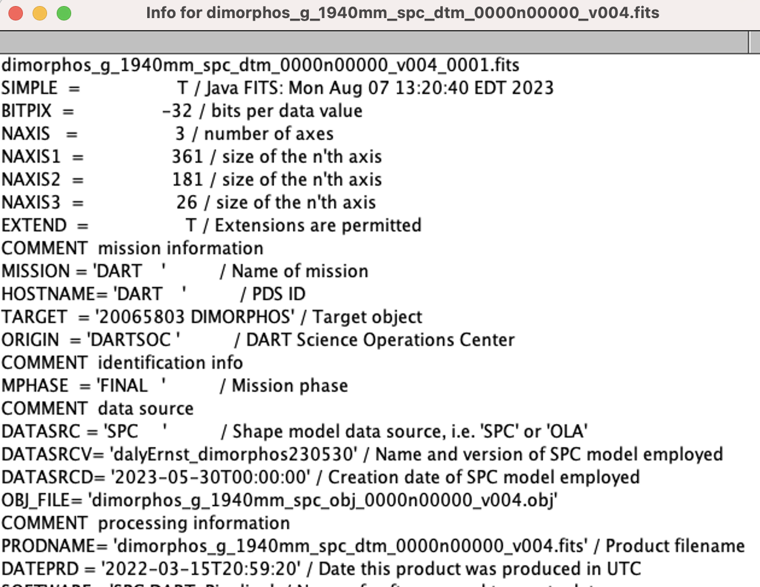
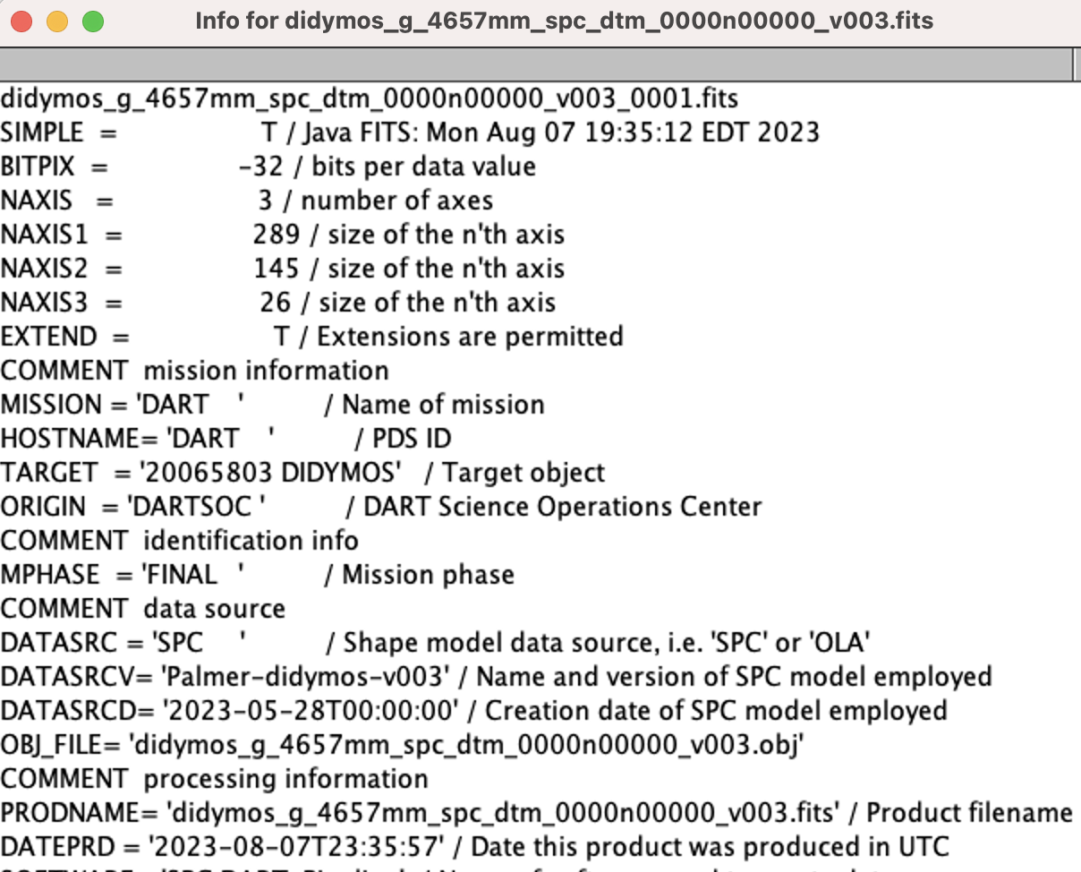
Product Validation (Minimal)
Image Cube FITS files have been tested with AstroImageJ
LIEN from 2022 review - The header has an incorrect value for the target keyword (or the documentation is wrong) :
TARGET = 'DIMORPHOS' instead of '920065803 Dimorphos’
TARGET = '20065803 DIMORPHOS’ OR TARGET = '20065803 DIDYMOS’
These values differ from the SIS. This sis says – TARGET = ‘920065803 Dimorphos’ OR ‘120065803 Didymos’
Strings that include NAIF ID and name are not (and will not be) recognized by SPICE. The header TARGET naming convention should be updated [LIEN]
Please update to something along the lines of 'DIDYMOS'/'DIMORPHOS', or '65803 DIDYMOS'/'DIMORPHOS', or '65803 Didymos'/'(65803) Didymos I (Dimorphos)’ as used in the XML labels <name> fields

Slide 12
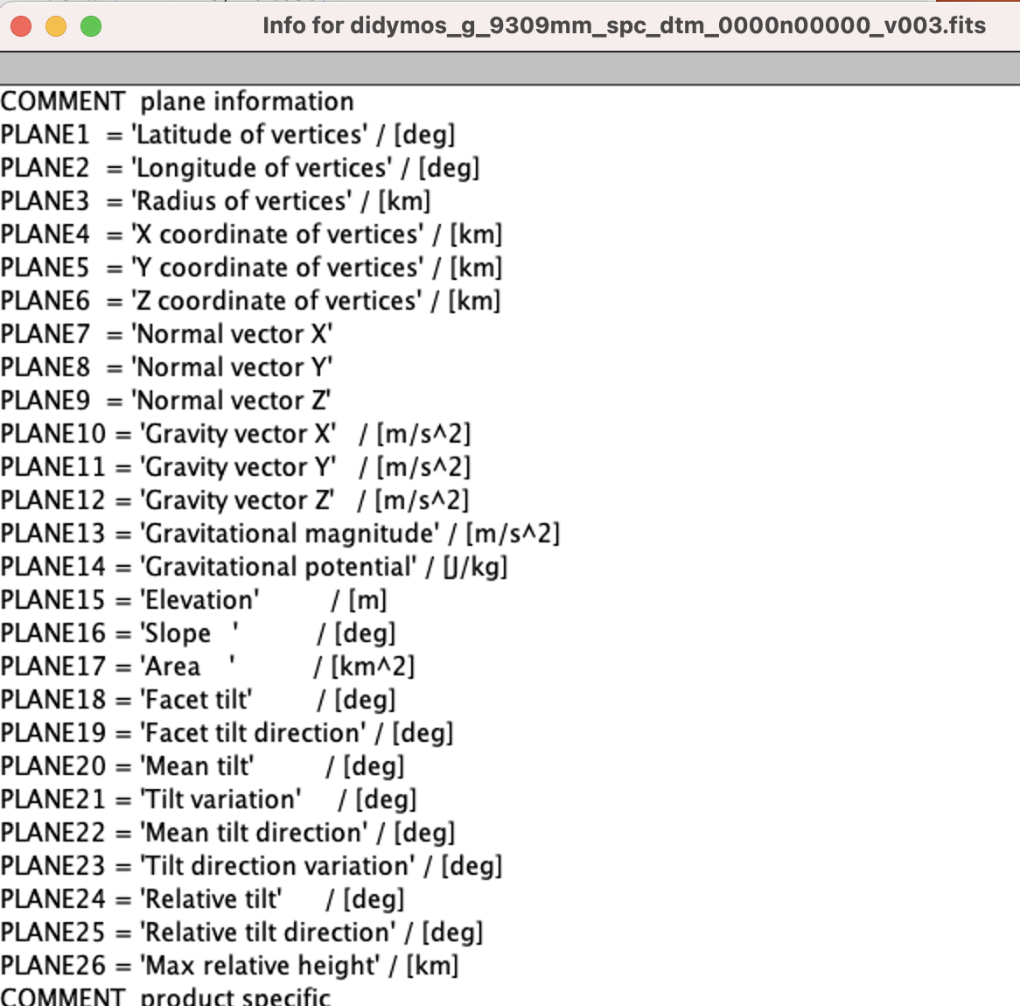
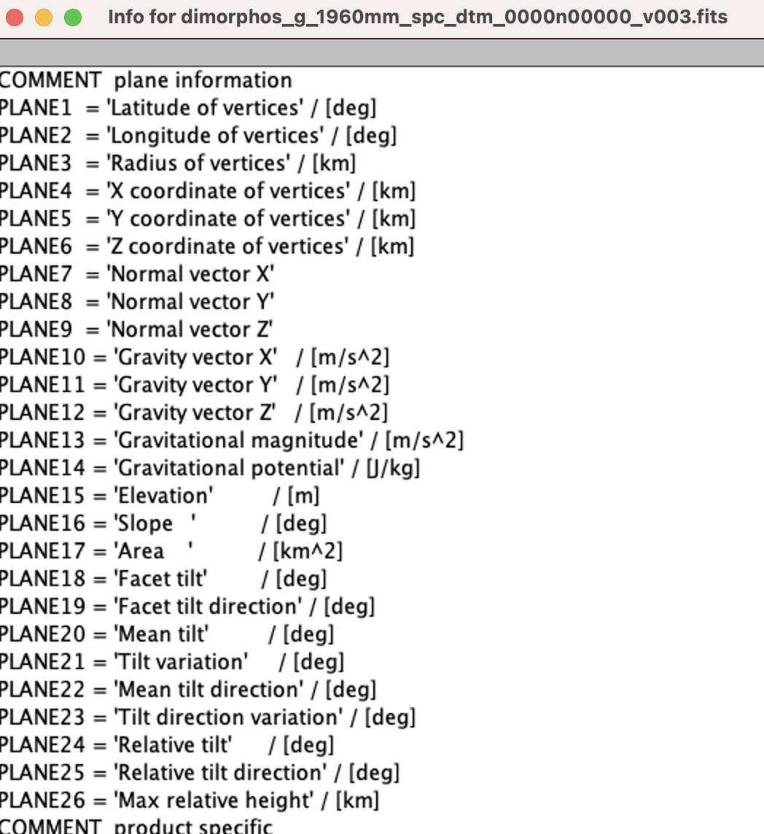
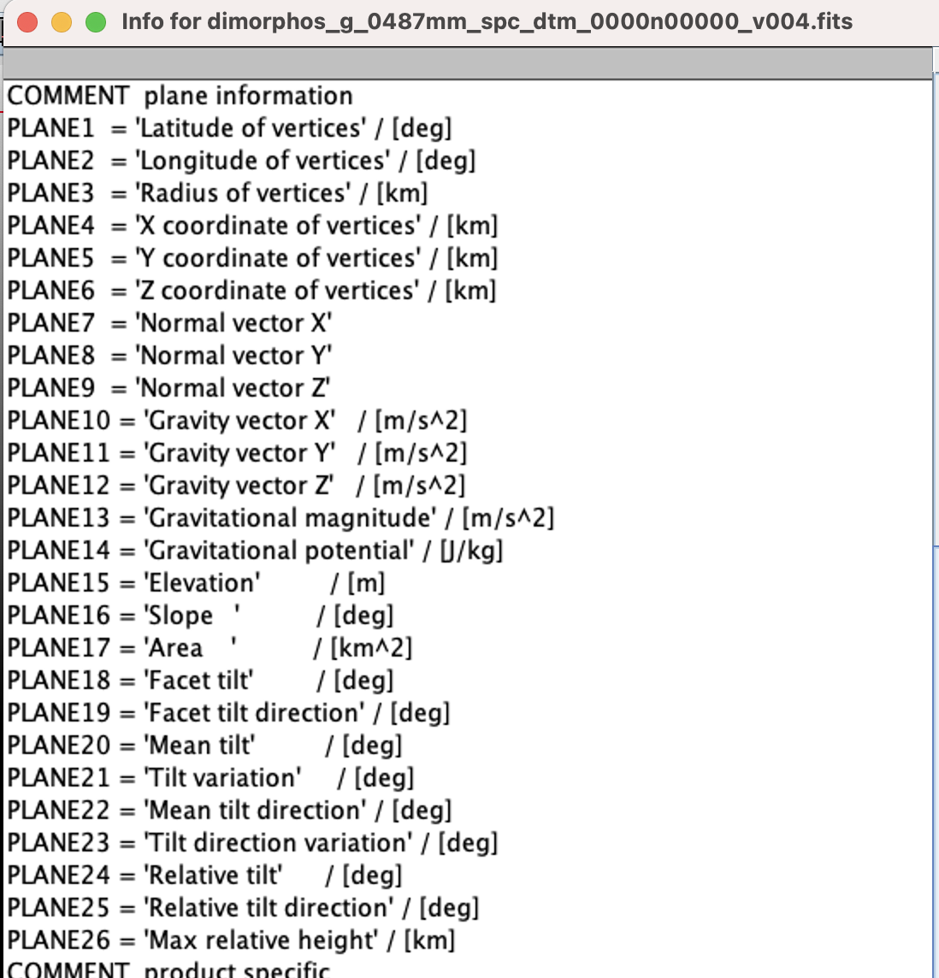
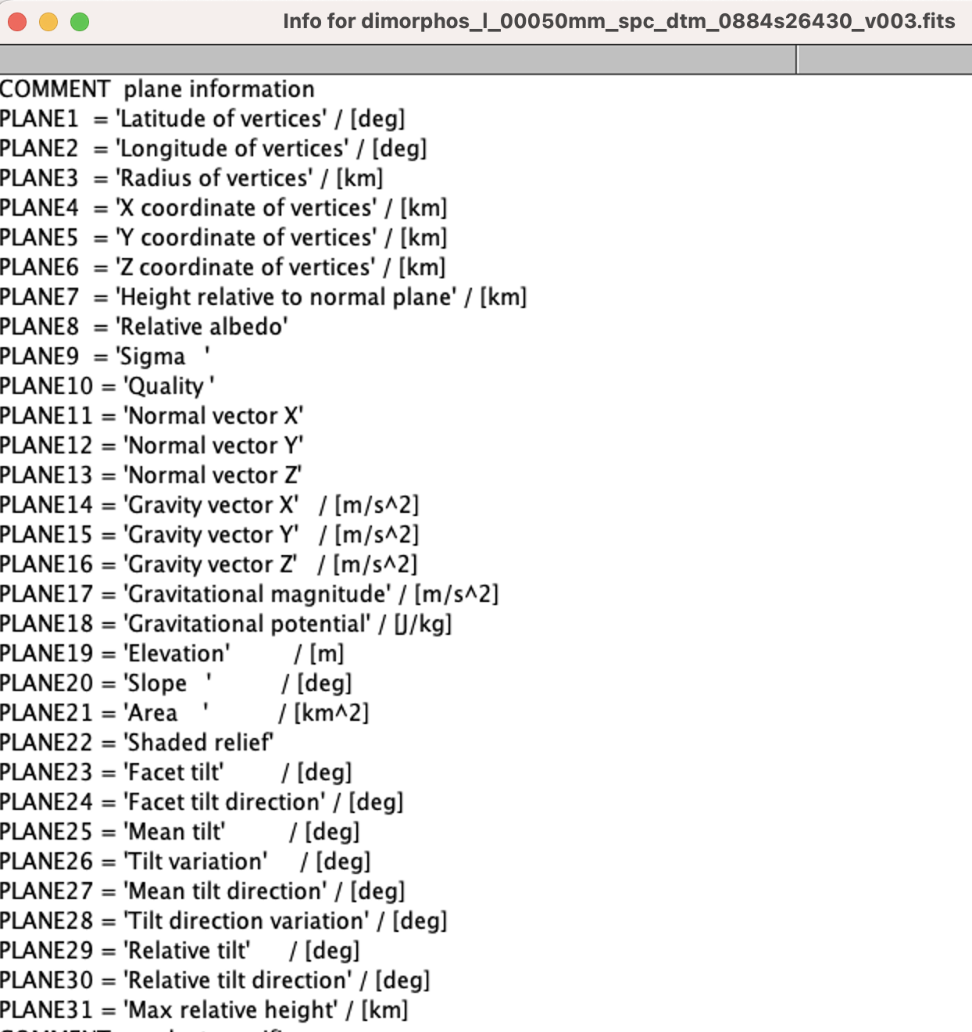
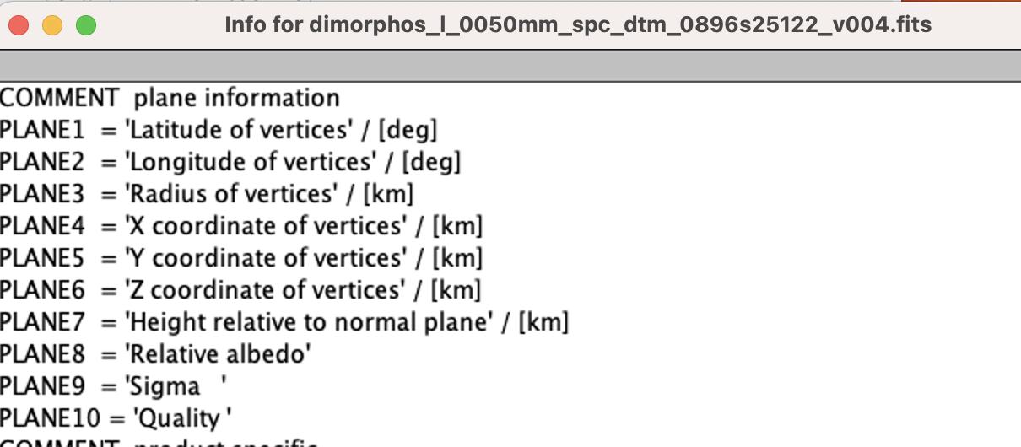
Product Validation (Minimal)
LIEN from 2022 review - There is a plane (ALBEDO) missing in the global image cube, that is present as an ancillary FITS file :
g_08440mm_spc_alb_dimo_0000n00000_v002.fits
Local Dimorphos DTMs v3 & v4 have albedo
Global DTMs are still missing Albedo [LIEN]
Why do the Dimorphos v3 and v4 local DTMs have different PLANEs?
V3 Local DTM
V4 Local DTM
Didymos Global DTM
Dimorphos Global V3 DTM
Dimorphos Global V4 DTM

Slide 13
Document Collection
dimorphos_impact_point_model_v003.txt
Verified Lat with Daly et al. 2023, RECLAT SPICE API, and impact site XYZ with v1 Impact SPK
REFERENCE_SHAPE = dimorphos_g_1960mm_spc_obj_0000n00000_v003.obj
dimorphos_impact_point_model_v004.txt
Verified Lat with RECLAT SPICE API, and impact Site XYZ with v2 Impact SPK
REFERENCE_SHAPE = dimorphos_g_1960mm_spc_obj_0000n00000_v004.obj – File does not exist [LIEN]
Should this be dimorphos_g_1940mm_spc_obj_0000n00000_v004.obj ?
dart_shapemodel_sis.pdf
Miscellaneous little things are noted in my review notes – ie. Typos or suggestions
LIEN from 2022 review - dart_coordinate_system_for_didymos_and_dimorphos_v1.pdf is incorrect, the PDF/A version must be corrected.
This document no longer exists but is referenced in sections 4.3.7 & 5.2.4 [LIEN]
4.3.4 Wording makes it sound like the SPICE-kernel products are in this archive. Please make the wording clearer to emphasize these products are in the DART SPICE archive at the NAIF Node. [LIEN]
4.3.5 states this archive conforms to PDS 1.7 IM - BUT 1.4 is used in the labels [LIEN]
5.2.5 talks about SPICE PCK kernels and mentions 'BODY920065803_NUT_*' terms which are not included in the DART 'didymos_system' PCK. This should be removed if they are not planning on being added to the PCK file [LIEN]
5.2.5 section states 920065803 is assigned for Dimorphos which is incorrect [LIEN]
This ID is assigned for Didymos.
From the NAIF IDs -
920065803 'DIDYMOS'
120065803 'DIMORPHOS’
5.2.7 says spacecraft pointing and trajectory will be provided as SPICE kernels - please make it clear they are located at NAIF in the DART SPICE archive and not within this archive [LIEN]
7.1 The SPICE definition should be changed to ‘NASA's observation geometry information system developed and maintained by NAIF. SPICE acronym comes from Spacecraft ephemeris (SPK), Planetary constants (PCK), Instrument (IK), Camera-matrix (CK), and Events (EK).’ [LIEN]

Slide 14
Shape Models (obj files)
Examined DSK "comments”
noted duplicate vertices/Euler formula violations
Converted all shape-archive OBJs to SPICE DSKs
success (after stripping OBJ comments which MKDSK cannot process)
Visualized shape-archive-based DSKs in Cosmographia
v3 and v4 _g_ shapes appear consistent, a with small rotational shift
corresponding _g_ and _l_ shapes appear consistent
side-by-side visual comparison with SPICE-archive DSKs looked OK ☺
Dumped DSKs from SPICE-archive to OBJs and compared with shape-archive OBJs
consistent data for all Dimorphos _g_ shapes
SPICE archive does not include DSKs for _l_ shapes and for Didymos (a lien on DART SPICE archive)
Independently checked archive-based DSKs for Euler formula violations
same results as reflected in OBJ comments
Rendered a few shape-archive OBJs in Blender
success
Notes:
This part of the review was carried out by Boris Semenov

Slide 15
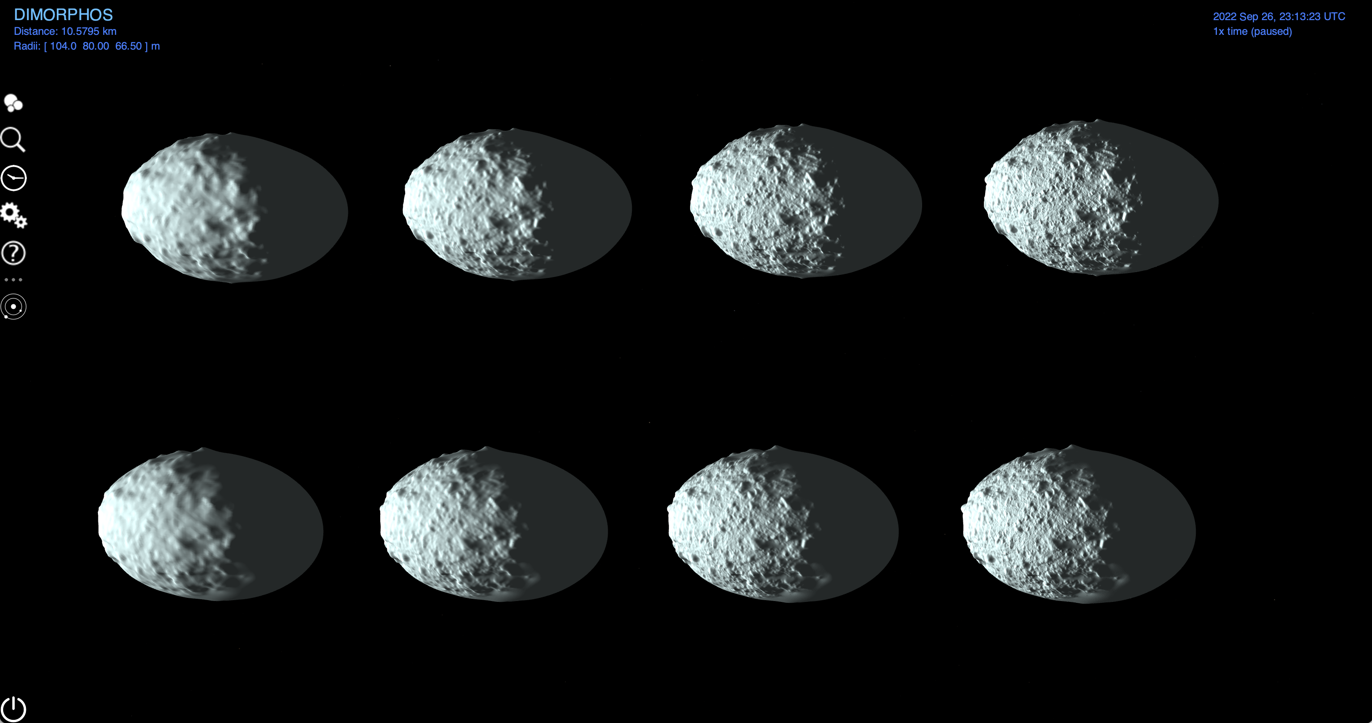
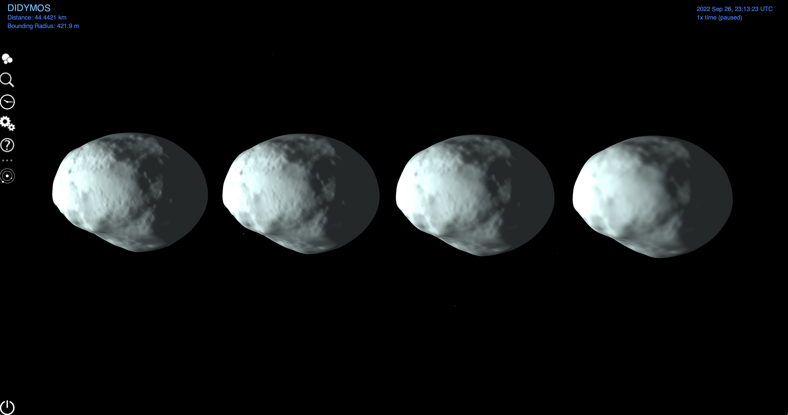
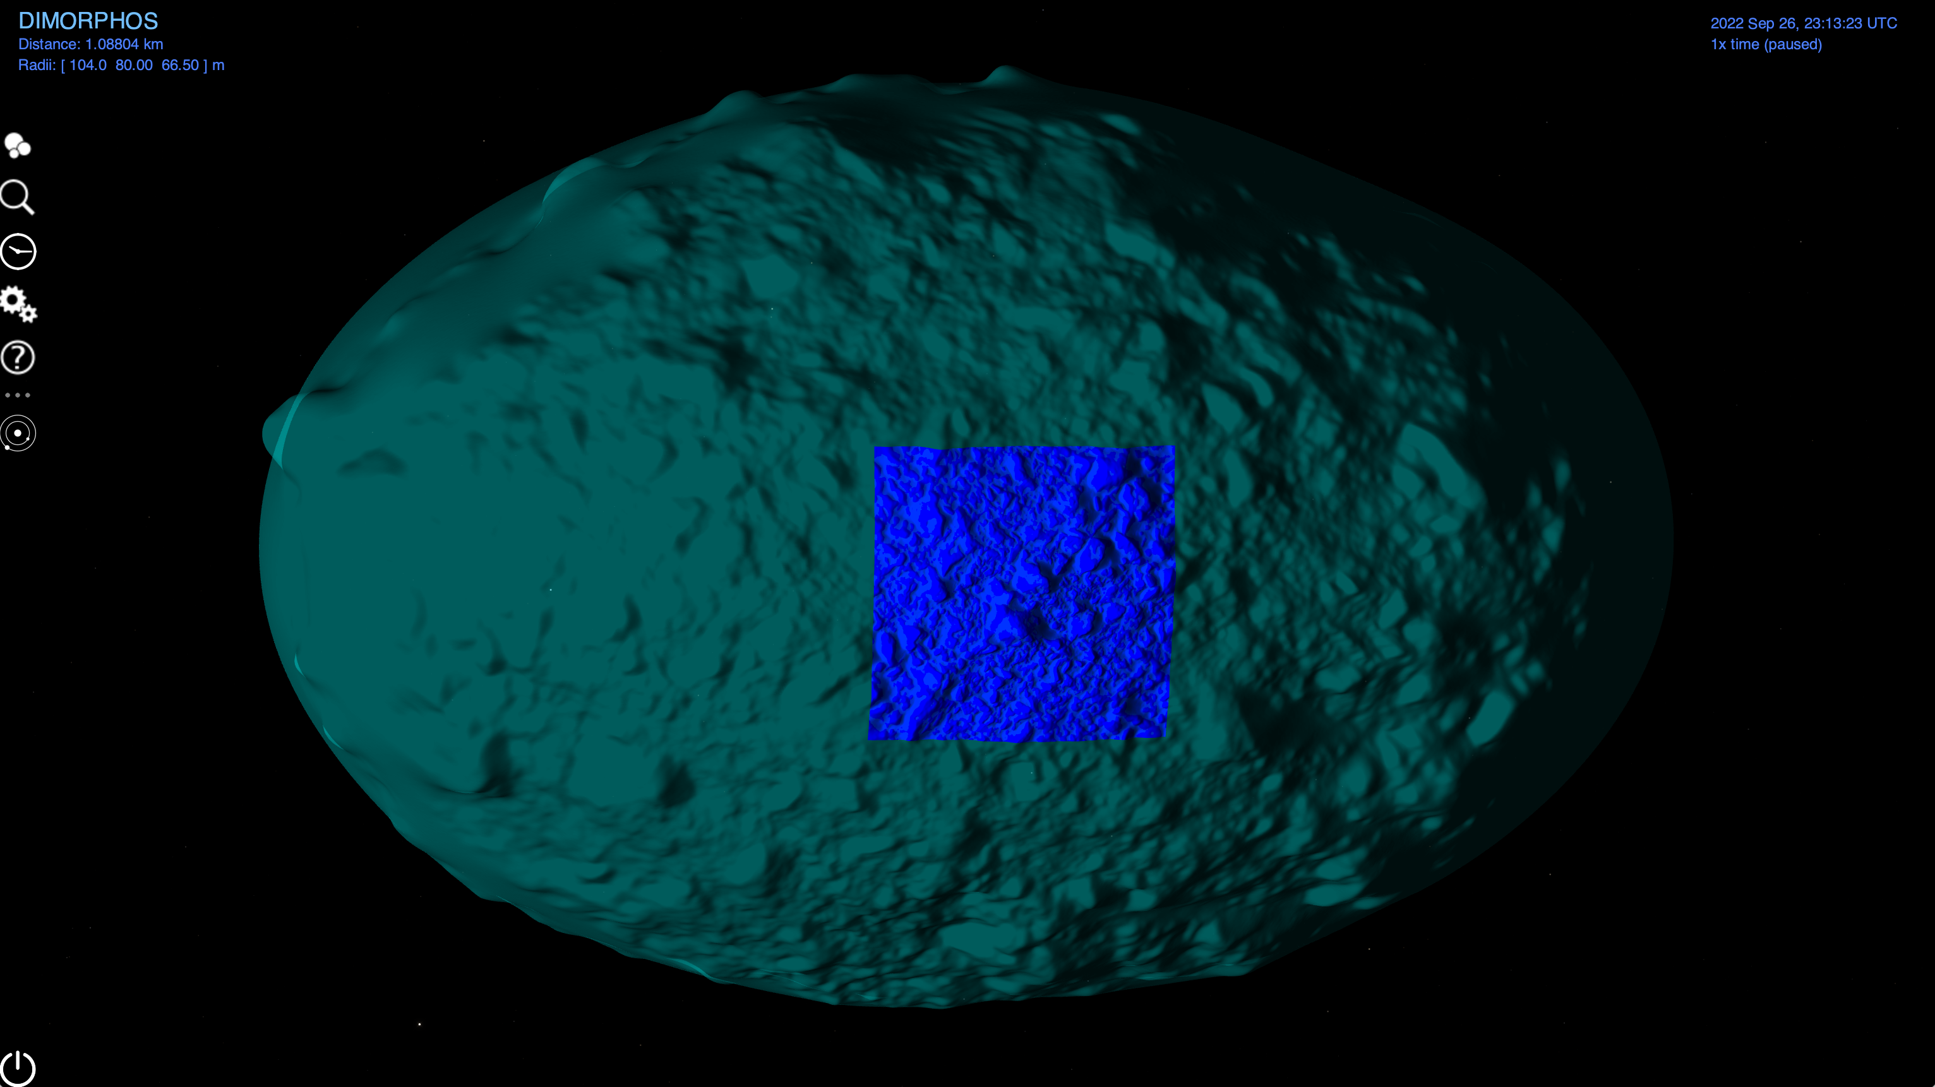
Shape Models
Dimorphos global shape models
v4 shape models on top
v3 shape models on bottom
resolution increases going left to right.
Didymos global shape models
resolution increases going right to left.
Dimorphos Highest resolution V4 Global with the V4 Local ‘patch’ overtop
dimorphos_g_0243mm_spc_obj_0000n00000_v004 dimorphos_l_0050mm_spc_obj_0896s25122_v004

Slide 16
Conclusions
Validate Tool Runs should result in no errors or warnings -including context products
9 Document related Liens
6 PDS4 label/wrapping Liens
5 Data related liens
OBJ files are consistent with dart_spice DSKs ☺
Validation reports and my notes are included in the review material
Notes:
OBJ files are consistent with the Dimorphos DSKs available in the dart_spice archive!

