Slide 1
Review of Lucy LEISA Data
Karl Hibbitts
11/26/2023

Slide 2
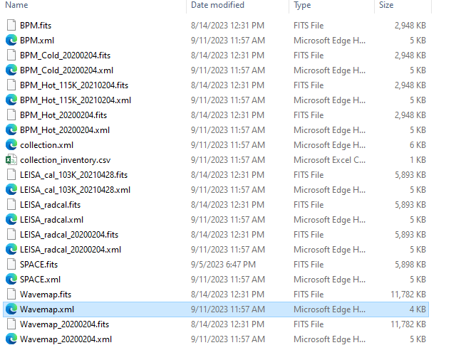
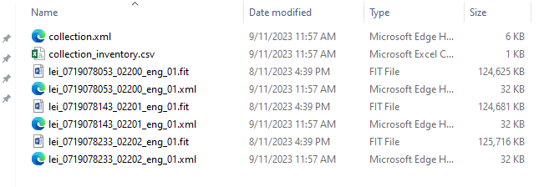
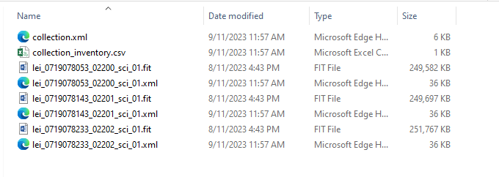
What I reviewed
Viewed XML in PDF4 viewer
Reviewed the SIS file
Attempted to read in the data and calibrate the raw data
Instrument characteristics
LVF pushbroom spectromter.
Thus has wavelength calibration mapped to individual pixel elements.

Slide 3
Viewing XML in PDS4 viewer and analysis in matlab
Able to open the XML file and view the data in PDS4 Viewer.
The labels rendered fine
The earth is apparent.
The data, both raw and calibrated can be viewed in both PDS4 viewer and in Matlab
A readme file is needed for those of us not familiar with the data.
The label information all seemed fine but I did not look in great detail
Attempting to reproduce the provided calibrated data by starting with the raw data. I do not get the same calibrated data when starting with the raw data and following the procedures in the SIS. Two issues: the bad pixel maps do not line up exactly and the calibrated data is different by a small amount. I hypothesize the provided calibrated data may have had a non-zero background subtracted from it.

Slide 4
SIS File
Overall, clearly written. Provided clear instructions.
Minor typo on page 7 “an” should be “and”
Table 2-1 inconsistency. Cross-track start and end of 192 and 1216 → 1025 (not 1024)
There should be a ‘detector map’ to help understand the intricate details. the full 2D MCT detector. Shows masks. shows optimal science FOV. shows cross track direction and spectral direction of filters.
There are some missing links ‘ Error! Reference source no found’
Table 3-1. Unclear why there are Didymos files mentioned (DART target)
Keywords look good
ICD for SOC to PDS looks fine

