Slide 1
L’Ralph LEISA PDS Review
Adam McKay

Slide 2
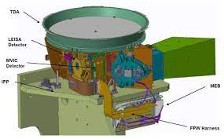
L’Ralph/LEISA Overview
Successor to similar instruments on New Horizons and OSIRIS-REx
“Push-broom” Imaging IR spectrometer, covering 0.95-4 microns
Scans across target to obtain image cube with spectral information

Slide 3
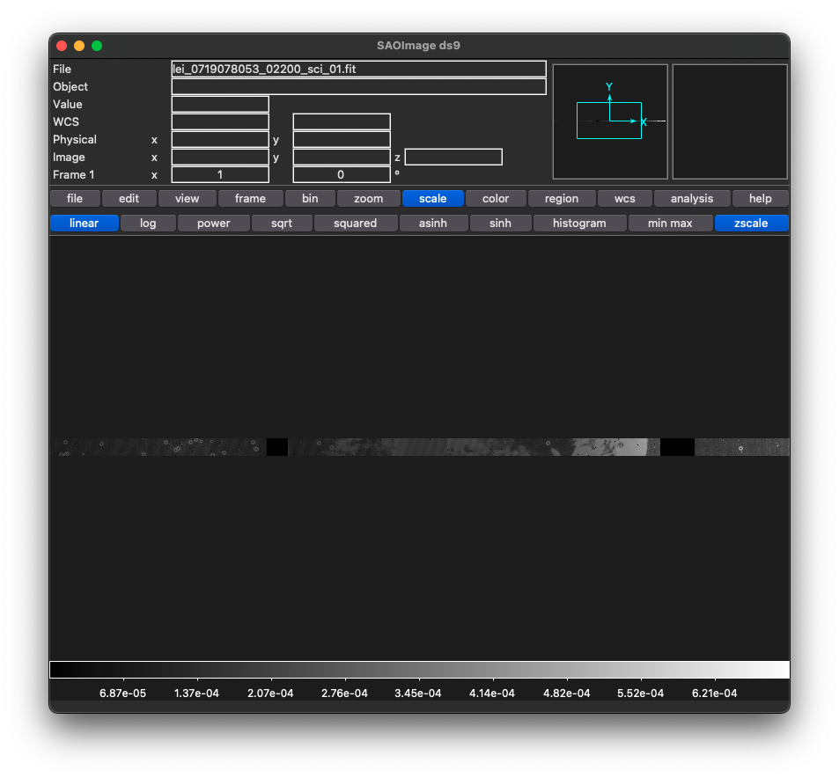
Updates Since Last Time
Added a couple more test observations of Earth, engineering and science calibrated data, also includes some of the calibration files
Everything looks OK! Headers informative and well organized
Delivery also includes XML files for all data, look OK
target name in FITS headers was blank, now says Earth

Slide 4
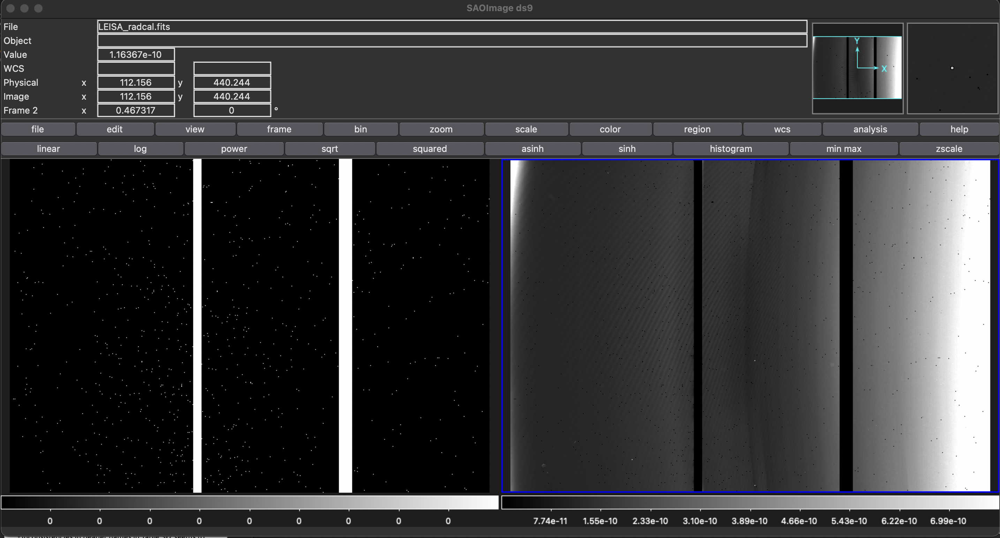
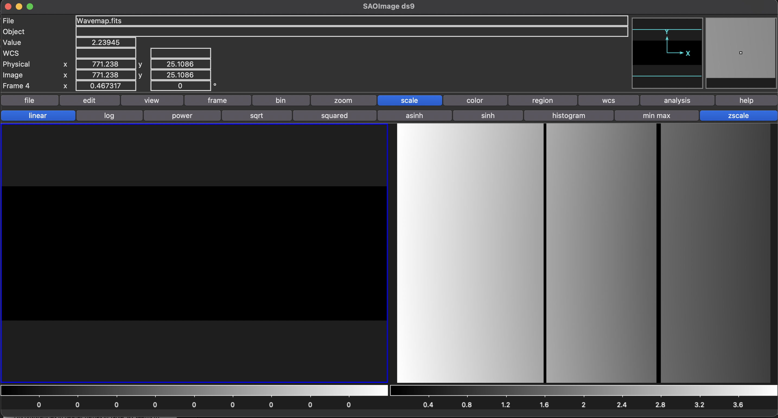
Calibration Data
Includes bad pixel masks, radiance calibrators, background file (all values set to zero as described in PDF) and wavelength map, all look OK
More info about the differences between different versions of the same type of file would be beneficial (maybe a README file or something like that)
Example Bad Pixel Mask (left) and Radiometric Calibration (right)
Example Background (left) and Wavelength Map (right)

Slide 5
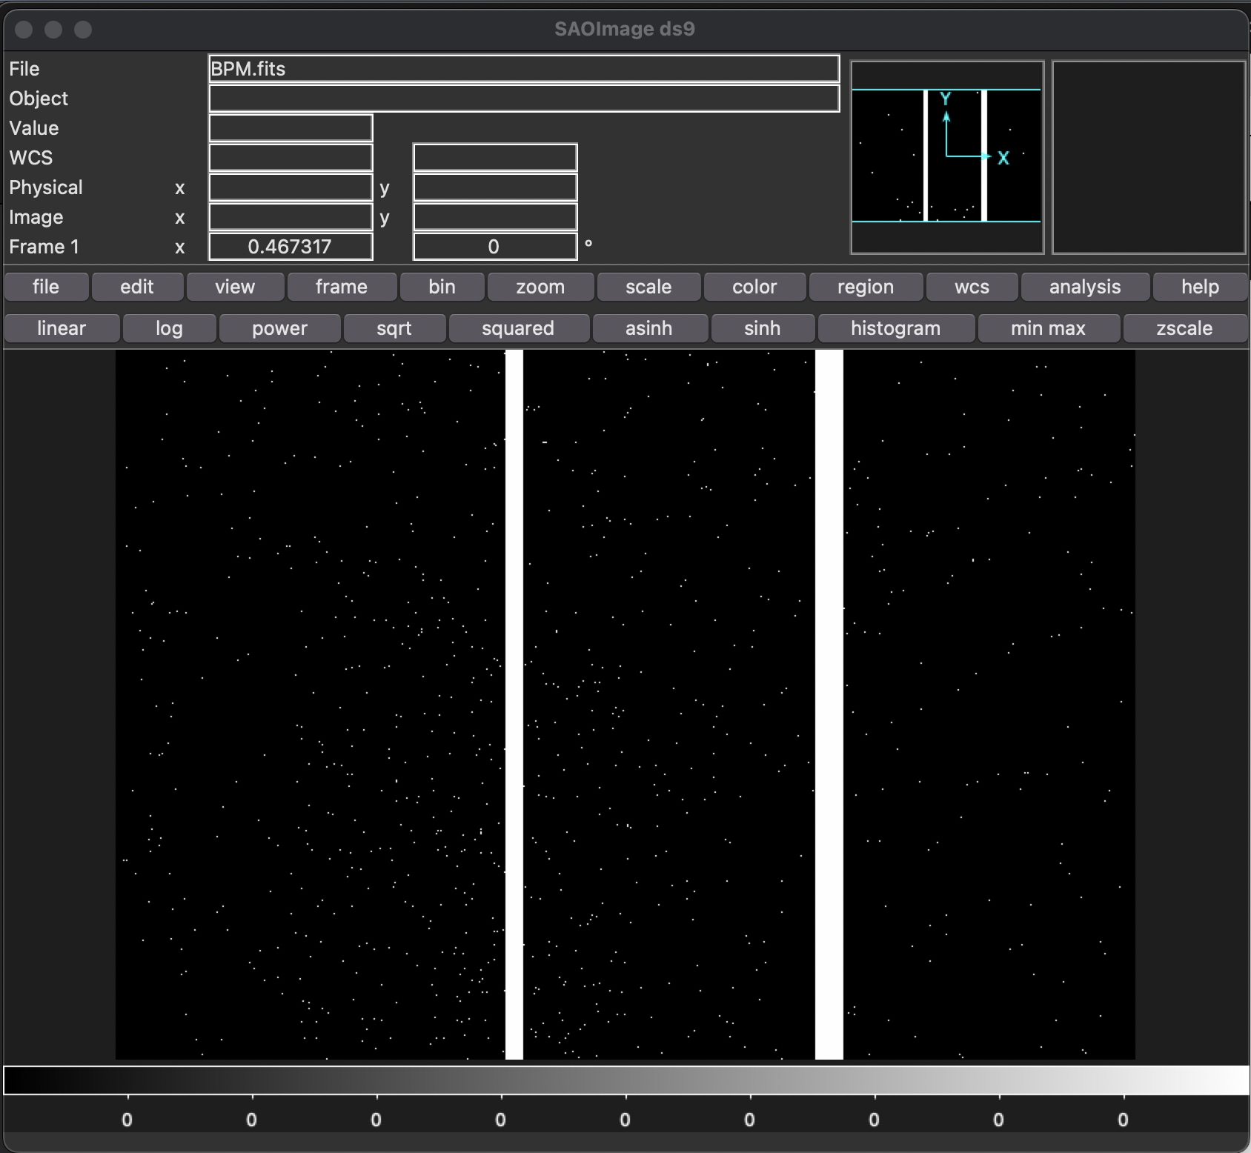
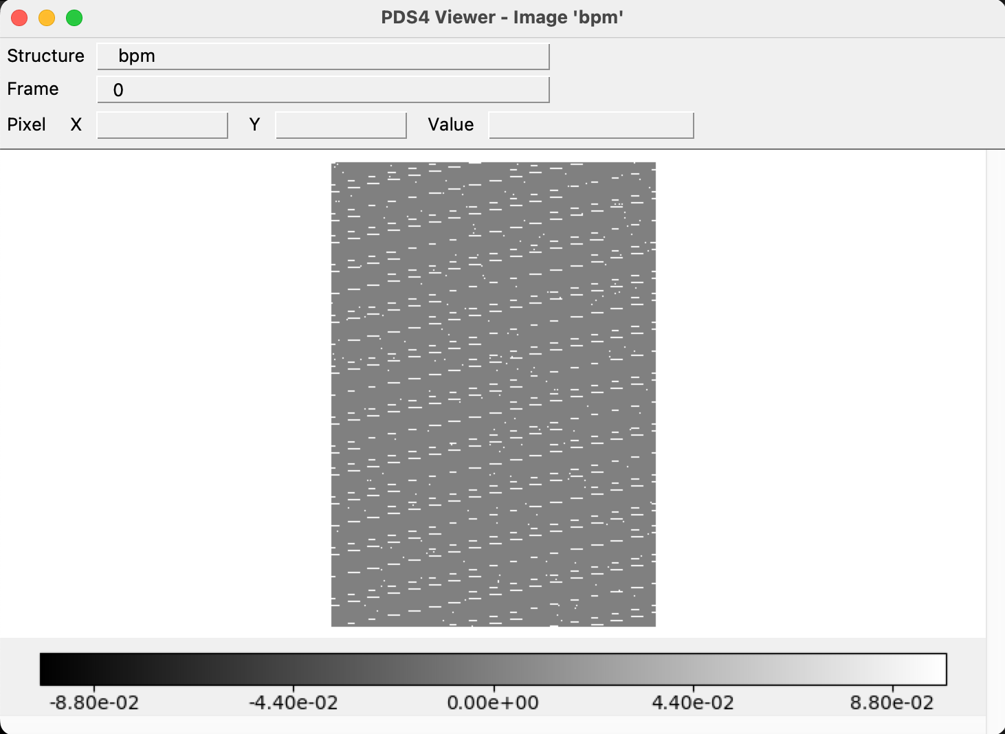
Displaying Data
For all files, able to open in both DS9 and PDSViewer
For calibration images, I don’t think images were displaying correctly in PDSViewer (likely an issue on my end, as it often pops up complaining that no display settings were found)
Bad Pixel Mask in DS9
Bad Pixel Mask in PDSViewer

Slide 6
Documentation
Includes PDF documentation that seems to be a much more developed version of what was included with previous release
End of Section 2.2 says “A complete description of the various files is given in Error! Reference source not found.” I presume the error is some kind of link error in the pdf source file?
Occurs again in section 2.3.1 and 2.3.2
Inconsistencies in header names in Table 3-2 seems to be corrected

Slide 7
Conclusions
Data is certifiable, a few fixes and updates needed in documentation

