Slide 1
PDS SBN L’TES Pipeline Review
Ben Sharkey

Slide 2
Documentation
From last time – discussion of how to nightside measurements are ensured, example diagram refers to spherical targets and “1/8 diameter” offsets. Clarification for irregular shapes?
Could there be a summary of how measurables become radiance?
Emphasize basic path of IFGM -> vspec -> radiance -> temps -> geometry -> surface properties?
However, table 2-3 in SIS covers much of this for me
Minor: Statement on which axis the DFT is performed on? This felt implied to me, especially since axis names (“observation” and “sample”) don’t make it sound obvious to me as a non-expert
“The LTES CDP module transforms the interferogram into a voltage spectrum. The transformation is done by performing Discrete Fourier Transform (DFT) on the raw interferogram.”

Slide 3
Labels/Metadata
ENG data – IFGM labels sample/observation mixups (thanks, Tim!)
It appears to not happen in the case where number of samples > number of observations
ENG data – quantities described, IFGMs appear ok (non-expert opinion)
Cal file labels seem good, describe relevant geometry circumstances, spectra
BUT: Did not understand how to correlate samples in ENG data to terms in calibration equation, therefore could not make sense of SCI file to perform my own calibration
Could revised file organization/naming make this clearer?
Main confusion: not understanding which observations (rows) to actually use

Slide 4
Data
Brightness temps on SCI data zeros?
All files open ok, SCI file appears to have valid radiance spectra, voltage spectra, interferograms
HDF files appear to have consistent IFGM axes, when opened in python (readpds in python, also found h5py module useful for looking at the hdf files themselves)

Slide 5
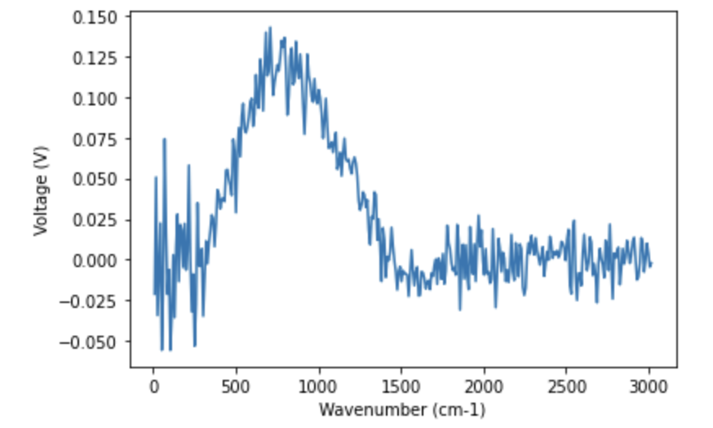
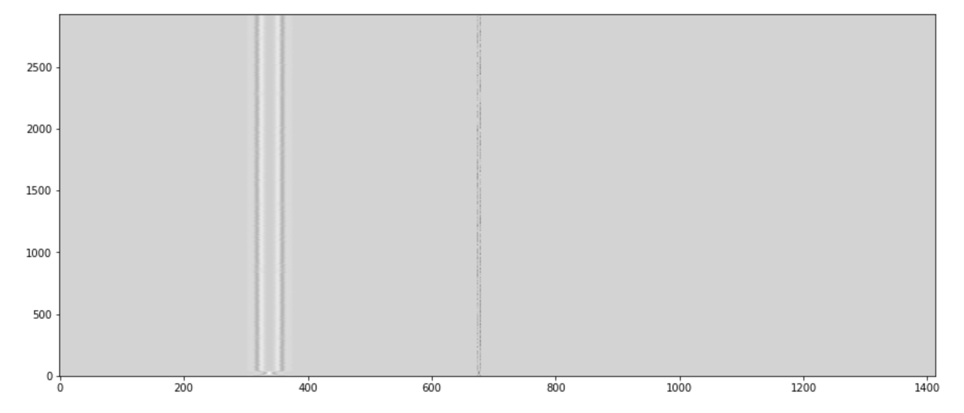
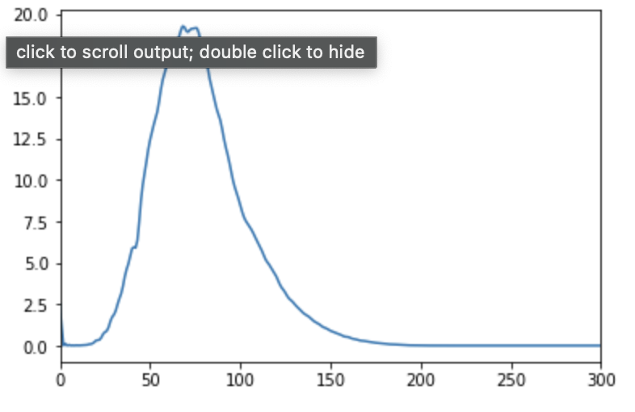
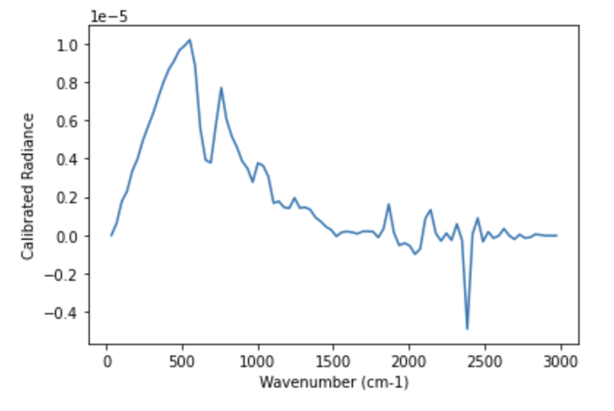
Plots from data
tes_seq_2022286_sci_l2_01.hdf,
”vspec” plotted with “xaxis”
tes_0718934934_02059_eng_01.hdf, “ifgm”
tes_seq_2022286_sci_l2_01.hdf,
”calibrated_radiance” plotted with “xaxis”
Power spectrum
of row 1500
(zoomed to 0<x<300:

