Slide 1
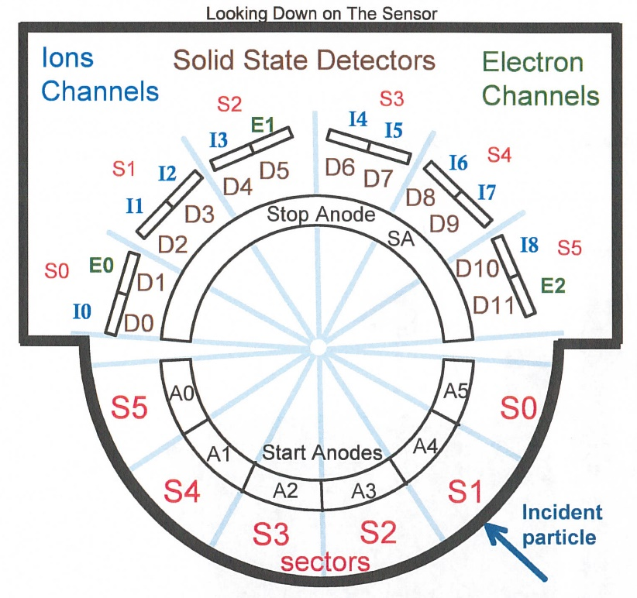
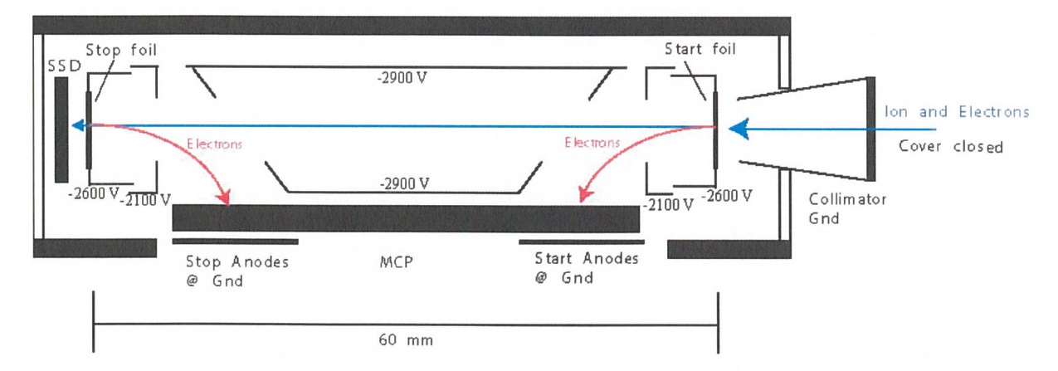
New Horizons Pluto Energetic Particle Spectrometer Science Investigation (PEPSSI)
Reviewed by S. Joy (primary)
PRINCIPAL INVESTIGATOR: Ralph McNutt, APL
DESCRIPTION: Medium Energy Particle Spectrometer
ENERGY RANGE: 25-1000 keV (protons)
60-1000 keV (atomic ions)
25-500 keV (electrons)
FIELD OF VIEW: 160 deg x 12 deg
ANGULAR RESOLUTION: 25 deg x 12 deg
ENERGY RESOLUTION: 0.25 keV
SENSOR SIZE: 7.6 cm dia. x 2.5 cm thick
POWER: 1.4 watt
MASS: 1.5 kg

Slide 2
New Horizons PEPSSI Data Sets
Data ->
nh-x-pepssi-2-kem2-v1.0
nh-x-pepssi-3-kem2-v1.0

Slide 3
New Horizons PEPSSI Data Set Evaluation Tools
All Data Processing and Evaluation -
Machine: Dell XPS 15 9510
Operating System: Windows 10

Slide 4
Comments on review procedure
The catalog, documents, and calib directories of these volumes are nearly identical, and most of their contents have been previously reviewed many times.
I have taken advantage of this fact to reduce the review effort.
I used the folder compare option in BeyondCompare 3.3.13 to compare like folders across the four volumes, and then compare files contained in the folders. Most of the time, the only variation in the directory contents or the
file therein were the file time stamps and the data_set_id’s in the label files.
Once this information was available to me, I only reviewed unique files
Lastly, I looked at issues raised in the Oct 2022 review to make sure that they had been addressed in this release.

Slide 5
Documentation
Evaluation

Slide 6
Root level files
AAREADME No issues found: -2- and -3- files essentially identical and are ok. VOLDESC No issues found – -2- and -3- files essentially identical and are ok.

Slide 7
Catalog files
catinfo.txt – ok, no ch
nh_kem.cat – ok, both versions identical
nh_kem2.cat – ok, both versions identical nhsc.cat – ok, both versions identical pepssi.cat – ok, both versions identical
ref.cat – ok, both versions identical dataset.cat (nh-x-pepssi-2-kem2-v1.0 and nh-x-pepssi-3-kem2-v1.0) – both ok

Slide 8
Calib files
calinfo.txt – good
Files
hk_stat_input_20041016.tab (lbl) – good, both versions identical
hk_n1_input_20050228.tab (lbl) – good, both versions identical
rateboxdefinitionplanes.fit (lbl) – good, both versions identical
calpars folder on -3- volumes only (as expected)
calpinfo.txt – good
calpar_columns.fmt – good
pep_*_0x691_calpar.tab – ok, contents clear and self-explanatory. No corresponding .lbl file but that has been the case throughout the mission and has been previously accepted.

Slide 9
Document files
DOCINFO.TXT – good
All PDS documents (codmac_level_definitions, lunineetal1995, payload_ssr, pepssi_ssr, soc_inst_icd) appear to be properly formatted as PDF/A and the document labels appear to be valid. Most of these document files have been reviewed many times and have not changed recently. They appear to be the latest versions of each.
soc_icd.pdf July 2023 version
The PEPSSI chapter of the soc_icd should be updated at some point to more completely describe the operational consequences of the FSW 5 update.
nh_fov.png (.lbl) – good nh_met2utc.tab (.lbl) – complete (last weekly entry 2025-01-01), good
nh_mission_trajectory.tab (.lbl) – complete (last entry 2022-04-30), good nh_pepssi_v110_ti.txt – good
pep_bti.tab (.lbl) – good, complete (last entry 2022-143)
quat_axyz_instr_to_j2k.asc (.lbl) – good
seq_pepssi_kem1.tab (.lbl) – good, complete (last entry 2022-04-30)
PEPSSI_BTI_GoodTimeIntervalsBadTimeIntervals_2022_149.txt described on ICD page 96 is missing. This file (and lbl) should be added to the archive.

Slide 10
Index files
INDXINFO.TXT – good
Index.tab (lbl) - both files good in all datasets
Slimindx.tab (lbl) ) - both files good in all datasets
Checksum.tab (lbl) - both files good in all datasets

Slide 11
Data
Evaluation

Slide 12
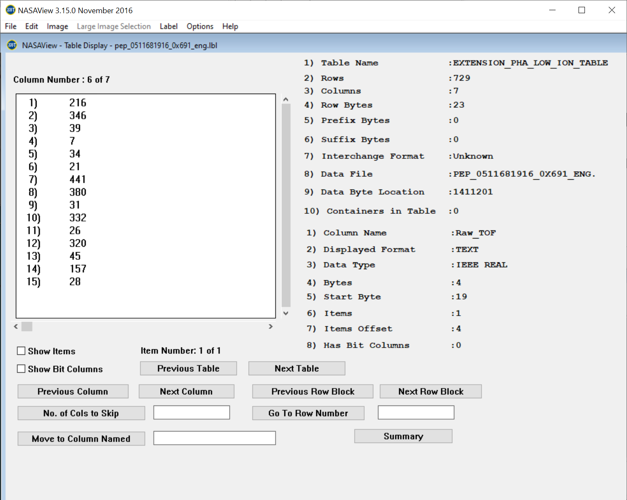
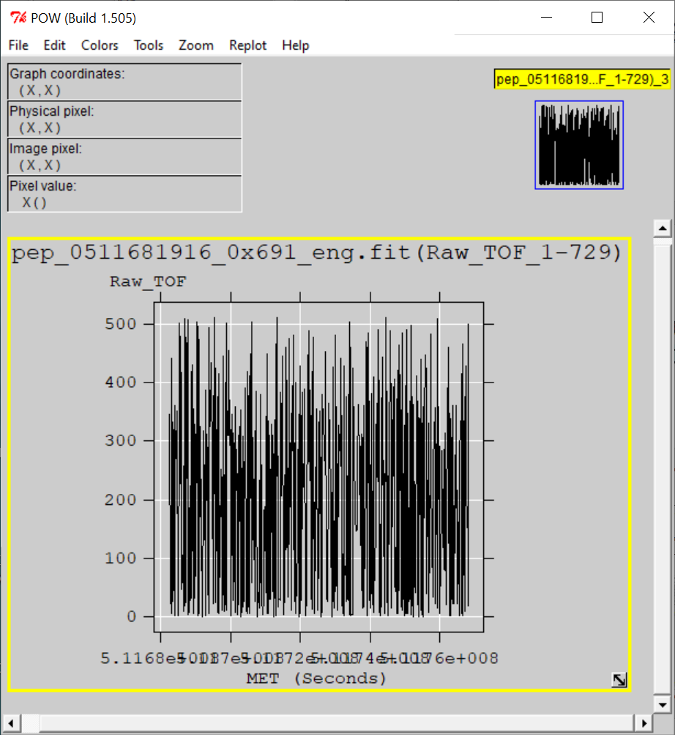
nh-x-pepssi-2-kem2-1.0
Files open with both NASAVIEW and FV suggesting that the PDS and FITS labels are well-formed. Validate tool did not catch any errors with labels. All of the files and labels selected for spot inspection appeared nominal.
All tables and columns accessible in NASAVIEW, listings look as expected
FV allow the user to plot data from any table versus time (MET or ET) and the plots look nominal (Raw TOF vs MET from PHA_Low_Ions)

Slide 13
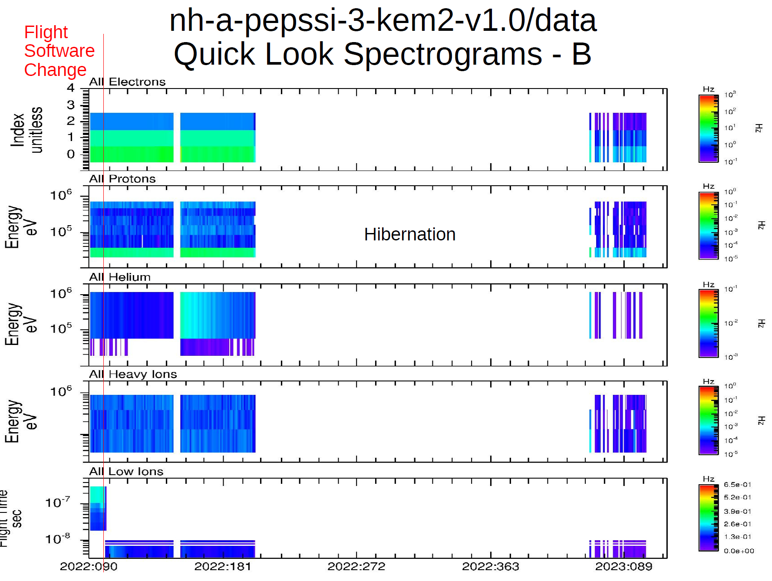
nh-x-pepssi-2-kem2-1.0
Instrument appears to operate nominally across the FSW change
Plot courtesy of R. Frahm

Slide 14
nh-x-pepssi-3-kem2-v1.0
Files open with both NASAVIEW and FV suggesting that the PDS and FITS labels are syntactically well-formed.
All of the data files selected for spot inspection appeared nominal. NASAView has some display issues with these data/labels
FV allow the user to plot data from any table versus time (MET or ET) and the plots look nominal.
New Data Files
NASAVIEW won’t allow users to navigate past the first image in the file – known s/w problem
Electron Energy vs. Channel from 2022-04-08 (FV)
Weak TOF vs Energy signal matches similar PHA result from FV for this data file (2022-04-08)

Slide 15
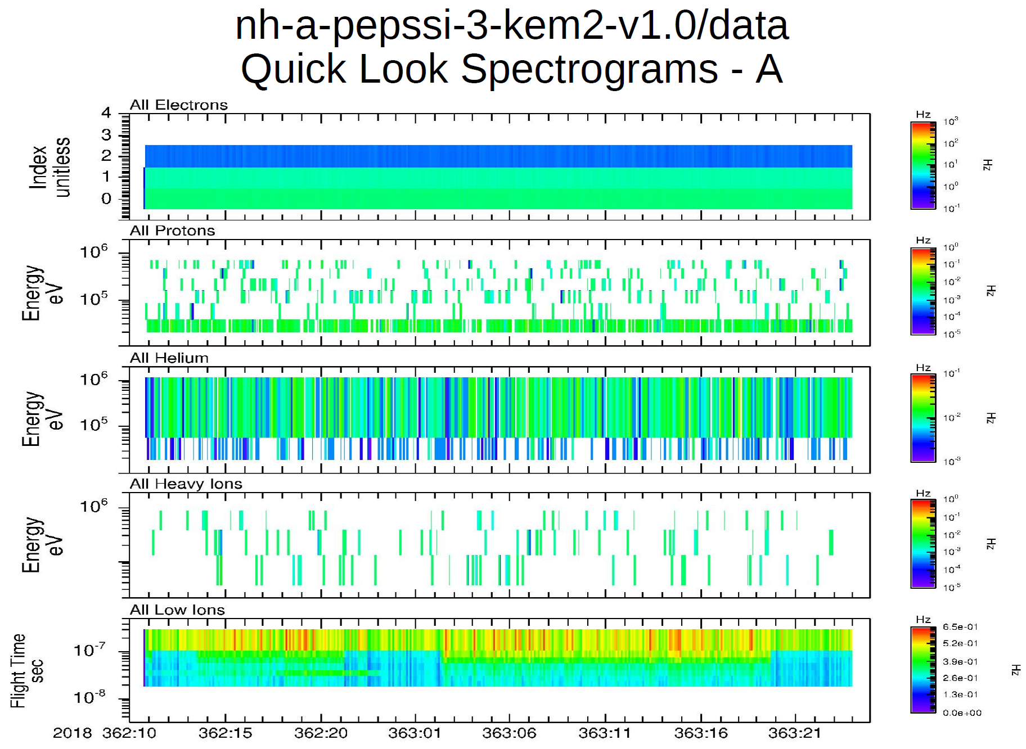
nh-x-pepssi-3-kem2-v1.0
Particles of all measured species look nominal
Plot courtesy of R. Frahm

Slide 16
Summary of Liens
In general, the documentation is a bit sparse, particularly the dataset.cat files which are generic, not specific to the datasets.
Editorial Comment: The PEPSSI chapter in the soc_icd should be updated before the next release to flush out the discussion of the FSW release 5.
Liens
The missing PEPSSI_BTI_GoodTimeIntervalsBadTimeIntervals_2022_149.txt needs to be provided in the documents directory
Certification: Depends on the answers to some of the questions Rudy raises

