Slide 1
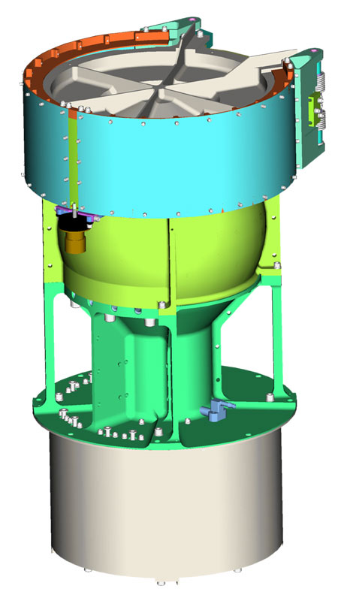
New Horizons Solar Wind Around Pluto
SWAP
Reviewed by S. Joy (secondary)
Low Energy Plasma Instrument consisting of a Retarding Potential Analyzer (RPA), and Electrostatic Analyzer (ESA), and a deflector (DFL).
Mass: 3.29 kg
Power: 2.84 W
Energy (min,max): 30-7700 eV
Energy Resolution: 1 eV
Field of View: 270º x 10º
Angular Resolution: N/A
Geometric Factor 1.8x10⁻³cm² sr eV/eV
Sweep Time (128 steps) 64 s
Accumulation Time 0.39 s

Slide 2
NH-SWAP Data Set Evaluation Tools
Evaluation -
Machine: Dell XPS 15 9510
Operating System: Windows 10

Slide 3
Datasets: nh-x-swap-2-pluto-v2.0 nh-x-swap-2-kem2-v1.0 nh-x-swap-3-kem2-v1.0
Volumes:
NHKESW_1001 NHKESW_2001
Volume Level Files
AAREADME – files are acceptable
VOLDESC – files are acceptable

Slide 4
Comments on review procedure
The catalog, documents, and calib directories of these volumes are nearly identical, and most of their contents have been previously reviewed many times.
I have taken advantage of this fact to reduce the review effort.
I used the folder compare option in BeyondCompare 3.3.13 to compare like folders across the four volumes, and then compare files contained in the folders. Most of the time, the only variation in the directory contents or the
file therein were the file time stamps and the data_set_id’s in the label files.
Once this information was available to me, I only reviewed unique files
Lastly, I looked at issues raised in the October 2022 (KEM1) review to make sure that they had been addressed in this release.

Slide 5
Catalog Directory:
catinfo.txt - ok
nh_kem.cat – ok
Nh_kem2.cat - ok
nhsc.cat – ok
ref.cat – ok
There are no differences between files that should be identical on the two volumes (nh_kem.cat, nh_kem2.cat, nhsc.cat, ref.cat, swap.cat, etc.) – good, correct versions included
dataset.cat (NH-X-SWAP-2-KEM2-V1.0) and
dataset.cat (NH-X-SWAP-3-KEM2-V1.0)
are effectively the same file with only the most minor differences

Slide 6
Calib Directory:
calinfo.txt - good
background_009_dac.tab (lbl) - good
background_009_dac_jup.tab (lbl) - good
esa_rpa_v16_energy_binsf_new.tab (lbl) - good
esa_rpa_v18_energy_binsf_new.tab (lbl) - good
esa_rpa_v19_energy_binsf_new2.tab (lbl) – good
esa_shape.tab (lbl) – good
fov_mask_2d.tab (lbl) – good
list_energy.tab (lbl) – good
rpa_shape.tab (lbl) – good
Beyond Compare of all files to Feb 2022 release versions shows that the
only changes are to the DSID version (-V5.0 to –V6.0) in the LBL files.

Slide 7
Document Directory:
docinfo.txt – BC reports that the version on -2- dataset includes UTF-8 characters not found on the -3- dataset version. Several characters appear bold in Notepad and UltraEdit on the -2- version. The same error occurs for -2- : lunineetal1995.lbl, quat_axyz_instr_to_j2k.asc, swap_ssr.lbl
Analysis of these files shows that these files are fine, this must a transmission or decompression error codmac_level_definitions, lunineetal1995, payload_ssr, swap_ssr PDF files all PDF/A format. All previously reviewed and acceptable swap_cal – good
soc_inst_icd.pdf (lbl) (errors in equation 3 fixed again)
nh_met2utc.tab file is complete.
data_summary_plots directory contents are ok, plots are useful
nh_mission_trajectory.tab (lbl) - good
quat_axyz_instr_to_j2k.asc (lbl) – good
seq_swap_kem1.tab (.lbl) - good
seq_swap_kem2.tab (.lbl) – good
nh_fov.png (lbl) - good
Document/data_summary_plots Directory:
Plots available for all days when calibrated data are available Directory listing is overwhelmed by 1 day files, consider subfolders
Document/traj Directory trajinfo.txt – good traj_2006_2028_1d.tab (lbl, fmt) – ok, unclear where the reconstructed vs. predict boundary occurs in the file based on the kernels listing.

Slide 8
Index Directory:
indxinfo.txt - good, all 3 datasets
index.tab (lbl) - good, all 3 datasets
slimindx.tab (lbl) - good, -2- and -3- datasets
checksum.tab (lbl) - good, all 3 datasets

Slide 9
Data Directories:
nh-a-swap-2-kem2-v1.0
Data appear to be complete
Labels validate
FITS files open in FV and the contents appear to be valid
nh-a-swap-3-kem2-v1.0
Data appear to be complete
Labels validate
FITS files open in FV and the APID contents appear to be valid Summary plots show valid data with large hibernation gaps
nh-a-swap-2nh-a-swap-2-kem1-v4.0-kem1-v4.0

Slide 10
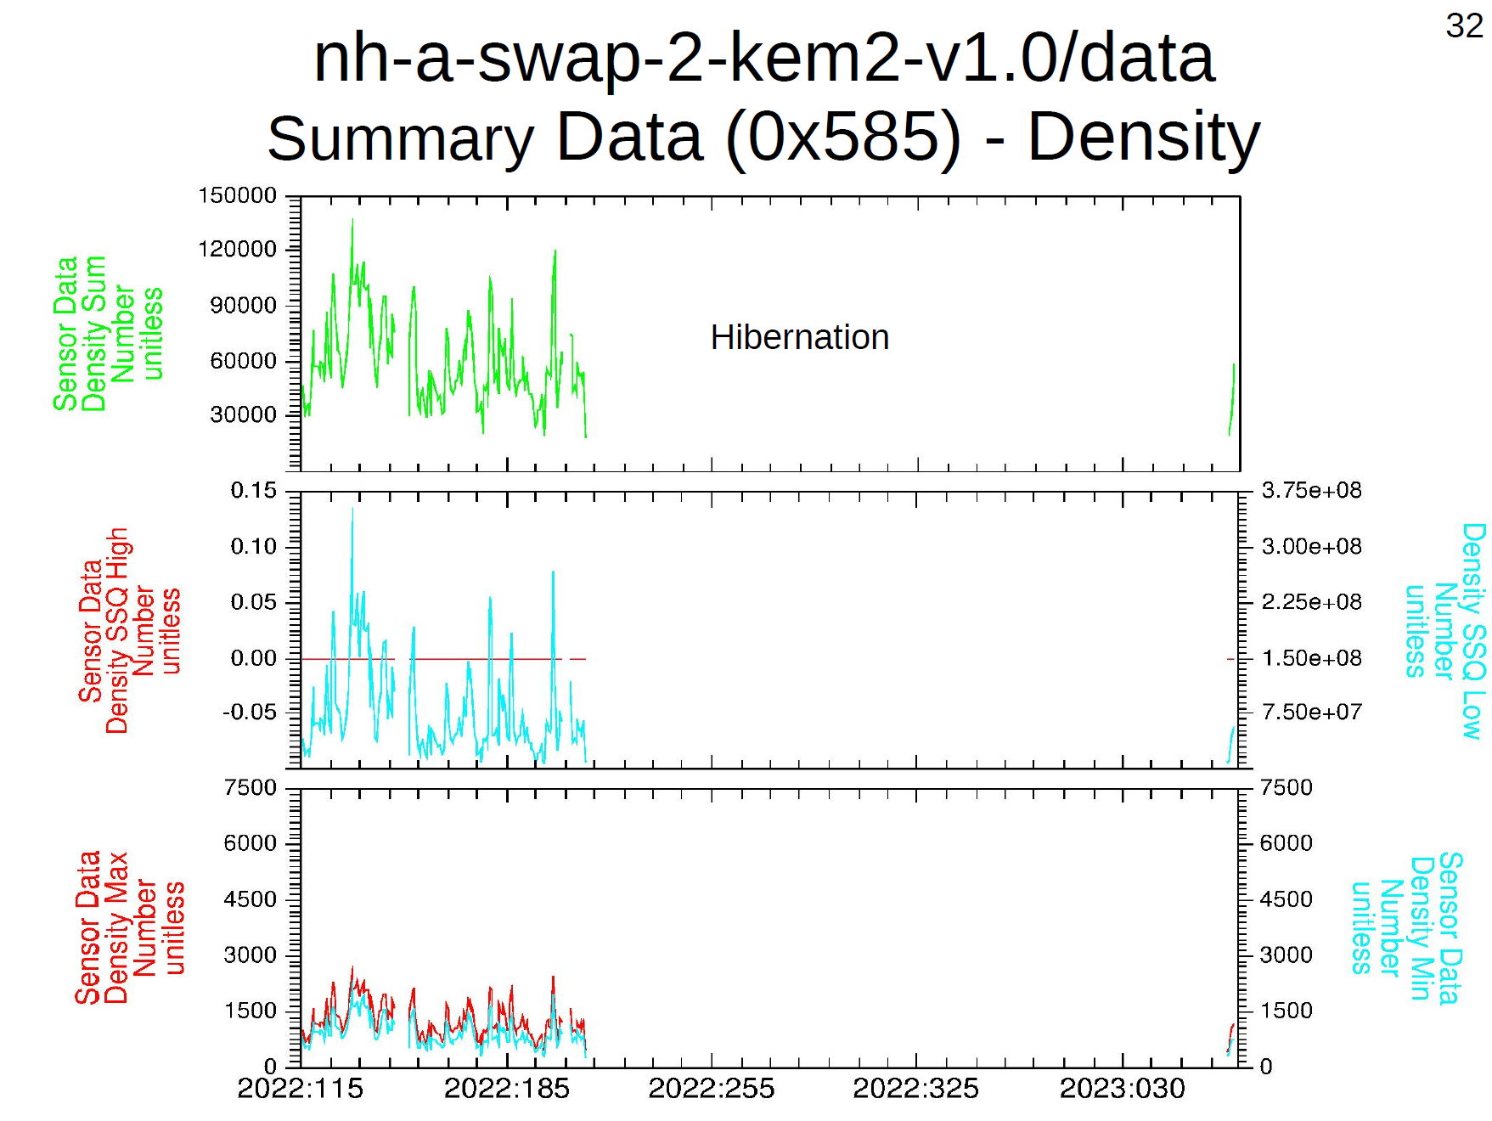
Data Directory Contents
nh-a-swap-2-kem2-v1.0
Data look good
Plot courtesy of R. Frahm

Slide 11
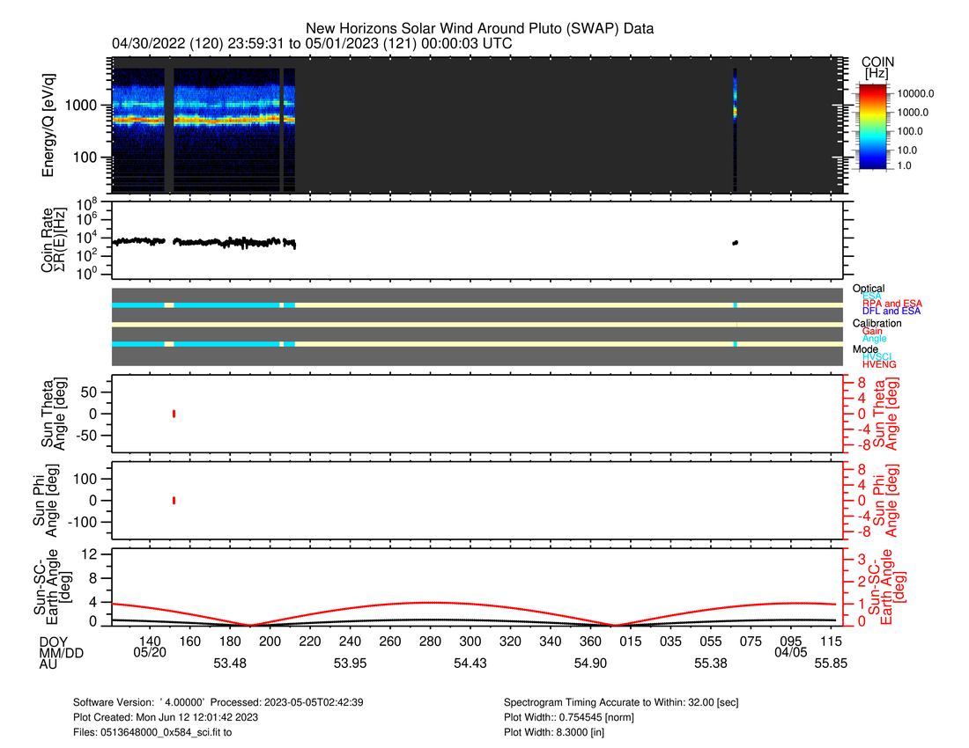
Data Directory Contents
nh-a-swap-3-kem2-v1.0
Data look good
Plot courtesy of R. Frahm
Annual plot included with archive

Slide 12
Recommendations
In general, both of these datasets are in good shape. As previously noted, the dataset.cat descriptions are very generic and do not contain any specific discussion of these particular data. Since the other documentation is complete, no liens have been written.
Liens: None
1) Certification: Good to certify both -2- and -3-

