Slide 1
Lucy Dinkinesh T’TCAM Review
Adeline Gicquel
09-23-2024

Slide 2
General comments
The bundle.xml file is missing?
I would delete one of the <name> and then replace Lucy Spacecraft by Lucy to be consistent with other files and the context object
<Observing_System> <name>Lucy Spacecraft</name> <Observing_System_Component>
<name>Lucy Spacecraft</name>
I would remove Mission in the <name>Lucy Mission</name> to be consistent with the context object
I would remove Spacecraft in the <name> Lucy Spacecraft </name> to be consistent with the context object
I would update the <name> to be consistent with the name in the context object
<Observing_System_Component>/<name>Lucy Terminal Tracking Cameras (TTCAM)</name> instead of just having <name>TTCAM</name>
I would suggest to add “lucy” in the <title> of every XML PDS4 labels
I would suggest to be more consistent. You have TTCAM or TTcam

Slide 3
Data- Raw and calibrated data
I would change the description/comment to have the same between raw and calibrated
Raw <description>Terminal Tracking Camera (TTCam) observational science data product</description> vs calibrated <description>TTCam observational science data product</description>
Raw <comment>TTCam observations</comment> vs calibrated <comment>TTCAM observations</comment>
The target name name should be (152830) Dinkinesh. Also, the target name should not be capitalized
<name>DINKINESH</name>
<geom:name>DINKINESH</geom:name>
<lucy:target_fov_name>DINKINESH</lucy:target_fov_name>
I would add the target NAIF ID if applicable. For (152830) Dinkinesh it is 920152830 (TARGETID in the FITS header)
<geom:Orbiter_Identification>/<geom:Geometry_Target_Identification>/<geom:body_spice_name>
I would delete one of this block that you have twice in the raw data
<proc:name>Lucy Data Processing Pipeline</proc:name> <proc:process_owner_name>Lucy Science Operations Center</proc:process_owner_name> <proc:process_owner_institution_name>Southwest Research Institute</proc:process_owner_institution_name>
I would add a <comment> to explain the <Reference_List>/<Internal_Reference> for all the data_to_calibration_product and data_to_document
I would not capitalize words in the Lucy Dictionary. For example: <lucy:observation_complete>COMPLETE</lucy:observation_complete>
I would suggest the <title> to be Lucy Terminal Tracking Cameras (TTcam) or to at least add “Lucy” in the PDS4 data to be consistent with the collection_overview.xml file
The Space Science Reviews paper is part of the document collection. I would remove the citation or add a comment explaining that it is the external source of this document's paper or change it from <External_Reference> to <Internal_Reference>
Does the PDS4 attribute msss_cam_mh:instrument_mode_id refer to the PDS3 fits header T2CAI001= 1 / camera: 1=DVR, 2=test image injection in the port IMAGE MINI-HEADER section ? If yes, then I would replace the number by the description text

Slide 4
Data- Raw and calibrated data
You need to change the following things in the PDS4 XML Label for the first five TTCam1 images and all five TTCam2 images because they were part of a standard functional test and star calibration activity for the cameras, prior to the actual flyby observations of Dinkinesh (overview_collection.txt)
It should not be Science but Calibration <Primary_Result_Summary>/<purpose>Science</purpose>
It should not be DINKINESH but the name of the Star
<Target_Identification>/<name>DINKINESH</
<lucy:mission_segment>DINKINESH</lucy:mission_segment> ? Not sure about this one
<lucy:target_fov_name>DINKINESH</lucy:target_fov_name>
geom:Geometry_Target_Identification>/<geom:name>DINKINESH</geom:name>
It should not be Asteroid but Star <Target_Identification>/<type>Asteroid</type>
It should be removed because the target is not the asteroid
<Internal_Reference> <lid_reference>urn:nasa:pds:context:target:asteroid.152830_dinkinesh</lid_reference> <reference_type>data_to_target</reference_type> </Internal_Reference>
I would suggest using the Small Bodies dictionary <sb:SB_Metadata> to add the <sb:Calibration_Information>, <sb:Calibration_Applied> and <sb:Calibration_Reference_Files>
Most of the <Reference_List>/<Internal_Reference> in the calibrated data should be <lidvid_reference> and not <lid_reference>

Slide 5
Data – Missing attributes
Why are you not including the following values in your PDS4 XML labels?
APID = / source data ApID
RATEX/Y/Z = / [urad/s] angular rate about inst. frame +X/Y/Z axis
RATEXY/ZY/XZ = / [urad/s] drift rate magnitude in inst. XY/ZY/XZ plane
IPI/IPOGANG = / [deg] IPP inner/outer gimbal angle
IPI?IPOGRATE= / [deg/s] IPP inner/outer gimbal angle rate
PA_YINST= / [deg] PA +Y, E of J2000 N
PA_SUN = / [deg] PA of Sun, E of J2000 N
PA_SUN_X/Y= / [deg] PA of Sun, E of +X/Y
TGT_ELON= / [deg] angle btw target and inst. Boresight
EAR_ELON= / [deg] angle btw Earth and inst. Boresight

Slide 6
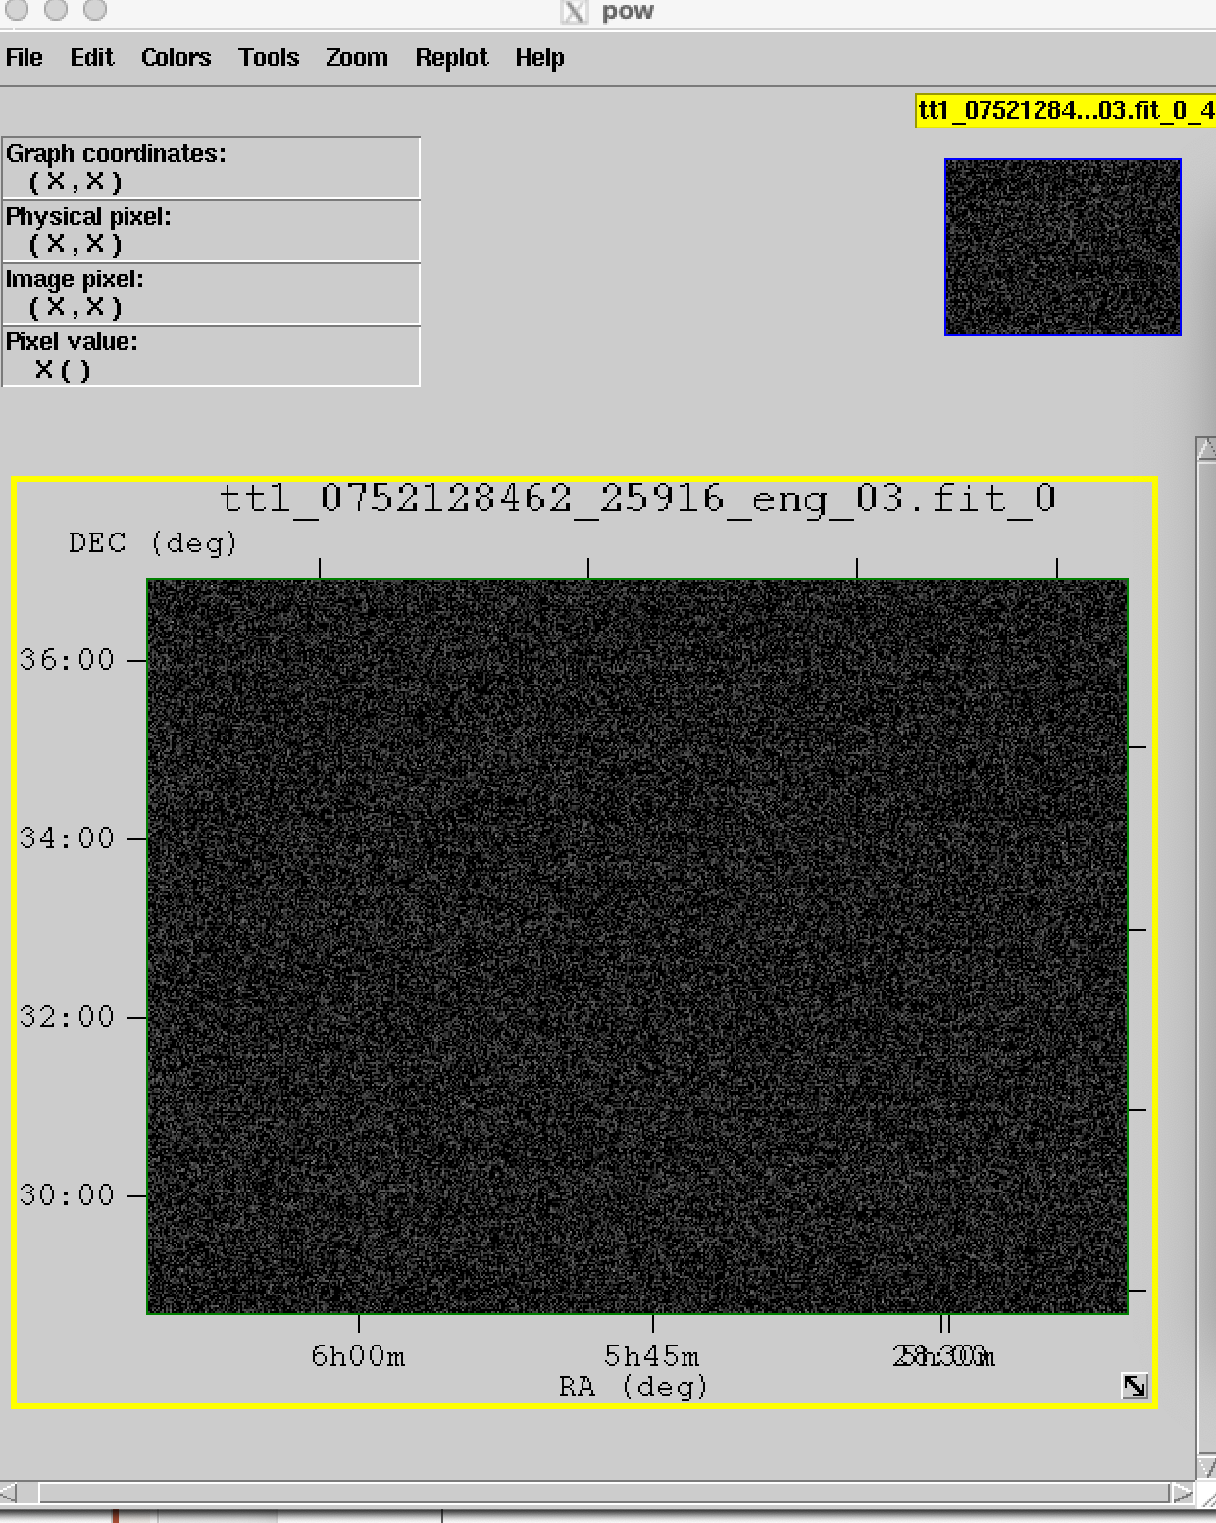
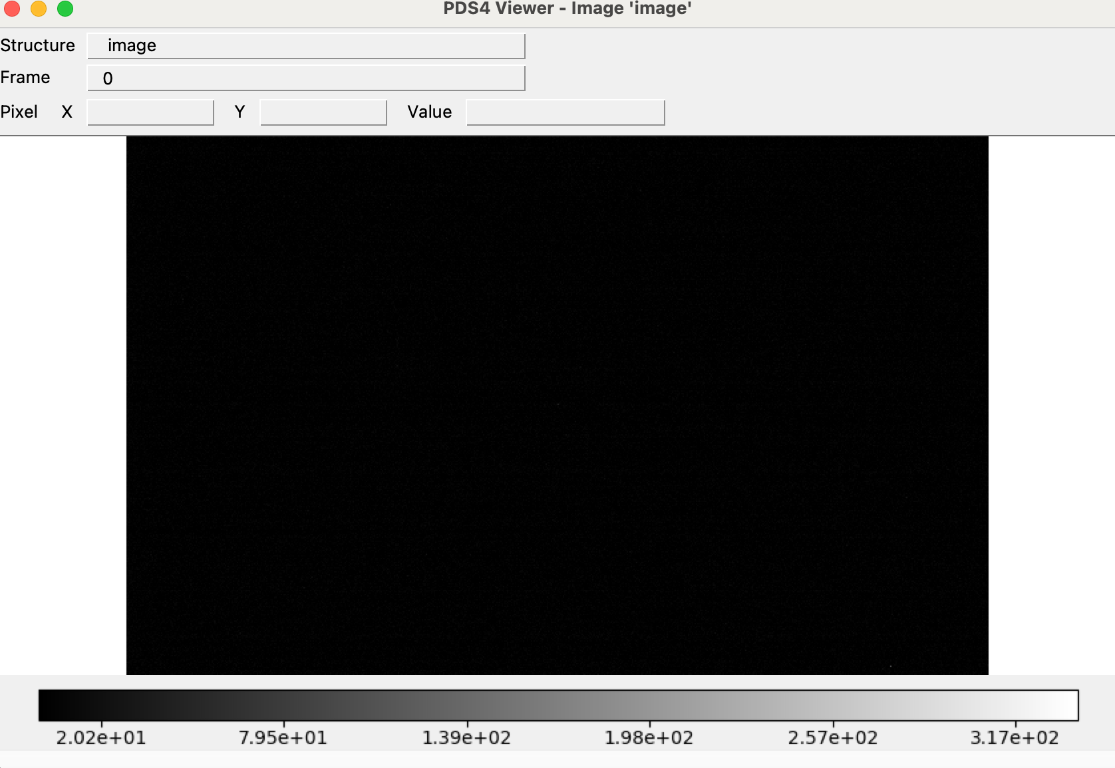
Data - Raw and calibrated data
PDS4 XML labels accurately describes the data when using he PDS4 Viewer.
The values in the PDS3 fits header and PDS4 XML labels are identical
The PDS4 XML labels validated
The values in the table are the same but the display of the images between fv and the PDS4 Viewer are different. No difference in display between DS9 and PDS4 viewer
PDS4 Viewer
Fv

Slide 7
Data - Collection files - Raw and calibrated data
collection_overview.txt
Please add the name of the files or the date of observations that correspond to this statement
“Note that the first five TTCam1 images and all five TTCam2 images were part of a standard functional test and star calibration activity for the cameras, prior to the actual flyby observations of Dinkinesh.”
collection_overview.xml
Update the date <publication_date>2024-08</publication_date>
collection.xml
I would suggest the <title> to be Lucy Terminal Tracking Cameras (TTcam) or to at least add “Lucy” to be consistent with the collection_overview.xml file
Bundle lucy.mission is not archived yet. Be sure to archive these products and confirm LID references. I also didn’t see it in the Lucy Mission Document collection
<lid_reference>urn:nasa:pds:lucy.mission:document:lucy_mission_info</lid_reference>
<Reference_List> < Internal_Reference >
I would add the LID for the raw and partially processed data.
I would add the LID for the calibration collection.
I would add the LID for the document collection.
I would add the LIDVID for the overview document
I would add a <comment> to each of the reference
<Primary_Result_Summary>
I would add the <Science_Facets >
I would add the <purpose> Calibration</purpose>
collection_inventory.csv
No problem.

Slide 8
Calibration
The Space Science Reviews paper is part of the document collection. I would remove the citation or add a comment explaining that it is the external source of this document's paper or change it from <External_Reference> to <Internal_Reference>.
I would add the <Internal_reference> to the entire document collection instead of putting it in the <description>See the documentation (in collection urn:nasa:pds:lucy.ttcam:document) for details.</description>
<Internal_reference> /<lid_reference>urn:nasa:pds:lucy.ttcam:document</lid_reference>
I would add a <comment> to each of the <reference_List>
I would add a more specific <description> to each file to explain what is the file. You have the same generic description for all the files
It needs to be updated or deleted in sn194504param.xml, sn194504masterflat_v1.xml, sn194503param.xml and sn194503masterflat_v1.xml
<Time_Coordinates> <start_date_time>2021Z</start_date_time> <stop_date_time>2021Z</stop_date_time> </Time_Coordinates>
<creation_date_time>2021Z</creation_date_time>
I would suggest the <title> to be Lucy Terminal Tracking Cameras (TTcam) or to at least add “Lucy” in the PDS4 XML data template and collection.xml to be consistent with the collection_overview.xml file
PDS4 XML labels accurately describes the data when using the PDS4 Viewer. All calibration products display correctly in PDS4 Viewer, fv and DS9

Slide 9
Calibration - Collection files
collection_overview.txt and collection_inventory.csv
No problem.
collection_overview.xml
Update the date <publication_date>2024-08</publication_date>
collection.xml
I would suggest the <title> to be Lucy Terminal Tracking Cameras (TTcam) to be consistent with the collection_overview.xml file
The <processing_level> should be Derived and not <processing_level>Raw</processing_level>
This needs to be removed or corrected
<Time_Coordinates> <start_date_time>1970-01-01T00:00:00Z</start_date_time> <stop_date_time>1970-01-01T00:00:00Z</stop_date_time> </Time_Coordinates>
Bundle lucy.mission is not archived yet. Be sure to archive these products and confirm LID references. I also didn’t see it in the Lucy Mission Document collection
<Reference_List> <Internal_Reference> <lid_reference>urn:nasa:pds:lucy.mission:document:lucy_mission_info</lid_reference> <reference_type>collection_to_document</reference_type> </Internal_Reference>
I would add a <comment> to explain the <Reference_List>/<Internal_Reference>
I would add the LIDVID for the overview document
I would add the LID for the CDP User's Guide document

Slide 10
Calibration – Validation test
2 labels did not validate
sn194503param.xml
ERROR [error.label.invalid_object_definition] line 2: Invalid object definition for object #2. The previously defined object ends at byte 159. Offset defined in label: 72
ERROR [error.label.invalid_object_definition] line 3: Invalid object definition for object #3. The previously defined object ends at byte 159. Offset defined in label: 92
ERROR [error.label.invalid_object_definition] line 4: Invalid object definition for object #4. The previously defined object ends at byte 159. Offset defined in label: 102
ERROR [error.label.invalid_object_definition] line 5: Invalid object definition for object #5. The previously defined object ends at byte 159. Offset defined in label: 114
sn194504param.xml
ERROR [error.label.invalid_object_definition] line 2: Invalid object definition for object #2. The previously defined object ends at byte 159. Offset defined in label: 72
ERROR [error.label.invalid_object_definition] line 3: Invalid object definition for object #3. The previously defined object ends at byte 159. Offset defined in label: 92
ERROR [error.label.invalid_object_definition] line 4: Invalid object definition for object #4. The previously defined object ends at byte 159. Offset defined in label: 102
ERROR [error.label.invalid_object_definition] line 5: Invalid object definition for object #5. The previously defined object ends at byte 159. Offset defined in label: 114

Slide 11
Calibration step
In section 2.3.2.2 of the SIS “The uncalibrated TTCam images are calibrated by performing a series of calibration steps resulting in a FITS 2-dimensional array data product in radiance units with the upper bound size of 2752x2004 pixels for full frame dark pixels on images, with an active area of 2592x1944…. When typical 2592x2000 pixel calibration images are read out, the gray areas are ignored in processing”. In section In section “If dark pixels are available in the image, the average and standard deviation of the dark values are extracted from rows 1966:1989 and columns 16:2607.
The first five TTCam1 images and all five TTCam2 images were part of a standard functional test and star calibration activity for the cameras wth a size of 2592x2000 pixel. All the other image are a size of 2592x1944. With the images in this archive, we can’t reproduce the bias/dark current correction because it’s outside the size of the images.
I was not able to reproduce calibrated images probably because of the dark correction
The units are correct between the SIS and the FITS header
It would have been helpful to have the idl code to try to reproduce the calibrations data as explained in the ASU TTCAM CDP User’s guide.

Slide 12
IDL Astro Master
I didn’t review it. PDS4 doesn’t archive software so why is this here?

Slide 13
Document
zhao_et_al_2024.xml
Should it be TTcam instead of Ttcams <description>PDF/A version of the TTCams calibration document.</description>
ttcam_ssr.xml, zhao_et_al_2024.xml
I would add <Reference_List>/<External_Reference> for the papers with a description. I would add the <doi>
I would move the <doi> to the <Reference_List>/<External_Reference>
lucy_ttcam_cdp_users_guide_ver1.6.xml, ttcam_sis.xml, zhao_et_al_2024.xml
Update <publication_date>2024</publication_date>
In some file you added a description of the TTCAM instrument. I think this should be added in every files (data, document, calibration)
SSI.pdf
Page 4 it’s written that the image are lossless compressed. I would suggest adding that to the PDS4 XML for the data
Table 3.2, both 3.3, 3.4 and 3.6 need to be revised. Many of the PDS XML Label Class/Attribute are wrong
There are 2 tables 3.3
Missing some acronym definitions
lucy_ttcam_cdp_users_guide_ver1.6.pdf
Can’t review without the software. Also, PDS4 doesn’t archive software so why is this document here?

Slide 14
Document - Collection files
Collection_inventory.csv and Collection_overview.txt
No problem.
Collection.xml
I don’t think this is relevant here. I would remove it. Or I would add a <comment>
<Internal_Reference> <lid_reference>urn:nasa:pds:lucy.ttcam:document:ttcam_sis</lid_reference> <reference_type>collection_to_document</reference_type> </Internal_Reference>
Bundle lucy.mission is not archived yet. Be sure to archive these products and confirm LID references. I also didn’t see it in the Lucy Mission Document collection
<Reference_List> <Internal_Reference> <lid_reference>urn:nasa:pds:lucy.mission:document:lucy_mission_info</lid_reference> <reference_type>collection_to_document</reference_type> </Internal_Reference>
Collection_overview.xml
Update the date <publication_date>2024-08</publication_date>
The PDS4 XML labels validated

