Slide 1
LTES PDS Review
Andrew Rivkin

Slide 2
General comments
This was a very difficult dataset to work with at a very basic level. While I recognize that HDF files are accepted in Earth Science and other scientific communities, I’ve never encountered one before and I suspect this might be the only PDS-SBN archive that uses them. Precursor instrument datasets used FITS files.
The fact that PDS Viewer doesn’t work with the current Mac operating system (and hasn’t for months) also made reviewing more difficult than my general experience.
I was ultimately able to extract some spectra and do some analysis, but the process was more tedious than I might have liked.

Slide 3
SIS (etc.)
SIS seems overall OK, I think.
There is disagreement within the materials in general whether the instrument is called L’TES or LTES.
There are some statements that are inconsistent with the datasets themselves. The most obvious one is that “LTES collects data in the spectral range 5.71—100 µm”, while the calibrated data runs from 3.3-1157 µm. The label for the calibrated data disagrees with both of those, with the “Field Of View” saying it collects data from 6-75 µm.
The SIS says “The instrument will start collecting data one day before closest approach…continue until one day after closest approach”. That’s not true for the Dinkinesh data.
The SIS says in the section on calibrated data that “The interferograms…are converted into voltage spectra…then converted into calibrated radiance spectra using the LTES calibration software”. I don’t see that this software is included?
The equation on Page 10 includes terms that are the Fourier transform of the interferogram, and are in Volts (”Voltage value”). Array index 26 (on page 21) is “ifgm”, which claims to be the interferogram, but is also in Volts. Are all of these consistent?
The “intended_target” keyword explicitly says that it may differ from the actual target. I did not run across an “actual target” keyword, and am not sure how the users are supposed to know what the actual target is.
I was surprised to see Davinci listed as the only “applicable software”. The page pointed to has been updated once since 2011 (to include new binaries to download) and has very little in the way of support for new users.

Slide 4
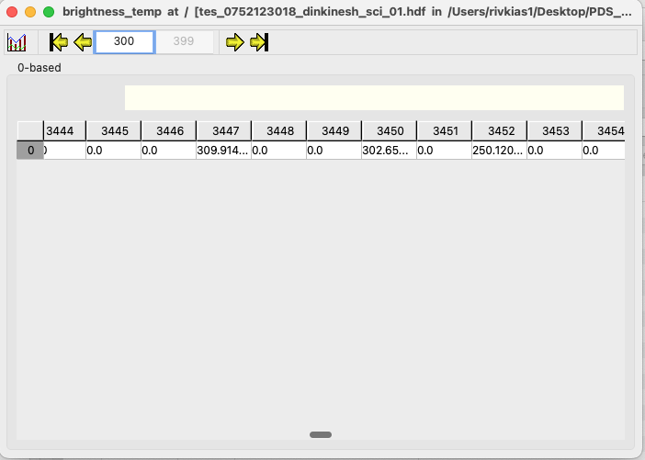
Calibrated Files
Using HDFView, since PDS4_Viewer not working
HDFView only showing things in the calibrated file as 1-D even when 2-D. See brightness temperature on right
My impression is that this should show as a spreadsheet.
Nothing can be plotted, I’m assuming this is an issue with HDFView rather than the data?
The values for ”xaxis” (which really should be renamed ”wavenumber”) in slots 348-399 are all identical. Is there a reason they aren’t trimmed?

Slide 5
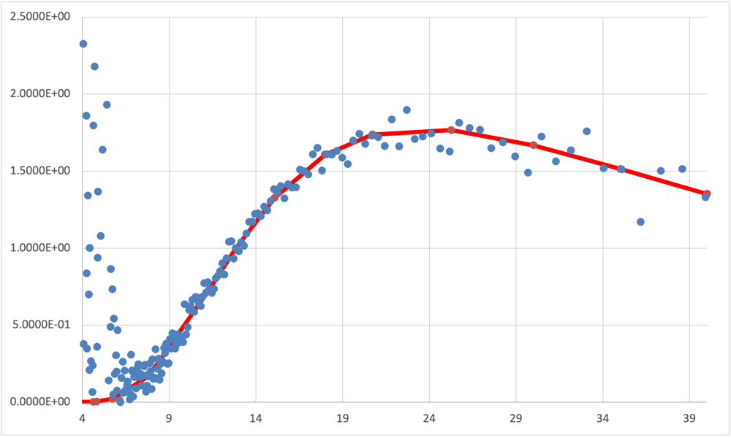
Working with Calibrated Radiance
The range to surface data suggests closest approach is at sample 3299.
Eventually was able to extract radiance data from columns 3297-3302 (one at a time, had to transpose them to being rows and then export) and export the wavenumber data.
Fit that to standard thermal model, still some inconsistencies I but didn’t do a rigorous job, so likely OK
At least some values are not what I’m expecting for some keywords/files/attributes/whatever you call them.
The phase angle, for instance, is 9999 for all samples, despite it pointing at the target.
The same is true of the emission angle, for instance.
Sub-spacecraft latitude is there, though.
So data can be extracted, after some gnashing of teeth, but some useful information is absent.

