Slide 1
LORRI Data Review New Horizons KEM 1 V2.0 & KEM 2 v1.0
Bryan Holler (SECONDARY)
PDS SBN Review
February 10, 2025

Slide 2
Data set description
Includes 2 different data sets:
Second version of the New Horizons KEM 1Long Range Reconnaissance Imager (LORRI) data set (target: Arrokoth)
V2 appears to be a subset of V1
First version of the New Horizons KEM 2 LORRI data set (targets: Saturn, NGC 3532, 2010 KS11, cosmic background, and interplanetary dust)
72 total sequences in the KEM 2 data set, none of which were skipped (all instrument fields populated with “LOR” in the seq_lorri_kem2.lblx
No sequence file for the KEM 1 data set

Slide 3
Data accessibility
KEM 1
Total of 477 raw and 477 calibrated files
All raw and calibrated files accessed with astropy.io.fits
KEM 2
Total of 519 raw and 519 calibrated files
All raw and calibrated files accessed with astropy.io.fits
No issues opening any of the files

Slide 4
Data labels & fits headers
The .lblx files were examined using the PDS4 Viewer
FITS headers were examined using astropy.io.fits and ds9
No issues accessing labels or headers

Slide 5
LORRI Pipeline: Bias removal
Compute the mean in unilluminated column(s) and subtract this value from the science image to remove the overall bias level
Potential issue? The SOC document says compute a median, but the FITS headers say that a mean was used, via the BIASMTHD keyword
Need to remove the unilluminated column(s) after calculating the mean to prevent array size mismatches later
1x1 binning has 4 unilluminated columns, 4x4 binning has 1 unilluminated column
Use the corresponding cal file to determine which bias file was used, then subtract the delta-bias file from the science image to remove pixel-to-pixel variations in the detector bias
A step to remove the “amplifier undershoot” in the unilluminated columns is mentioned in the SOC document but is not described in detail, so this step was not performed

Slide 6
LORRI Pipeline: Desmearing & flat-fielding
Smearing occurs because LORRI does not have a shutter, so flux continues to accumulate as the detector is read out
The SOC document provides a set of equations to remove this effect
Need the size of the illuminated array (NAXIS2) and the exposure time (EXPTIME) from the header to use these equations
desmear_ematrix_256.fit & desmear_ematrix_1024.fit are provided for use in these equations, based on the binning
After desmearing, divide the image by the flat field
Use the corresponding cal headers to determine the flat field used

Slide 7
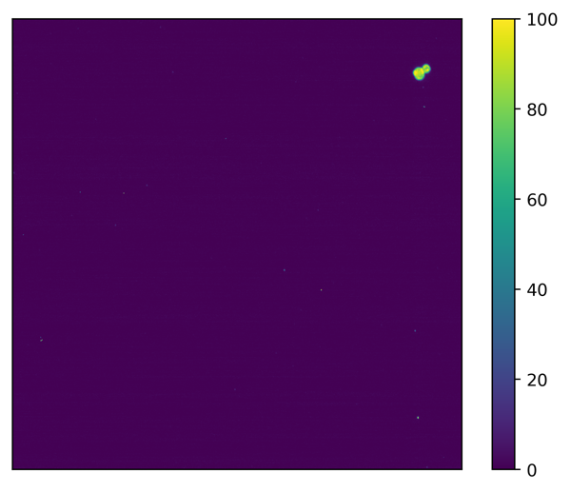
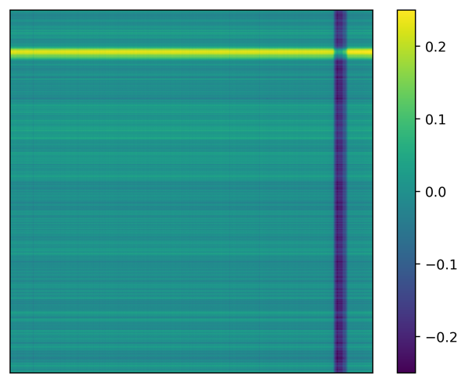
Calibrated data comparison example: KEM 1
Manually calibrated
SOC calibrated
(lor_0408617170_0x630_sci.fit)
Difference (SOC - manual)

Slide 8
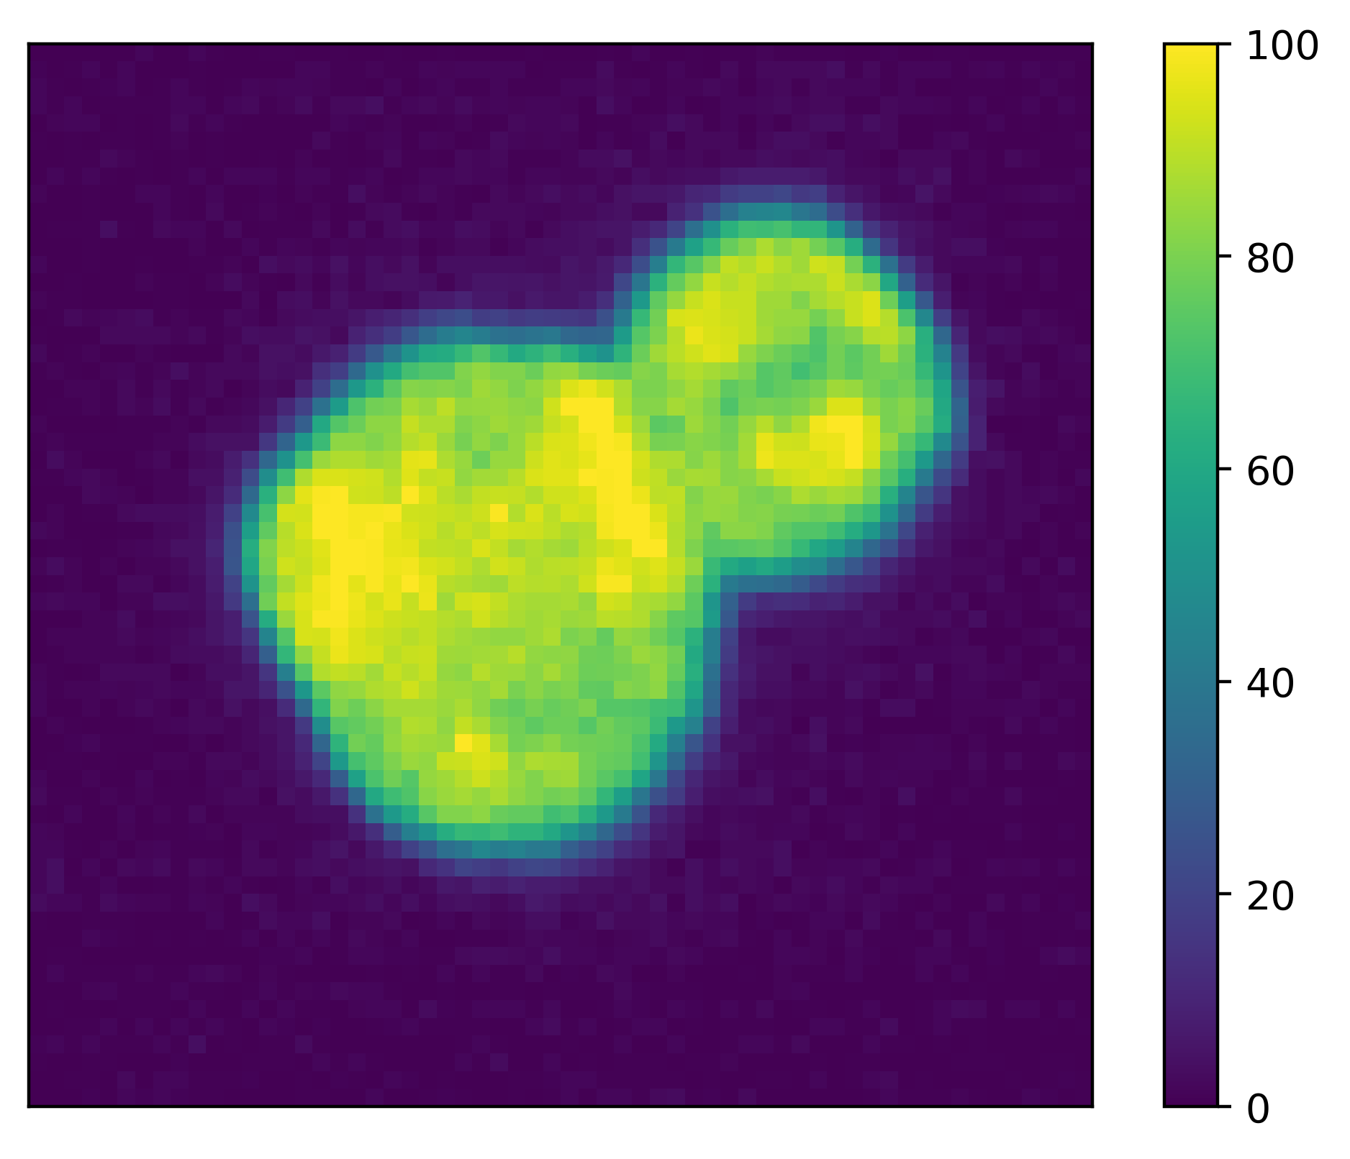
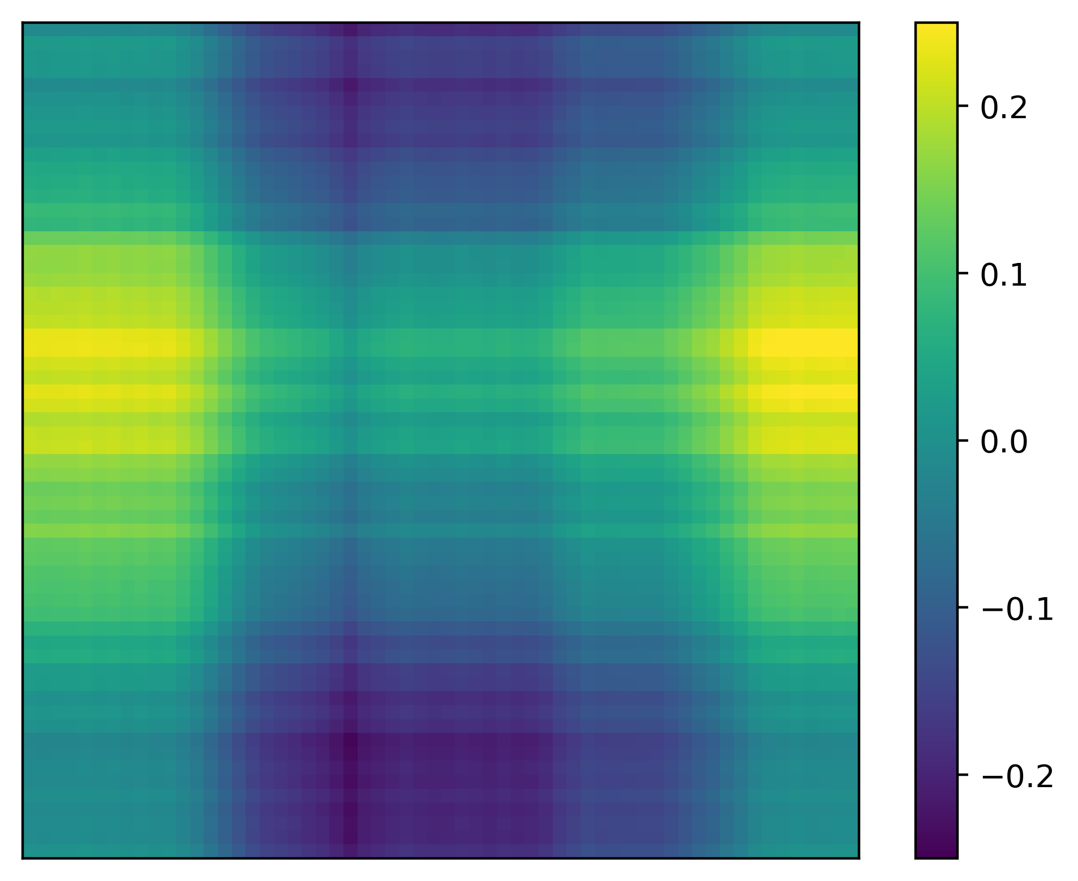
Calibrated data comparison example: KEM 1(zoom)
Manually calibrated
SOC calibrated
(lor_0408617170_0x630_sci.fit)
Difference (SOC - manual)

Slide 9
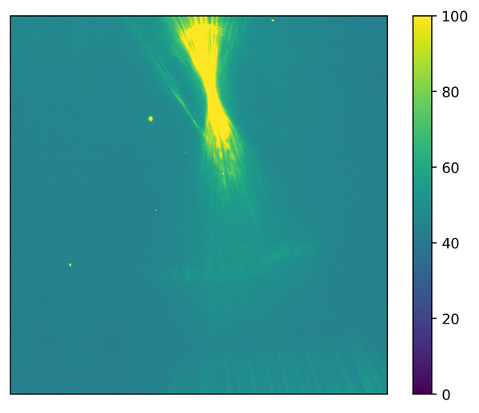
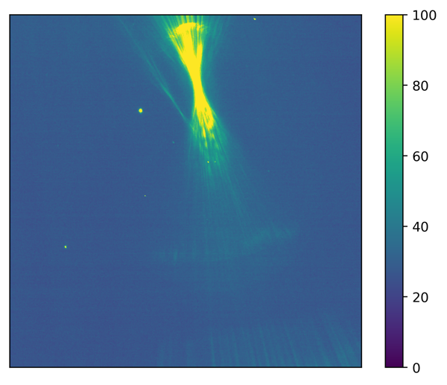
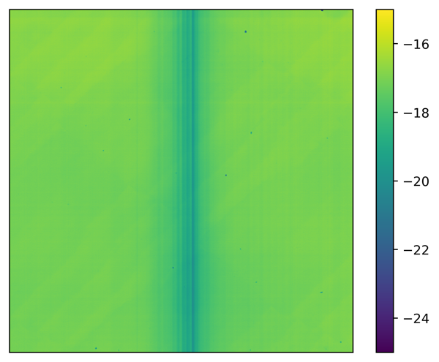
Calibrated data comparison example: KEM 2 (Saturn)
Manually calibrated
SOC calibrated
(lor_0553857717_0x630_sci.fit)
Difference (SOC - manual)
Potential issue? No description in the SOC document of how to remove the bias for windowed images

Slide 10
Summary
MAJOR ISSUES
None
MINOR ISSUES
SOC document describes taking a median of the dark columns in the bias subtraction process, but in the headers the mean is used instead (see keywords BIASMTHD & BIASLEVL)
No description in the SOC document of how to remove the bias for windowed images

