Slide 1
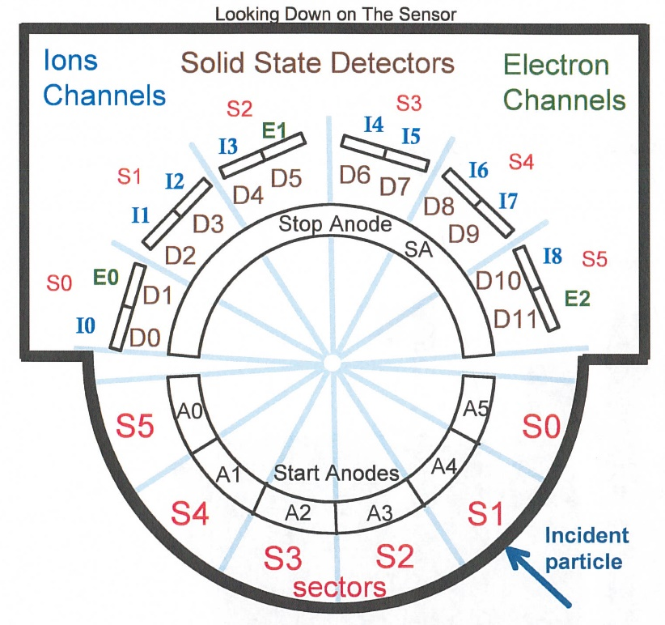
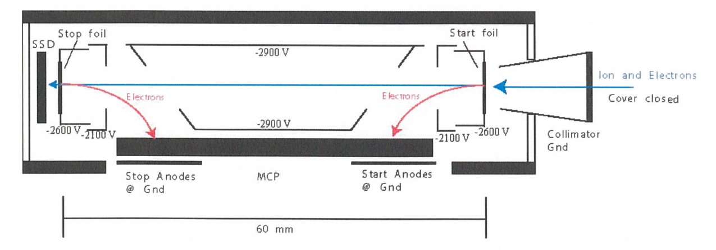
New Horizons Pluto Energetic Particle Spectrometer Science Investigation (PEPSSI)
Reviewed by S. Joy (primary)
PRINCIPAL INVESTIGATOR: Ralph McNutt, APL
DESCRIPTION: Medium Energy Particle Spectrometer
ENERGY RANGE: 25-1000 keV (protons)
60-1000 keV (atomic ions)
25-500 keV (electrons)
FIELD OF VIEW: 160 deg x 12 deg
ANGULAR RESOLUTION: 25 deg x 12 deg
ENERGY RESOLUTION: 0.25 keV
SENSOR SIZE: 7.6 cm dia. x 2.5 cm thick
POWER: 1.4 watt
MASS: 1.5 kg

Slide 2
New Horizons PEPSSI Data Sets
Data Collections->
urn:nasa:pds:nh_pepssi:kem1_raw::2.0 migrated from nh-x-pepssi-2-kem1-v2.0?
urn:nasa:pds:nh_pepssi:kem1_cal::2.0
migrated from nh-x-pepssi-3-kem1-v2.0?
urn:nasa:pds:nh_pepssi:kem2_raw::1.0
migrated from nh-x-pepssi-2-kem2-v2.0?
urn:nasa:pds:nh_pepssi:kem2_cal::1.0 migrated from nh-x-pepssi-3-kem2-v2.0?
Other Collections ->
urn:nasa:pds:nh_documents:pepssi::2.0 urn:nasa:pds:nh_pepssi:calibration_files::2.0
urn:nasa:pds:nh_documents:mission::3.0

Slide 3
New Horizons PEPSSI Data Set Evaluation Tools
All Data Processing and Evaluation -
Machine: Dell XPS 15 9510
Operating System: Windows 10 (22H2)

Slide 4
Comments on review procedure
This is the first time reviewing these data with PDS4 structure and metadata. Comparing the current PDS4 labels and other metadata to the previous PDS3 version is non-trivial and I’m not aware of any tools to facilitate the process.
PDS4 Labels were validated using the PDS Validate tool (3.6.3) on a Linux platform
I did not review every data file in the “bundle”. I created small subsets of files at the start, a few in places in the middle, and at the end of the collections. Hopefully these files are representative of the entire collection. Where possible, I reviewed calibrated data from the same time intervals as the raw data.
Lastly, I looked at issues raised in the Jan 2023 PDS3 review to make sure that they had been addressed in this release.

Slide 5
Documentation
Evaluation

Slide 6
Mission Document Collection Files
In the reorganization that occurred migrating the archive from PDS3 to PDS4, many documents and catalog files were moved out of the instrument level bundles into a mission bundle. I provide comments on those files here.
soc_inst_icd.pdf (lblx) The PEPSSI section (p96) of this document refers to a file called
PEPSSI_BTI_GoodTimeIntervalsBadTimeIntervals_2022_149.txt that is not included in the PEPSSI document collection. This issue was reported at the last review (pep_bti.tab is included). Updates to describe FSW5 impacts have been included!!!
nh_mission_trajectory.tab (lblx) appears to be complete and correct pluto_ao_pdfa1b.pdf Validate reports “ERROR [error.pdf.file.not_pdfa_compliant] Validation failed for flavour PDF/A-1b”.
lunineetal1995 .pdf, nh_fov.png, nh_met2utc.tab, quat_axyz_instr_to_j2k.asc, payload_ssr.pdf(.lblx) – Good, previously reviewed
spacecraft_ssr.pdf, subframe_window_summary.txt (.lblx) – New products I’ve never reviewed before - Good
nh_mission_overview.pdf, nh_sc_overview.pdf, nhkem1_mission_overview.pdf, nhkem2_mission_overview.pdf (lblx) – Former catalog files - Good

Slide 7
PEPSSI Bundle level files
None found. I was sort of expecting Bundle level files. Is this a PEPSSI bundle or collections in some larger bundle?

Slide 8
nh_documents:pepssi::2.0
PDS documents (pepssi_ssr, pepssi_inst_overview) appear to be properly formatted as PDF/A and the document labels appear to be valid.
inventory.csv (.lblx)
pep_bti.tab (.lblx) – Good, may be complete (last entry 2024-051)
seq_pepssi_kem1.tab (.lblx) – Probably incomplete (last entry 2022-04-30: power off) There are data files continuing until the phase ends 2022-09-30
seq_pepssi_kem2.tab (.lblx) – Probably incomplete (first entry 2023-03-05: power on) There are data files starting at 2022-10-01 when the Phase starts
The purpose of PREVIOUSLY_RELEASED_FOR_REFERENCE folder and it’s contents are unclear. My feeling is that documents that are going to be present in the data release should be in the main folder. I provide comments on files that I would expect to be promoted to the main collection level.
pepssi_inst_overview.pdf (.lblx) – Good, old instrument catalog file
pepssi_ssr.pdf (.lblx) – Good nh_pepssi_v110_ti.txt (.lblx) – Good, SPICE instrument FOV kernel

Slide 9
calibration_files collection:
Files
Collection and overview (.lblx) – Good, files validate
hk_n1_input_20050228 and hk_stat_input_20041016 (.lblx) both fail Validate. FATAL_ERROR [error.label.schematron] Cannot read schematron from URL https://pds.nasa.gov/pds4/img/v1/PDS4_IMG_1J00_1900.sch
When I remove this set of schematron rules, it reports: FATAL_ERROR [error.label.unresolvable_resource] https://pds.nasa.gov/pds4/img/v1/PDS4_IMG_1J00_1900.xsd
When I paste these links into my browser I get “Not Found” errors
On the JPL site I can find IMG_1M00_1900.* in PDS4 1.22.0.0
In PDS4 1.19.0.0 where I find PDS4_PDS_1J00.sch, I only find IMG_1M00_1870.*
When I compare the .tab files to the previous review versions using BeyondCompare the files are identical.
hk_n1_input_20050228 and hk_stat_input_20041016 (.lblx)
Visually the labels look fine except each contain a missing space in the Table_Character description field “containscoefficients”

Slide 10
Data
Evaluation

Slide 11
Data Review
I ran the PDS4 Validate tool on all of the data files and it failed on all of them. The errors are related to the initialization statements at the top of the labels where the XML schema and schematron rules are defined.
It’s not clear to me that these errors are real but SBN should comment
I have no tools for analyzing F&P data in FITS format so I rely on tools that are freely available on the web. For this review I have relied on the FV (FITS_VIEW) tool and the pds4_viewer tool available from the Small Bodies Node of PDS.
Summary:
1 product(s)
251 error(s)
240 warning(s)
Product Validation Summary:
0 product(s) passed
1 product(s) failed
0 product(s) skipped
1 product(s) total
Referential Integrity Check Summary:
0 check(s) passed
0 check(s) failed
0 check(s) skipped
0 check(s) total
Message Types:
5 error.label.schema
4 error.label.schematron
242 error.label.unresolvable_resource
240 warning.label.schema
End of Report

Slide 12
kem1_raw
FV allows the user to plot FITS data from versus time (MET or ET). The SBN has a similar tool (pds4_viewer) that reads the data label (.lblx) and displays the data based on the file structure information in the label file. I have plotted the PHA_ELECTRON data (Raw_Energy vs. ET) from pep_0408606717_0x691_eng using both tools and display the results below.
pds4_viewer
FV

Slide 13
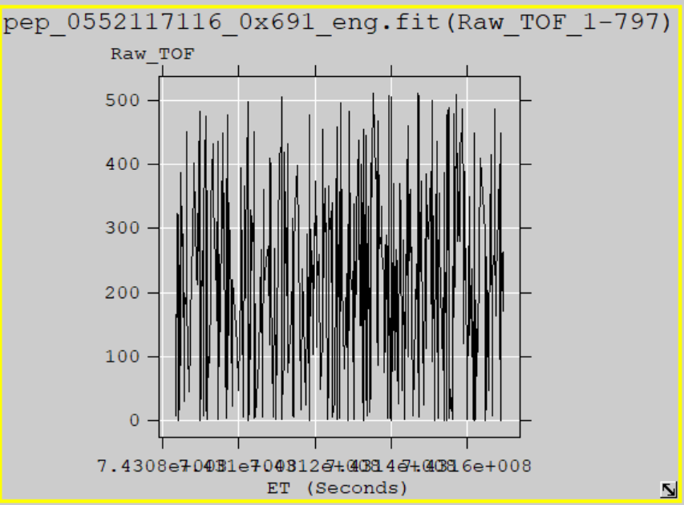
kem2_raw
I have plotted the PHA_LOW_ION data (Raw_TOF vs. ET) from pep_0552117116_0x691_eng using both tools and display the results below.
Despite the Validate problems pds4_viewer reads the data correctly which suggests that the file structure is being properly describe by the PDS labels. FV reading the files suggests that the FITS format is correct
pds4_viewer
FV

Slide 14
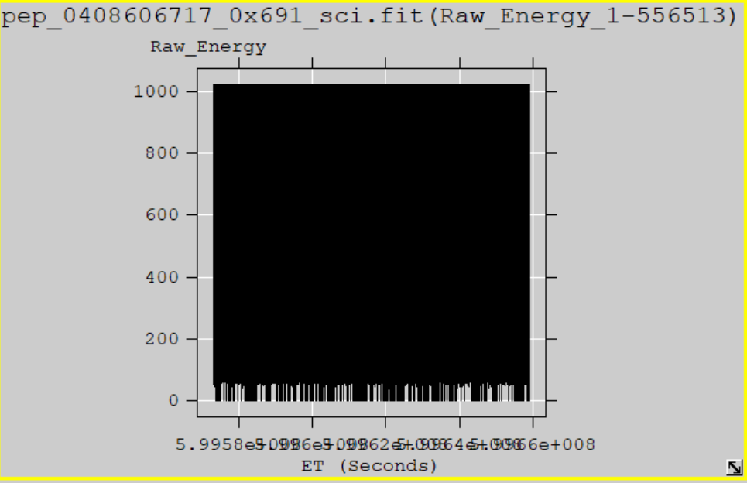
kem1_cal
Plot similar to the ones shown for the raw data. The file selected is the calibrated version of the raw data shown on slide 12.
The plots show Energy vs time from the PHA_ELECTRON data
pds4_viewer
FV

Slide 15
kem2_cal
Plot similar to the ones shown for the raw data. The file selected is the calibrated version of the raw data shown on slide 13. The plots show Speed vs Time taken from the PHA_LOW_ION data.
Like the raw data, the pds4_viewer reads the data correctly which suggests that the file structure is being properly describe by the PDS labels. FV reading the files suggests that the FITS format is correct
pds4_viewer
FV

Slide 16
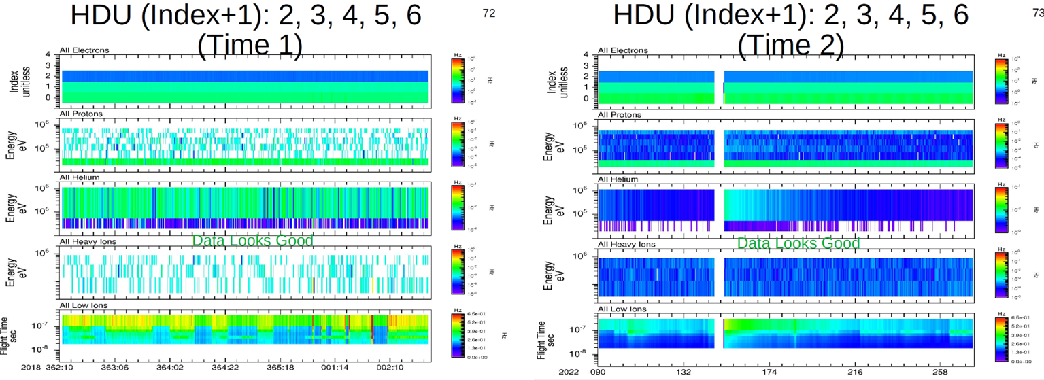
kem1_cal
Rudy’s plots show that the KEM1 calibrated data look good
Weak TOF vs Energy signal matches similar PHA result from FV for this data file (2022-04-08)
Plots courtesy of R. Frahm

Slide 17
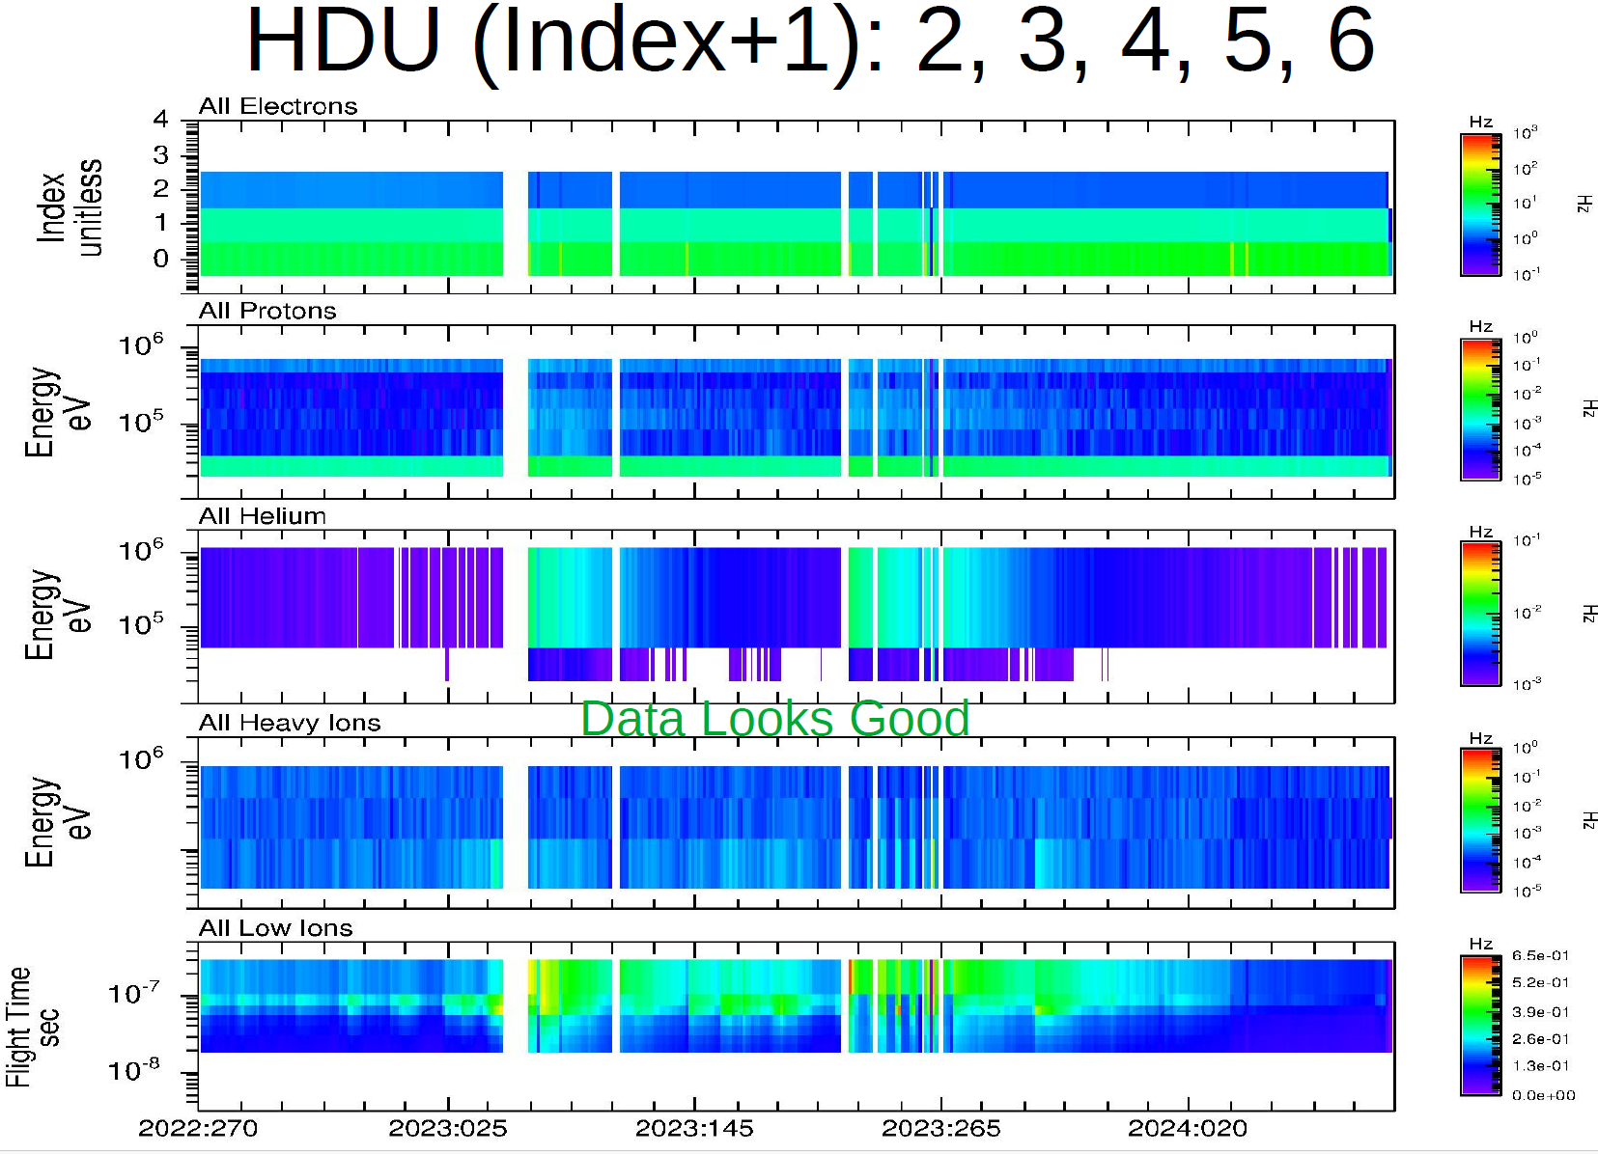
kem2_cal
Rudy’s plots show that the KEM2 calibrated data look good
Plot courtesy of R. Frahm

Slide 18
Summary of Liens
Editorial Comments:
PDS4 Validate has issues with all of the metadata that I reviewed. It’s not clear to me that the metadata are wrong, it could be an problem with the software or accessing the correct files at the ENG Node. SBN should investigate. Rudy seemed to be running the same version of validate (3.6.3) without any issues.
Overall I was able to read and understand the documentation. However other users familiar with the PDS3 structure and content might benefit from a “readme” file that explains the locations of familiar files (catalog, document) in either the Mission or the PEPSSI bundles
Mission Bundle Liens: pluto_ao_pdfa1b.pdf needs to be converted to PDF/A-1b
PEPSSI Liens:
1) The missing PEPSSI_BTI_GoodTimeIntervalsBadTimeIntervals_2022_149.txt either needs to be provided in the documents directory or the soc_inst_icd needs to be modified so that it refers to the “pep_bti.tab” file. 2) Fix “containscoefficients” typos in hk_n1_input_20050228 and hk_stat_input_20041016 (.lblx) 3) Update the seq_pepssi_kemX.tab files – these are most likely incomplete.
Rudy found several minor issues that I missed. These problems also need to be corrected
Certification: The data are scientifically useful as currently provided. The liens are minor and should be corrected quickly.

