Slide 1
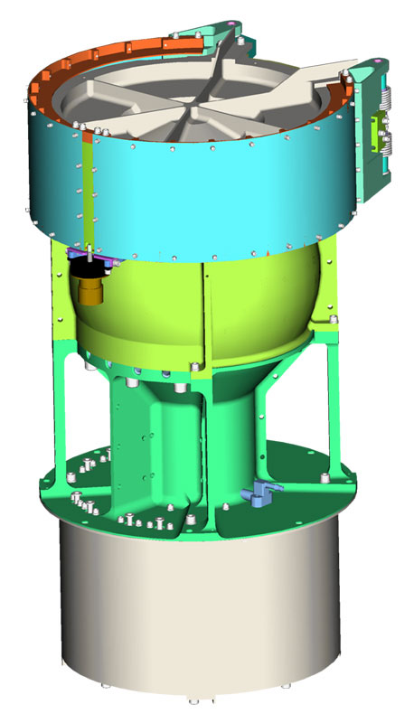
New Horizons Solar Wind Around Pluto
SWAP
Reviewed by S. Joy (secondary)
Low Energy Plasma Instrument consisting of a Retarding Potential Analyzer (RPA), and Electrostatic Analyzer (ESA), and a deflector (DFL).
Mass: 3.29 kg
Power: 2.84 W
Energy (min,max): 30-7700 eV
Energy Resolution: 1 eV
Field of View: 270º x 10º
Angular Resolution: N/A
Geometric Factor 1.8x10⁻³cm² sr eV/eV
Sweep Time (128 steps) 64 s
Accumulation Time 0.39 s

Slide 2
NH-SWAP Data Set Evaluation Tools
Evaluation -
Machine: Dell XPS 15 9510
Operating System: Windows 10

Slide 3
Data Collections->
urn:nasa:pds:nh_swap:kem1_raw::2.0 migrated from nh-x-swap-2-kem1-v2.0?
urn:nasa:pds:nh_swap:kem1_cal::2.0
migrated from nh-x-swap-3-kem1-v2.0?
urn:nasa:pds:nh_swap:kem2_raw::1.0
migrated from nh-x-swap-2-kem2-v2.0?
urn:nasa:pds:nh_swap:kem2_cal::1.0 migrated from nh-x-swap-3-kem2-v2.0?
Other Collections ->
urn:nasa:pds:nh_documents:mission::3.0
urn:nasa:pds:nh_swap:calibration_files::2.0
urn:nasa:pds:nh_documents:swap::2.0
urn:nasa:pds:nh_swap:trajectory::2.0

Slide 4
Comments on review procedure
This is the first time reviewing these data with PDS4 structure and metadata. Comparing the current PDS4 labels and other metadata to the previous PDS3 version is non-trivial and I’m not aware of any tools to facilitate the process.
PDS4 Labels were validated using the PDS Validate tool (3.6.3) on a Linux platform
I did not review every data file in the “bundle”. I created small subsets of files at the start, a few in places in the middle, and at the end of the collections. Hopefully these files are representative of the entire collection. Where possible, I reviewed calibrated data from the same time intervals as the raw data.
Lastly, I looked at issues raised in the Jan 2023 PDS3 review to make sure that they had been addressed in this release.

Slide 5
Documentation
Evaluation

Slide 6
Mission Bundle files
In the reorganization that occurred migrating the archive from PDS3 to PDS4, many documents and catalog files were moved out of the instrument level bundles into a mission bundle. I provide comments on those files here.
soc_inst_icd.pdf (lblx) (equation 3 correct, this has been a problem in the past)
nh_mission_trajectory.tab (lblx) appears to be complete and correct pluto_ao_pdfa1b.pdf Validate reports “ERROR [error.pdf.file.not_pdfa_compliant] Validation failed for flavour PDF/A-1b”.
lunineetal1995 .pdf, nh_fov.png, nh_met2utc.tab, quat_axyz_instr_to_j2k.asc, payload_ssr.pdf(.lblx) – Good, previously reviewed
spacecraft_ssr.pdf, subframe_window_summary.txt (.lblx) – New products I’ve never reviewed before - Good
nh_mission_overview.pdf, nh_sc_overview.pdf, nhkem1_mission_overview.pdf, nhkem2_mission_overview.pdf (lblx) – Former catalog files - Good

Slide 7
SWAP Bundle level files
None found. I was sort of expecting Bundle level files. Is this a SWAP bundle or collections in some larger bundle?

Slide 8
Document files
PDS documents (swap_ssr, swap_inst_overview) appear to be properly formatted as PDF/A and the document labels appear to be valid.
seq_swap_kem1.tab (.lblx) – Probably incomplete (last entry 2022-06-01:power off) Summary plots show data until 2022-09-29, Phase ends 2022-09-30
seq_swap_kem2.tab (.lblx) – Probably incomplete (first entry 2023-03-05: rate change) Summary plots show data starting 2022-10-01 when the phase starts. Summary Plots (kem1, kem2)
Plots look good, labels validate

Slide 9
calibration_files collection:
collection_inventory.csv (.lblx) - Good
overview.txt (.lblx) - good
background_009_dac.csv (lblx) – probably good
background_009_dac_jup.csv (lblx) - probably good
esa_shape.dat (lblx) – why “.dat” rather than “.csv”, probably good
list_energy_files.csv (lblx) – probably good
rpa_shape.dat (lbxl) – why “.dat” rather than “.csv”, probably good
Labels for the “probably good” files did not validate because of an issue locating and loading a schematron file. This may just be an issue with the PPI configuration but it should be looked at by the folks at SBN.
All of the labels in this collection are very sparse. The old PDS3 labels contained descriptions for all of the columns and a lot of text describing the tables that doesn’t seem to have made it into the PDS4 labels.

Slide 10
trajectory collection:
collection.lblx – No collection inventory file provided!
This folder is a mess! Lots of leftover PDS3 labels, format files, etc.
This needs to be cleaned up before the bundle is released.

Slide 11
Data Review
I ran the PDS4 Validate tool on all of the data files and it failed on all of them. The
errors are related to the initialization statements at the top of the labels where the
XML schema and schematron rules are defined.
FAIL: file:/pds/work1/WORKING/NewHorizons/SWAP/kem1_raw/swa_0520646400_0x584_eng.lblx ERROR [error.label.schematron] Schematron 'https://pds.nasa.gov/pds4/img/v1/PDS4_IMG_1J00_1900.sch' error: Cannot read schematron from URL https://pds.nasa.gov/pds4/img/v1/PDS4_IMG_1J00_1900.sch
Begin Schema: https://pds.nasa.gov/pds4/img/v1/PDS4_IMG_1J00_1900.xsd
FATAL_ERROR [error.label.unresolvable_resource] https://pds.nasa.gov/pds4/img/v1/PDS4_IMG_1J00_1900.xsd
End Schema: https://pds.nasa.gov/pds4/img/v1/PDS4_IMG_1J00_1900.xsd
Begin Schematron: https://pds.nasa.gov/pds4/img/v1/PDS4_IMG_1J00_1900.sch FATAL_ERROR [error.label.schematron] Cannot read schematron from URL https://pds.nasa.gov/pds4/img/v1/PDS4_IMG_1J00_1900.sch
End Schematron: https://pds.nasa.gov/pds4/img/v1/PDS4_IMG_1J00_1900.sch
1 product validation(s) completed
It’s not clear to me that these errors are real but SBN should comment
I have no tools for analyzing F&P data in FITS format so I rely on tools that are freely available on the web. For this review I have relied on the FV (FITS_VIEW) tool and the pds4_viewer tool available from the Small Bodies Node of PDS.
I’ve looked at examples of all of the labels for raw/cal KEM1/2 and none of the PDS4 labels contain column descriptions – just names, data types, and offsets. A lot of work was put into adding detailed descriptions to the columns in the data labels. Without that information these files would be next to impossible to use.

Slide 12
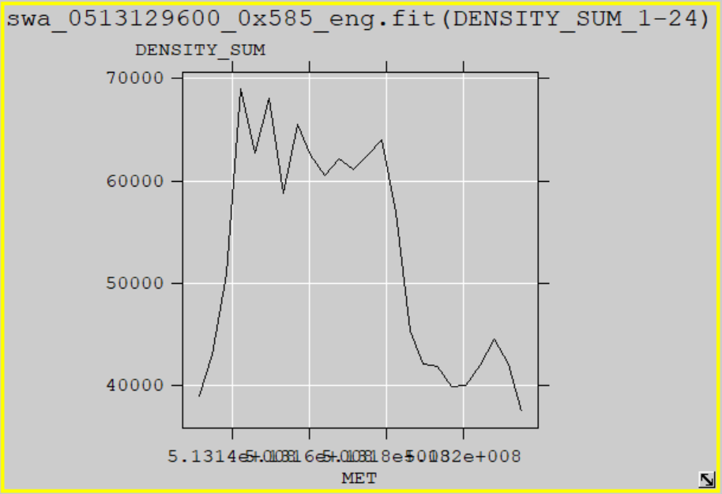
kem1_raw
FV allows the user to plot FITS data from versus time (MET or ET). The SBN has a similar tool (pds4_viewer) that reads the data label (.lblx) and displays the data based on the file structure information in the label file. I have plotted the Summary data (Density_Sum vs. MET) from swa_0513129600_0x585_eng using both tools and display the results below.
Despite the Validate problems pds4_viewer reads the data correctly which suggests that the file structure is being properly describe by the PDS labels. FV reading the files suggests that the FITS format is correct
pds4_viewer
FV

Slide 13
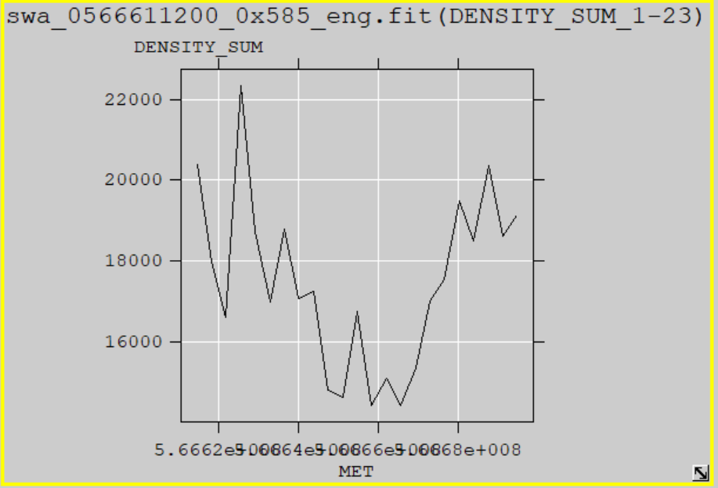
kem2_raw
I have plotted the Summary data (Density_Sum vs. MET) from swa_0566611200_0x585_eng using both tools and display the results below..
pds4_viewer
FV

Slide 14
kem1_cal
I have selected the COIN_SPECT_HZ data “Image” from swa_0523670400_0x584_eng (2022-08-24T18:18 - 2022-08-25T17:58) using both tools and display the results below. The pds4_viewer app gave the following error before rendering the plot shown below:
“No valid/supported Display Settings found. Displayed image may not be correct.”
The pds4_viewer app correctly displayed all 13 of the data file arrays so it appears to be mostly. When I display the “Table” they appear as a sparse table as would be expected.
FV
pds4_viewer

Slide 15
kem1_cal
10 day Summary Plot showing data interval from the last slide. Top panel looks like FV image

Slide 16
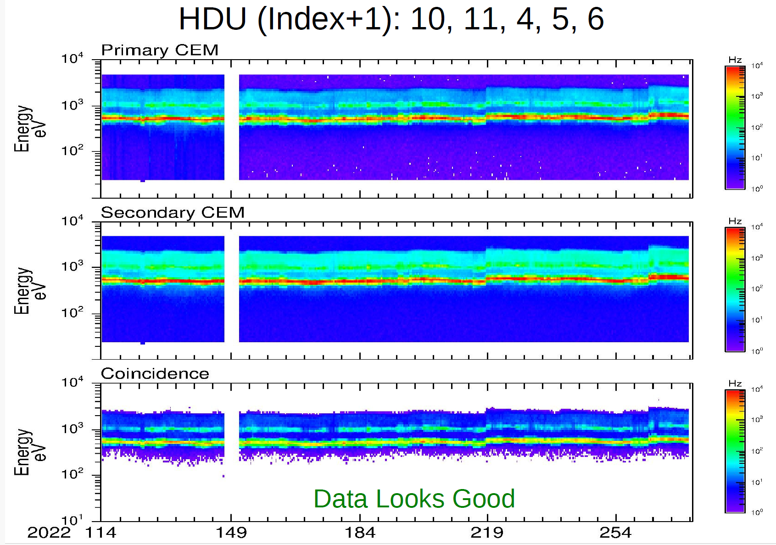
kem1_cal
Summary plot courtesy of R. Frahm

Slide 17
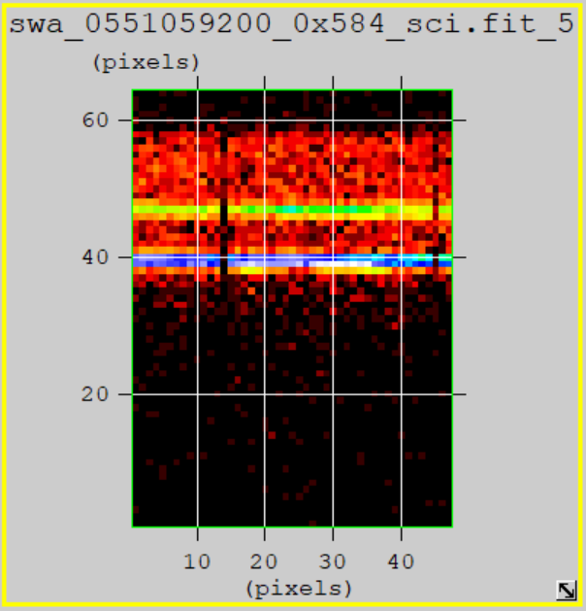
kem2_cal
I have selected the COIN_SPECT_HZ data “Image” from swa_0522288000_0x584_eng (2023-07-07T18:11 - 2023-07-08T17:55) using both tools and display the results below.
pds4_viewer
FV

Slide 18
kem2_cal
10 day Summary Plot showing data interval from the last slide. Top panel looks like FV image

Slide 19
kem2_cal
Summary plot courtesy of R. Frahm

Slide 20
Summary of Liens
Editorial Comments:
PDS4 Validate has issues with all of the metadata that I reviewed. It’s not clear to me that the metadata are wrong, it could be an problem with the software or accessing the correct files at the ENG Node. SBN should investigate. Rudy seemed to be running the same version of validate (3.6.3) without any issues.
Mission Bundle Liens: pluto_ao_pdfa1b.pdf needs to be converted to PDF/A-1b
SWAP Liens:
1) Sort out the problems with the trajectory data collection, it’s a mess. 2) Clean up the labels in the calibration_files collection – add back a lot of the info that was previously present in the PDS3 labels. 3) Verify that the seq_swap_kemX.tab files are complete or provide complete files. 4) Add table and column descriptions that are available in the PDS3 labels to all PDS4 labels (Data, calibration, trajectory, etc.)
Rudy found several minor issues that I missed. These problems also need to be corrected
Certification: The data are scientifically useful as currently provided but the metadata and associated documentation, calibration, etc. are too incomplete to use.
Not Certified – delta review required.

