Slide 1
PDS DB of Comet Polarimetry v3.0 Review
Yuna Kwon
(Caltech/IPAC)

Slide 2
Label
dbcp.xml (published dataset)
Label opened well.
Incompleteness of filters.txt (will revisit later)
Typos: Field_Character (#11)’s unit: ARSEC → ARCSEC, doubled space in Field_Character’s description
Question: Usage of the term “Box” for the apertures, which are mostly in circular shape
Kilometers vs. Kilometres (e.g., #12)

Slide 3
Label
dbcp.xml (published dataset)
Inconsistent units: Angstrom in Field_Character, but micron in filters.txt and so on.
All other .xml files are well opened on the PDS4 viewer.

Slide 4
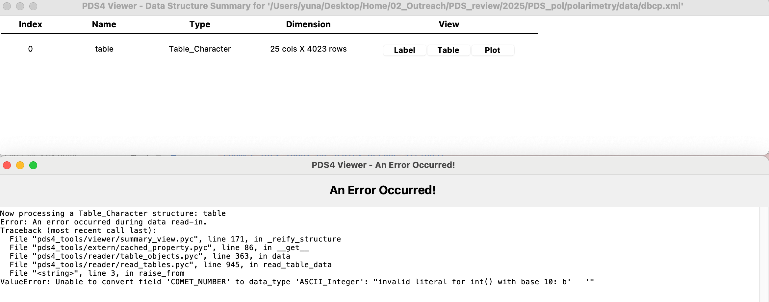
Table
dbcp.xml (published dataset)
Table is unable to be opened.

Slide 5
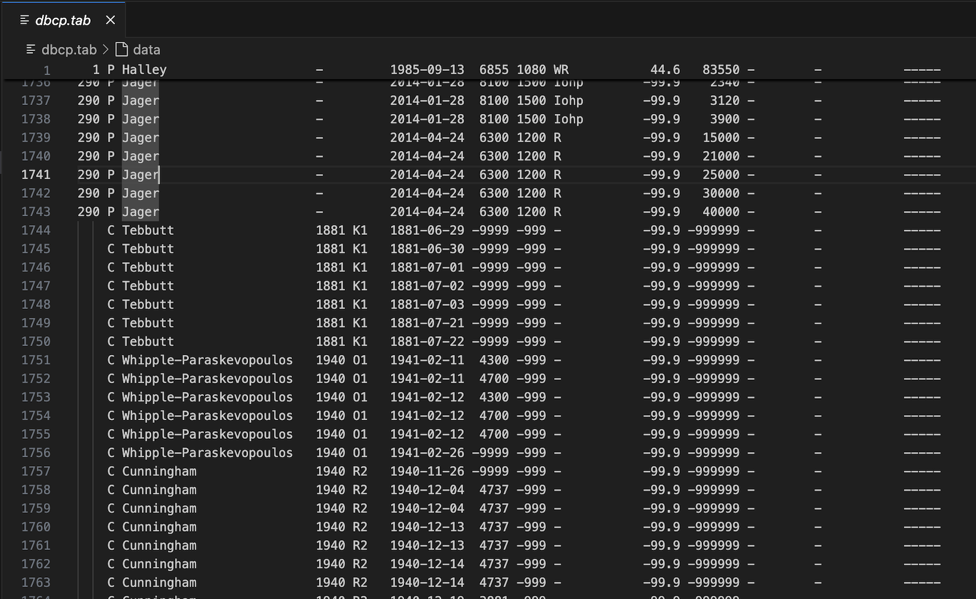
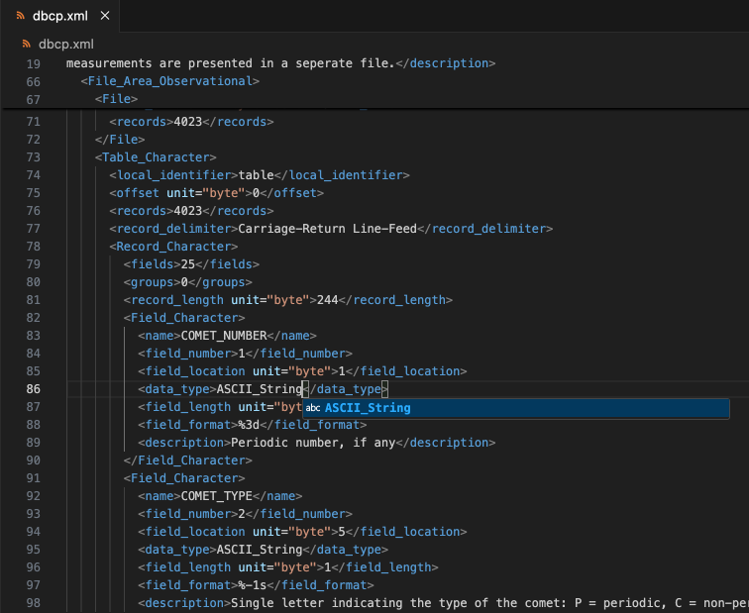
Table
dbcp.xml (published dataset)
Incorrect data type setting for #0 Suggestion: ASCII_String

Slide 6
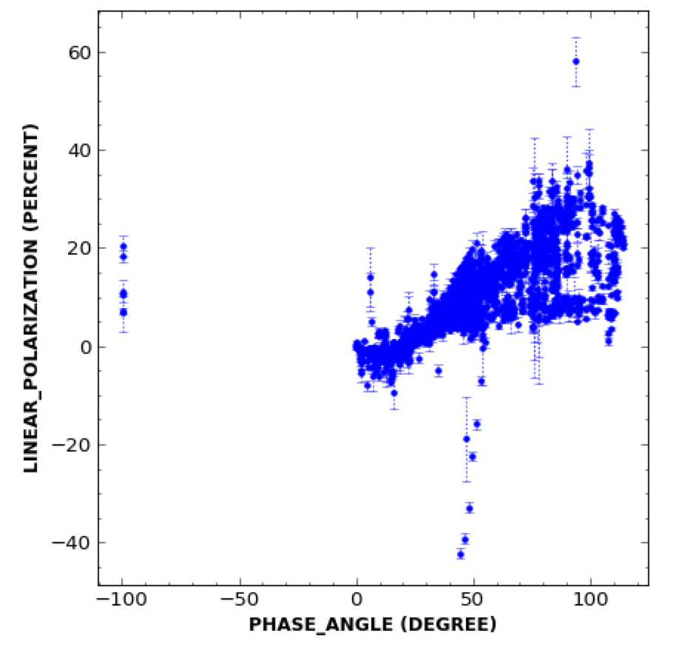
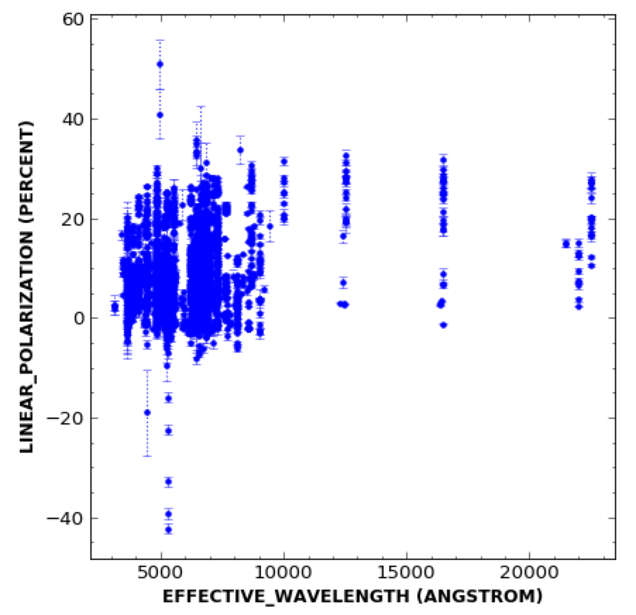
Plot
dbcp.xml (published dataset)
Once the type was changed to ASCII_String, Plot worked. But…

Slide 7
Plot
dbcp.xml (published dataset)
Once the type was changed to ASCII_String, Plot worked. But…
Incorrect numbers (should be +, not -), primarily due to the typo from the previous column (extra – made the sign of the next cell number negative)
Also, typo: e.g., C/2020 F3 (NEOWISE) from Zhuzhulina+2022: should be 8.92-ish rather than -18.92 %?

Slide 8
Data: Critical typo #1
dbcp.xml (published dataset)
Incorrect date info.

Slide 9
Data: Critical typo #2
dbcp.xml (published dataset)
Broken symbols in filters.txt
Not a rendering problem. Looks like a broken Unicode or so?

Slide 10
Data: Inconsistent filter info. (+typos)
dbcp.xml (published dataset)
The filter names mentioned:
{'-', 'B', 'B (Johnson)', 'BC', 'BC (HB)', 'BC (IHW)’,
'C2', 'C2 (HB)', 'C2 (IHW)', 'C3', 'C3 (IHW)', 'CB', 'CB (ESA)', 'CN', 'CN (IHW)', 'CN (red)', 'CO+', 'CO+ (HB)', 'CO+ (IHW)', 'CR', 'CR (ESA)', 'F606W', 'F775W’,
'G (SDSS)', 'GC (HB)', 'H', 'H (Johnson)', 'H2O+', 'H2O+ (HB)', 'H2O+ (IHW)’,
'I', 'I (Cousins)', 'I (Gunn)', "I' (Gunn)", 'IF443', 'IF684', 'IR', 'Ic', 'If', 'Iigo', 'Iohp’,
'J', 'J (Johnson)', 'K', 'K (Johnson)', 'Ks', 'NH2', 'NH2 (ESA)', 'NH2 alpha’,
'OH (IHW)', 'R', 'R (Becker)', 'R (Bessell)', 'R (Cousins)', 'R (Gunn)', 'R (Johnson)', 'R (SDSS)', 'R(Bessell)', 'R-Spatial', 'RC', 'RC (HB)', 'RC (IHW)', 'RX', 'Rb(Bessell)', 'Rc', 'Rf', 'Rigo', 'Rohp', 'SED500’,
'Thuan-Gunn', 'U', 'U (Johnson)', 'UC (HB)', 'UC (IHW)', 'V', 'V (Bessell)', 'V (Cousins)', 'V (Johnson)', 'Vf', 'WR', 'WRC', 'g-sdss', 'i (Sloan)', "i' Gunn", 'r', 'r-sdss’}
… in alphabetical order

Slide 11
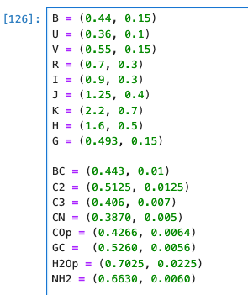
Data: Inconsistent filter info. (+typos)
dbcp.xml (published dataset)
Most of the filters are not mentioned in filters.txt, though the description mentioned that relevant details are available in filters.txt.
Unexplained filters (including duplicates):
CB, CB (ESA)
CN (red)
CR, CR (ESA)
F606W, F775W, IF443, IF684
If?
J, J (Johnson), K, K (Johnson)
SED500, Thuan-Gunn
etc.

Slide 12
Data: Inconsistent filter info. (+typos)
dbcp.xml (published dataset)
29 CN 0.387 0.37 0.005
45 CN 0.387 0.37 0.005
58 CN 0.387 0.37 0.005
70 CN 0.387 0.37 0.005
84 CN 0.387 0.37 0.005
115 CN 0.387 0.37 0.005
133 CN 0.387 0.37 0.005
141 CN 0.387 0.37 0.005
166 CN 0.387 0.37 0.005
192 CN 0.387 0.37 0.005
209 CN 0.387 0.37 0.005
223 CN 0.387 0.37 0.005
243 CN 0.387 0.37 0.005
246 CN 0.387 0.37 0.005
271 CN 0.387 0.37 0.005
273 CN 0.387 0.37 0.005
292 CN 0.387 0.37 0.005
357 CN 0.387 0.37 0.005
541 CN 0.387 0.37 0.005
565 CN 0.387 0.37 0.005
607 CN 0.387 0.37 0.005
Outside the specified filter range

Slide 13
Data: Inconsistent filter info. (+typos)
dbcp.xml (published dataset)
631 BC (HB) 0.443 0.5259 0.01
Typo: should be GC (Jewitt 2004; 2P/Encke paper)
682 C2 0.5125 0.55 0.0125
Another bandhead(s) --> should be mentioned in filters.txt
688 NH2 alpha 0.663 0.702 0.006
689 NH2 alpha 0.663 0.738 0.006

Slide 14
Data: Inconsistent filter info. (+typos)
dbcp.xml (published dataset)
723 WRC 0.684 0.7228 0.009 724 WRC 0.684 0.7228 0.009 732 WRC 0.684 0.7228 0.009 733 WRC 0.684 0.7228 0.009 734 WRC 0.684 0.7228 0.009 797 WRC 0.684 0.7228 0.009 800 WRC 0.684 0.7228 0.009 801 WRC 0.684 0.7228 0.009
+ there are more relevant rows
Should be mentioned in filters.txt
810 RC 0.684 0.642 0.009
825 RC 0.684 0.642 0.009
828 RC 0.684 0.642 0.009
829 RC 0.684 0.642 0.009
830 RC 0.684 0.642 0.009
877 RC 0.684 0.642 0.009
888 RC 0.684 0.642 0.009
890 RC 0.684 0.642 0.009
891 RC 0.684 0.642 0.009
892 RC 0.684 0.642 0.009
893 RC 0.684 0.642 0.009
898 RC 0.684 0.642 0.009
901 RC 0.684 0.642 0.009
902 RC 0.684 0.642 0.009
903 RC 0.684 0.642 0.009
904 RC 0.684 0.642 0.009
RC != Rc
Here, should be Rc, instead of RC.
1580 RC 0.684 0.7128 0.009

Slide 15
Data: Inconsistent filter info. (+typos)
dbcp.xml (published dataset)
957 UC (IHW) 0.365 0.3871 0.008
1539 UC (IHW) 0.365 0.3871 0.008
2251 UC (IHW) 0.365 0.3871 0.008
2256 UC (IHW) 0.365 0.3871 0.008
2261 UC (IHW) 0.365 0.3871 0.008
Inconsistent with the specified range in filters.txt
1233 H 1.6 0.676 0.5
1234 H 1.6 0.676 0.5
Typos of near-IR H filters? Or R-band filters?

Slide 16
Data: Inconsistent filter info. (+typos)
dbcp.xml (published dataset)
3552 RC (HB) 0.7128 0.684 0.0058
3649 RC (HB) 0.7128 0.684 0.0058
Inconsistent with the specified range in filters.txt
3971 RC 0.684 0.7128 0.009
3985 RC 0.684 0.7128 0.009
3990 RC 0.684 0.7128 0.009
3994 RC 0.684 0.7128 0.009
These should be RC (HB), otherwise, they are inconsistent.

Slide 17
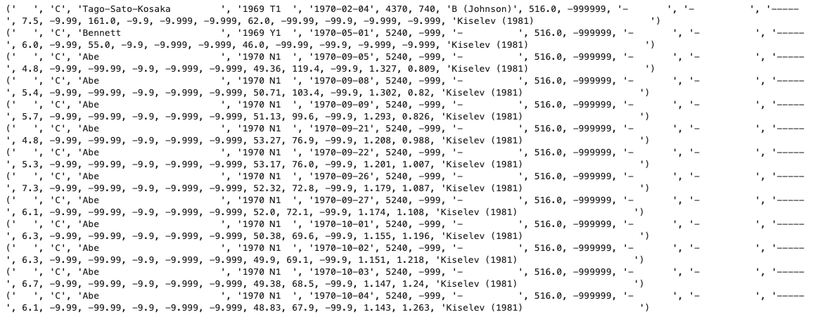
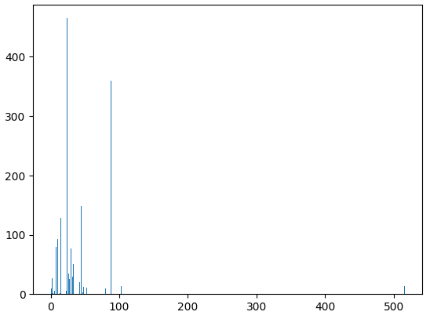
Data: unavailable reference?
dbcp.xml (published dataset)
#9 aperture size in arcsec:

Slide 18
Reviewer’s advantage
dbcp.xml (published dataset)
Data range definition
There are several data obtained in 2024 (e.g., Gray et al. 2024), though the overview mentioned that the archive contains data up to 2023. → which means Kwon et al. (2024) C/2017 K2 (PANSTARRS) data are not included.

Slide 19
Label
dbcp_unpubl_data.xml (published dataset)
Opened well.
The same typos and inconsistencies as dbcp.xml

Slide 20
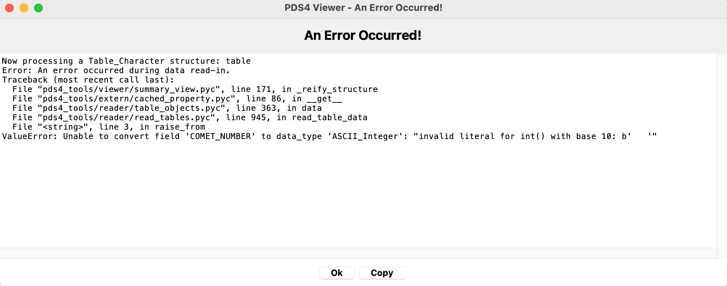
Table
dbcp_unpubl_data.xml (published dataset)
It can’t be opened. The same cause as dbcp.xml
Once fixed with ASCII_String, loaded well.

Slide 21
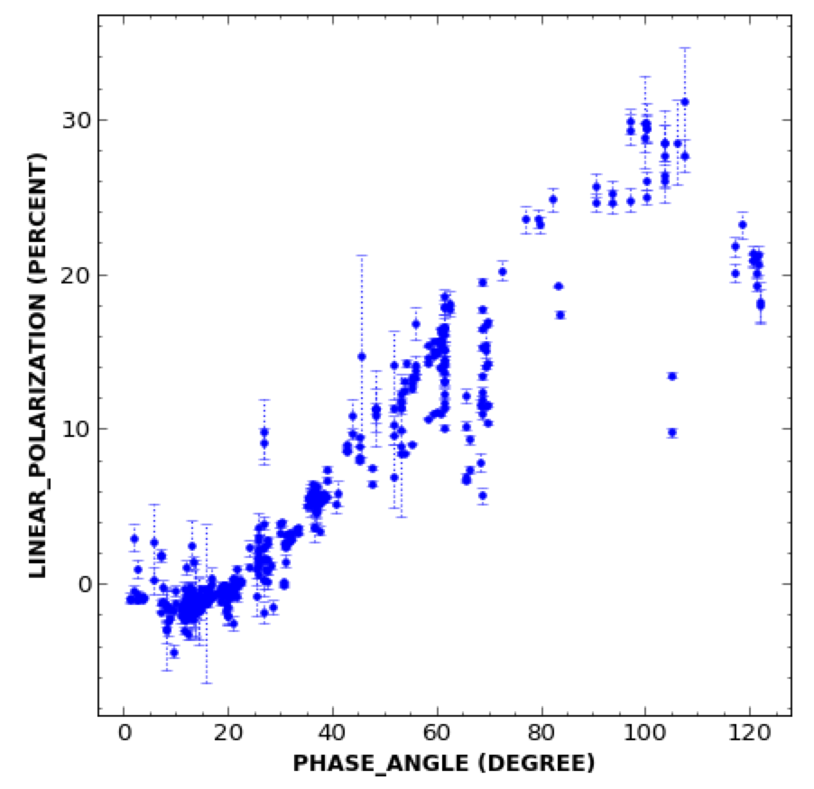
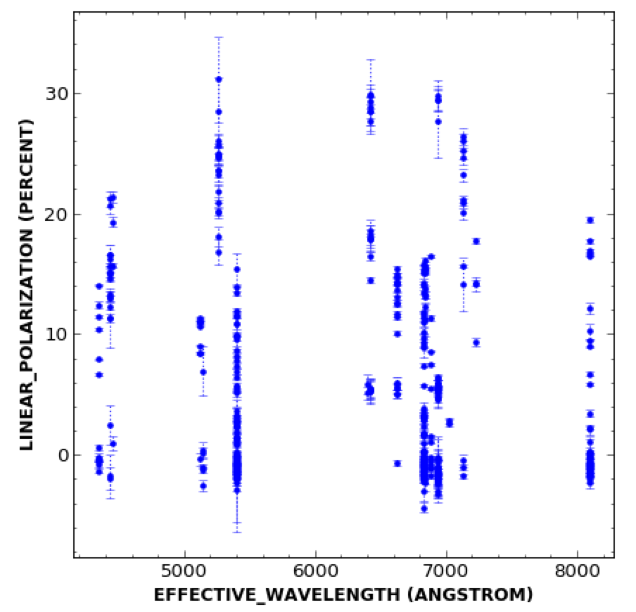
Plot
dbcp_unpubl_data.xml (published dataset)
Plotted well.

Slide 22
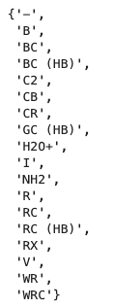
Data Sanity Check
dbcp_unpubl_data.xml (published dataset)
Date information is correctly entered.
Filter/wavelength information-wise, the same inconsistencies exist.

Slide 23
Data: Inconsistent filter info. (+typos)
dbcp_unpubl_data.xml (published dataset)
6 WRC 0.684 0.7228 0.009
177 WRC 0.684 0.7228 0.009
180 WRC 0.684 0.7228 0.009
183 WRC 0.684 0.7228 0.009
Not specified in filters.txt
11 RC 0.684 0.7128 0.009
233 RC 0.684 0.7128 0.009
257 RC 0.684 0.7128 0.009
308 RC 0.684 0.7128 0.009
411 RC 0.684 0.7128 0.009
These should be RC (HB), otherwise, they are inconsistent.

