Slide 1
PDS Lowell Comet Imaging Review
Yuna Kwon
(Caltech/IPAC)

Slide 2
General descriptions
All xml. Files are well opened.
155 folders
Collection xml.: 2 cols x 13020 rows
Suggestions:
Better to have consistent folder names?
Better to compile distributed log information for users?
Better to folder calibs vs. sci images separately?

Slide 3
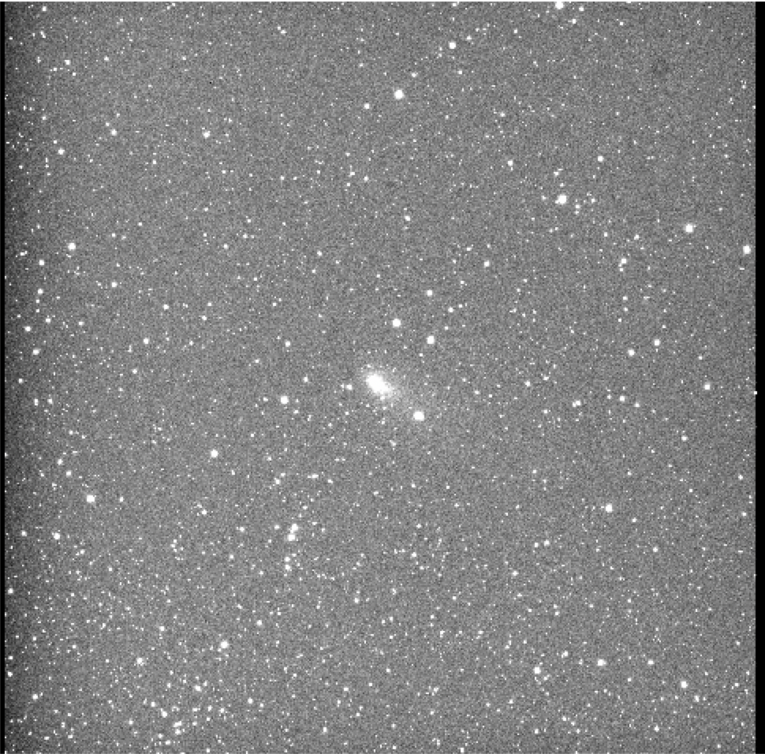
General descriptions
Not properly loaded in the PDS4 viewer? (cf. SAOds9)
e.g., 20180614 lmi_0090.xml vs. lmi_0090.fit

Slide 4
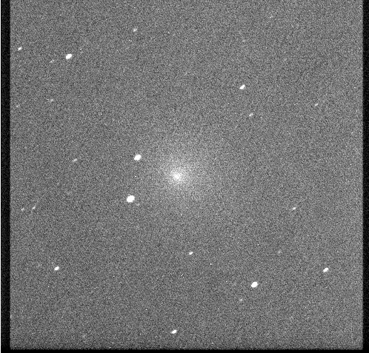
General descriptions
Not properly loaded in the PDS4 viewer? (cf. SAOds9)
e.g., 20180626 180626_113.xml vs. 180626_113.fit

Slide 5
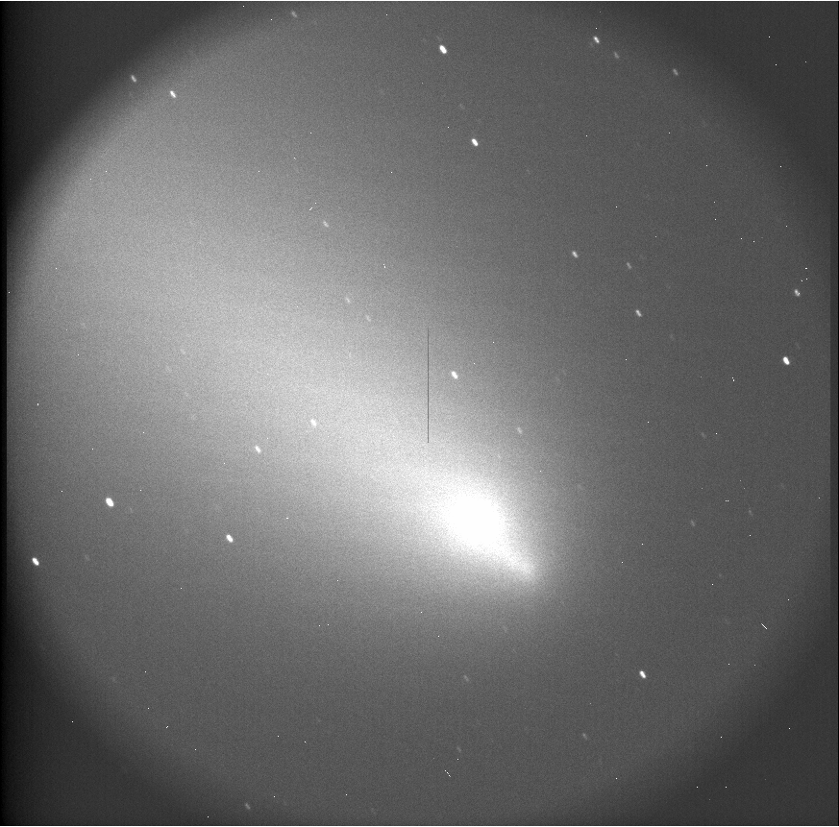
General descriptions
Not properly loaded in the PDS4 viewer? (cf. SAOds9)
e.g., 20200513 lmi_0012.xml vs. lmi_0012.fit

Slide 6
General descriptions
Suggestions:
Better to have consistent folder names?
Better to compile distributed log information for users?
Better to folder calibs vs. sci images separately?

Slide 7
Statistics Consistency Check
The general description says: … A total of 29 comets are archived, observed over 140 unique nights.
A total of 30 comets: 29P is missing on 10/4/2019

Slide 8
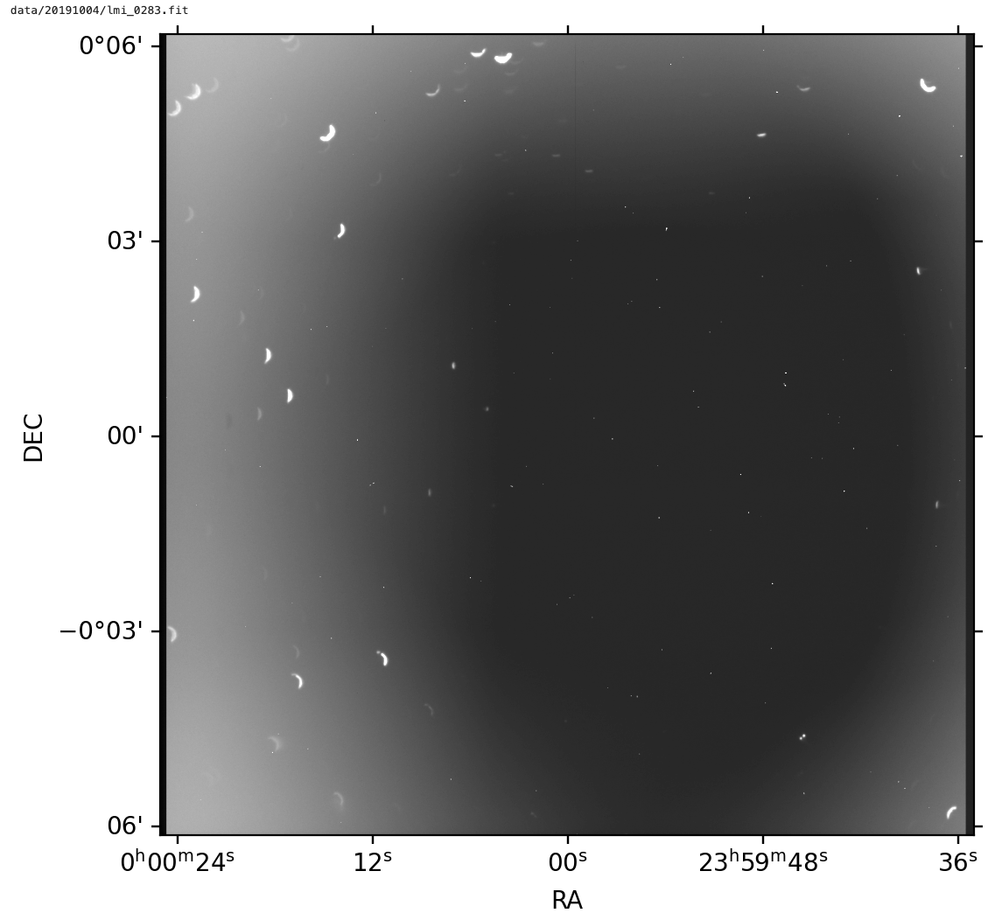
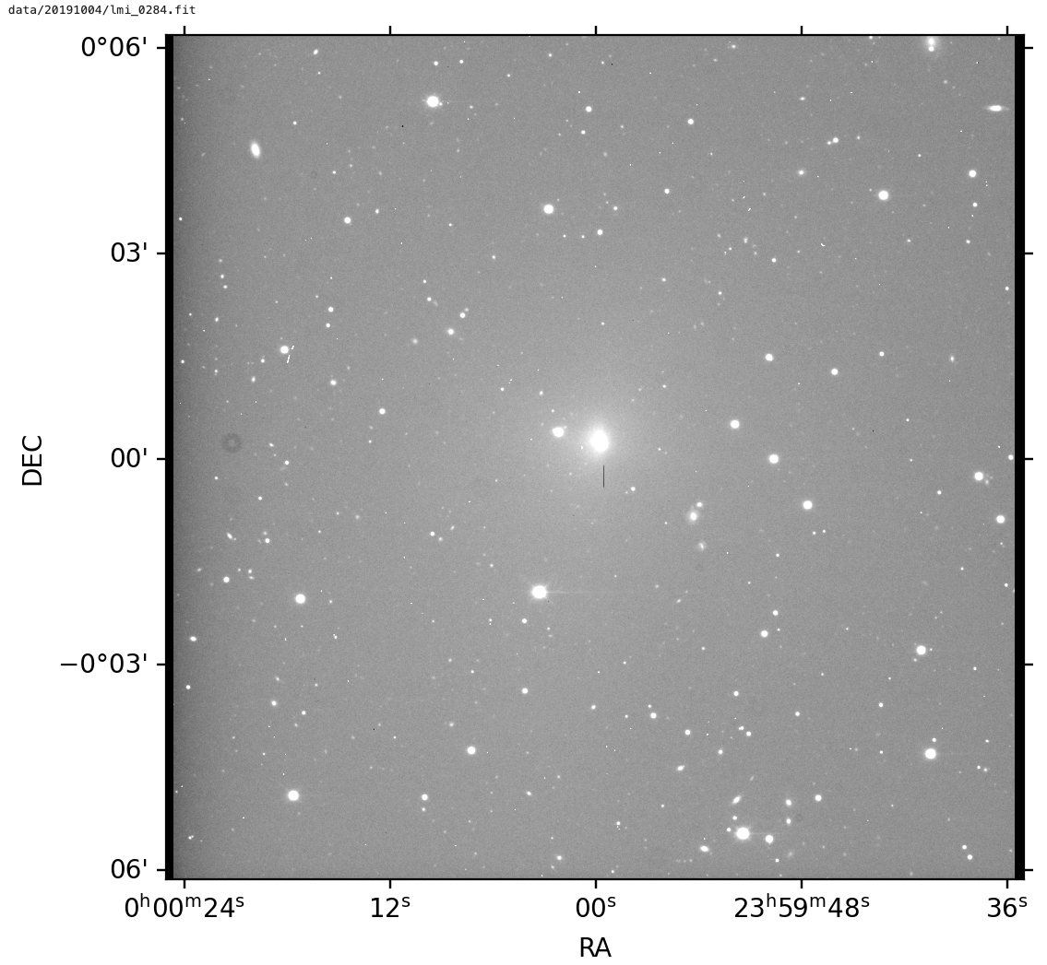
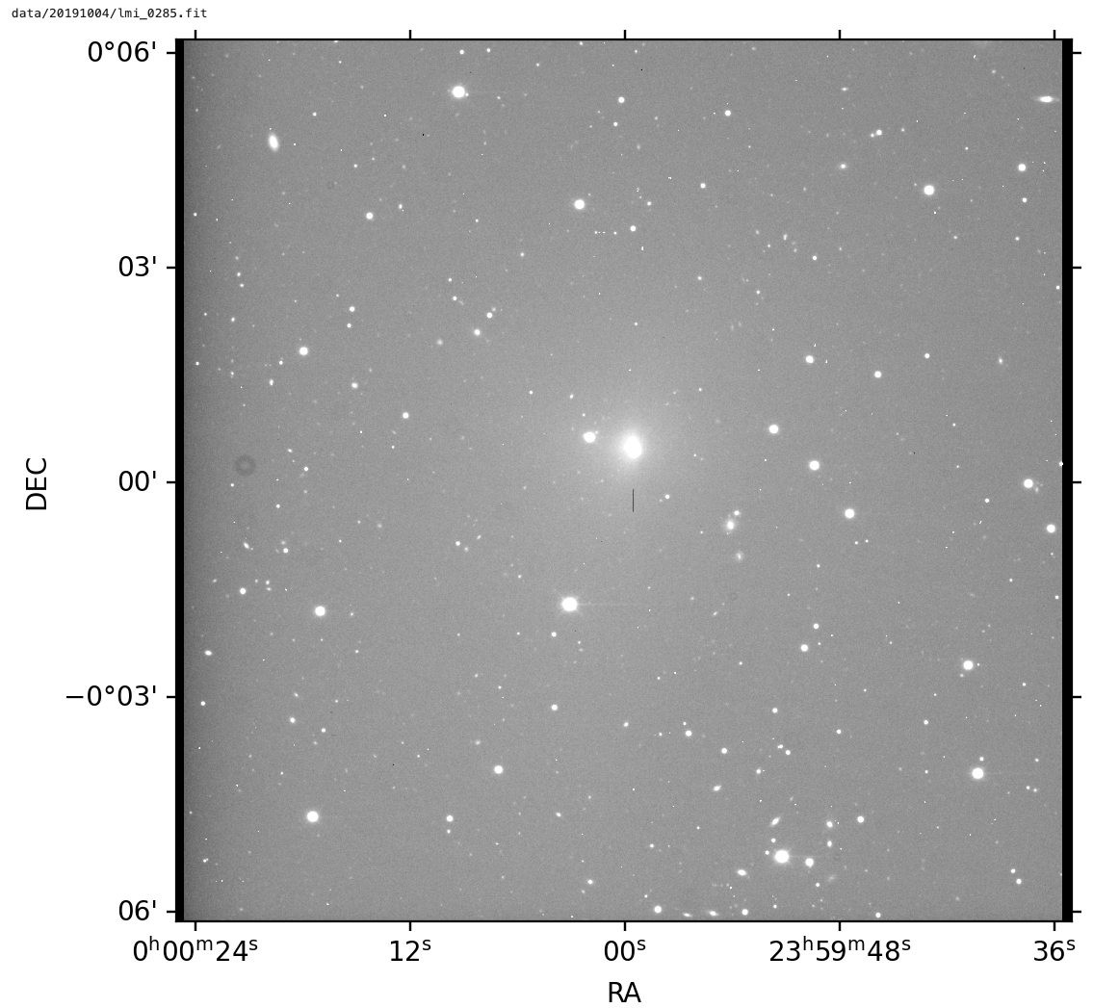
Statistics Consistency Check
Missing 29P/S-W: 3 images on 2019-10-04 (1 of them is a bad frame)

Slide 9
Statistics Consistency Check
The general description says: … A total of 29 comets are archived, observed over 140 unique nights.
Relevant documents (e.g., lowell_imaging_archive_2024.pdf and lowell_imaging_summary.pdf) should be updated.
A total of 30 comets: 29P is missing on 10/4/2019

Slide 10
Statistics Consistency Check
Comet names are inconsistent. For example,
2I BORISOV (LOWELL), 2019Q4 BORISOV (LOWELL), 2019Q4 BORISOV, 2I/BORISOV, 2I BORISOV
243P POS 1, 243P POS 2, 243P POS 3, 243P POS 4, 243P POS 5 (same for C/2013 US10)
For periodic comets, 64P SWIFT-GEHRELS or 48P/JOHNSON, etc.
Date formats and associated header keywords are different from one another.

Slide 11
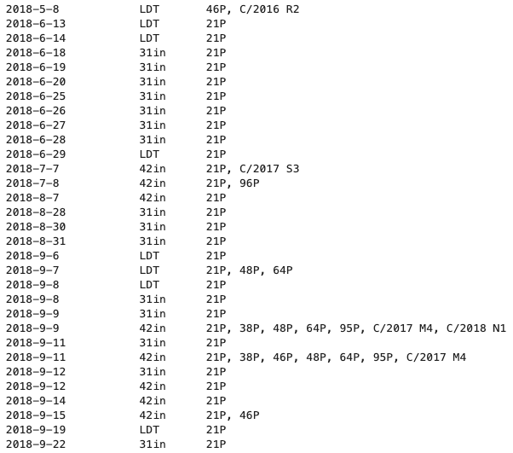
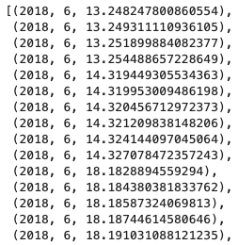
In lowell_imaging_summary.pdf
Incorrect observation date information. For example,
6/14 data were NOT taken in the second-half night of the 6/13 run.

Slide 12
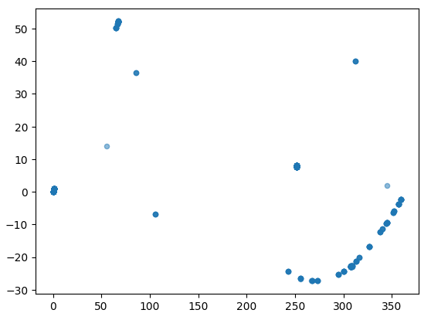
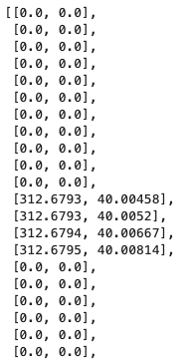
Astrometry Accuracy Check
Fundamental wcs header keywords are incorrectly written. → Astrometry can’t be performed using their headers.
CRVAL1, CRVAL2

Slide 13
Astrometry Accuracy Check
Astrometry updates required
Group | Type | #
1 | Images having CRVALs’ magnitudes >5 | 5,385
2 | Among Group 1, comets outside the FOV | 51
3 | Images having CRVALs’ magnitudes <5 | 4,753
4 | Among Group 1, comets inside the FOV | 581

Slide 14
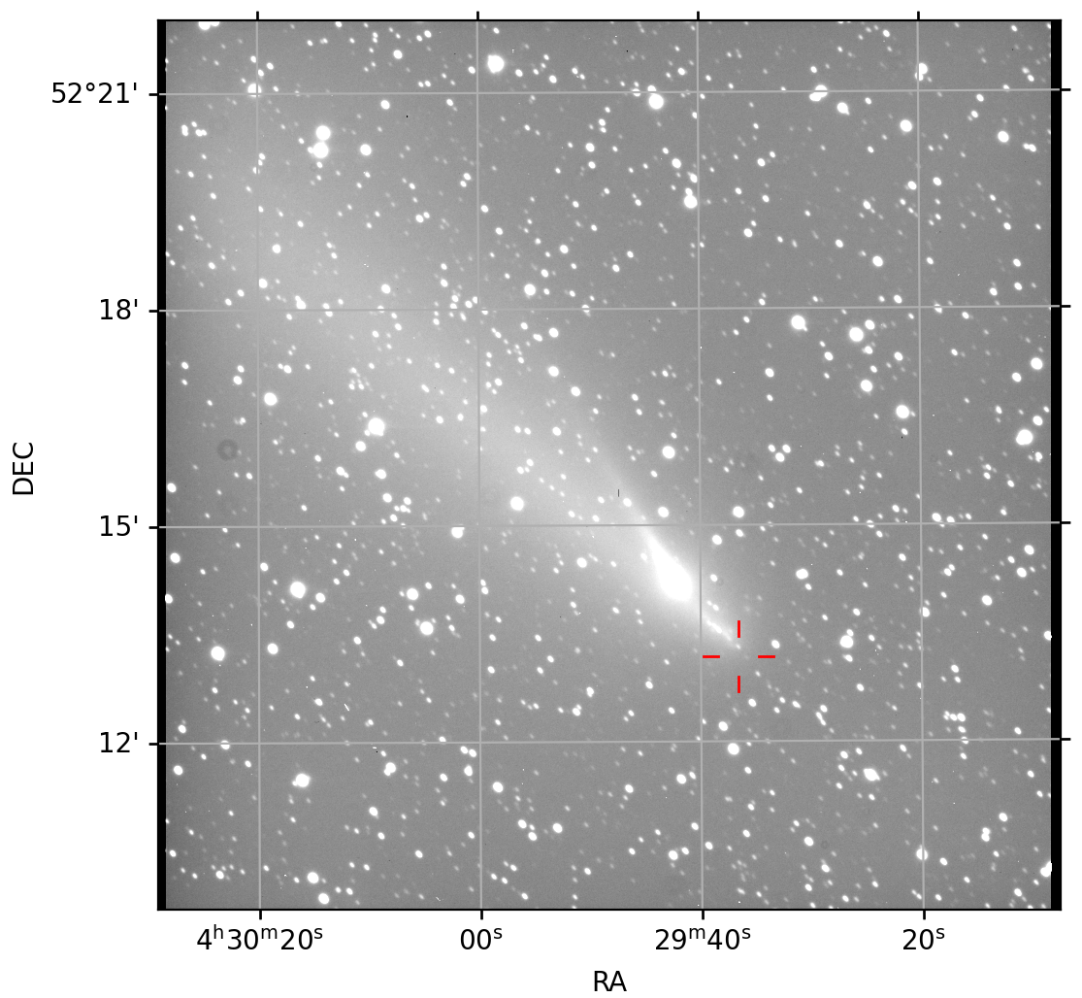
Astrometry Accuracy Check
Some of Group 4 comets appear to have correct WCS information. Below example: C/2019 Y4
Header-based position prediction
SPICE-kernel-based position calculation

Slide 15
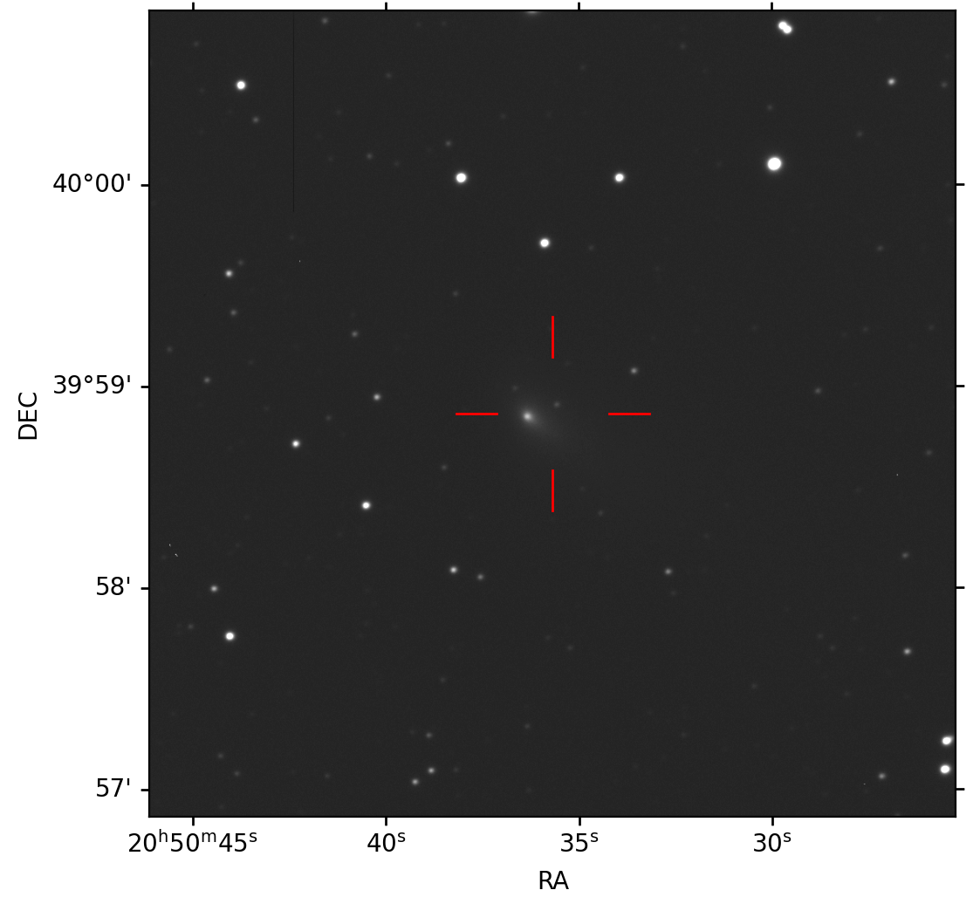
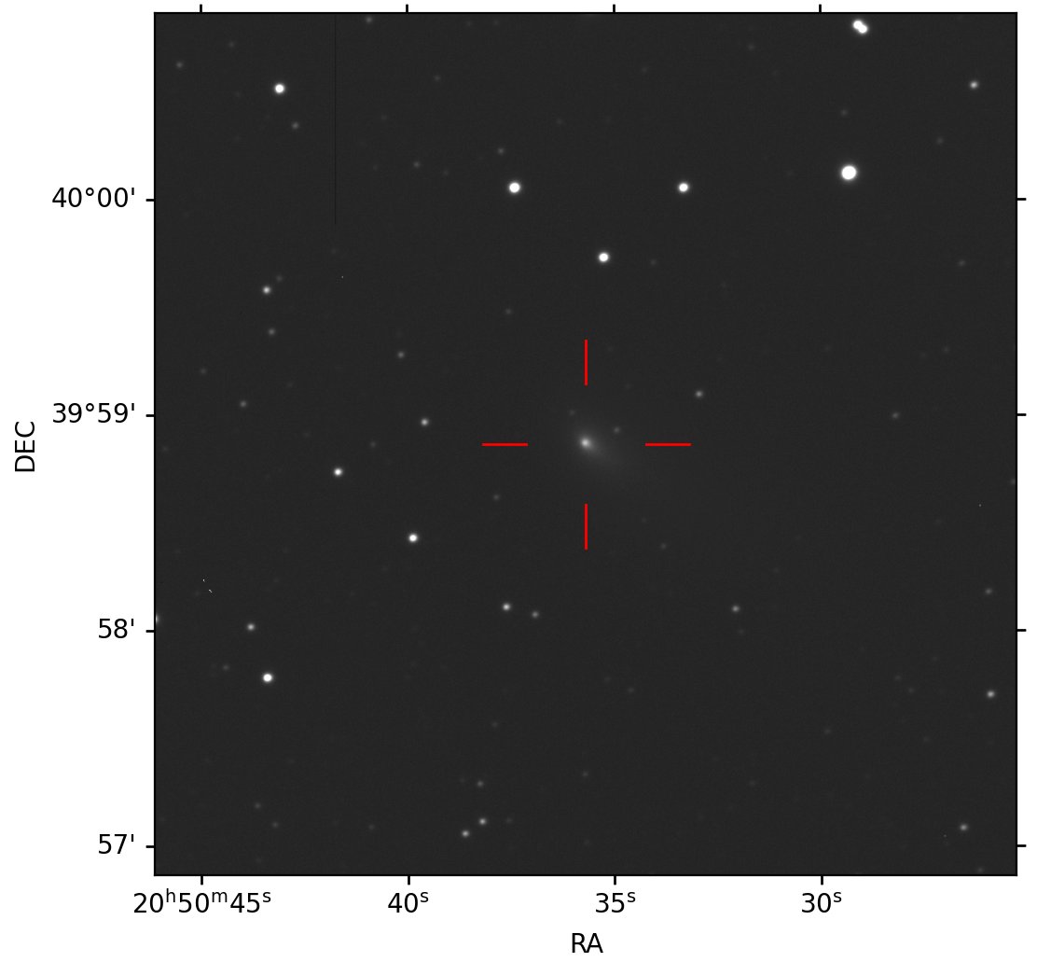
Astrometry Accuracy Check
… but Some of Group 4 comets have incorrect WCS information. Below example: 21P/G-Z (34.5 pixels off)
Header-based position prediction
SPICE-kernel-based position calculation

Slide 16
etc.
Some science images have negative seeing information.

