Slide 1
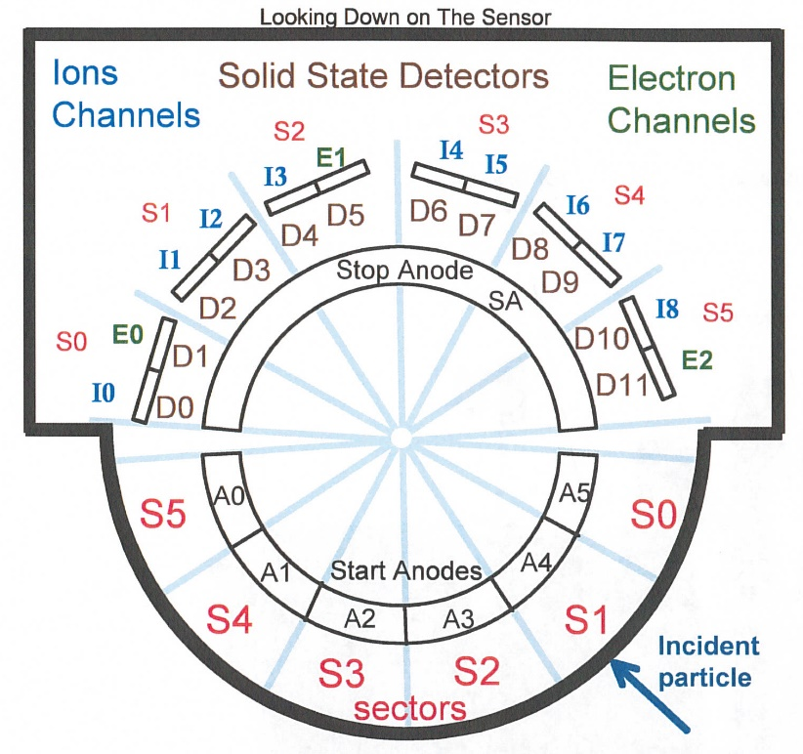
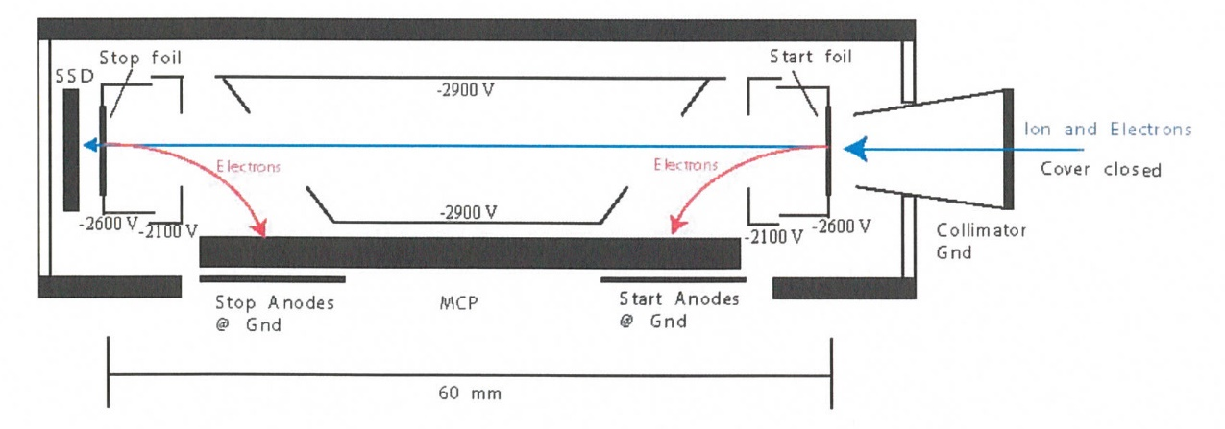
New Horizons
Pluto Energetic Particle Spectrometer Science Investigation
(PEPSSI)
Reviewed by S. Joy (primary)
PRINCIPAL INVESTIGATOR: Ralph McNutt, APL
DESCRIPTION: Medium Energy Particle Spectrometer
ENERGY RANGE: 25-1000 keV (protons)
60-1000 keV (atomic ions)
25-500 keV (electrons)
FIELD OF VIEW: 160 deg x 12 deg
ANGULAR RESOLUTION: 25 deg x 12 deg
ENERGY RESOLUTION: 0.25 keV
SENSOR SIZE: 7.6 cm dia. x 2.5 cm thick
POWER: 1.4 watt
MASS: 1.5 kg

Slide 2
New Horizons PEPSSI Data Sets
Data ->
urn:nasa:pds:nh_pepssi:kem1_raw::1.0
migrated from nh-x-pepssi-2-kem1-v2.0?
urn:nasa:pds:nh_pepssi:kem1_cal::1.0
migrated from nh-x-pepssi-3-kem1-v2.0?
urn:nasa:pds:nh_pepssi:kem1_raw::1.0
migrated from nh-x-pepssi-2-kem2-v2.0?
urn:nasa:pds:nh_pepssi:kem2_cal::1.0
migrated from nh-x-pepssi-3-kem2-v2.0?

Slide 3
New Horizons PEPSSI
Data Set Evaluation Tools
All Data Processing and Evaluation -
Machine: Dell XPS 15 9510
Operating System: Windows 10 (22H2)

Slide 4
  Comments on review procedure
  This is the first time reviewing these data with PDS4 structure and metadata.
  Comparing the current PDS4 labels and other metadata to the previous
  PDS3 version is non-trivial and I’m not aware of any tools to facilitate the
  process.
  PDS4 Labels were validated using the PDS Validate tool (3.6.3) on a Linux platform
  I did not review every data file in the “bundle”. I created small subsets of files at
  the start, a few in places in the middle, and at the end of the collections.
  Hopefully these files are representative of the entire collection. Where possible, I reviewed calibrated data from the same time intervals as the raw data.
  Lastly, I looked at issues raised in the Jan 2023 PDS3 review to make sure that they had been addressed in this release.

Slide 5
Documentation
Evaluation

Slide 6
Mission Bundle files
In the reorganization that occurred migrating the archive from PDS3 to PDS4, many
documents and catalog files were moved out of the instrument level bundles into a mission
bundle. I provide comments on those files here.
soc_inst_icd.pdf (lblx) The PEPSSI section (p96) of this document refers to a file called
PEPSSI_BTI_GoodTimeIntervalsBadTimeIntervals_2022_149.txt that is not included
in the PEPSSI document collection. This issue was reported at the last review
(pep_bti.tab is included). Updates to describe FSW5 impacts have been included!!!
nh_mission_trajectory.tab (lblx) appears to be complete and correct
pluto_ao_pdfa1b.pdf Validate reports “ERROR [error.pdf.file.not_pdfa_compliant]
Validation failed for flavour PDF/A-1b”.
lunineetal1995 .pdf, nh_fov.png, nh_met2utc.tab, quat_axyz_instr_to_j2k.asc,
payload_ssr.pdf(.lblx) – Good, previously reviewed
spacecraft_ssr.pdf, subframe_window_summary.txt (.lblx) – New products I’ve never
reviewed before - Good
nh_mission_overview.pdf, nh_sc_overview.pdf, nhkem1_mission_overview.pdf,
nhkem2_mission_overview.pdf (lblx) – Former catalog files - Good

Slide 7
PEPSSI Bundle level files
None found. I was sort of expecting Bundle level files similar to those found during my
SWAP review.

Slide 8
Document files
PDS documents (pepssi_ssr, pepssi_inst_overview) appear to be properly formatted as PDF/A and the document labels appear to be valid.
pep_bti.tab (.lblx) – Good, may be complete (last entry 2024-051)
seq_pepssi_kem1.tab (.lblx) – Good, may be complete (last entry 2022-04-30)
Phase ends 2022-09-30
seq_pepssi_kem2.tab (.lblx) – Good, may be complete (first entry 2023-03-05)
Phase starts 2022-10-01
It’s unclear if the gap between the kem1 and kem2 files occurs because PEPSSI was
off the entire time. The last command in the kem1 file is a power off and the first command in the kem2 file is a power on command so this interpretation is plausible.
pepssi_inst_overview.pdf(lblx) – Good, old instrument catalog file

Slide 9
Calibration files
Files
Collection and overview (.lblx) – Good, files validate
hk_n1_input_20050228 and hk_stat_input_20041016 (.lblx) both fail Validate.
FATAL_ERROR [error.label.schematron] Cannot read schematron from URL https://pds.nasa.gov/pds4/img/v1/PDS4_IMG_1J00_1900.sch
When I remove this set of schematron rules, it reports:
FATAL_ERROR [error.label.unresolvable_resource] https://pds.nasa.gov/pds4/img/v1/PDS4_IMG_1J00_1900.xsd
When I paste these links into my browser I get “Not Found” errors
On the JPL site I can find IMG_1M00_1900.* in PDS4 1.22.0.0
In PDS4 1.19.0.0 where I find PDS4_PDS_1J00.sch, I only find IMG_1M00_1870.*
When I compare the .tab files to the previous review versions using BeyondCompare the files are identical.
hk_n1_input_20050228 and hk_stat_input_20041016 (.lblx)
Visually the labels look fine except each contain a missing space in the Table_Character
description field “containscoefficients”

Slide 10
Data
Evaluation

Slide 11
Data Review
I ran the PDS4 Validate tool on all of the data files and it failed on all of them. The errors are related to the initialization statements at the top of the labels where the XML schema and schematron rules are defined.
FAIL: file:/pds/work1/WORKING/NewHorizons/PEPSSI/kem1_raw/pep_0408261117_0x691_eng.lblx
WARNING [warning.label.schema] line 499, 26: schema_reference.4: Failed to read schema document 'https://pds.nasa.gov/pds4/img/v1/PDS4_IMG_1J00_1900.xsd', because 1) could not find the document; 2) the document could not be read; 3) the root element of the document is not <xsd:schema>.
ERROR [error.label.schema] line 499, 26: cvc-complex-type.2.4.c: The matching wildcard is strict, but no declaration can be found for element 'img:Imaging'.
WARNING [warning.label.schema] line 504, 39: schema_reference.4: Failed to read schema document 'https://pds.nasa.gov/pds4/img/v1/PDS4_IMG_1J00_1900.xsd', because 1) could not find the document; 2) the document could not be read; 3) the root element of the document is not <xsd:schema>.
WARNING [warning.label.schema] line 505, 42: schema_reference.4: Failed to read schema document 'https://pds.nasa.gov/pds4/img/v1/PDS4_IMG_1J00_1900.xsd', because 1) could not find the document; 2) the document could not be read; 3) the root element of the document is not <xsd:schema>.
WARNING [warning.label.schema] line 506, 45: schema_reference.4: Failed to read schema document 'https://pds.nasa.gov/pds4/img/v1/PDS4_IMG_1J00_1900.xsd', because 1) could not find the document; 2) the document could not be read; 3) the root element of the document is not <xsd:schema>.
WARNING [warning.label.schema] line 507, 46: schema_reference.4: Failed to read schema document 'https://pds.nasa.gov/pds4/img/v1/PDS4_IMG_1J00_1900.xsd', because 1) could not find the document; 2) the document could not be read; 3) the root element of the document is not <xsd:schema>.
… many more similar lines
It’s not clear to me that these errors are real but SBN should comment
I have no tools for analyzing F&P data in FITS format so I rely on tools that are
freely available on the web. For this review I have relied on the FV (FITS_VIEW)
tool and the pds4_viewer tool available from the Small Bodies Node of PDS.

Slide 12
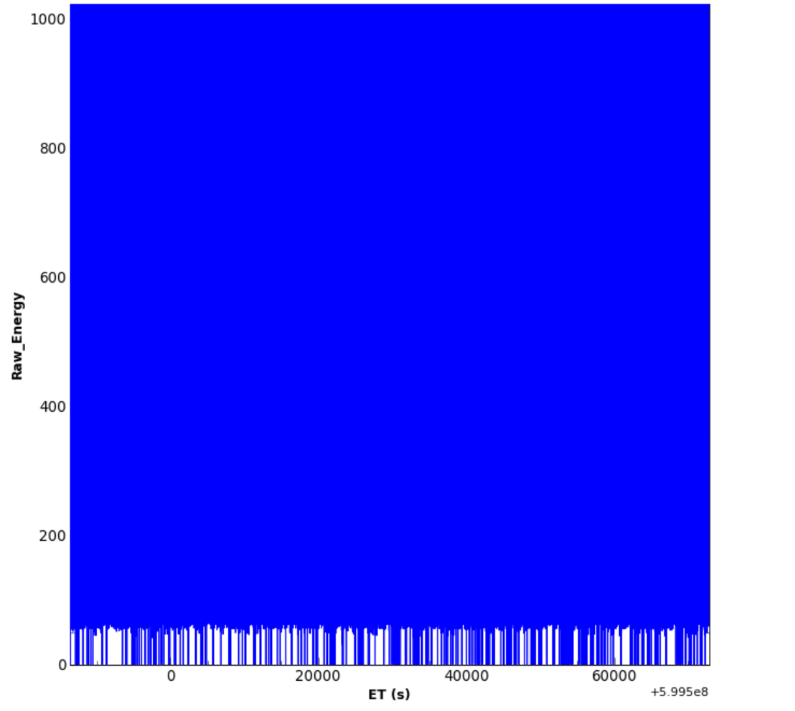
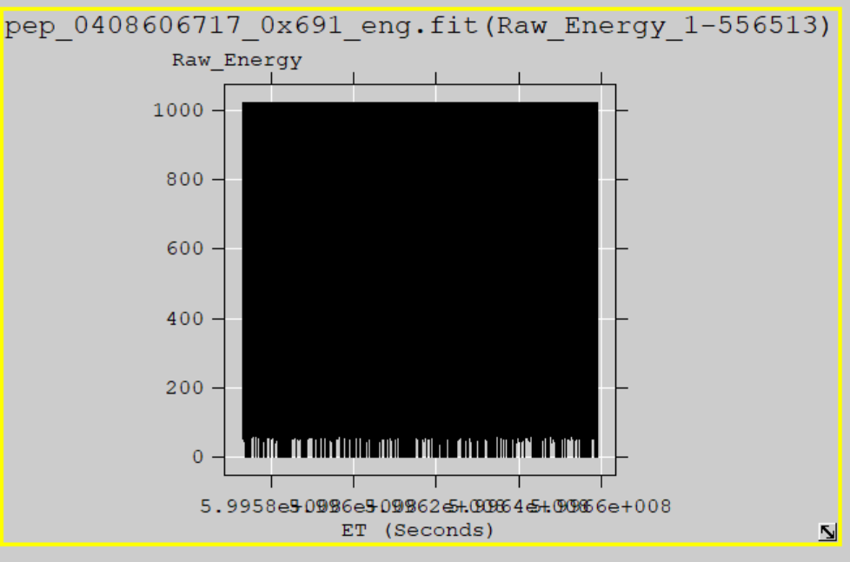
kem1_raw
FV allows the user to plot FITS data from versus time (MET or ET). The SBN has a similar
tool (pds4_viewer) that reads the data label (.lblx) and displays the data based on the file
structure information in the label file. I have plotted the PHA_ELECTRON data
(Raw_Energy vs. ET) from pep_0408606717_0x691_eng using both tools and display
the results below.
pds4_viewer
FV

Slide 13
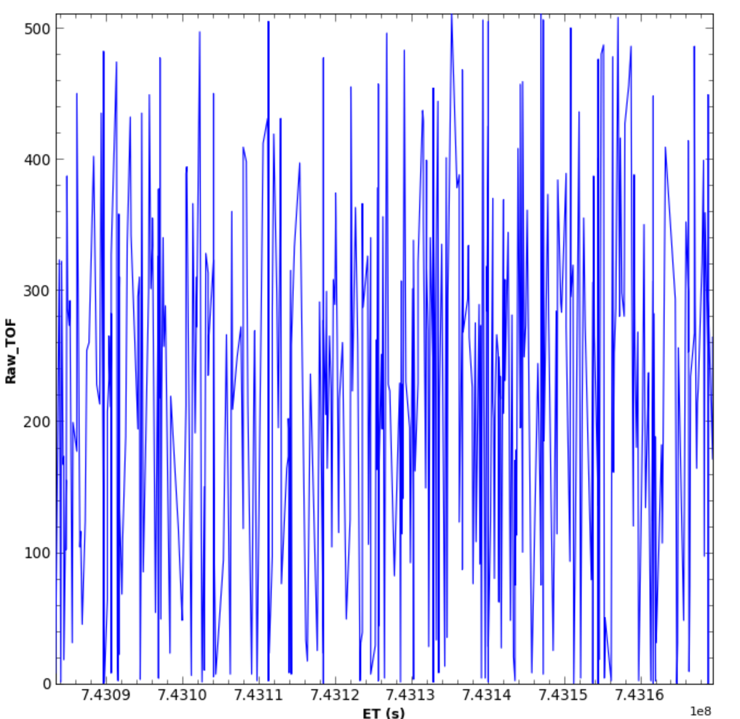
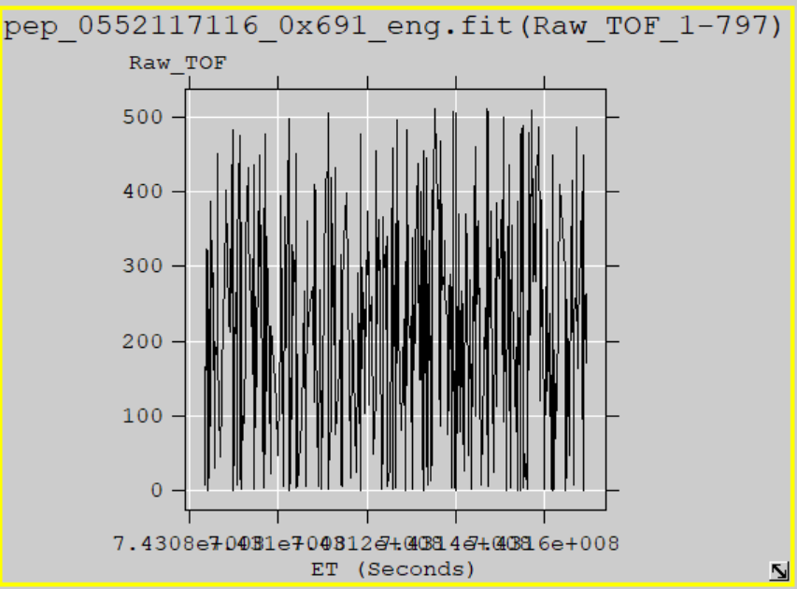
kem2_raw
I have plotted the PHA_LOW_ION data (Raw_TOF vs. ET) from
pep_0552117116_0x691_eng using both tools and display he results below.
Despite the Validate problems pds4_viewer
reads the data correctly which suggests that
the file structure is being properly describe
by the PDS labels.
FV reading the files suggests that the FITS
format is correct
pds4_viewer
FV

Slide 14
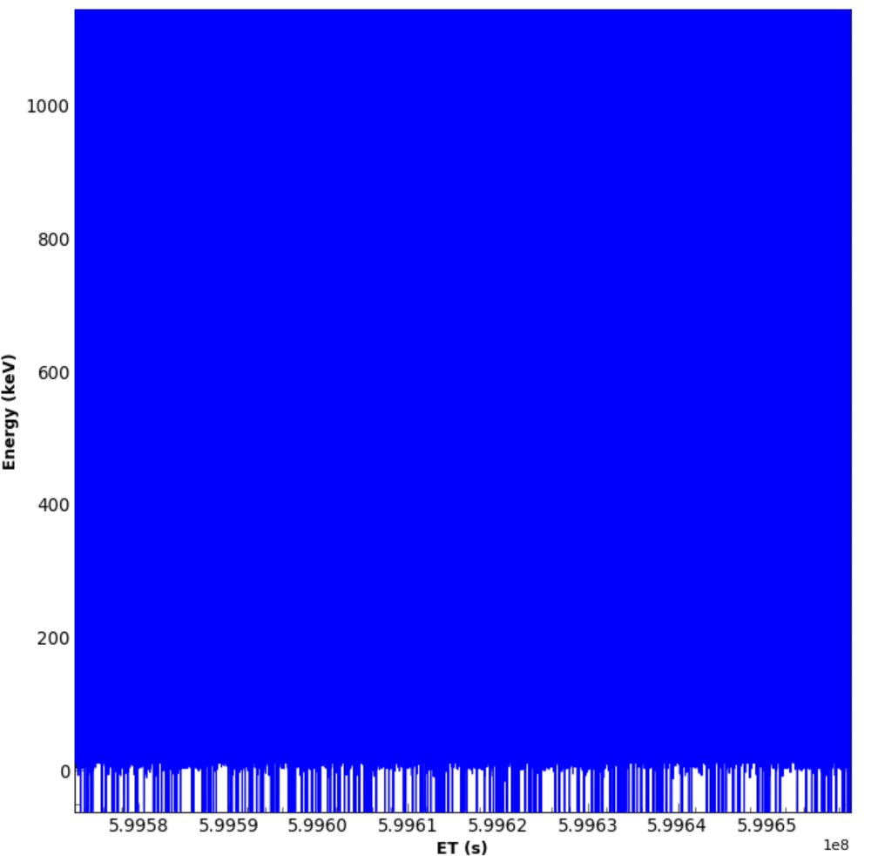
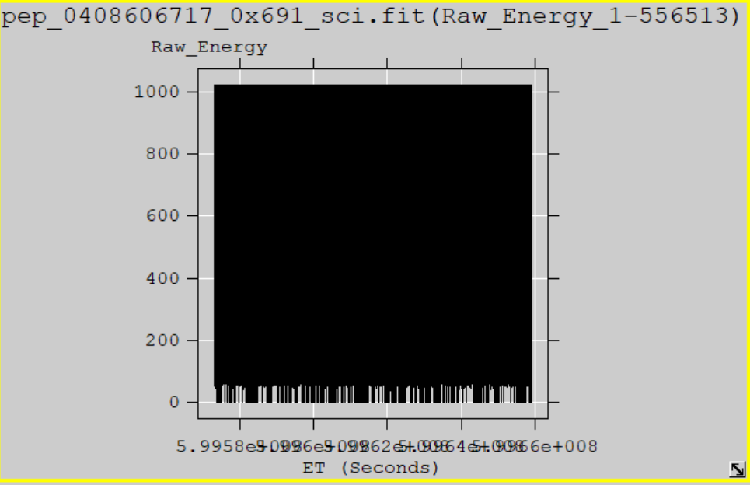
kem1_cal
Plot similar to the ones shown for the raw data. The file selected is the calibrated
version of the raw data shown on slide 12.
The plots show Energy vs time from the PHA_ELECTRON data
pds4_viewer
FV

Slide 15
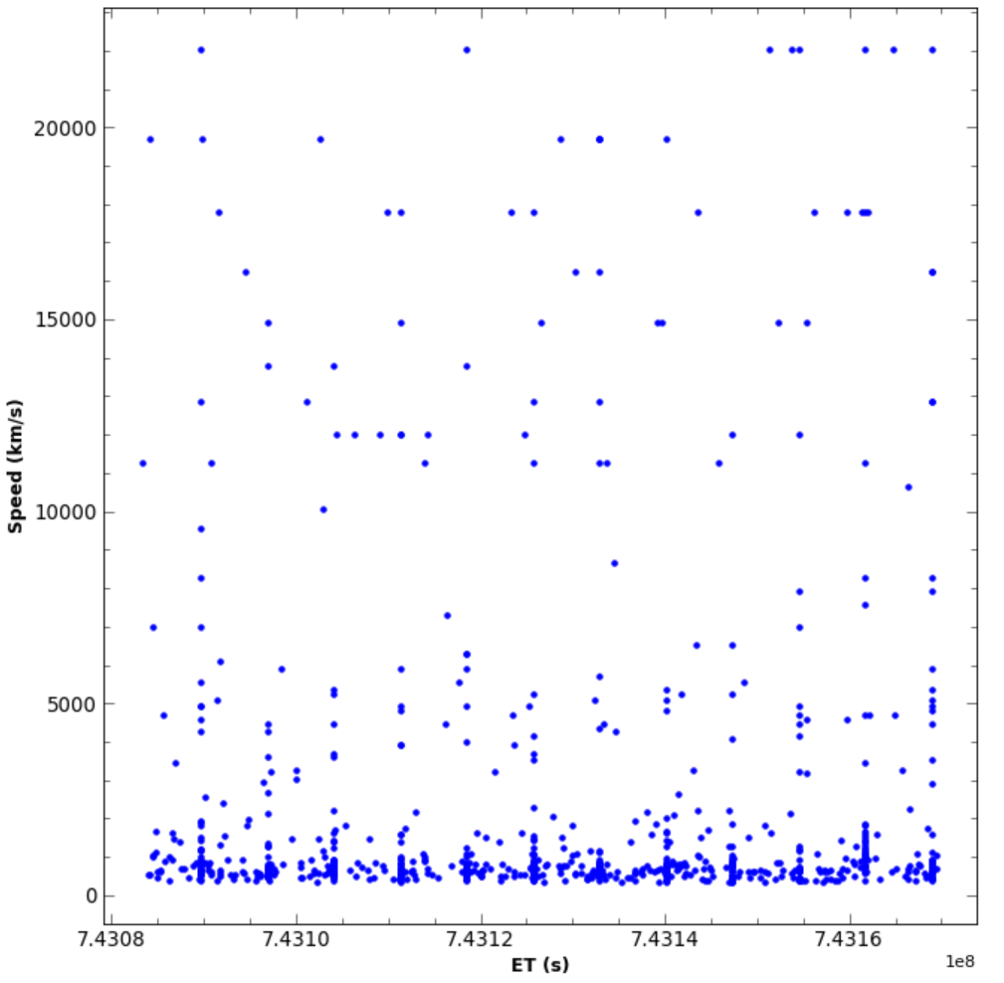
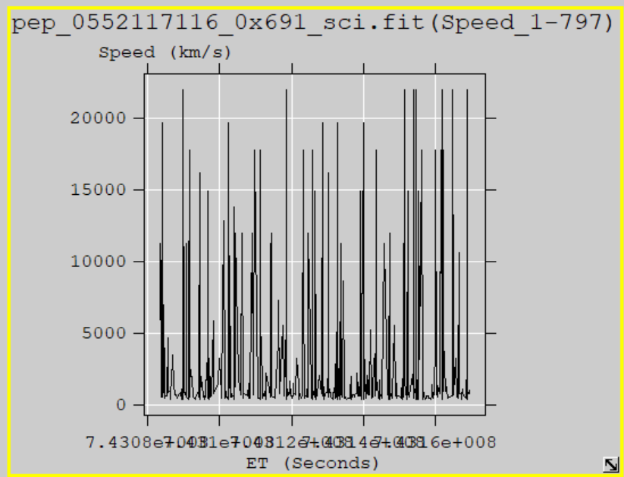
kem2_cal
Plot similar to the ones shown for the raw data. The file selected is the calibrated
version of the raw data shown on slide 13. The plots show Speed vs Time taken
from the PHA_LOW_ION data.
Like the raw data, the pds4_viewer reads the data correctly which suggests that the file structure is being properly describe by the PDS labels.
FV reading the files suggests that the FITS
format is correct
pds4_viewer
FV

Slide 16
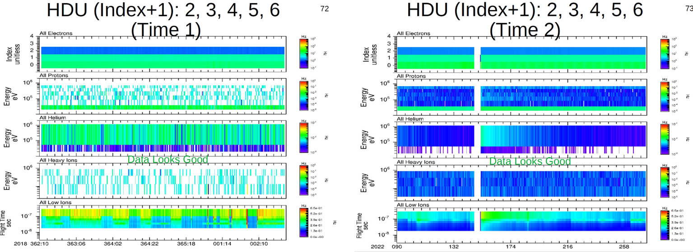
kem1_cal
Rudy’s plots show that the KEM1 calibrated data look good
Weak TOF vs Energy signal matches
similar PHA result from FV for this data
file (2022-04-08)
Plots courtesy of R. Frahm

Slide 17
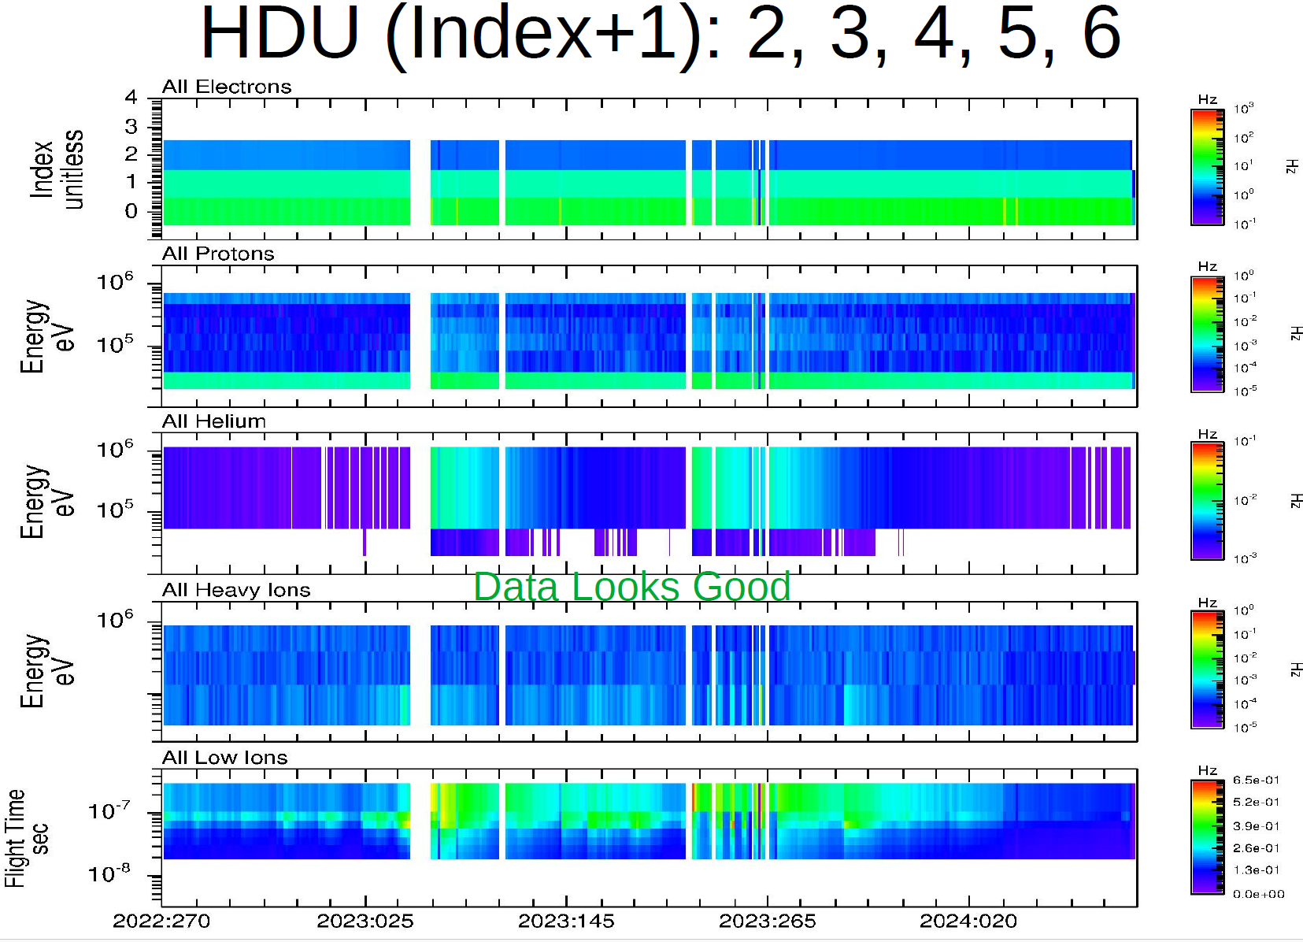
kem2_cal
Rudy’s plots show that the KEM2 calibrated data look good
Plot courtesy of R. Frahm

Slide 18
Summary of Liens
Editorial Comments:
PDS4 Validate has issues with all of the metadata that I reviewed. It’s not clear to me that the
metadata are wrong, it could be an problem with the software or accessing the correct files at
the ENG Node. SBN should investigate. Rudy seemed to be running the same version of
validate (3.6.3) without any issues.
Overall I was able to read and understand the documentation. However other users familiar
with the PDS3 structure and content might benefit from a “readme” file that explains the
locations of familiar files (catalog, document) in either the Mission or the PEPSSI bundles
Mission Bundle Liens:
pluto_ao_pdfa1b.pdf needs to be converted to PDF/A-1b
PEPSSI Liens:
1) The missing PEPSSI_BTI_GoodTimeIntervalsBadTimeIntervals_2022_149.txt
either needs to be provided in the documents directory or the soc_inst_icd needs to be
modified so that it refers to the “pep_bti.tab” file.
2) Fix “containscoefficients” typos in hk_n1_input_20050228 and
hk_stat_input_20041016 (.lblx)
Rudy found several minor issues that I missed. These problems also need to be corrected
Certification: The data are scientifically useful as currently provided. The liens are
minor and should be corrected quickly.

