Slide 1
Review of Lucy LEISA Data Archival Plan
Karl Hibbitts
10/17/2025

Slide 2
Bottom Line Up Front
Goal: check delivery by attempting to derive a radiance spectrum from the calibrated data of one observation containing DJ and by attempting to derive calibrated data from one frame of the file of uncalibrated and compare to the derived calibrated data
1. Downloaded the bundle review. All folders look populated. Although the file: collection_overview.txt is empty, the .xml is populated. It gave a basic description. Collection. Xml doesn’t seem to have much information. Most of the .xml files seem this way.
2. The document/LRalph_LEISA_activies.pdf has very useful big-picture insights into the data, such as which images contained resolved DJ and the fact that, although readily apparent, the operating temperature was often outside the calibrated range of 103 with calibration possible to 117K.
3. Successfully opened *2601 and displayed in PDS4 viewer. I find the object moved about 2.0195 pixels per frame, on average; not the ~ 1.53 pixels per integration time (which I took to be frame rate), which was stated relevant to Dinkinesh. So, I’m curious as to the apparent discrepancy.
4. Successfully opened the wavelength file. However, why do the wavelengths only begin after the bond gap, at 2.7um?
5. The derived an unrefined radiance spectrum but it doesn’t look too much like a solar spectrum convolved by a primitive asteroid, and a derived ‘I/F’ spectrum appears ‘wrong’ as well. Let’s confirm procedure.
6. I was unable to derive calibrated data from raw data because the size the flatfield (there were two) did not match the size of the image. Also, no BPM was provided.

Slide 3
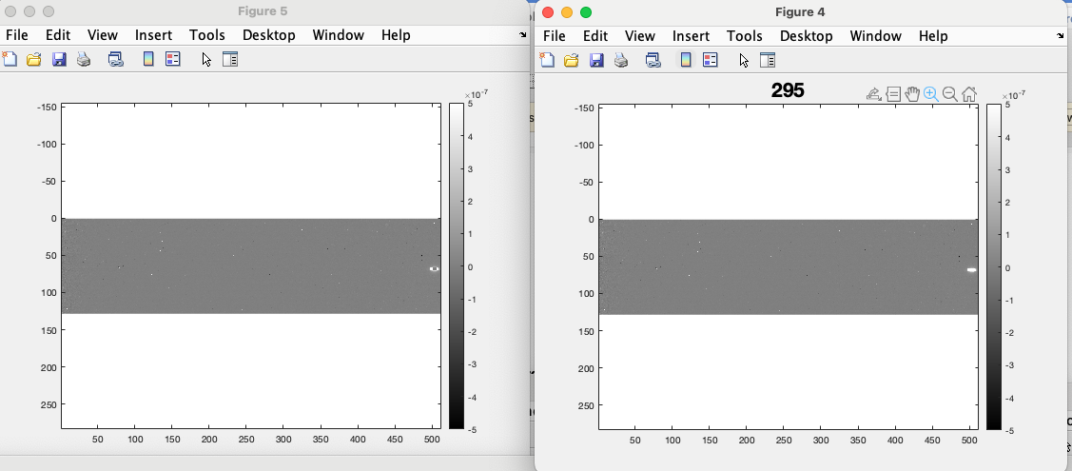
A random screen capture of the calibrated data
Step number:
Each step is ~2.0195 pixels
Shows the ROI used
Frame Number
Frame Number

Slide 4
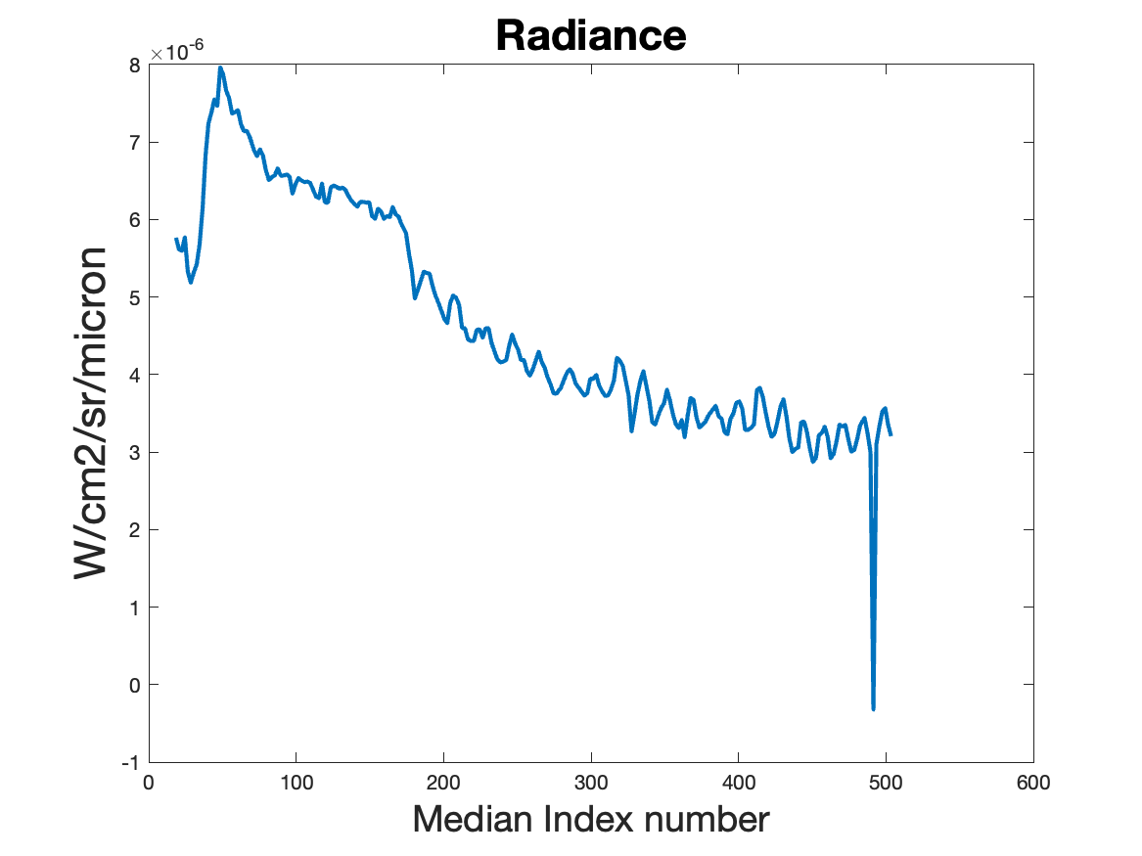
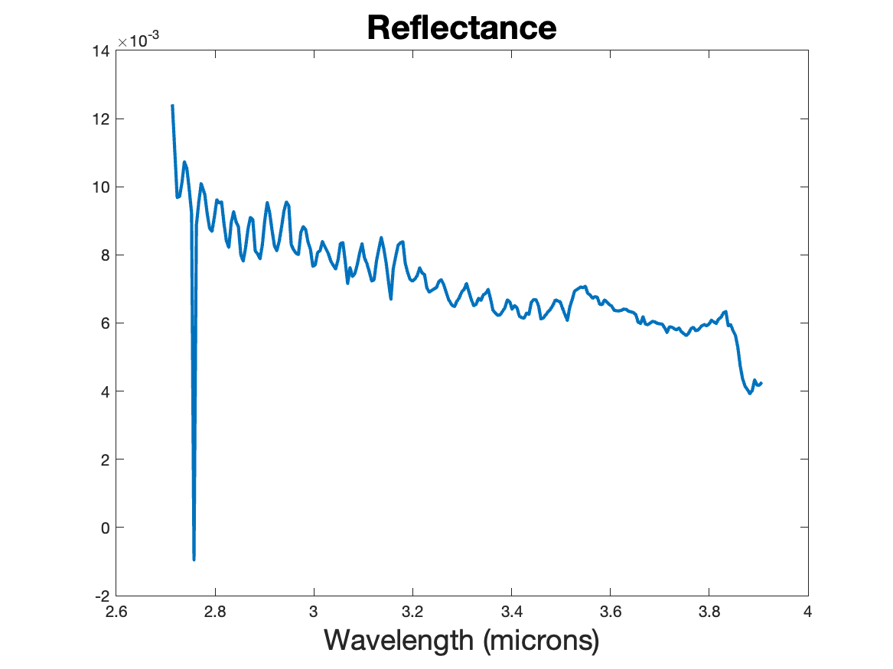
Analyzing Calibrated Data
lei_0798441080_02601_sci_04.fit
Is the overall shape as expected? And is the drop in radiance longward of 3.8um due to saturation? If so, should that be included in the calibrated data?

Slide 5
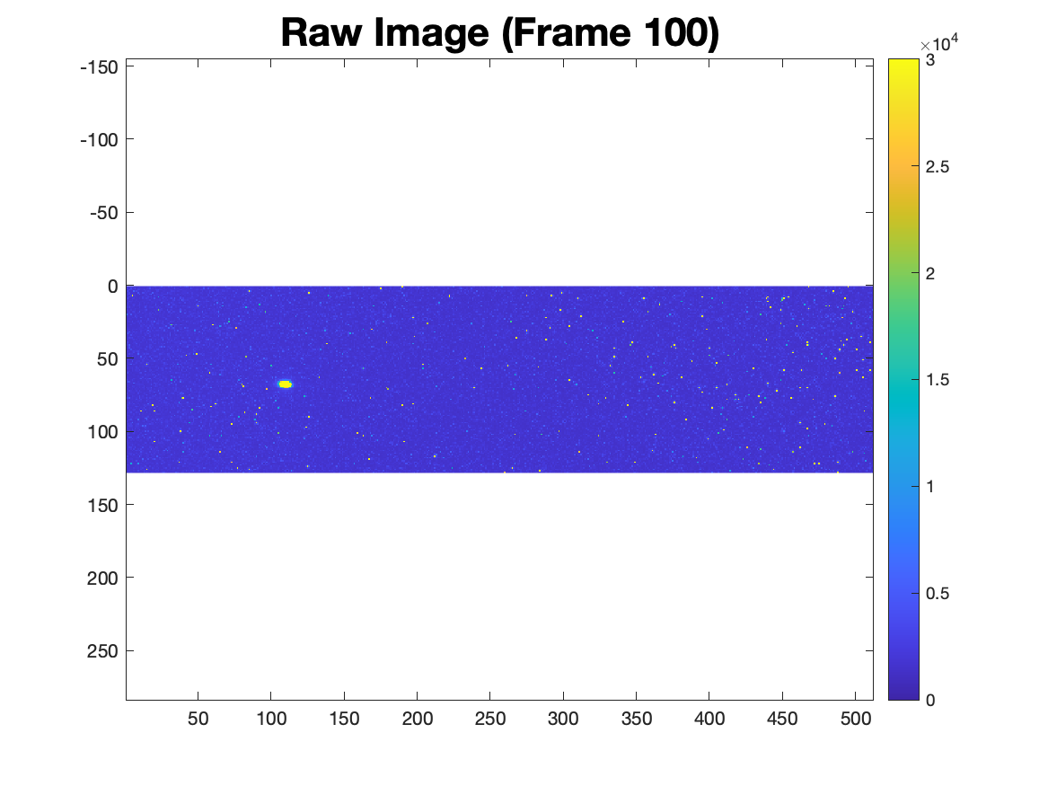
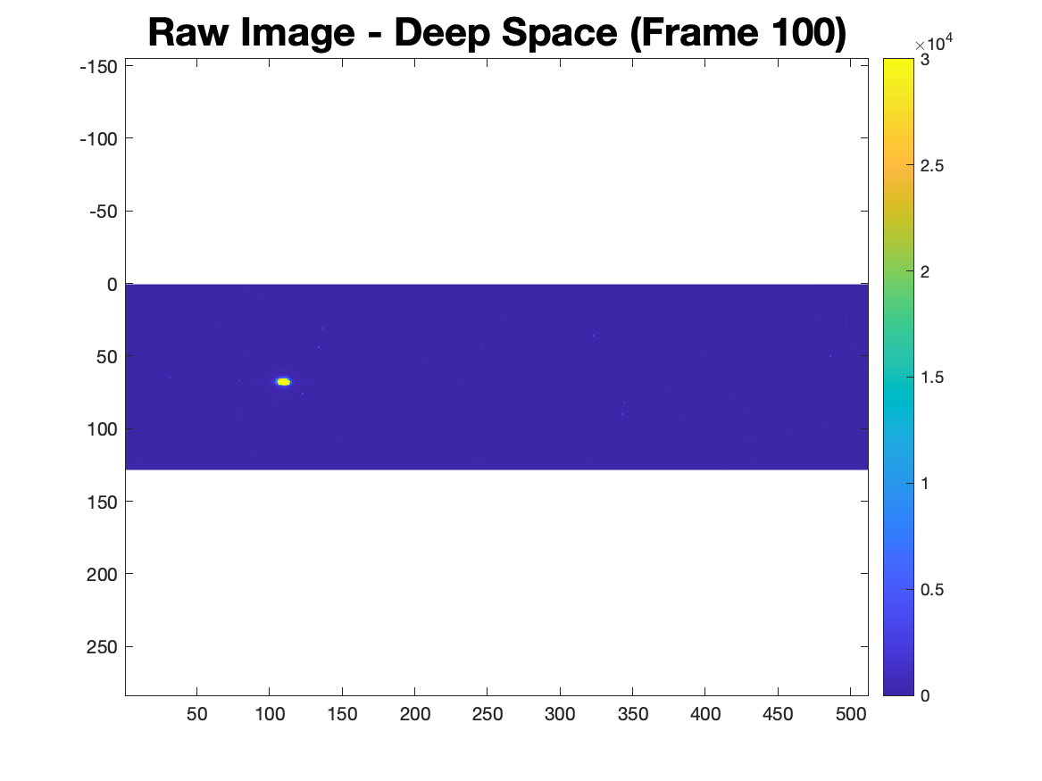
Calibrating Raw Data

Slide 6
Calibrating Raw Data
Was able to open raw file and deep space
However, no BPM was provided (as stated) but also was unable to apply the flatfield. There were two and not clear which should be used. Also, both FF were no the expected size.
lei_0798442993_02607_fflat_02.fit 52 x 1472
lei_0798443214_02610_fflat_02.fit. 200 x 704
Integration time was able to be calculated. From metadata: integration_time=1019.0 ms
From calibration instructions: LEIINT = (XTNUM + 3 + (2048 - XTNUM) / 144 + DF) * 0.72ms
LEIINT = (128 + 3 + (2048 - 128) / 144 + 1271) * 0.72ms = 1019.0 ms
The array temperature is -157C (120K). Thus, outside calibration range, which was stated might be the case.
Was unable to locate the appropriate radiometric conversion file.

