Slide 1
L’Ralph LEISA PDS Review
Adam McKay

Slide 2
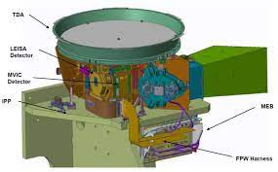
L’Ralph/LEISA Overview
Successor to similar instruments on New Horizons and OSIRIS-REx
“Push-broom” Imaging IR spectrometer, covering 0.95-4 microns
Scans across target to obtain image cube with spectral information

Slide 3
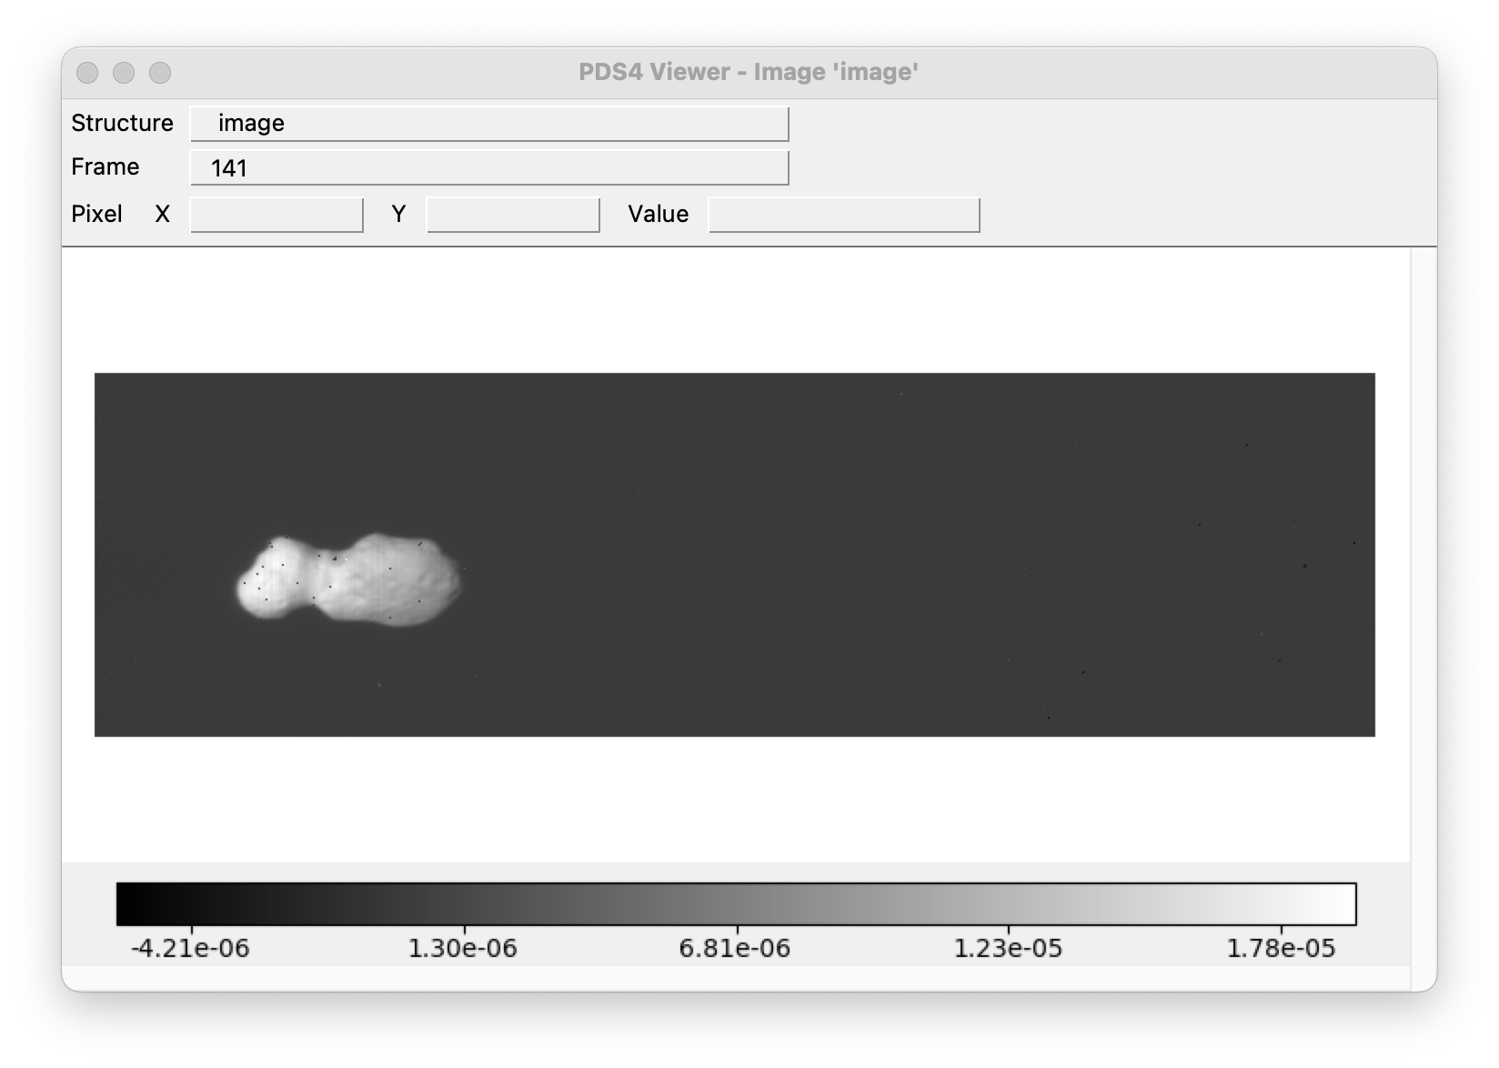
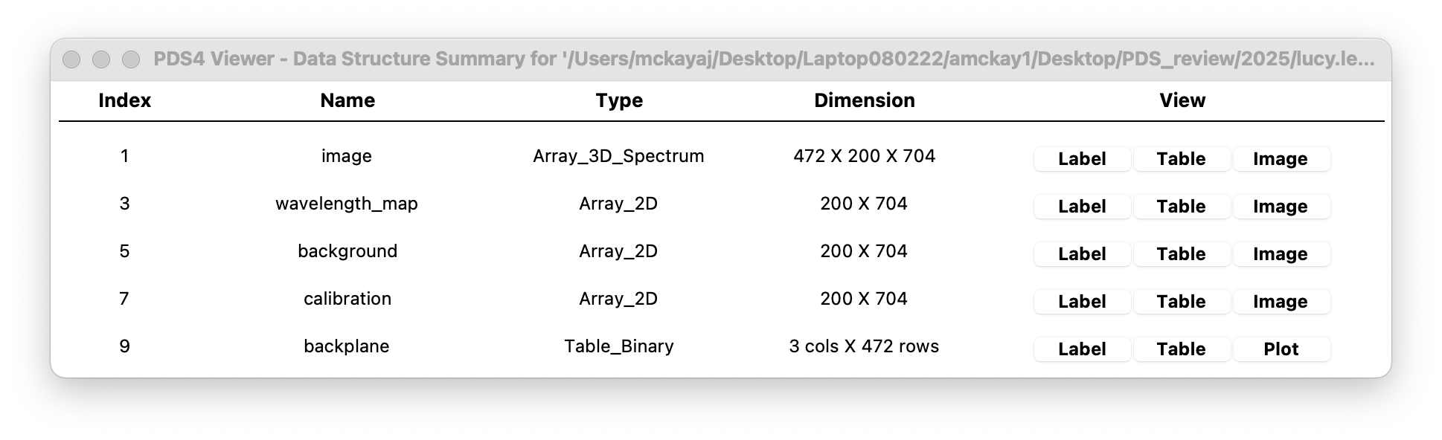
Donaldjohanson
Observations during the Donaldjohanson encounter, engineering and science calibrated data, also includes some of the calibration files
Most data look OK! Headers informative and well organized
Delivery also includes XML files for all data, look OK

Slide 4
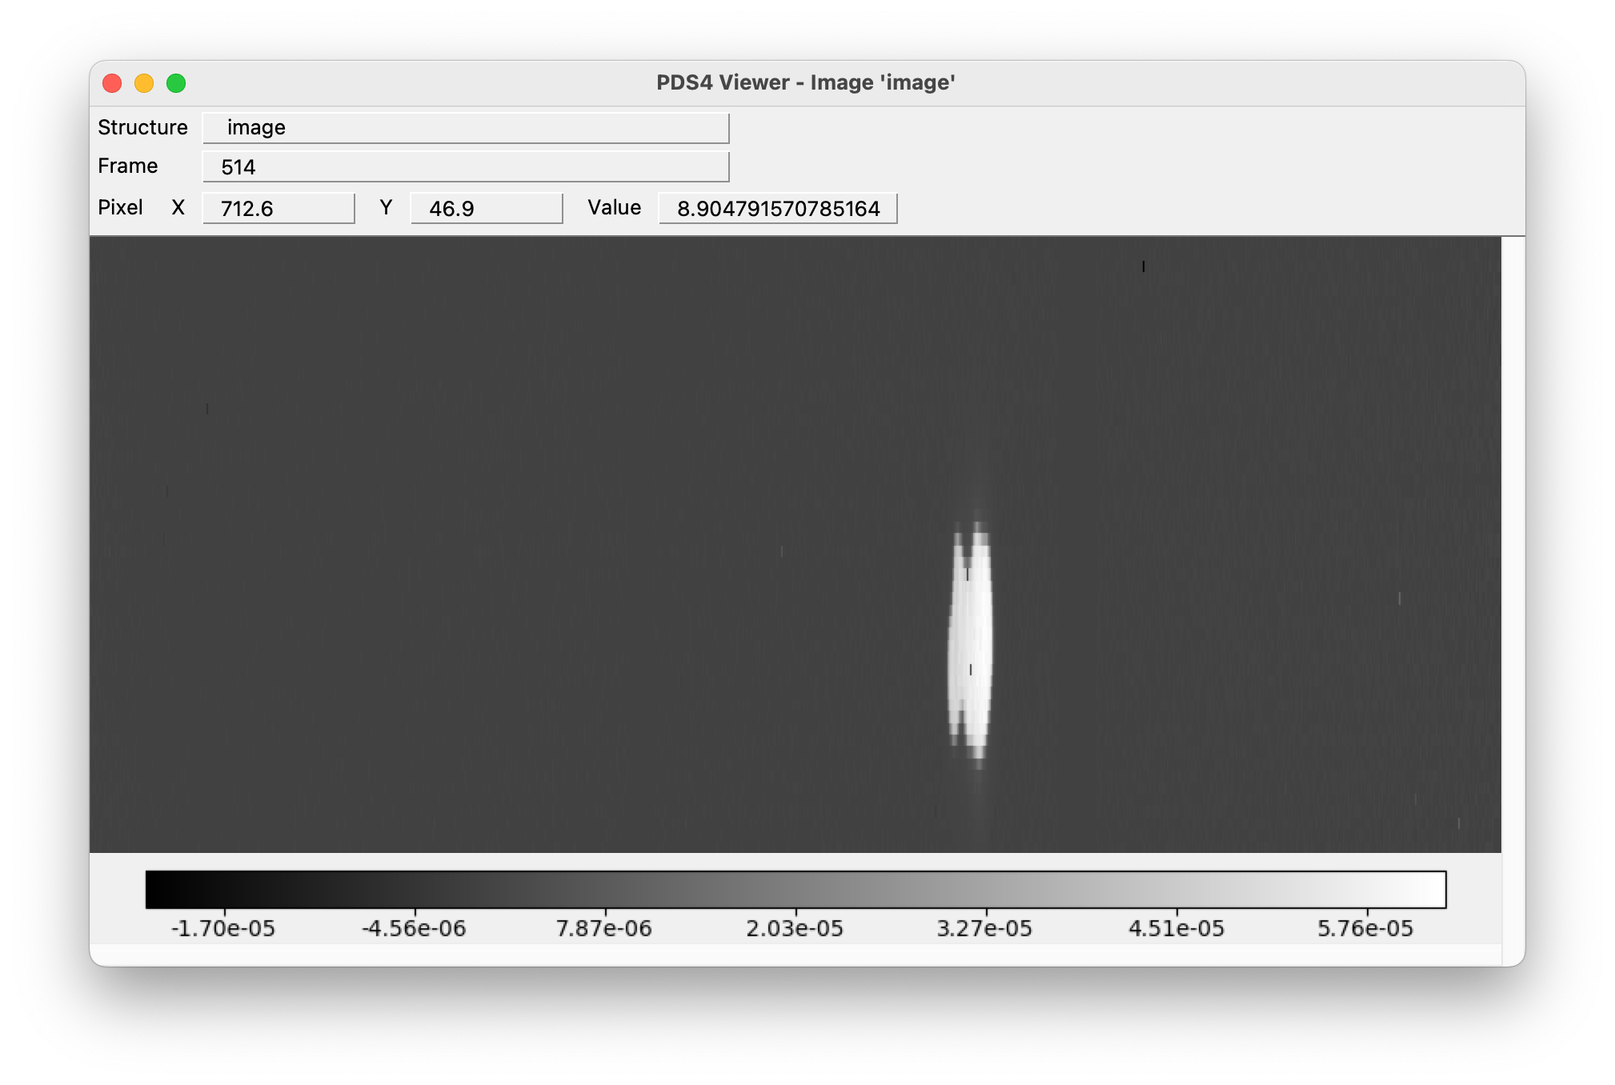
Engineering and Science Data
Image with ending 607 looks stretched out vertically, intentional?
Data has variety of sizes, reflects different scan strategies? Also seems most are split into short wavelength (1-2.4 microns) and long wavelength (2.4-4 microns) files, except for 607 and 610

Slide 5
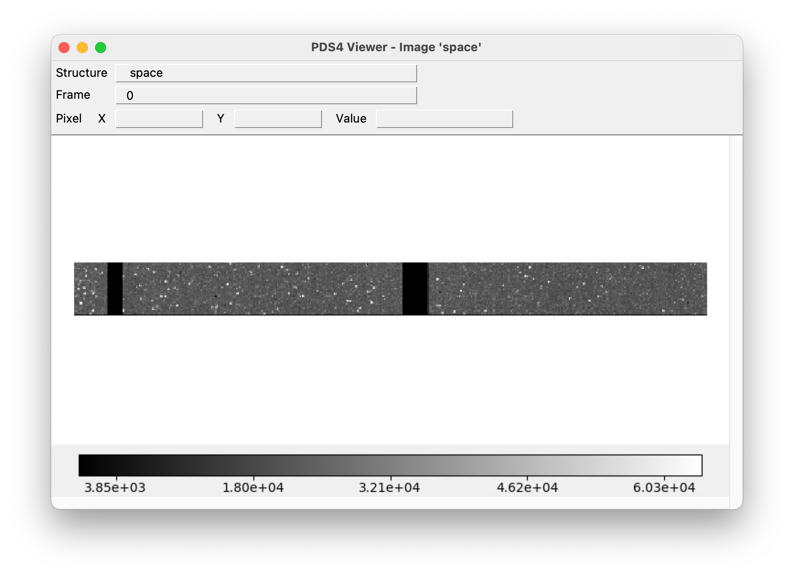
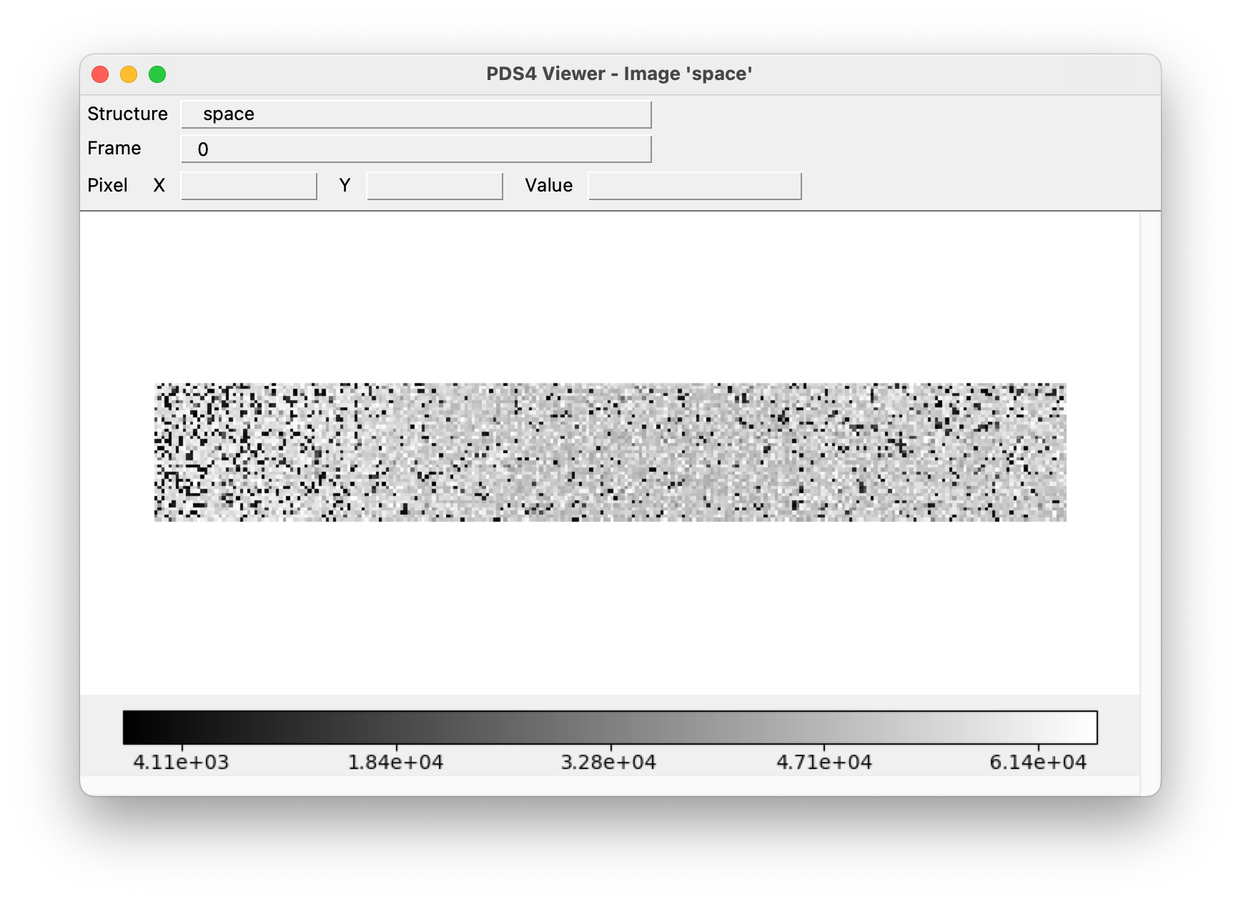
Calibration Data
Includes only backgrounds (space) and fringe flats
Wavelength, Radiometric Calibration, and Background included as extensions of calibrated science data, no bad pixel masks in this delivery
Space files seem to have two different appearances and sizes (which alternate), but I think this just reflects the short and long wavelength coverage of the data?

Slide 6
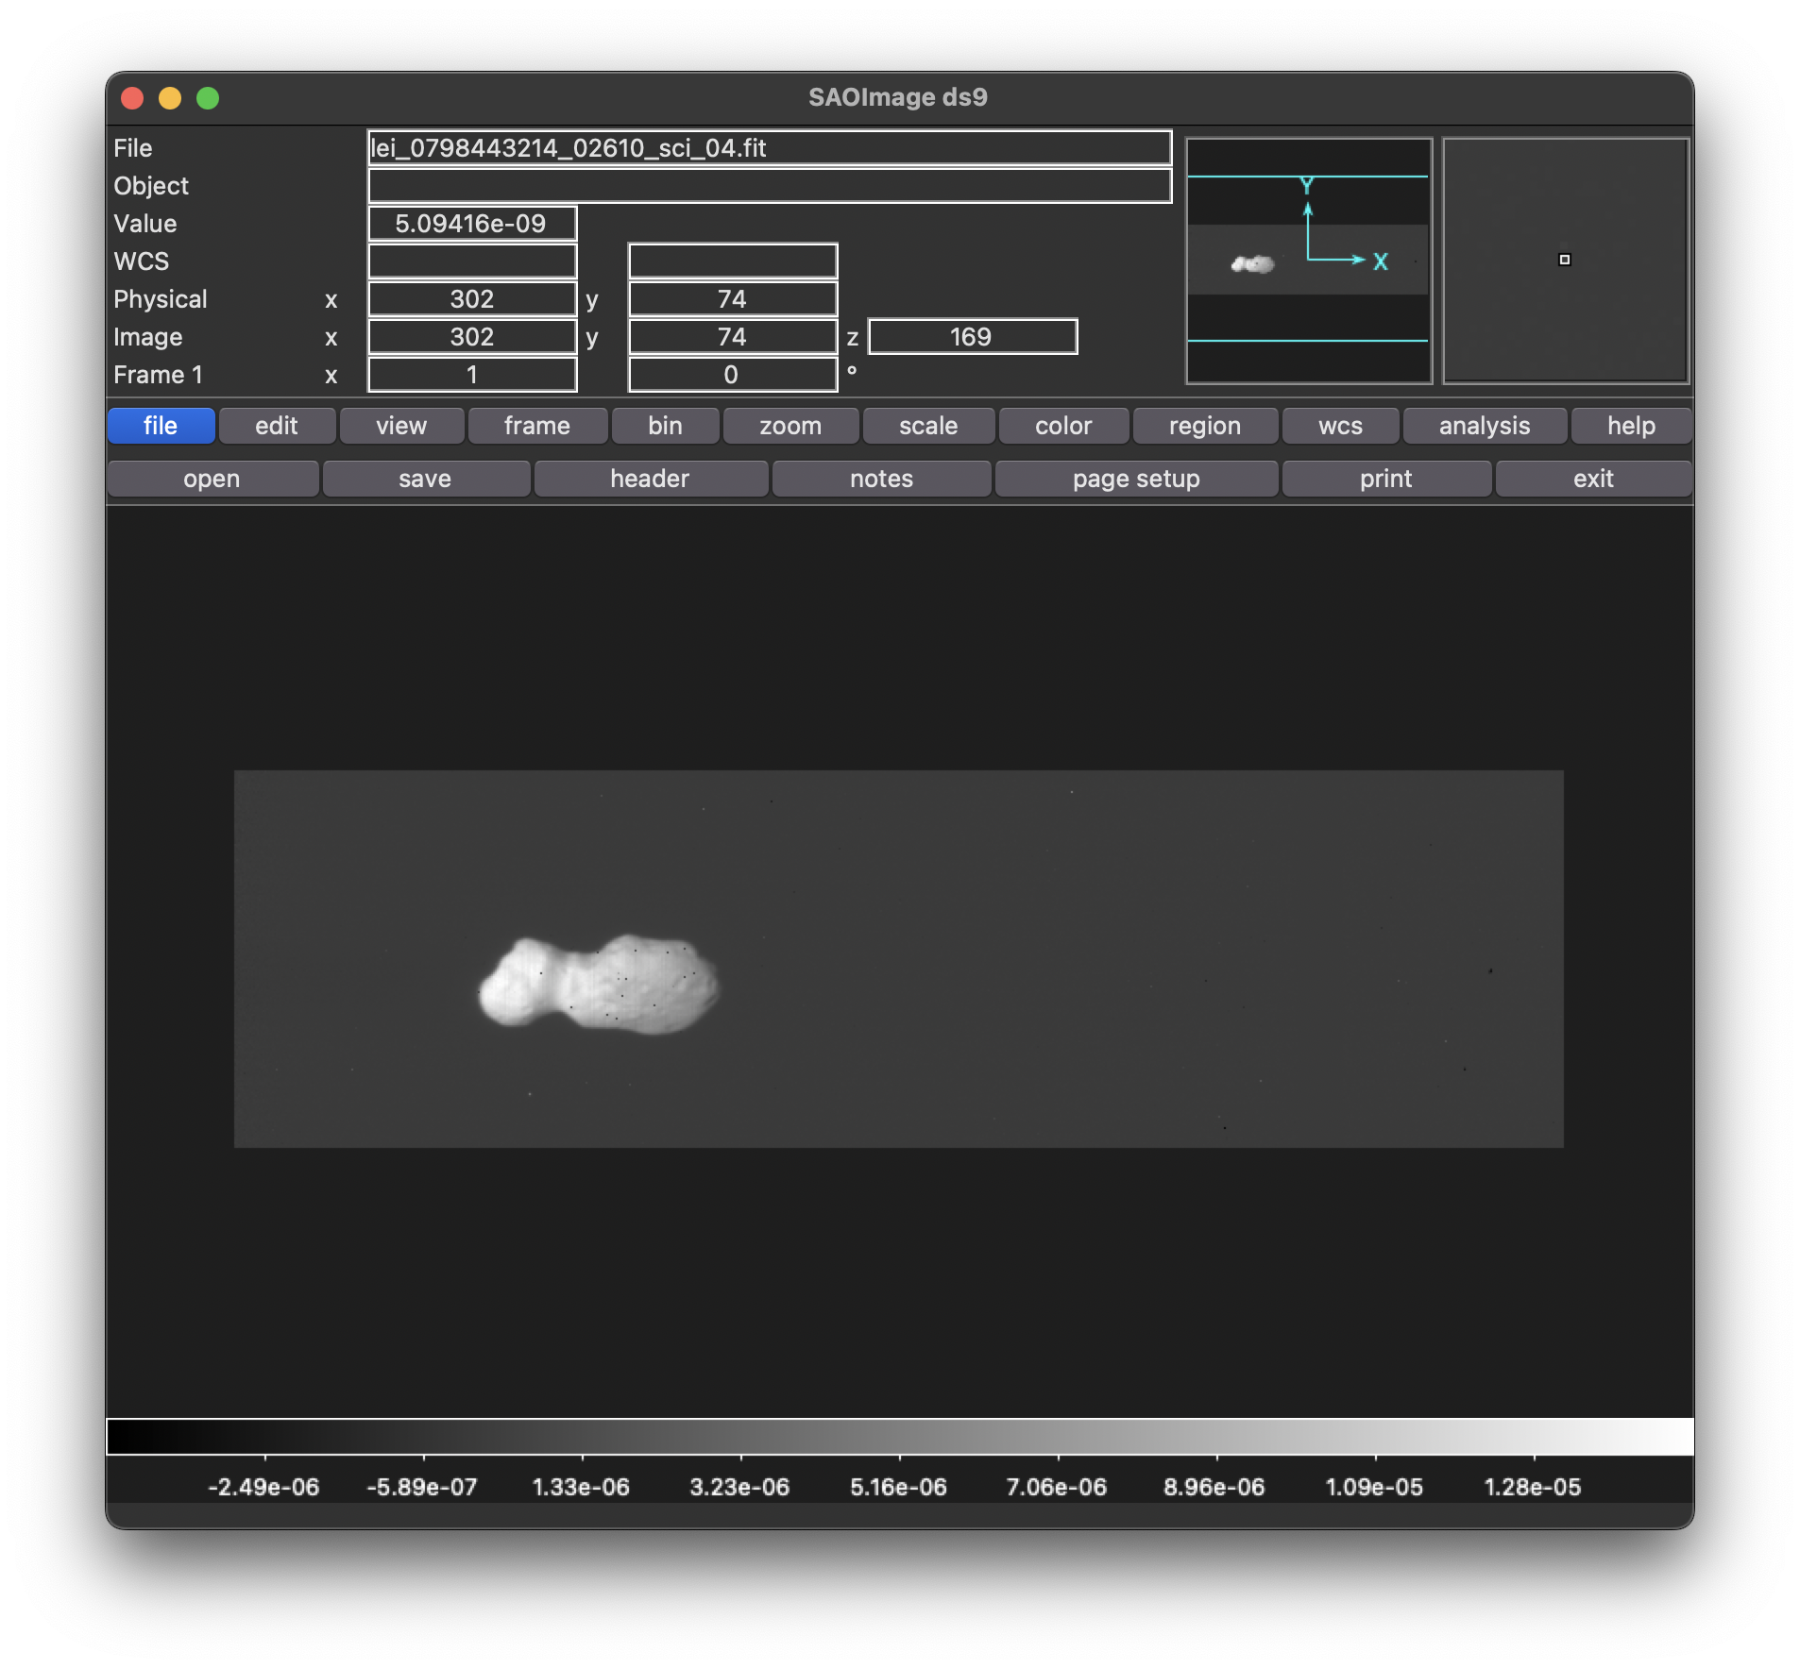
Displaying Data
For all files, able to open in both DS9 and PDSViewer4, no issues

Slide 7
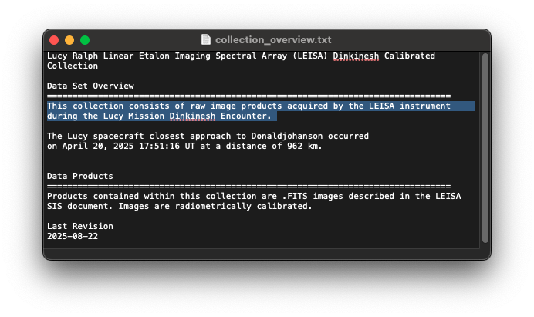
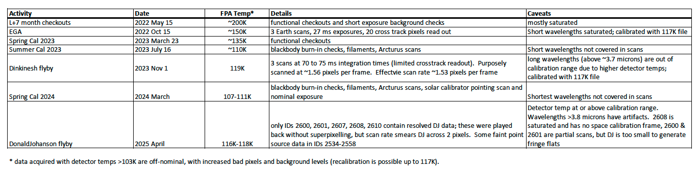
Documentation
Includes documentation that is generally in good order, a few typos and corrections needed
In Document Folder, collection_overview.txt file is empty (should it be?)
In Calibrated Folder, collection_overview.txt first sentence needs to be updated to say calibrated data from Donaldjohanson encounter, not raw from Dinkinesh, also title
In LRalph_LEISA_activities.pdf, typo in word “effective” for details column of Dinkinesh flyby
In Calibration folder, collection_overview.txt-under Bad Pixel Map Heading, “file” should be plural

Slide 8
Other General Questions
In LRalph Activities PDF, asterisk note on table for temperature notes that T > 103K are off-nominal. So is all data included in these submissions considered off-nominal?
In Post-Processing document for fringing, is the algorithm described something that will be included as a tool for users to use, or is it just the description of what should be done?
README.txt under calibrated data collection says it “contains partially processed images”. Does this just refer to the fact that they haven’t had the post-processing with the fringe flats?

Slide 9
Conclusions
Data is certifiable, as long as inconsistencies in data sizes are correct and image 607 is supposed to be stretched out
Some fixes to documentation needed

