Slide 1
Lucy Donaldjohanson L’LORRI Review
Adeline Gicquel
October 16-17, 2025

Slide 2
Dataset overview
Validation passed EXCEPT for some collection.xml (see later)
PDS4 XML labels accurately describes the data when using he PDS4 Viewer.
The values in the PDS3 fits header and PDS4 XML labels are identical
Bundle file – No problem
Two modes 1x1 and 4x4
2259 Raw data (1843 1x1 + 416 4x4)+ labels
1x1: Primary 2D image 1024 x 1028 (L'LORRI observational image) – Unit (DN)
4x4 : Primary 2D image 256 x 258 (L'LORRI observational image) – Unit (DN)
1x1 and 4x4: 3 Extensions 1D array (Histogram, Image Header, Image Descriptor) – Unit (DN)
716 TEST_IMAGE (714 1x1 + 2 4x4)
2259 Partially Processed data (1843 1x1 + 416 4x4) + labels
1x1 : Primary 2D image 1024 x 1024 (L'LORRI observational image) – Unit (DN/s)
1x1: 2 Extensions 2D images 1024 x 1024 (Error, Quality Flag) – Unit (DN/s)
4x4 : Primary 2D image 256 x 256 (L'LORRI observational image) – Unit (DN/s)
4x4 : 2 Extensions 2D images 256 x 256 (Error, Quality Flag) – Unit (DN/s)
716 TEST_IMAGE (714 1x1 + 2 4x4)

Slide 3
Collection files - Raw and Partially Processed data
collection.xml
You should add the <Primary_Result_Summary><purpose>Calibration because you have files that are TEST_IMAGE described as “Calibrator” types in the data labels
I’m getting an error for the raw collection file: The primary member 'urn:nasa:pds:lucy.llorri:data_donaldjohanson_raw:collection_overview' should include the version number
collection_inventory.csv
No problem.
collection_overview.txt
No Problem
collection_overview.xml
No Problem

Slide 4
Raw and Partially Processed data
The target name should probably always be in this format (52246) Donaldjohanson instead of DONALDJOHANSON
You could add the target NAIF ID if applicable: <Discipline_Area><geom:Geometry><geom:Geometry_Orbiter><geom:Orbiter_Identification><geom:Geometry_Target_Identification><geom:body_spice_name>
For the test images. See lor_0798446314_04697_00001_1x1_sci_03.xml
It should not be Science for the <Primary_Result_Summary><purpose>
The name TEST_IMAGE is producing warning in the validation report <Target_Identification><name>
You can remove geom:Orbiter_Identification because it’s empty <Discipline_Area><geom:Geometry><geom:Geometry_Orbiter><geom:Orbiter_Identification>

Slide 5
Raw and Partially Processed data
Possible missing attribute?
<Discipline_Area><ebt:Earth_Based_Telescope_Parameters><ebt:Telescope_Geometry><ebt:SIP_Distortion_Terms><ebt:AP_ORDER><ebt:polynomial_order>3
<ebt:p_polynomial_degree>0</ebt:p_polynomial_degree> <ebt:q_polynomial_degree>2</ebt:q_polynomial_degree>
<ebt:p_polynomial_degree>2</ebt:p_polynomial_degree> <ebt:q_polynomial_degree>1</ebt:q_polynomial_degree>
<ebt:p_polynomial_degree>0</ebt:p_polynomial_degree> <ebt:q_polynomial_degree>3</ebt:q_polynomial_degree>
<Discipline_Area><ebt:Earth_Based_Telescope_Parameters><ebt:Telescope_Geometry><ebt:SIP_Distortion_Terms><ebt:BP_ORDER><ebt:polynomial_order>3
<ebt:p_polynomial_degree>2</ebt:p_polynomial_degree> <ebt:q_polynomial_degree>0</ebt:q_polynomial_degree>
<ebt:p_polynomial_degree>3</ebt:p_polynomial_degree> <ebt:q_polynomial_degree>0</ebt:q_polynomial_degree>
<ebt:p_polynomial_degree>1</ebt:p_polynomial_degree> <ebt:q_polynomial_degree>2</ebt:q_polynomial_degree>

Slide 6
Raw data
You need to revise the <Reference_List><Internal_Reference>.
If you want to include the calibration files. Then you need to include the ones that are specific to this dataset dj_auto_flat_1x1.xml and dj_auto_flat_4x4.xml
Or you can remove then because this is the raw collection

Slide 7
Partially Processed data
You still have calibrated instead of partially processed in the <Identification_Area><Citation_Information><description>
You have the time offset corrections in the <Reference_List><Internal_Reference> and the FITS Header but nowhere it’s listed in the SB dictionary <Discipline_Area><sb:SB_Metadata><sb:Calibration_Information><sb:Calibration_Applied> and <Discipline_Area><sb:SB_Metadata><sb:Calibration_Information><sb:Calibration_Reference_Files>
For example, <lid_reference>urn:nasa:pds:lucy.llorri:calibration:llorri_toffsets_4x4</lid_reference>
This is listed twice <Reference_List><Internal_Reference><lid_reference>urn:nasa:pds:lucy.llorri:calibration:llorri_superbias_1x1
This is listed twice <Reference_List><Internal_Reference><lid_reference>urn:nasa:pds:lucy.llorri:calibration:llorri_toffsets_1x1
What is the difference between llorri_flat_1x1 and dj_auto_flat_1x1? They are both listed in the <Reference_List><Internal_Reference>. But in the geo<sb:Calibration_Reference_Files> <sb:Flat_Field><sb:file_name> you only have dj_auto_flat_1x1.
Most of the <Reference_List><Internal_Reference> should be <lidvid_reference> and not <lid_reference>. For example, the calibrations files that are <lidvid_reference> in the SB Dictionary. Also, all the calibrations files that are used for the specific file should be listed int the SB Dictionary and does not need to be repeated in <Reference_List>/<Internal_Reference> .

Slide 8
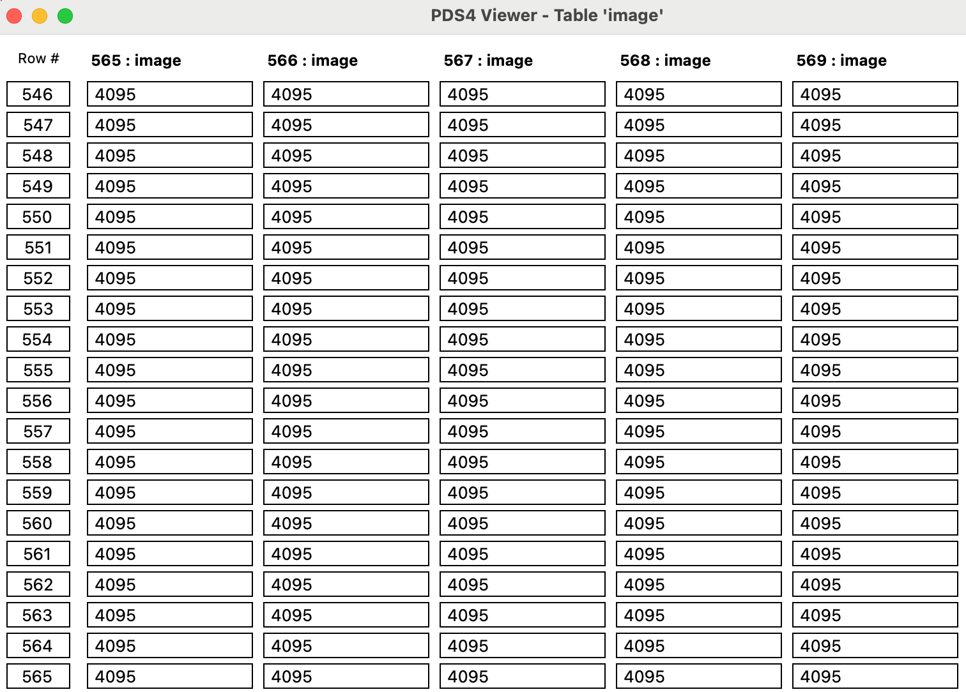
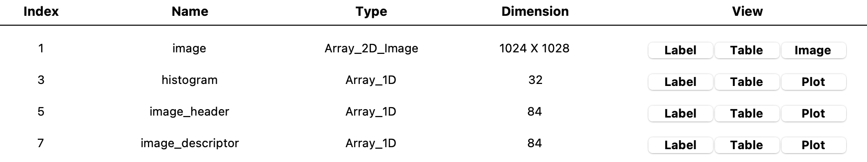
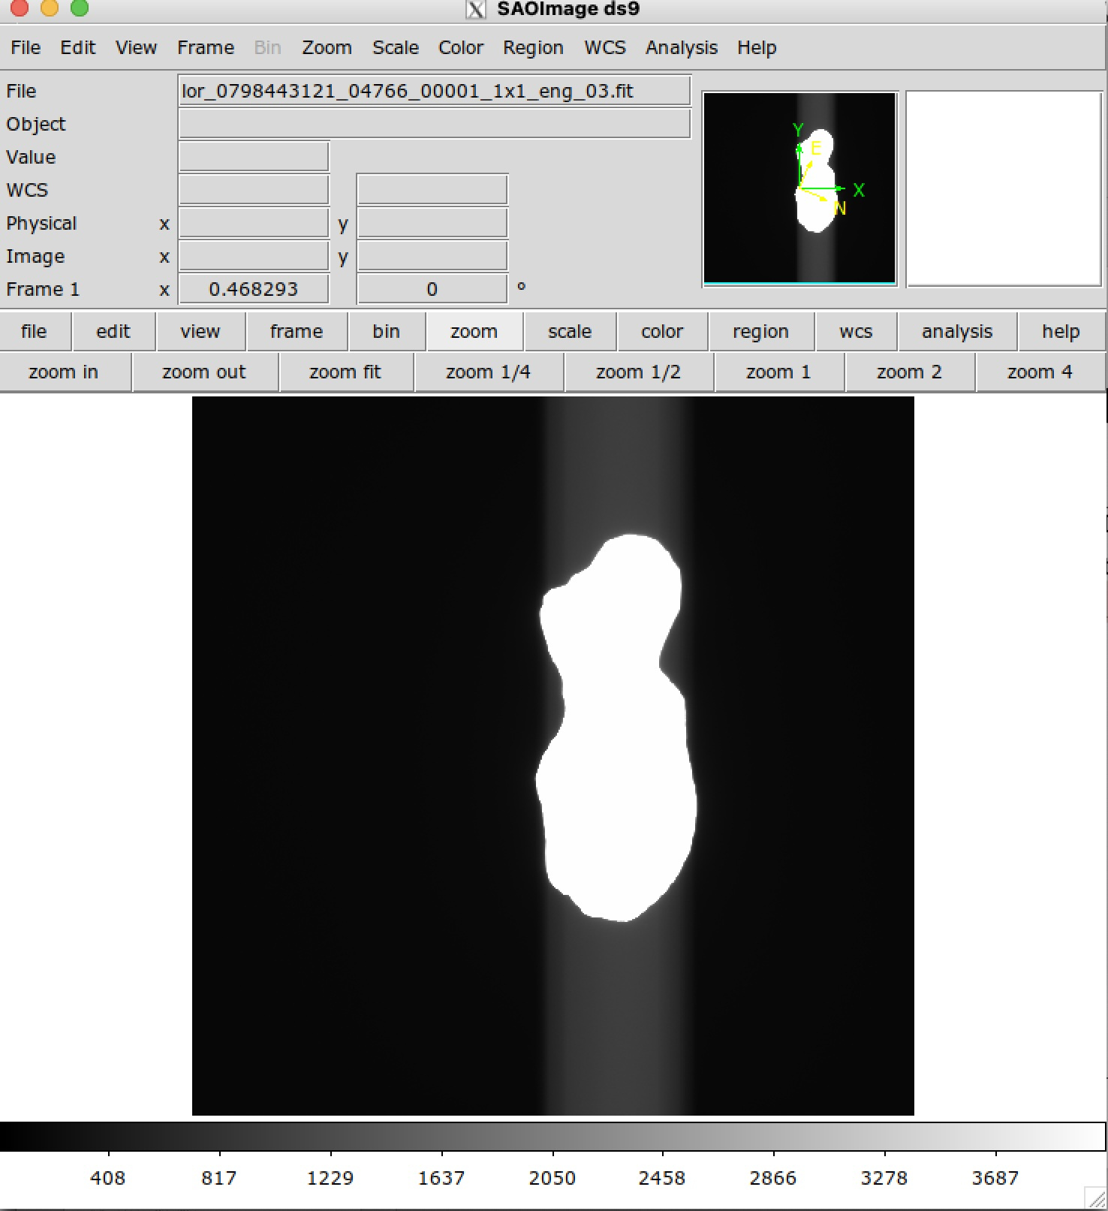
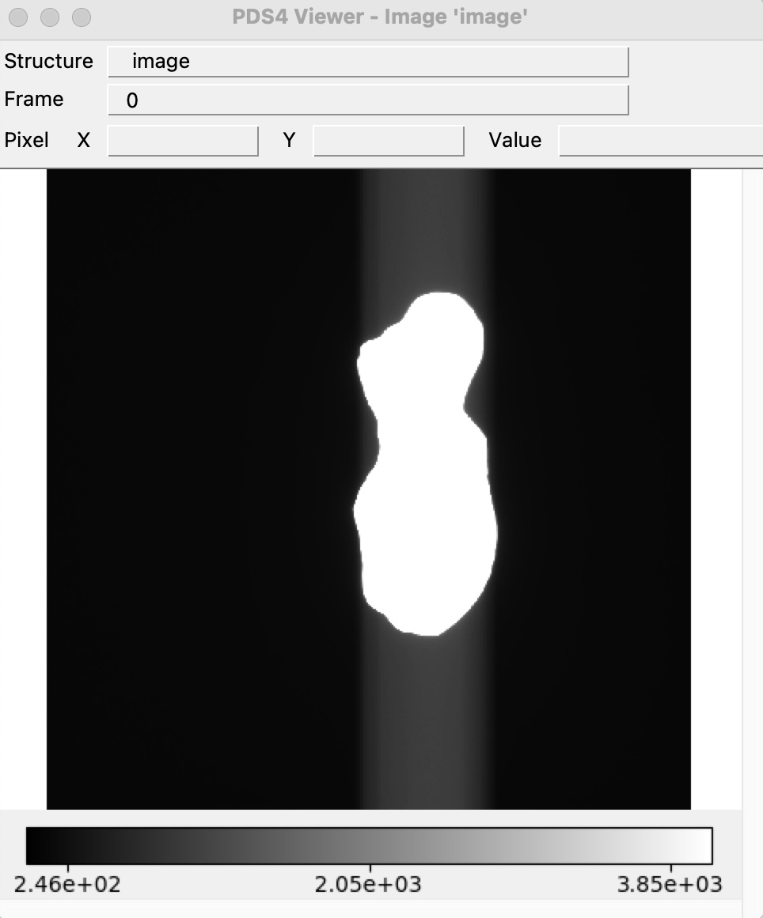
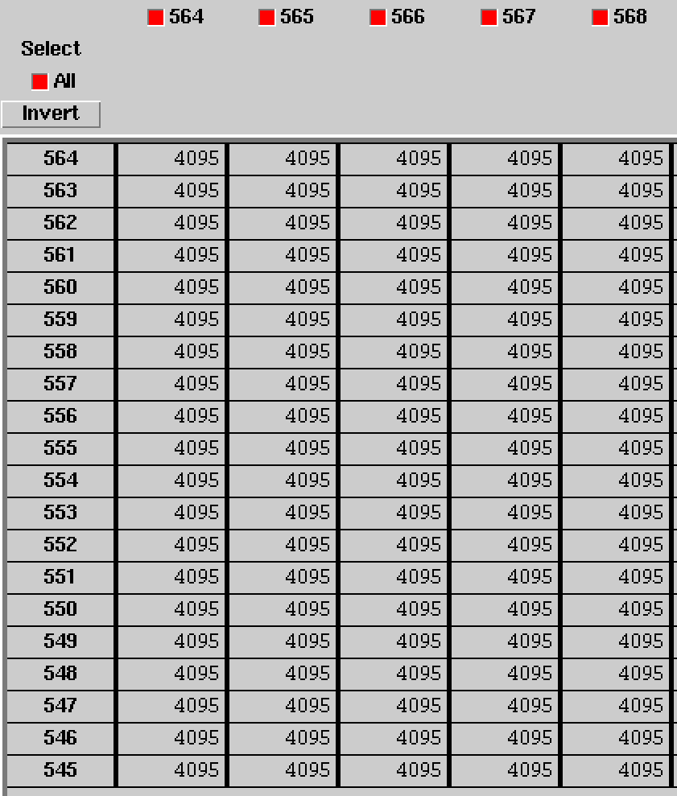
Raw Data - Primary data 1x1
No difference in display between DS9, fv, and PDS4 viewer
Able to open primary data and extensions with PDS4 viewer
Example lor_0798443121_04766_00001_1x1_eng_03

Slide 9
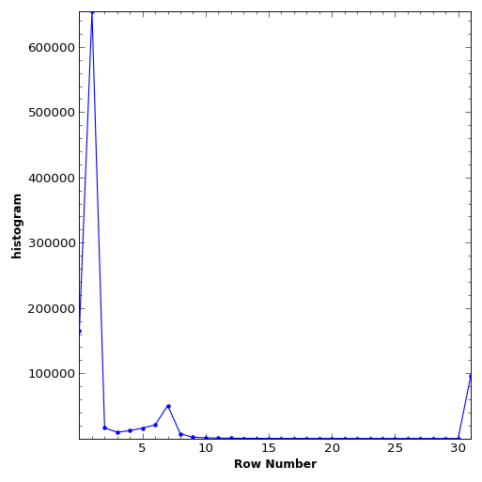
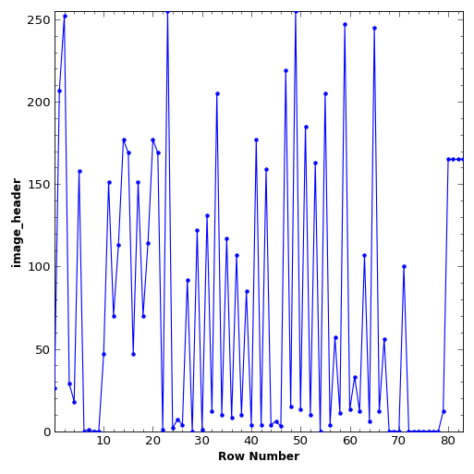
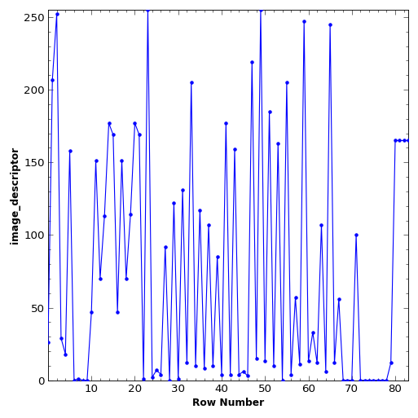
Raw Data - Extension data 1x1
The values for Image_header and Image descriptor are identical. Is that what is expected? What does that mean for Image_header and Image descriptor ?
Example lor_0798443121_04766_00001_1x1_eng_03

Slide 10
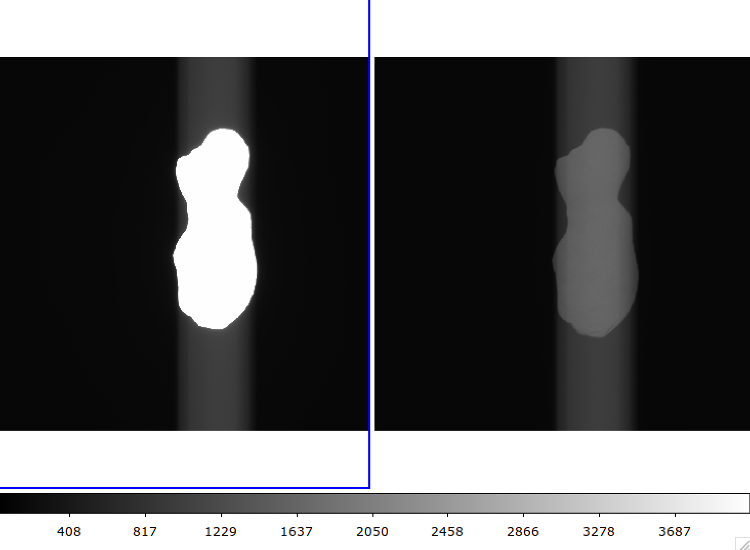
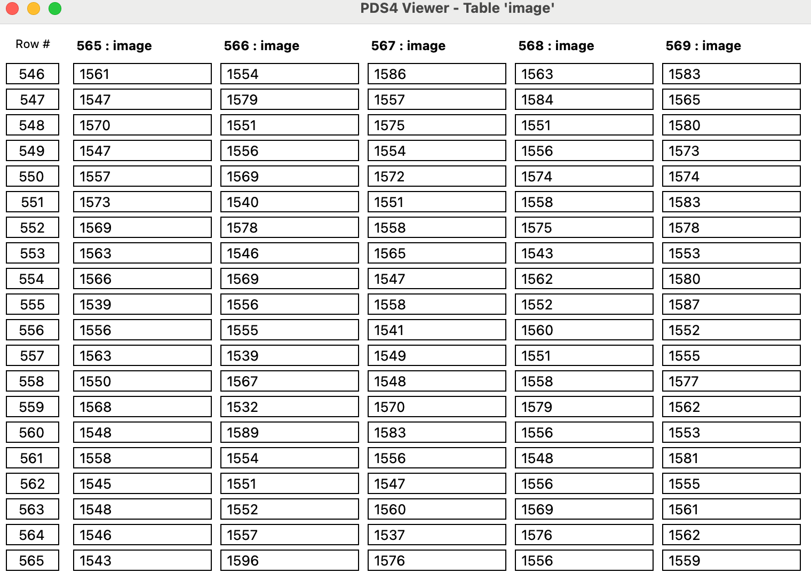
Raw Data - Primary data 1x1 Comparison
2 consecutives images
Example
lor_0798443121_04766_00001_1x1_eng_03 - <img:exposure_duration unit="s">0.09976875
lor_0798443132_04767_00001_1x1_eng_03 - <img:exposure_duration unit="s">0.005
lor_0798443121_04766_00001_1x1_eng_03
lor_0798443132_04767_00001_1x1_eng_03
lor_0798443132_04767_00001_1x1_eng_03
lor_0798443132_04767_00001_1x1_eng_03

Slide 11
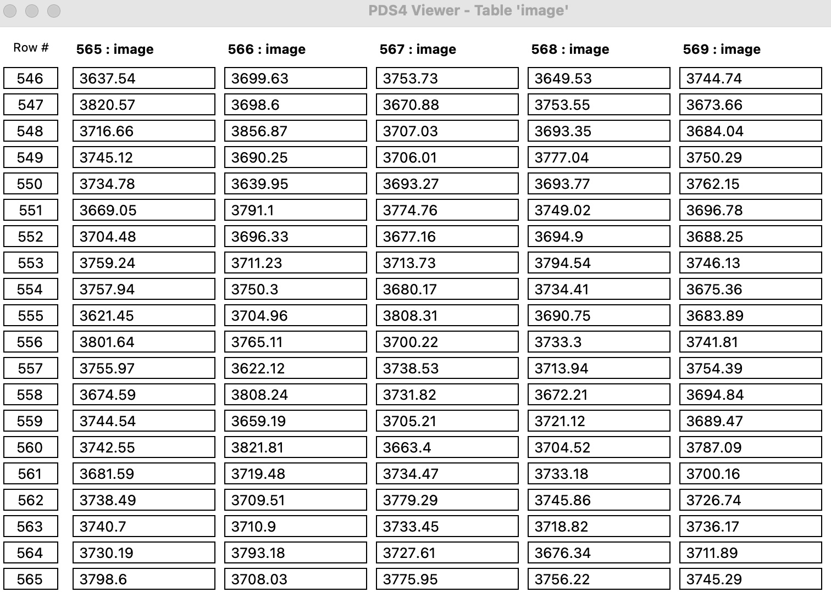
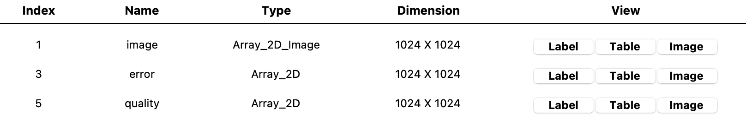
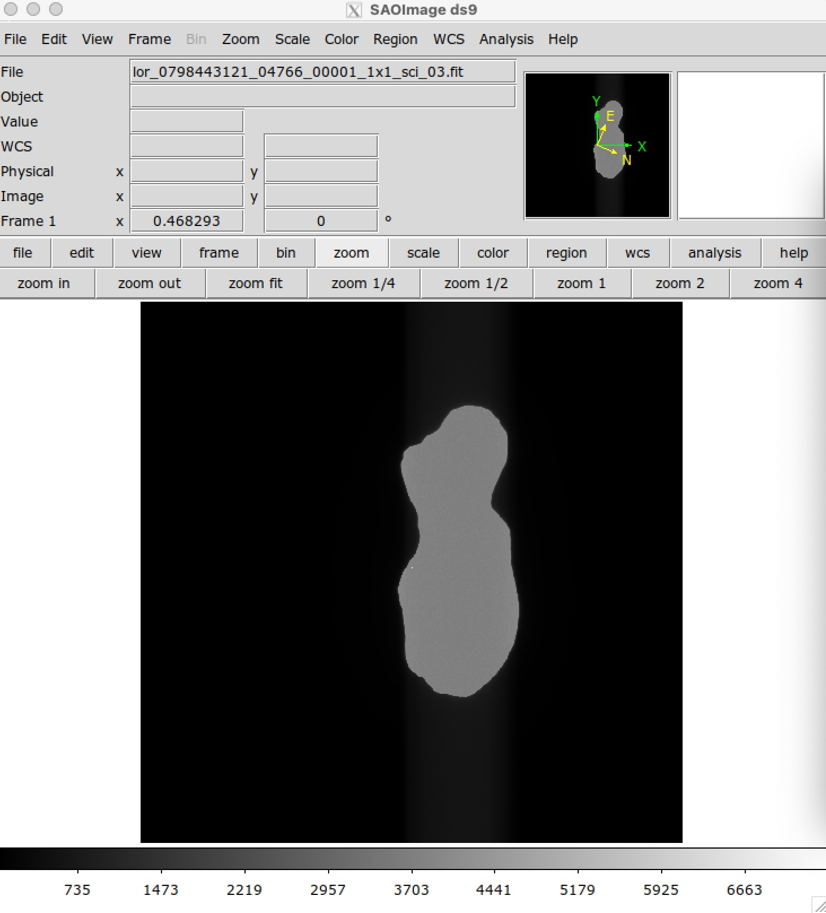
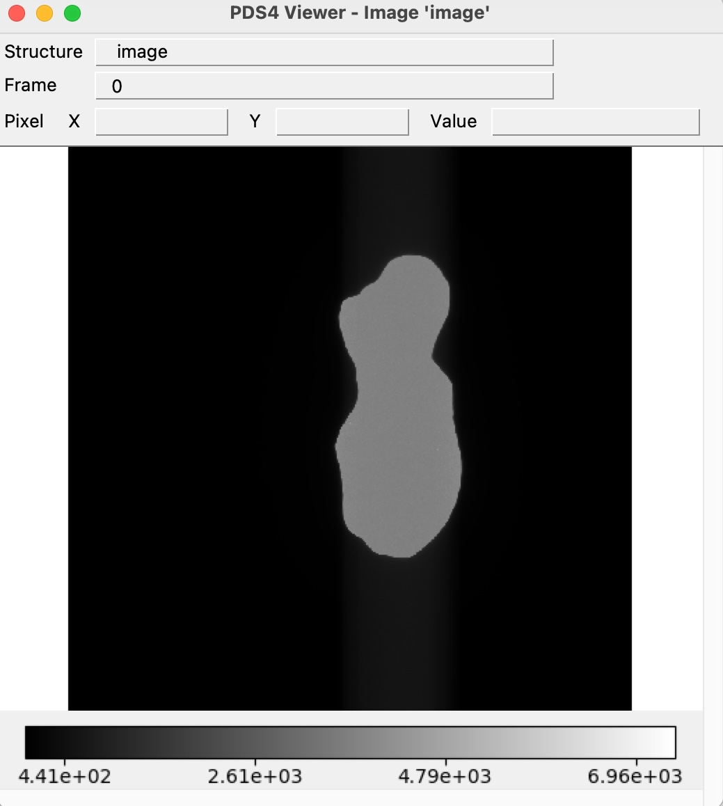
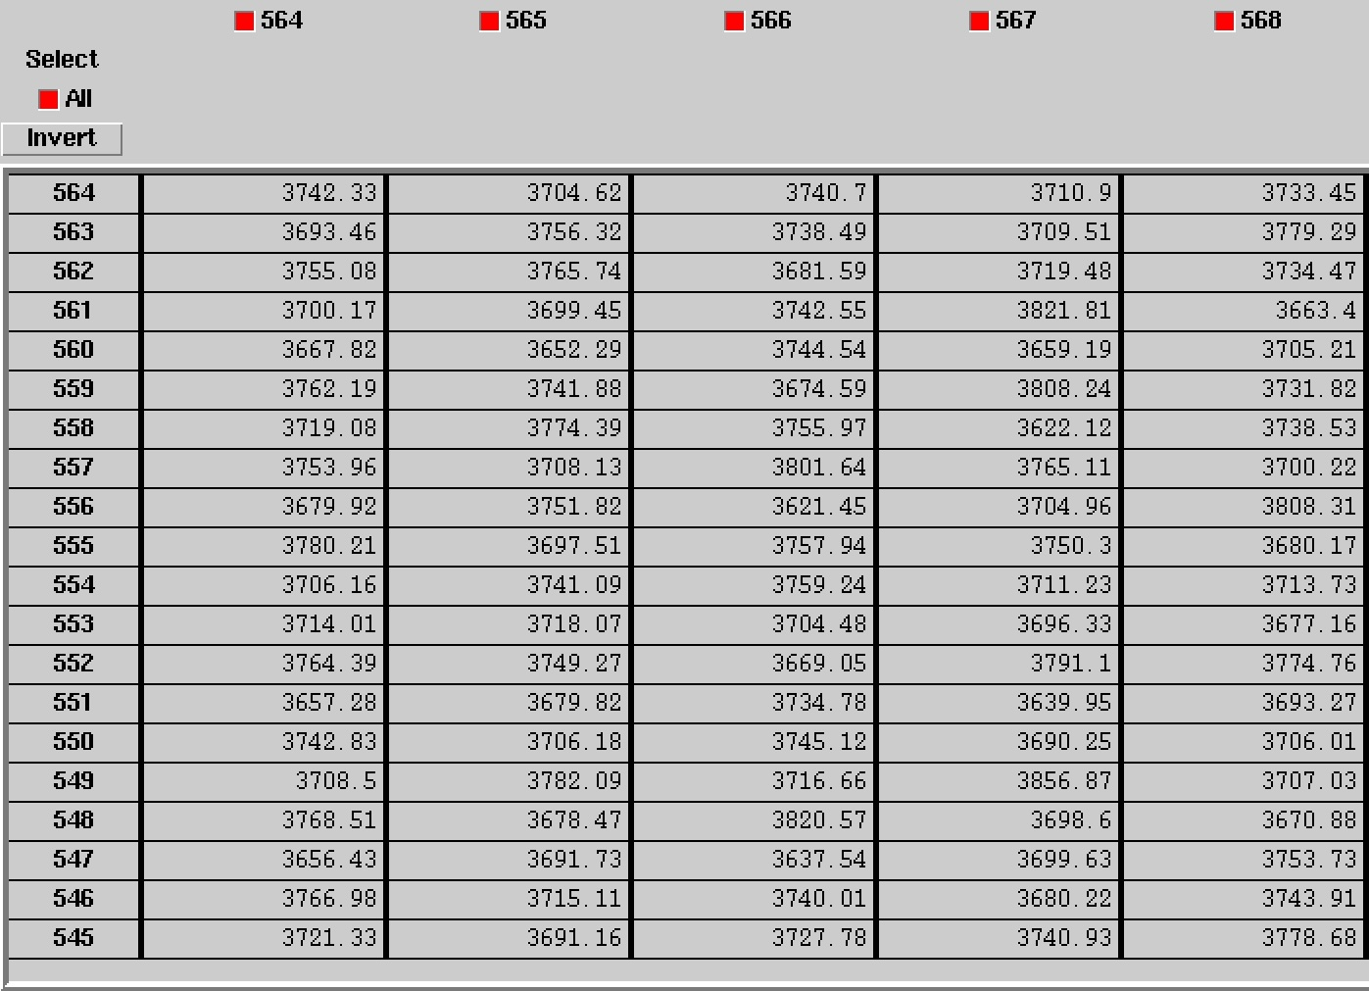
Partially Processed Data - Primary data 1x1
No difference in display between DS9, fv, and PDS4 viewer
Able to open primary data and extensions with PDS4 viewer
Example lor_0798443121_04766_00001_1x1_sci_03

Slide 12
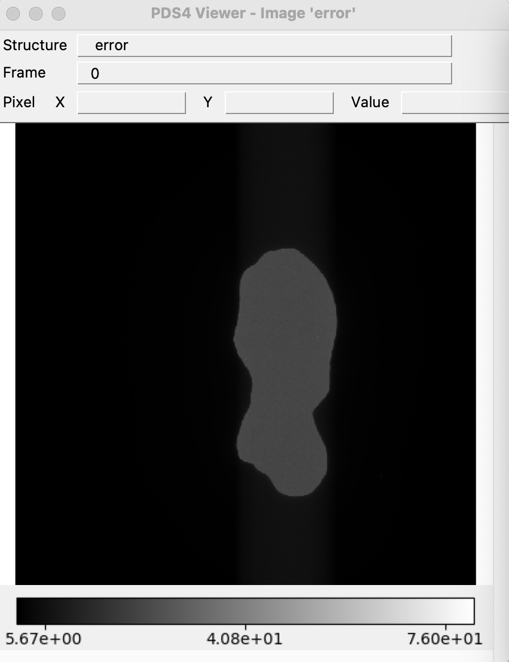
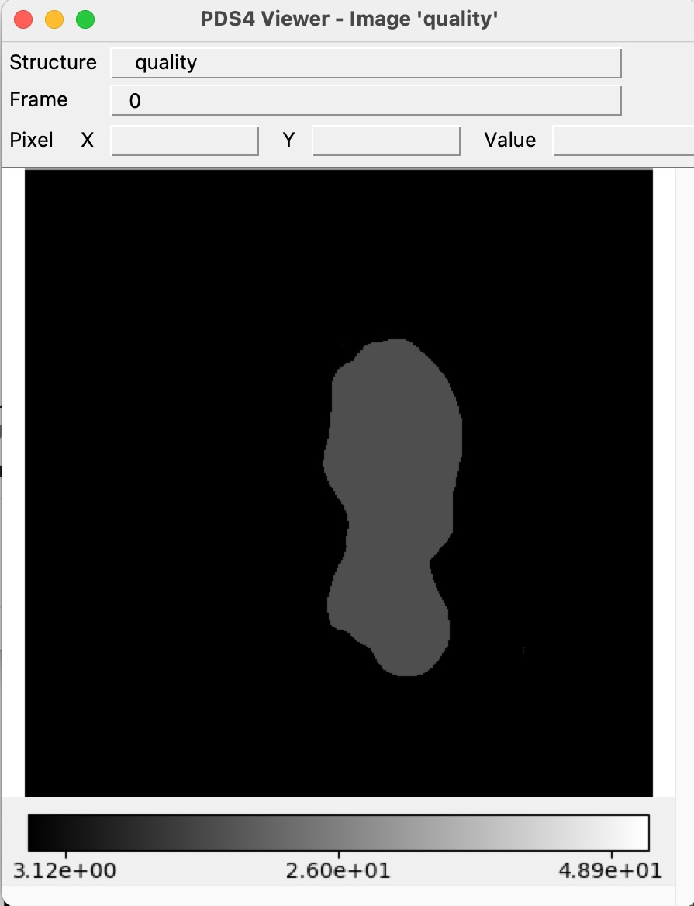
Partially Processed Data - Extension data 1x1
Example lor_0798443121_04766_00001_1x1_sci_03

Slide 13
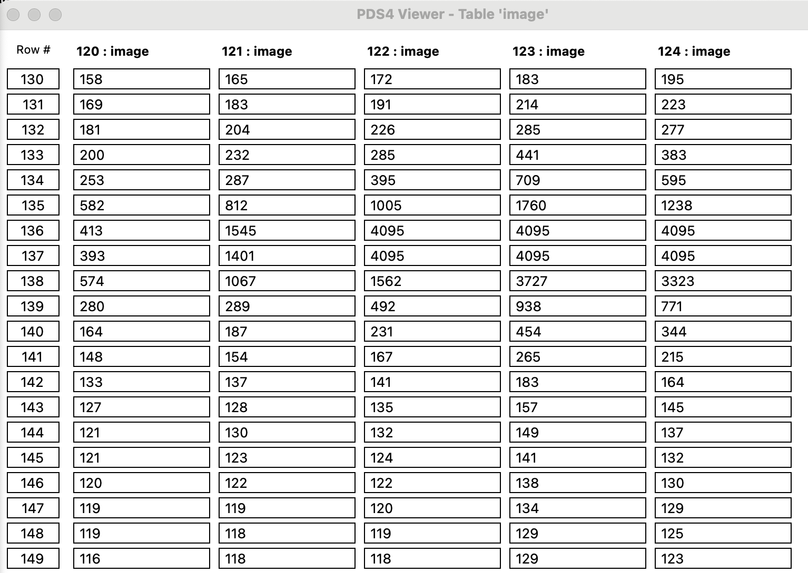
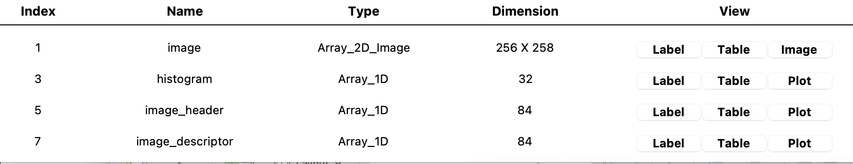
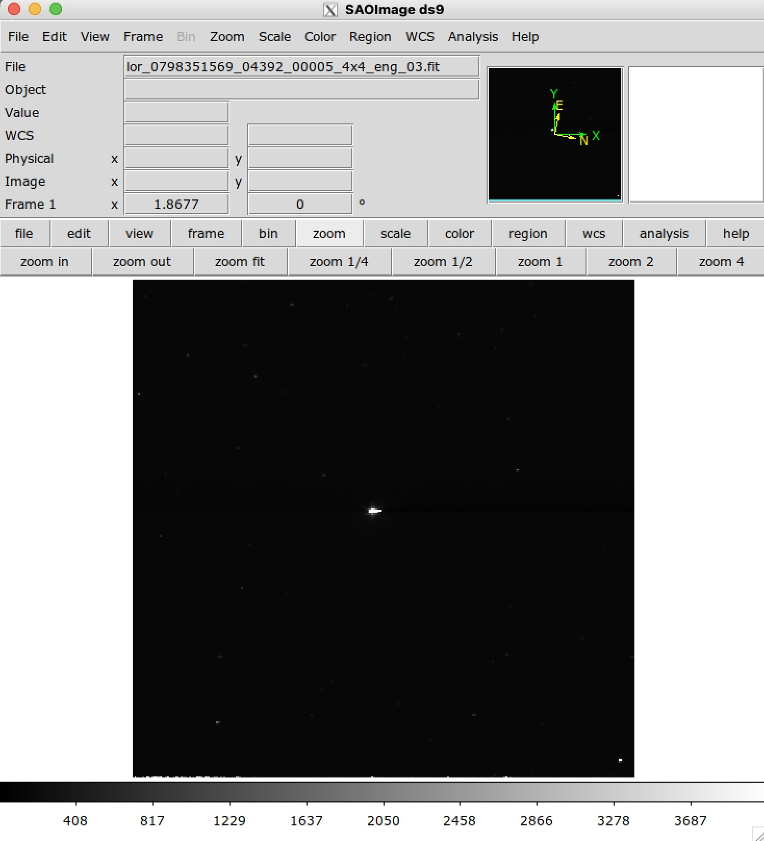
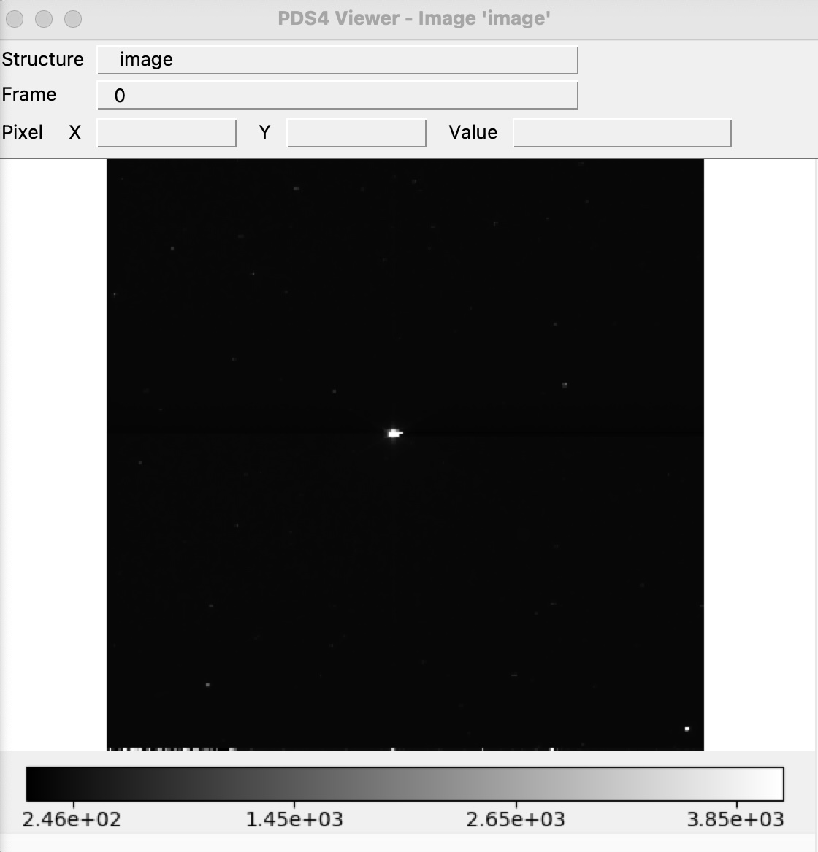
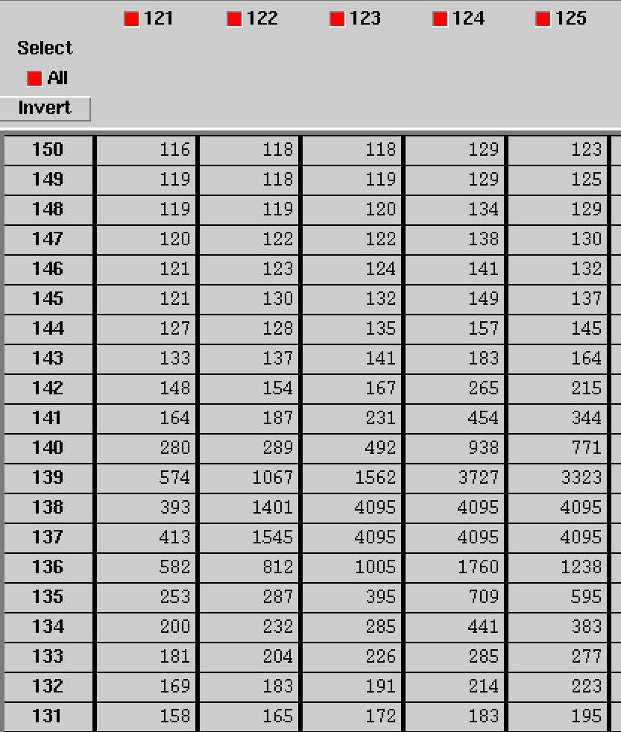
Raw Data - Primary data 4x4
No difference in display between DS9, fv, and PDS4 viewer
Able to open primary data and extensions with PDS4 viewer
Example lor_0798351569_04392_00005_4x4_eng_03

Slide 14
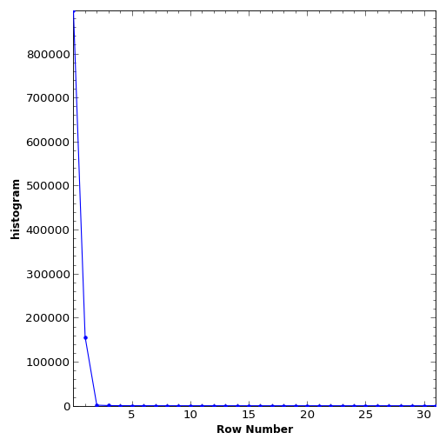
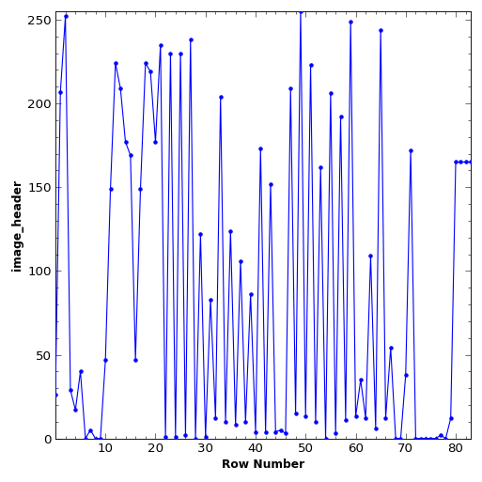
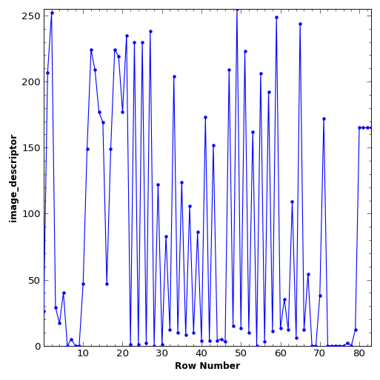
Raw Data - Extension data 4x4
The values for Image_header and Image descriptor are identical. Is that what is expected? What does that mean for Image_header and Image descriptor ?
Example lor_0798351569_04392_00005_4x4_eng_03

Slide 15
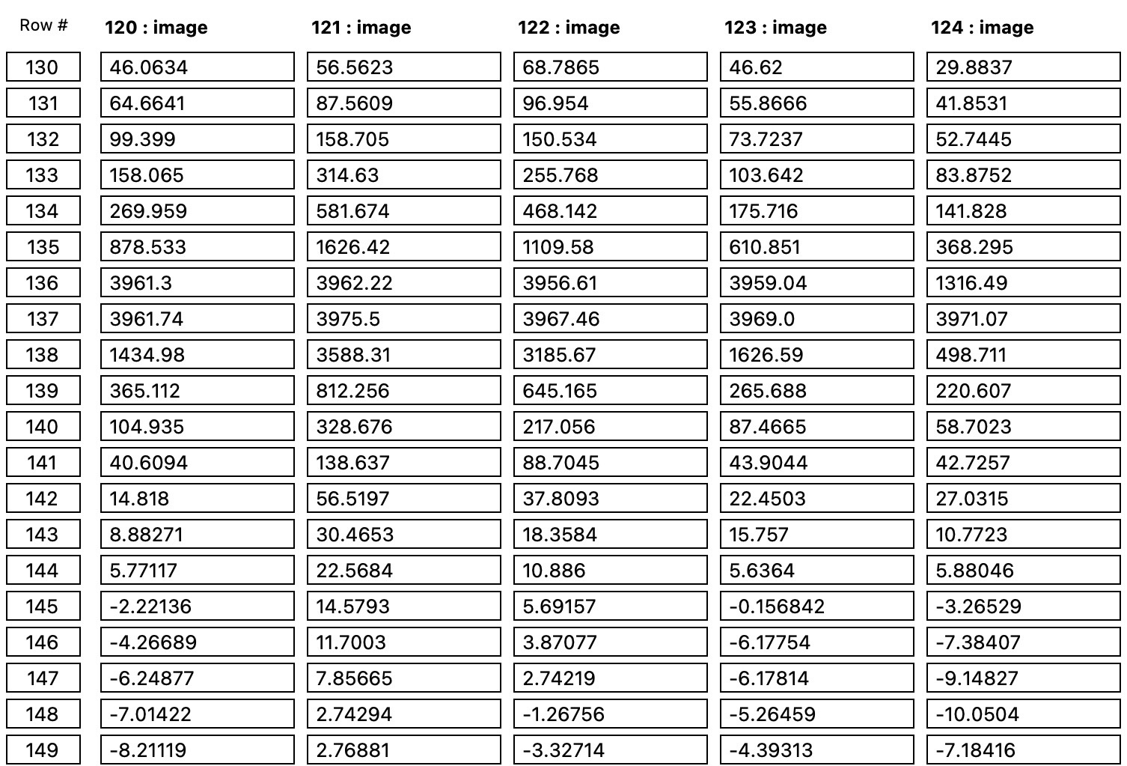
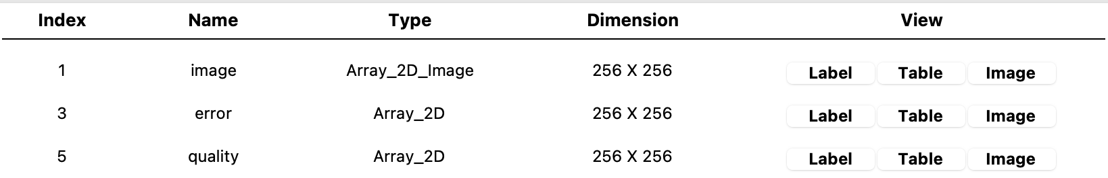
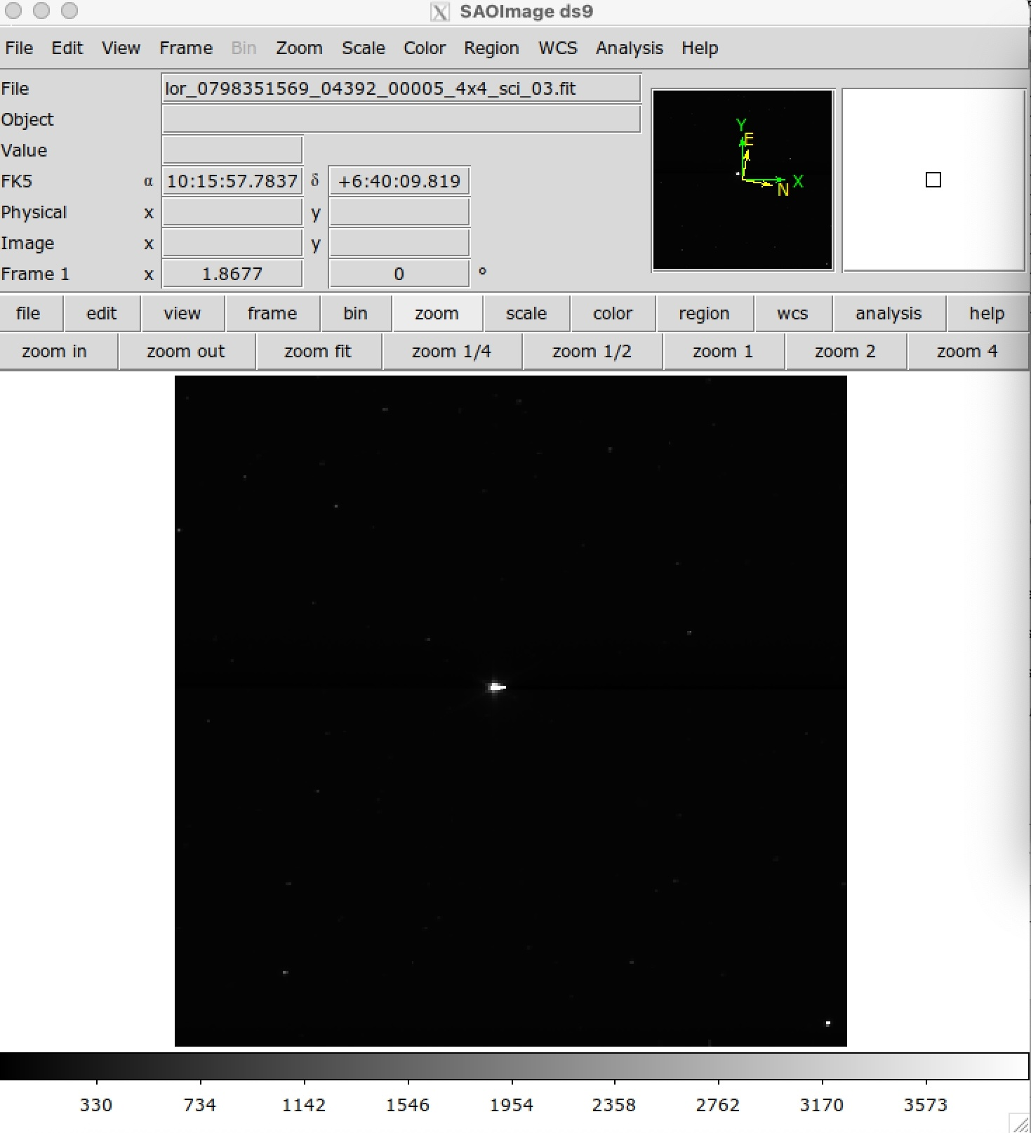
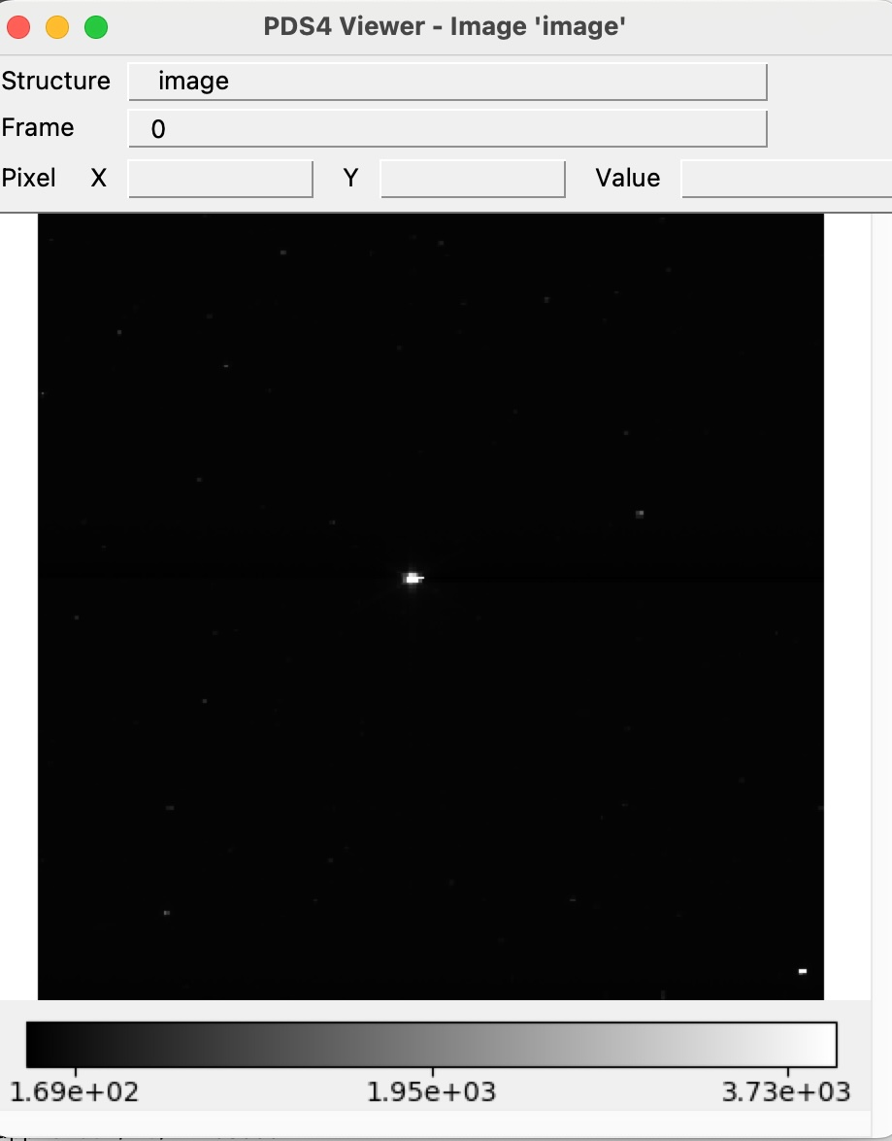
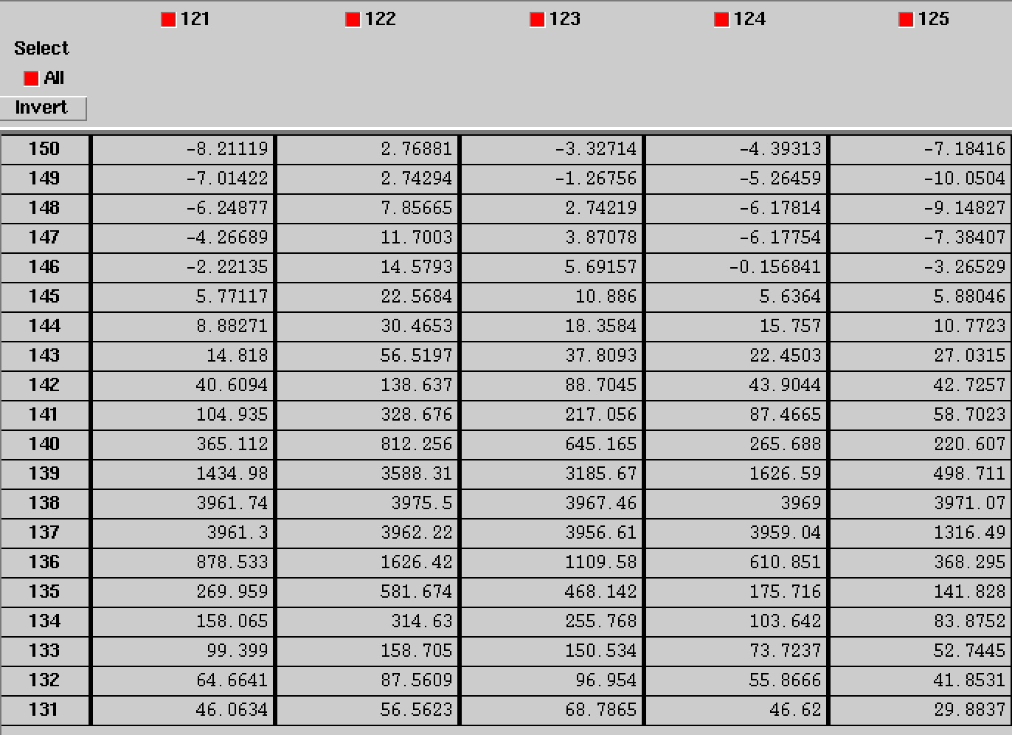
Partially Processed Data - Primary data 4x4
No difference in display between DS9, fv, and PDS4 viewer
Able to open primary data and extensions with PDS4 viewer
Example lor_0798351569_04392_00005_4x4_sci_03

Slide 16
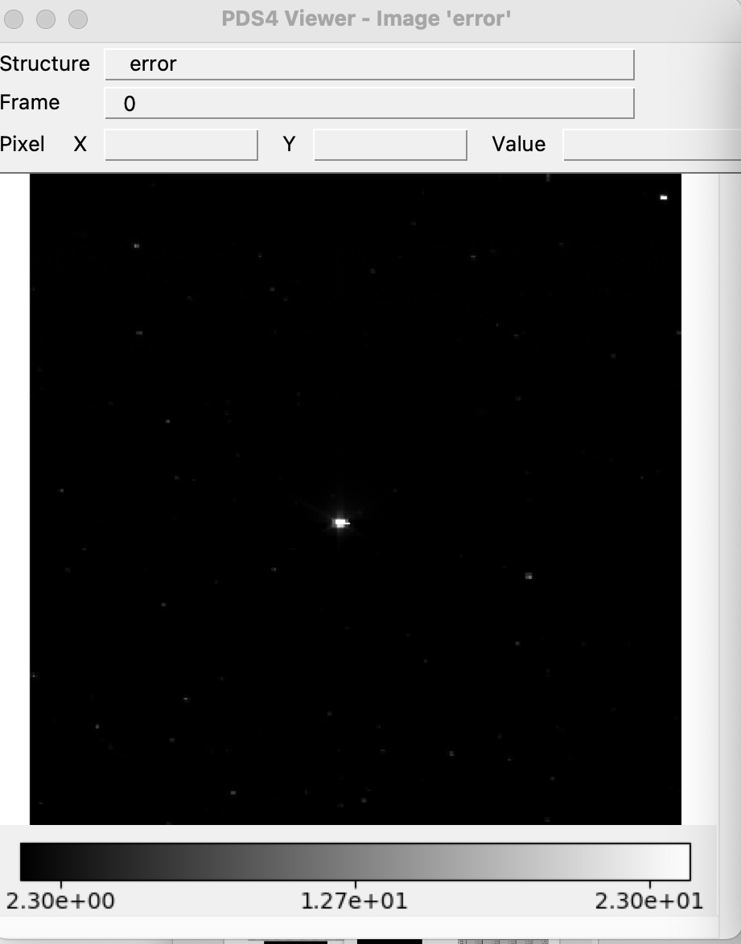
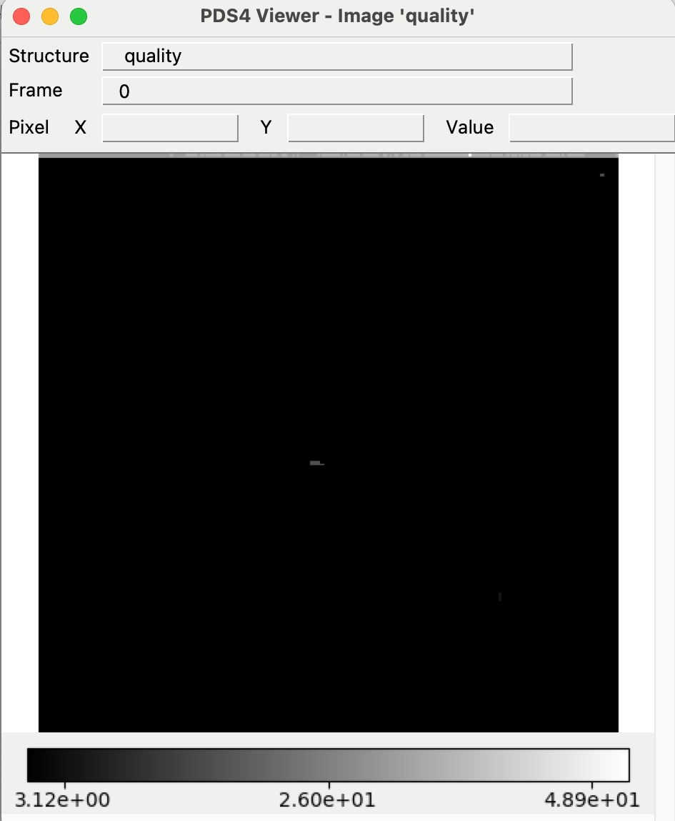
Partially Processed data - Extension data 4x4
Example lor_0798351569_04392_00005_4x4_sci_03

Slide 17
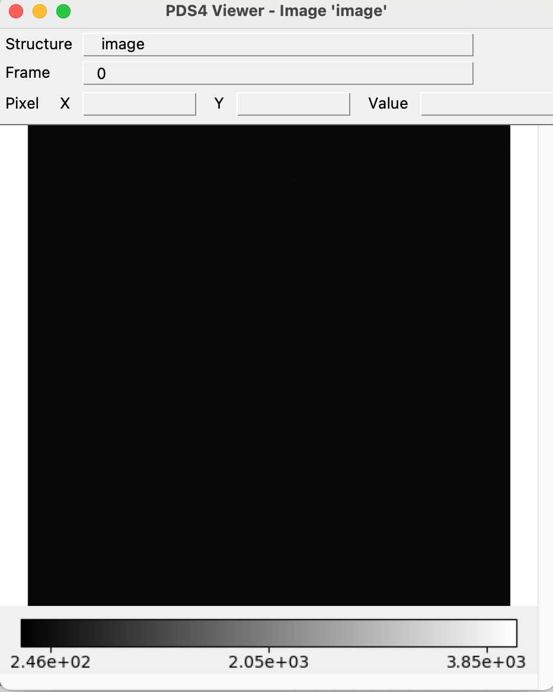
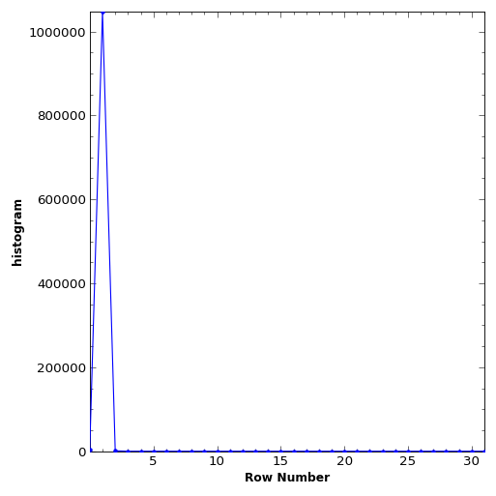
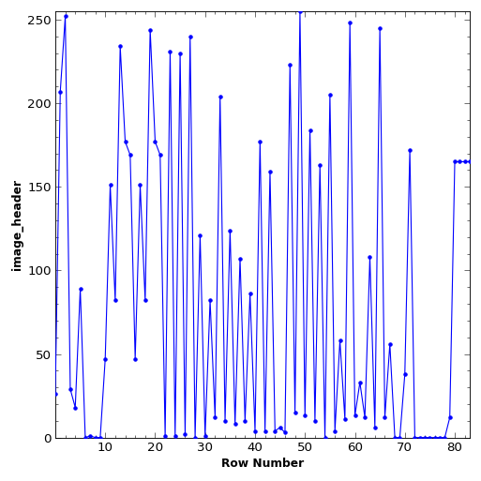
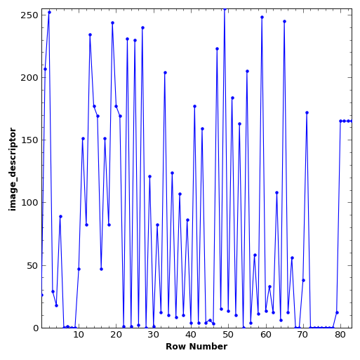
Raw Data – Test Image data
Able to open primary data and extensions with PDS4 viewer
Example lor_0798446314_04697_00001_1x1_eng_03
Primary
Extension -Histogram
Extension -Image Header
Extension -Image Descriptor

Slide 18
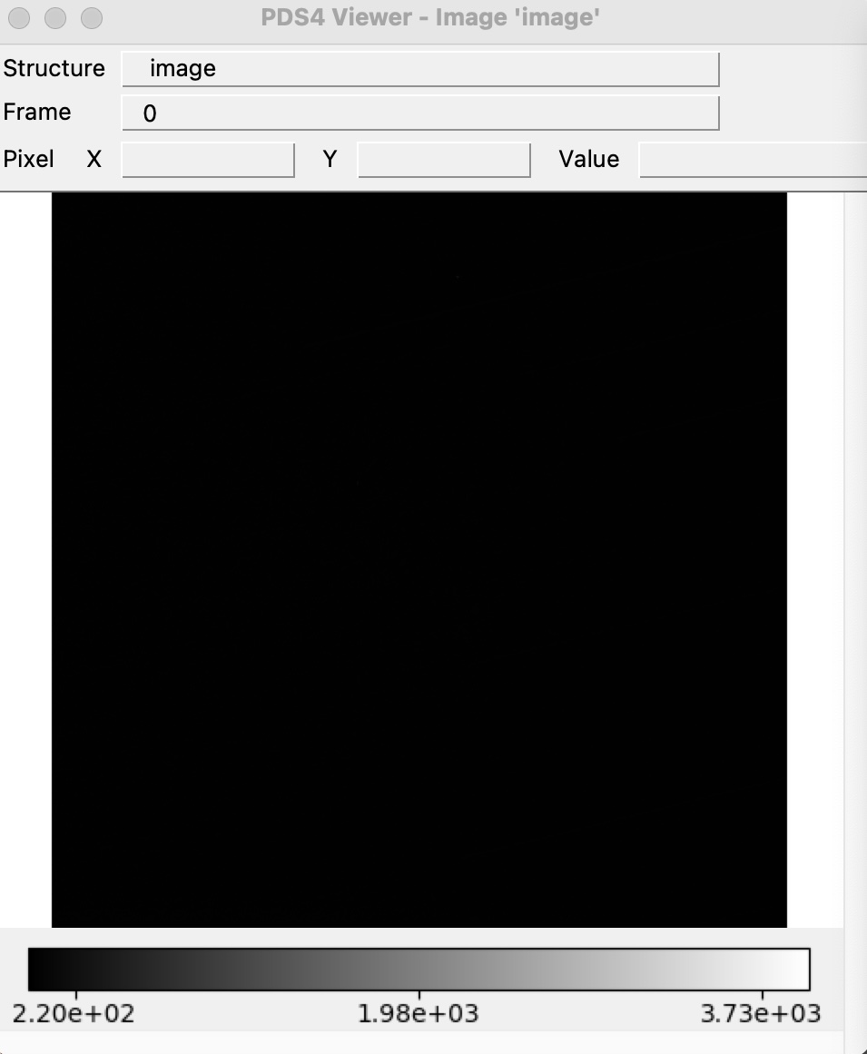
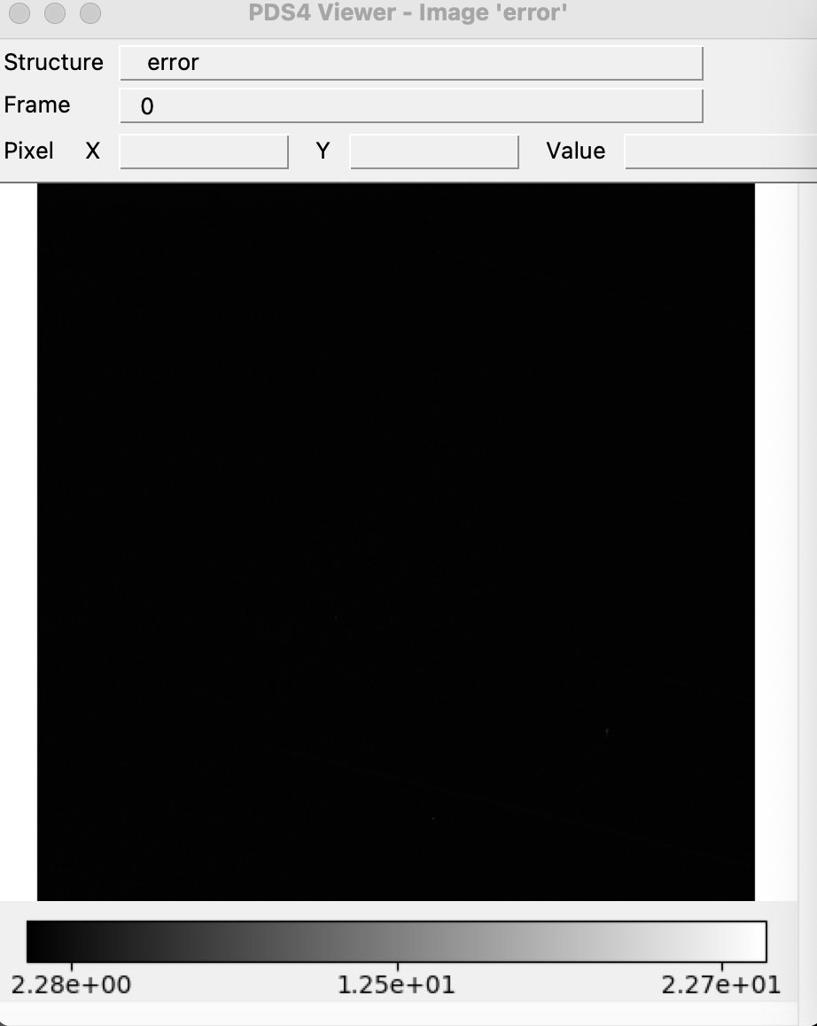
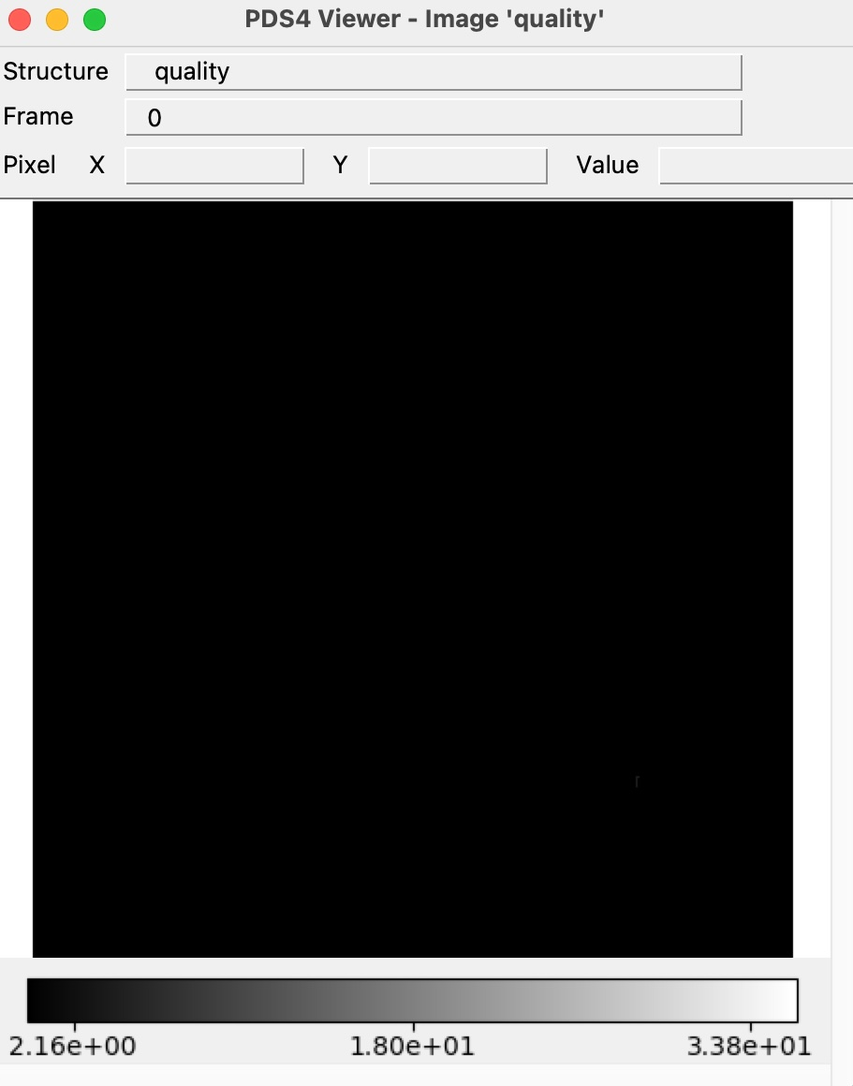
Partially Processed Data – Test Image data
Able to open primary data and extensions with PDS4 viewer
Example lor_0798446314_04697_00001_1x1_sci_03
Primary
Extension - Error
Extension - Quality

Slide 19
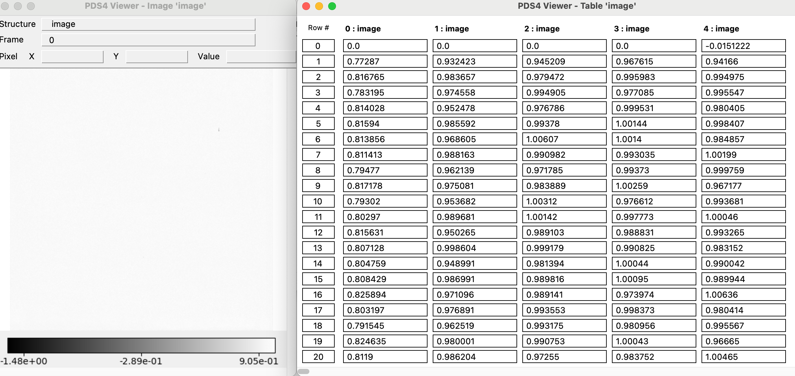
Calibration Collection
No new collection_overview.txt
No new collection_overview.xml
collection.xml
It should be Derived instead of Raw <Primary_Result_Summary><processing_level>
Based on the inventory file the <File_Area_Inventory><Inventory><records> should be 10 and not 2 ?
inventory.csv
Based on the collection file you have 2 files. Not sure if this is wrong or of the records in the collection file is wrong ?
dj_auto_flat_1x1.xml, dj_auto_flat_4x4.xml
Maybe adding the month at least?
<Time_Coordinates> <start_date_time> 2025Z </start_date_time> <stop_date_time> 2025Z </stop_date_time> </Time_Coordinates>
All calibration products display correctly in PDS4 Viewer, fv and DS9.
Example : dj_auto_flat_1x1

Slide 20
Calibration steps
Verify that the LIDVID for the calibration files in the partially processed files are valid
Didn’t try to reproduce the partially processed images from the raw images based on the problem previously reported and because I’m not sure if this step is done is the calibration process:
In the PDS4 XML label the exposure time is 30 s. And in the files llorri_toffsets_1x1.txt and llorri_toffsets_4x4.txt the exposure time is in ms with a max exposure of 999ms

Slide 21
Document Collection
No version 3.0 of the document collection – Are you still fixing the errors from the previous review?
Can be certified

