Slide 1
LTES Donaldjohansen Review

Slide 2
Housekeping/Raw data
Through a combination of Excel, HDFView, and PDSViewer was able to look at/extract/plot the data, though I had a little bit of a re-learning curve
Housekeeping data looked ok as far as I could tell
Same with raw data
Some parameters are missing units in the labels: BB and mirror temperatures are explicitly in degrees C, but detector and board temperatures don’t list units. Cal_res also missing units, though probably could be guessed?
As test extracted board temperatures, found them very stable: 5.839 ± 0.007 and 7.031 ± 0.005 degrees in the 16-sample range I looked at.

Slide 3
Calibrated data
Looks like no data at or after closest approach
Note that the phase angle is missing from all of these data, showing 9999. The emission and incidence angles also show 9999. So, need to get phase angle from different source, which requires cross-referencing the times LTES was looking at the target with UTC times, then going to ephemeris.
Extracted data for 21 spectra centered on sample 42760, and 31 spectra starting with sample 42990.

Slide 4
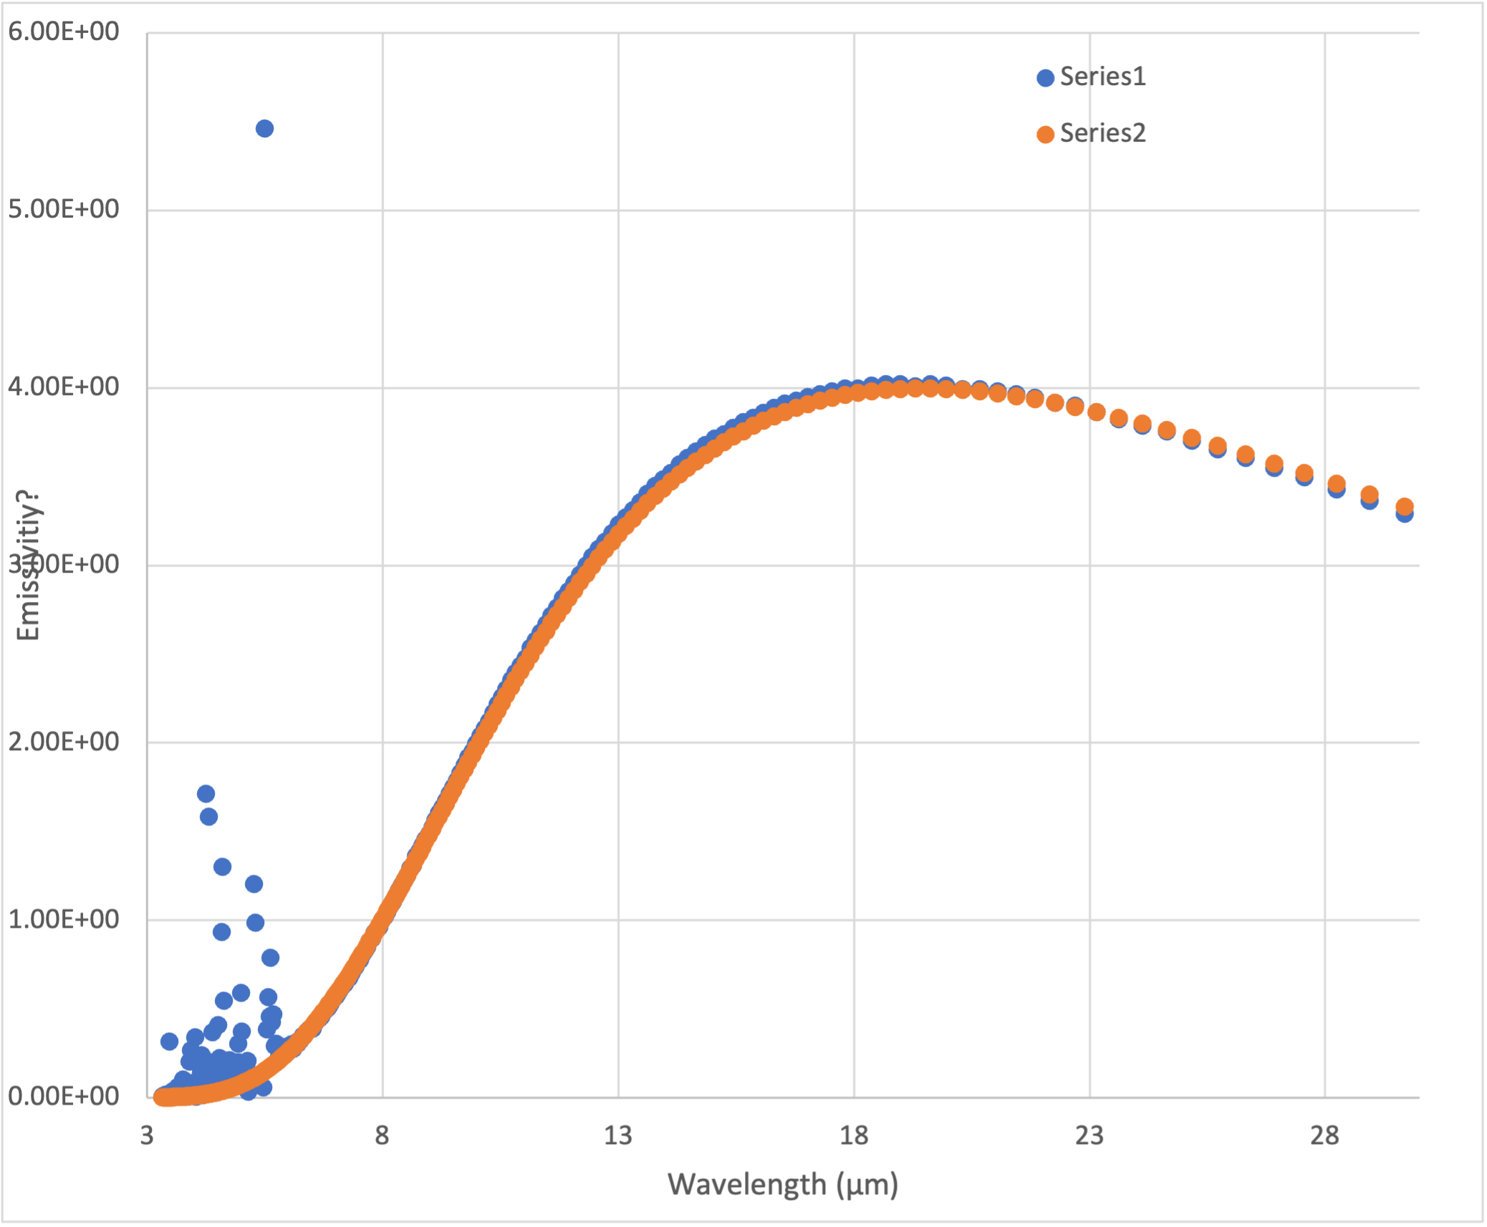
Try #1
Figuring the samples would be a mix of space and target and the space wouldn’t add anything, I summed the 21 spectra taken near 17:32 UTC
Good news! Good fit to data with STM, implying a temperature ~285-290 K with beaming parameter ~0.9

Slide 5
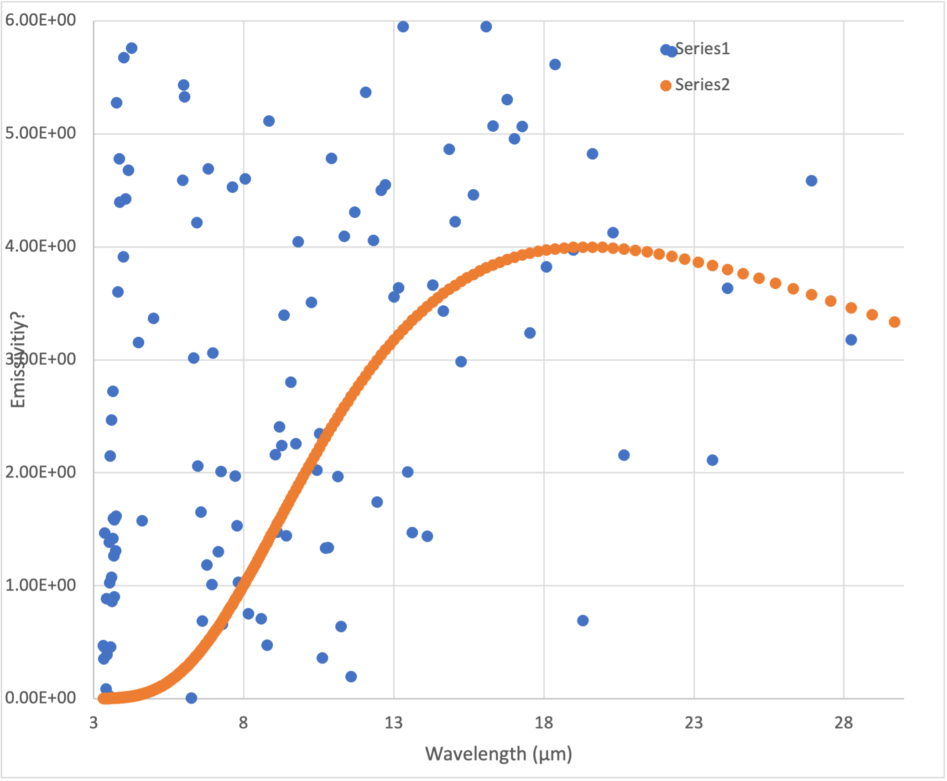
A sudden realization
However, looking closer, the flux seems to almost all come from the spectra that are pointing to space
The ones that have the flag set to target are instead basically noise?
These spectra are normalized to 8 microns.

Slide 6
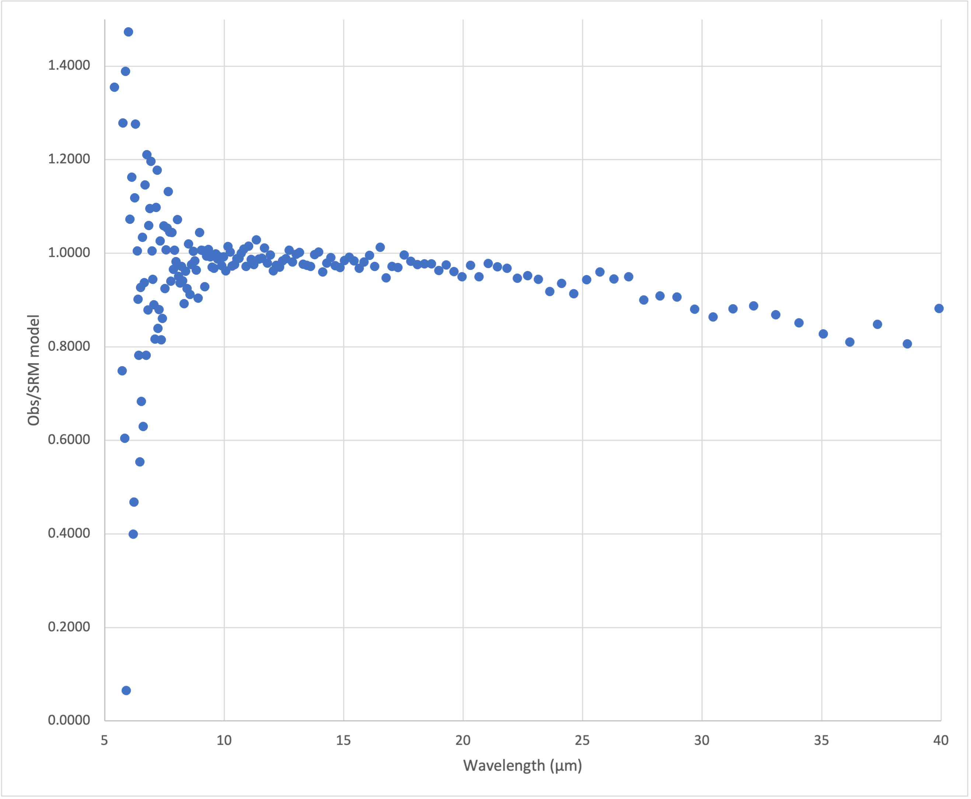
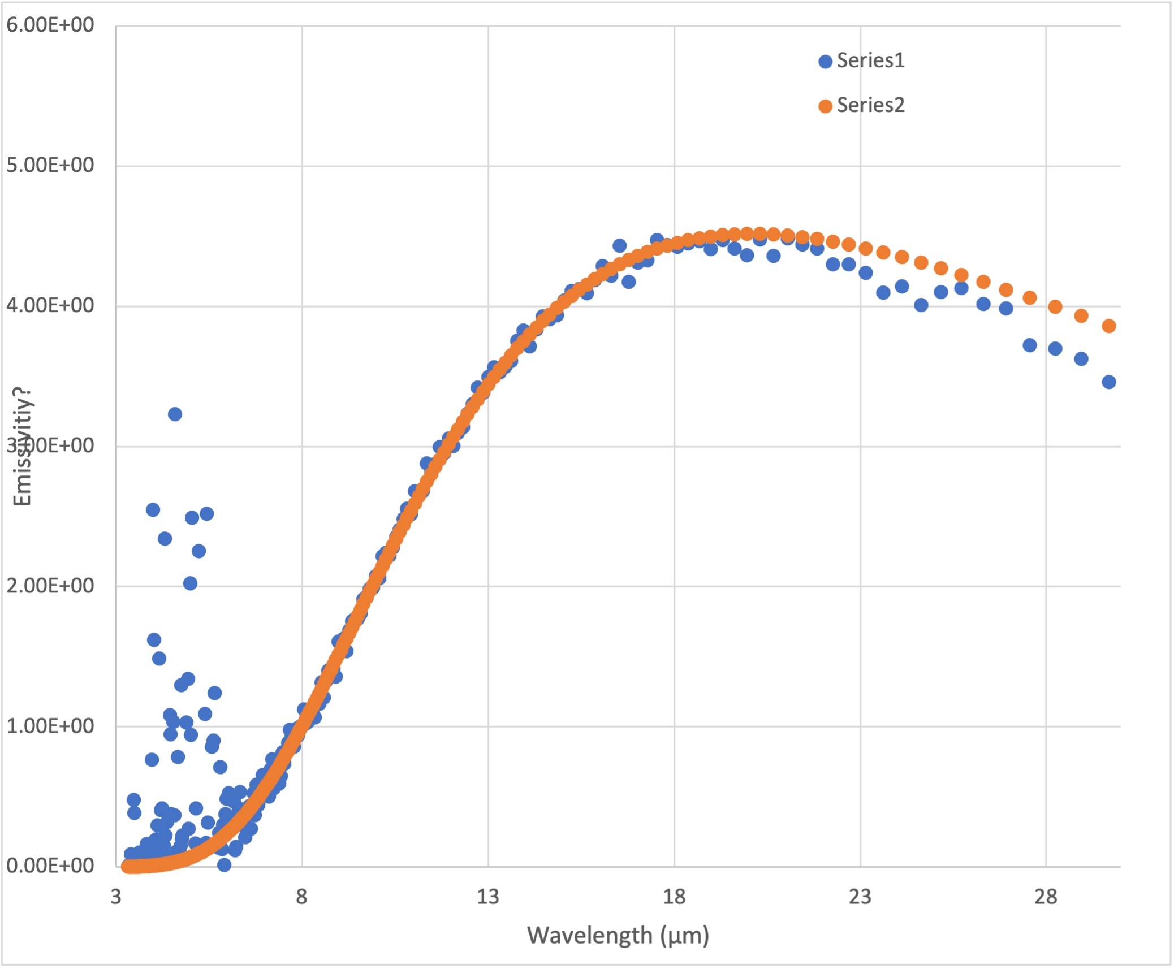
Closest approach
A few minutes later (17:46 UTC), additional observation
  This is what Tim looked at
Fit STM, found good fit shortward of 18 µm with beaming parameter = 1, implying sub-solar T ~280 K
When not normalizing, best fit to data for object with diameter ~1.9 km.
  Not bad!

Slide 7
Bottom line
I think the calibrated data themselves are certifiable in the sense that they can be extracted, and worked with
There are still missing parameters that would be useful if the data had been better, like phase angle
It would be good to figure out why (some of) the ”space” spectra have so much more flux than the “target” ones, which Tim covered well.
Should ideally also explain why there’s no post-close approach data

