Slide 1
Lucy Donaldjohanson
T’TCAM Review
Adeline Gicquel
October 16-17, 2025

Slide 2
Dataset overview
Validation passed
PDS4 XML labels accurately describes the data when using he PDS4 Viewer.
The values in the PDS3 fits header and PDS4 XML labels are identical
Bundle file – No problem
Two TTCams on board TTCam1 and TTCam2
195 Raw data (5 TTCam2 + 190 TTCam1)+ labels
  Primary 2D image (TTCam observational image) – Unit (DN)
    10 products with array 2000 x 2592 : 5 TTCam1 & 5 TTCam2:
    Other products with array 1944 x 2592
  No extension
  31 TEST_IMAGE
195 Calibrated data (5 TTCam2 + 190 TTCam1) + labels
  Primary 2D image (TTCam observational image) – Unit (uW/cm^2/nm/sr)
    10 products with array 2000 x 2592 : 5 TTCam1 & 5 TTCam2:
    Other products with array 1944 x 2592
  4 extensions 2D images (Bad Pixel Map, Radiance Error Image (uW/cm^2/nm/sr), I/F Image, I/F Error Image)
    10 products with array 2000 x 2592 : 5 TTCam1 & 5 TTCam2:
    Other products with array 1944 x 2592
  31 TEST_IMAGE

Slide 3
Collection files - Raw and calibrated data
collection.xml
  You should add the < Primary_Result_Summary><purpose>Calibration because you have 10 files that are described as “Calibration Mode” images in the collection_overview.txt
collection_inventory.csv
  No problem.
collection_overview.txt
  Please add the name of the files or the date of observations that correspond to this statement “TTCam images that are 2000 x 2592 rows x columns are “Calibration Mode” images, primarily of stars and star clusters, that are acquired during periodic calibration campaigns not associated with the mission’s actual asteroid flybys.”
collection_overview.cml
  Is this correct <Citation_Information><publication_date>2024-08</publication_date> ?

Slide 4
Raw and calibrated data
The target name should probably always be in this format (52246) Donaldjohanson instead of DONALDJOHANSON
You could add the target NAIF ID if applicable: <Discipline_Area><geom:Geometry><geom:Geometry_Orbiter><geom:Orbiter_Identification><geom:Geometry_Target_Identification><geom:body_spice_name>
For the test images. See tt1_0798446013_29460_sci_02.xml
  It should not be Science for the <Primary_Result_Summary><purpose>
  The name TEST_IMAGE is producing warning in the validation report <Target_Identification><name>
  You can remove geom:Orbiter_Identification because it’s empty <Discipline_Area><geom:Geometry><geom:Geometry_Orbiter><geom:Orbiter_Identification>

Slide 5
Raw and Calibrated data
Possible missing attribute?
  <Discipline_Area><ebt:Earth_Based_Telescope_Parameters><ebt:Telescope_Geometry><ebt:SIP_Distortion_Terms><ebt:AP_ORDER><ebt:polynomial_order>3
<ebt:p_polynomial_degree>0</ebt:p_polynomial_degree>
<ebt:q_polynomial_degree>2</ebt:q_polynomial_degree>
<ebt:p_polynomial_degree>2</ebt:p_polynomial_degree>
<ebt:q_polynomial_degree>1</ebt:q_polynomial_degree>
<ebt:p_polynomial_degree>0</ebt:p_polynomial_degree>
<ebt:q_polynomial_degree>3</ebt:q_polynomial_degree>
  <Discipline_Area><ebt:Earth_Based_Telescope_Parameters><ebt:Telescope_Geometry><ebt:SIP_Distortion_Terms><ebt:BP_ORDER><ebt:polynomial_order>3
<ebt:p_polynomial_degree>2</ebt:p_polynomial_degree>
<ebt:q_polynomial_degree>0</ebt:q_polynomial_degree>
<ebt:p_polynomial_degree>3</ebt:p_polynomial_degree>
<ebt:q_polynomial_degree>0</ebt:q_polynomial_degree>
<ebt:p_polynomial_degree>1</ebt:p_polynomial_degree>
<ebt:q_polynomial_degree>2</ebt:q_polynomial_degree>

Slide 6
Raw Data
You have this twice in the <Discipline_Area><proc:Processing_Information><proc:Process>
  <proc:name>Lucy Data Processing Pipeline</proc:name>
  <proc:process_owner_name>Lucy Science Operations Center</proc:process_owner_name>
  <proc:process_owner_institution_name>Southwest Research Institute</proc:process_owner_institution_name>
You have “?” for the target_fov_name. See tt1_0793310281_03584_eng.xml
  <Mission_Area><lucy:Lucy_Target_List><lucy:target_fov_name>

Slide 7
Calibrated Data
Why are you not using the SB dictionary that includes information about the calibration that is done ?
  <Discipline_Area><sb:SB_Metadata><sb:Calibration_Information><sb:Raw_Data_Product>
  <Discipline_Area><sb:SB_Metadata><sb:Calibration_Information><sb:Calibration_Applied>
  <Discipline_Area><sb:SB_Metadata><sb:Calibration_Information><sb:Calibration_Reference_Files>

Slide 8
5 TTCam 1 & TTCam 2 observational image
10 files (5 first TTCam 1 & 5 TTCam2) are described as “Calibration Mode” images in the collection_overview.txt
You should remove all the geometry associated with a target
<Discipline_Area><geom:Geometry><geom:Geometry_Orbiter><geom:Distances><geom:Distances_Specific>
<Discipline_Area><geom:Geometry><geom:Geometry_Orbiter><geom:Vectors><geom:Vectors_Cartesian_Specific>
It should not be Science but Calibration for the <Primary_Result_Summary><purpose>
You should remove <Primary_Result_Summary><Science_Facets><domain>Surface
It should not be 2 targets <Mission_Area><lucy:Lucy_Target_List> <lucy:target_fov_count>
It should not be DONALDJOHANSON but the name of the Star
    <Target_Identification><name>(52246) Donaldjohanson
    <Mission_Area><lucy:Lucy_Target_List><lucy:target_fov_name>DONALDJOHANSON
    <Discipline_Area><geom:Geometry><geom:Geometry_Orbiter><geom:Geometry_Target_Identification>/<geom:name>DONALDJOHANSON
It should not be Asteroid but Star for the <Target_Identification><type>
It should be removed because the target is not the asteroid <Target_Identification><Internal_Reference><lid_reference>urn:nasa:pds:context:target:asteroid.52246_donaldjohanson

Slide 9
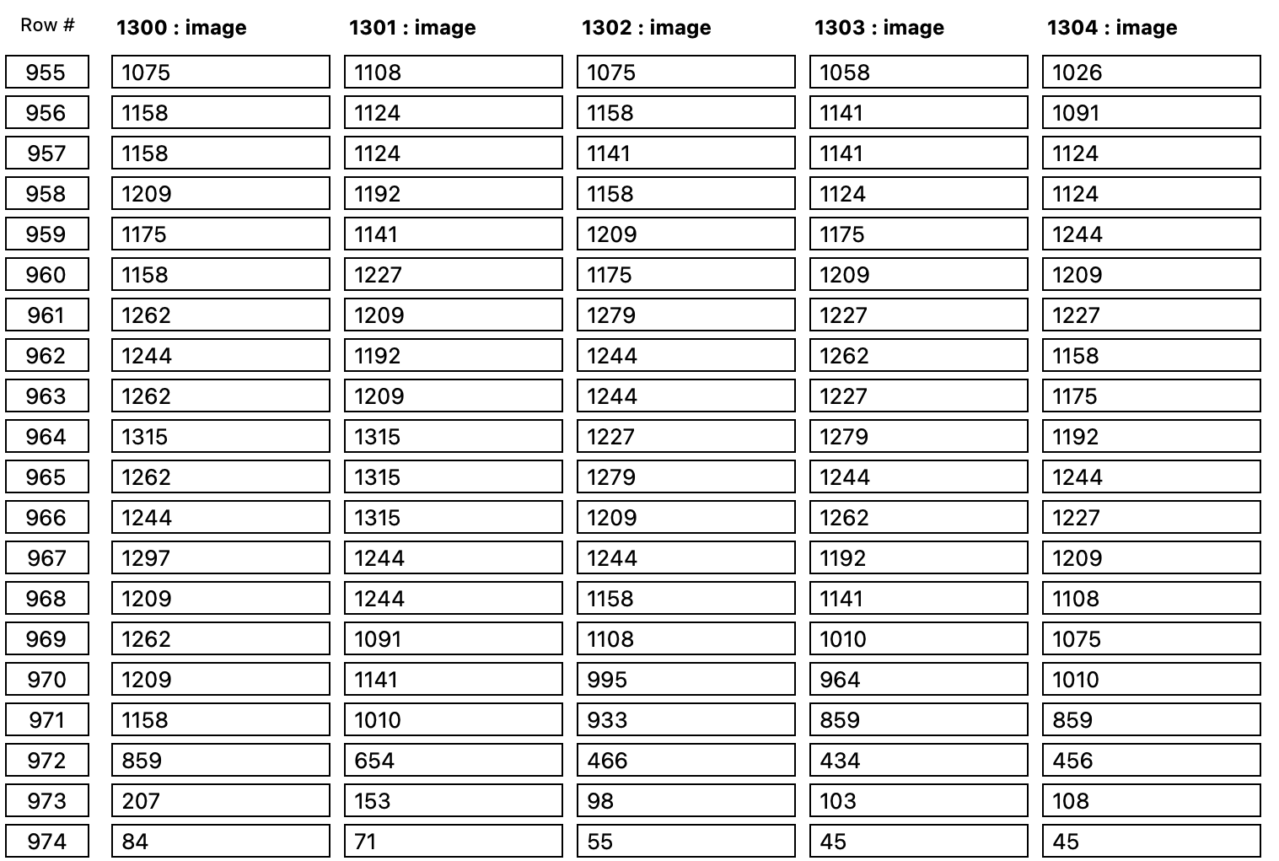
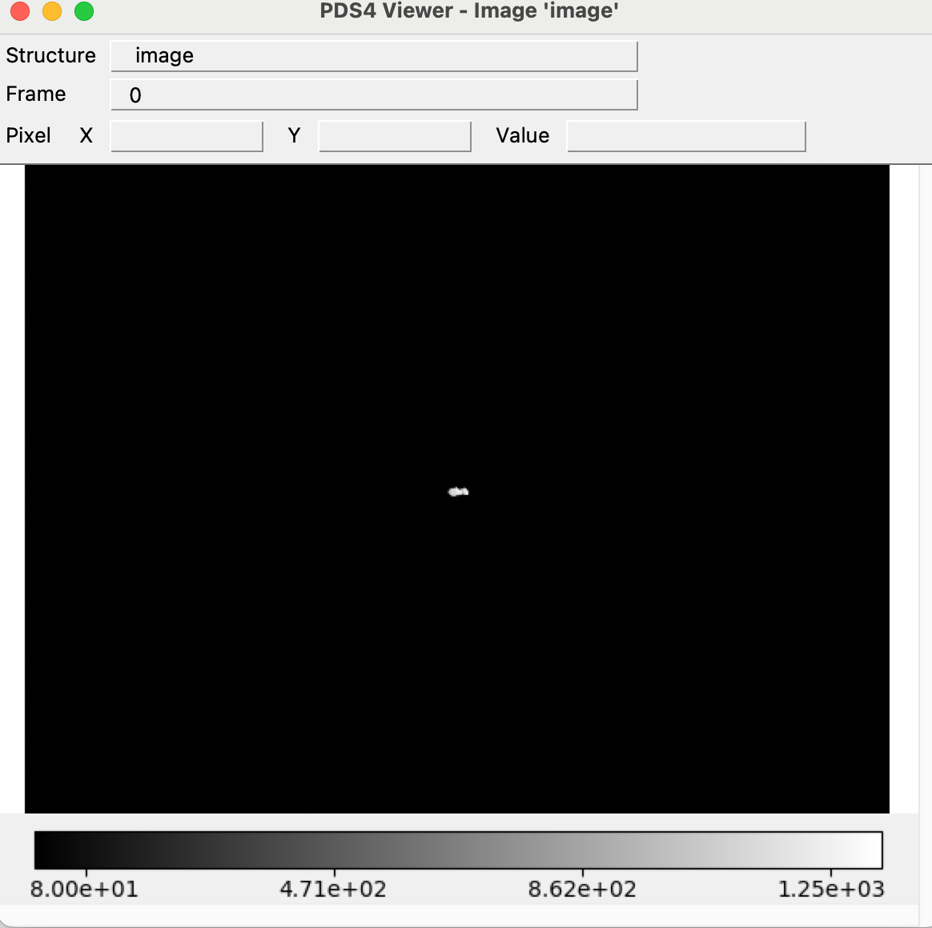
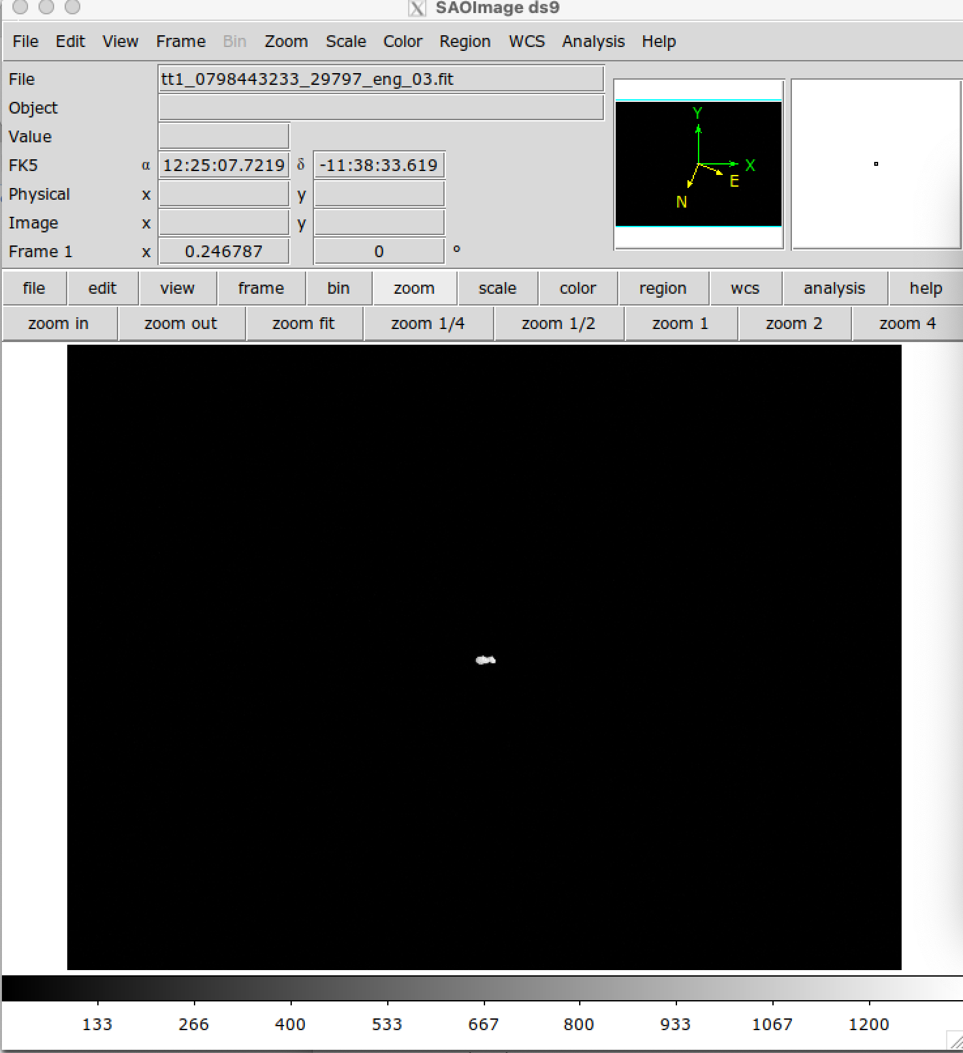
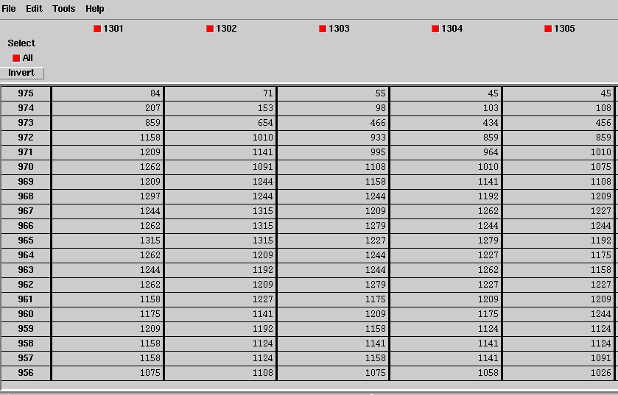
Raw data - Primary data
No difference in display between DS9, fv, and PDS4 viewer
Able to open primary data and extensions with PDS4 viewer
Example tt1_0798443233_29797_eng_03

Slide 10
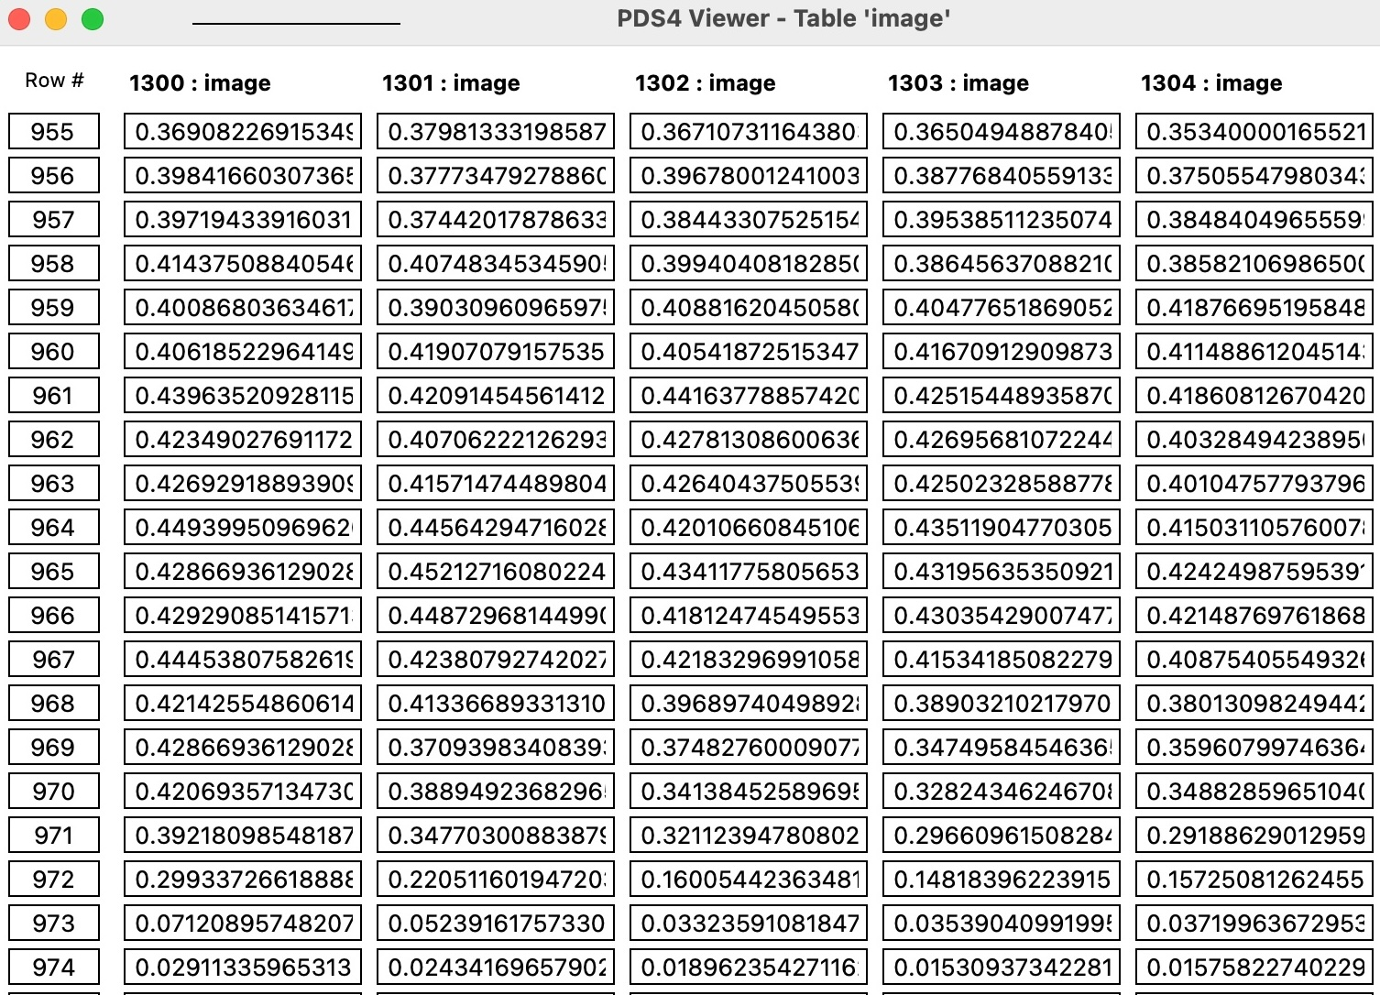
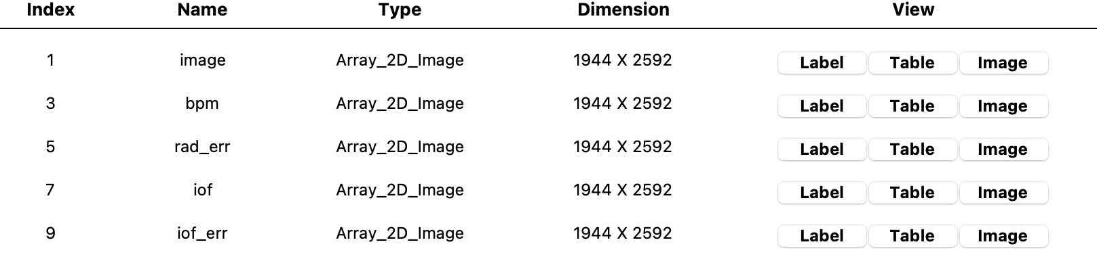
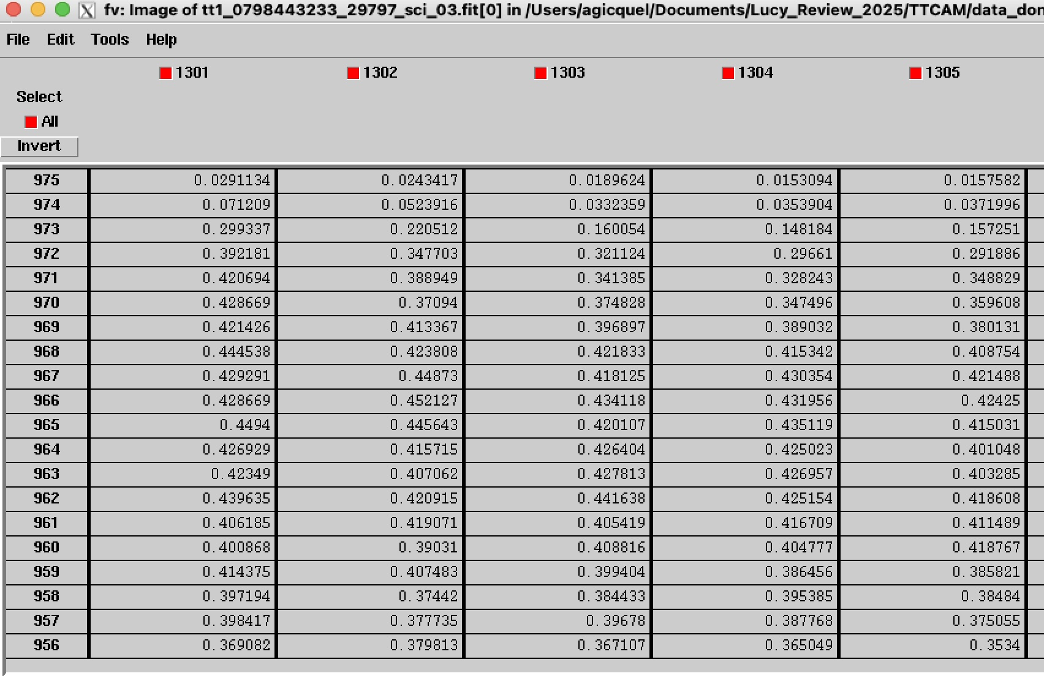
Calibrated Data - Primary data
No difference in display between DS9, fv, and PDS4 viewer
Able to open primary data and extensions with PDS4 viewer
Example tt1_0798443233_29797_sci_03

Slide 11
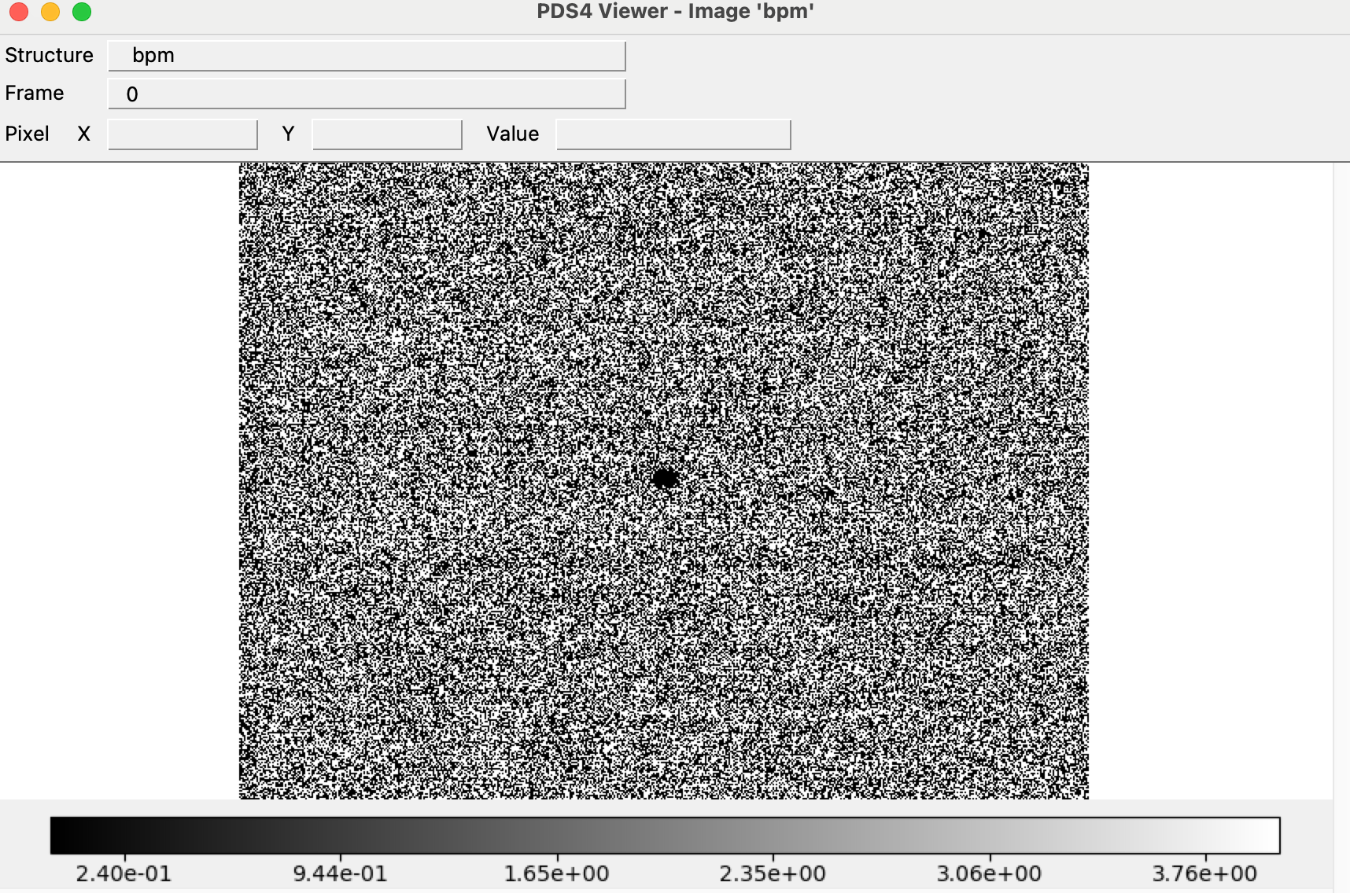
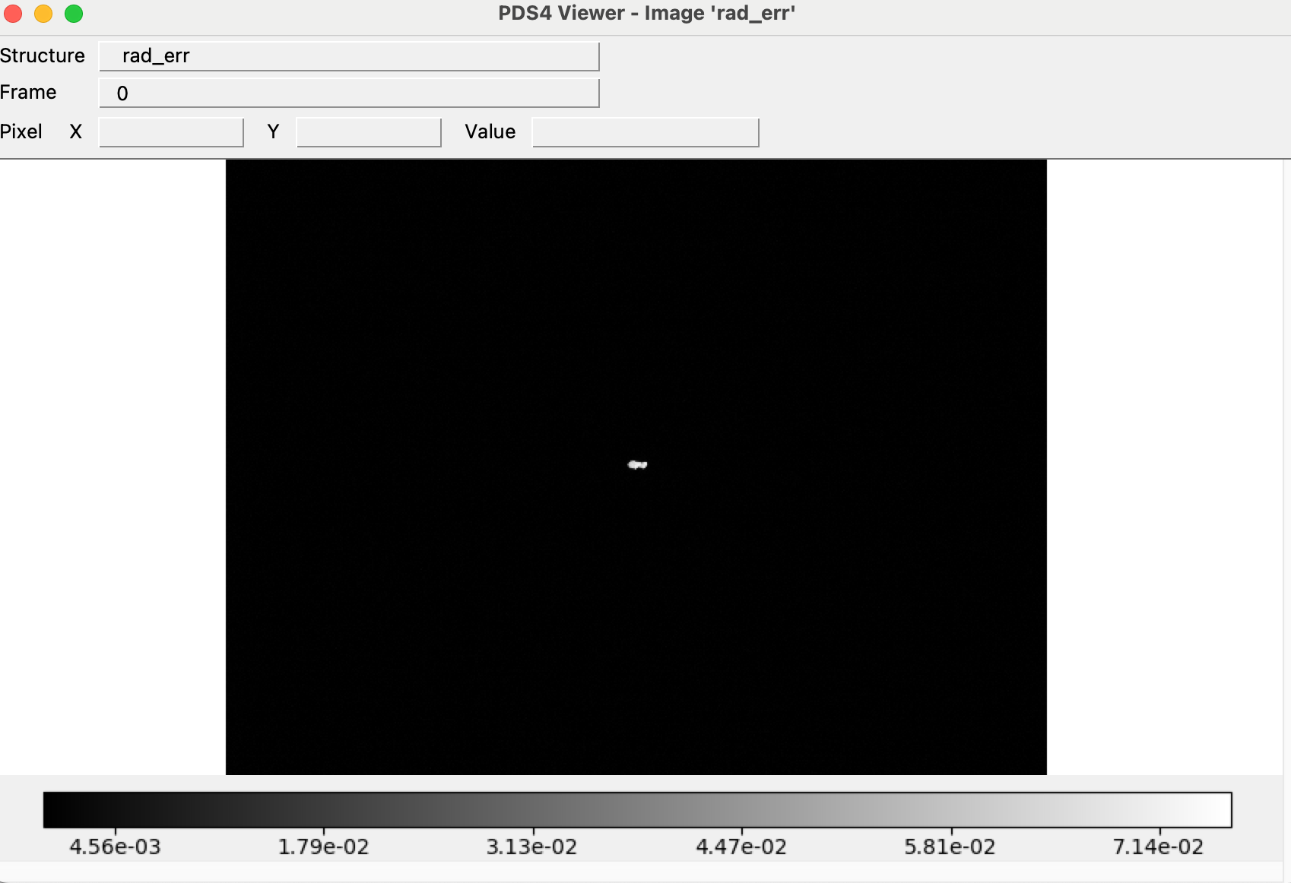
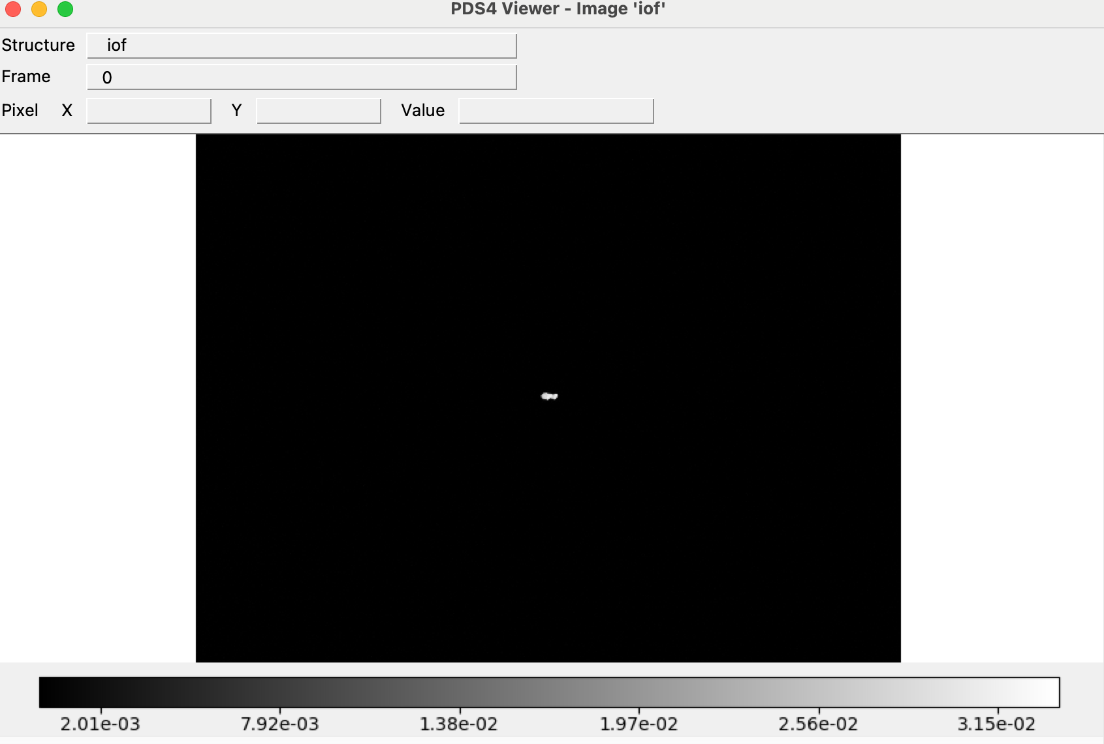
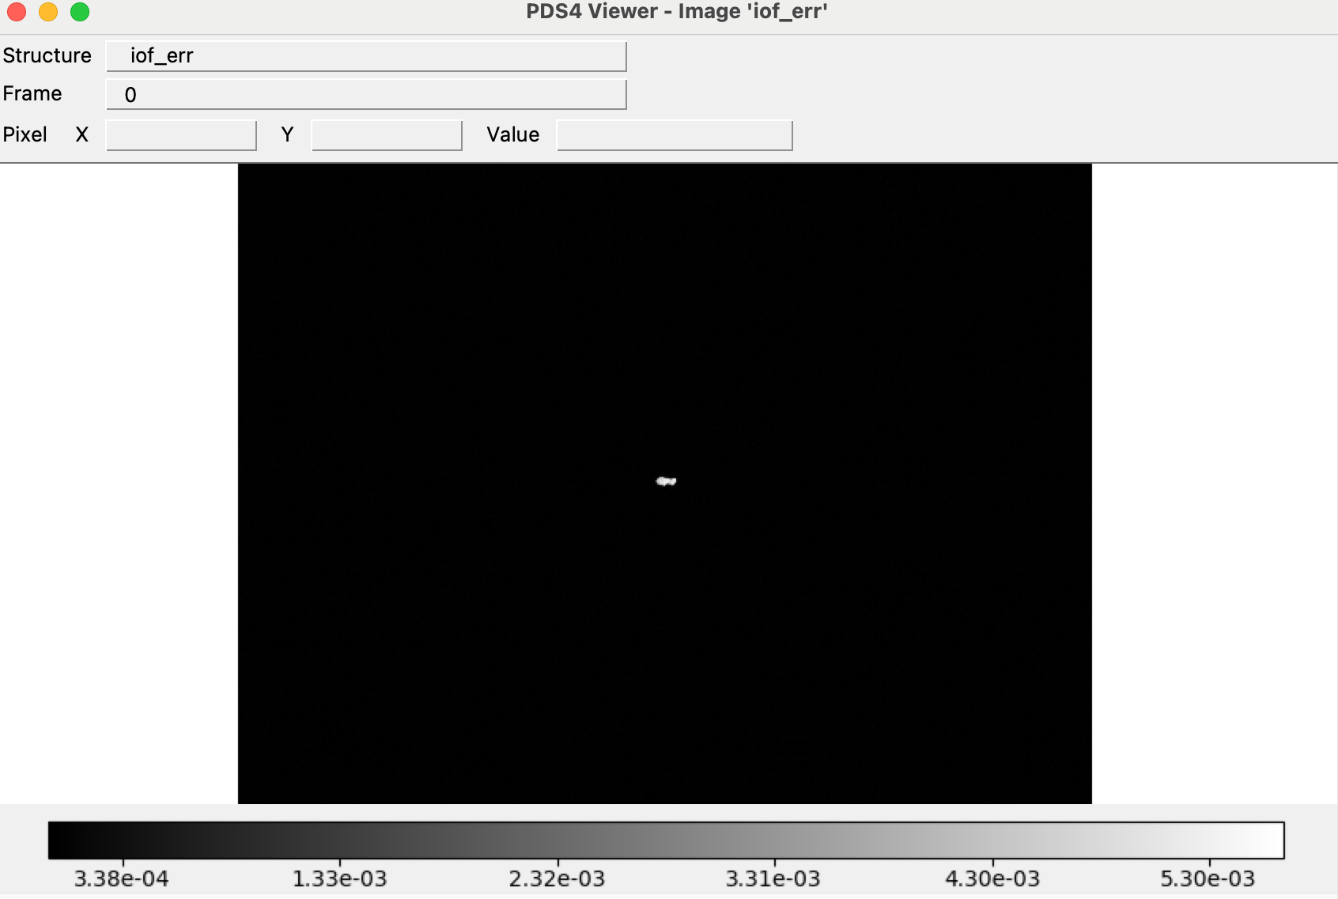
Calibrated Data - Extension data
_sci_03
Example: tt1_0798443233_29797_sci_03

Slide 12
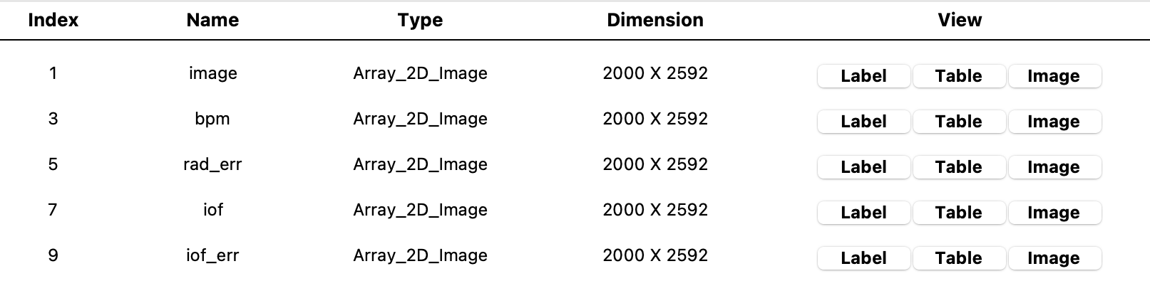
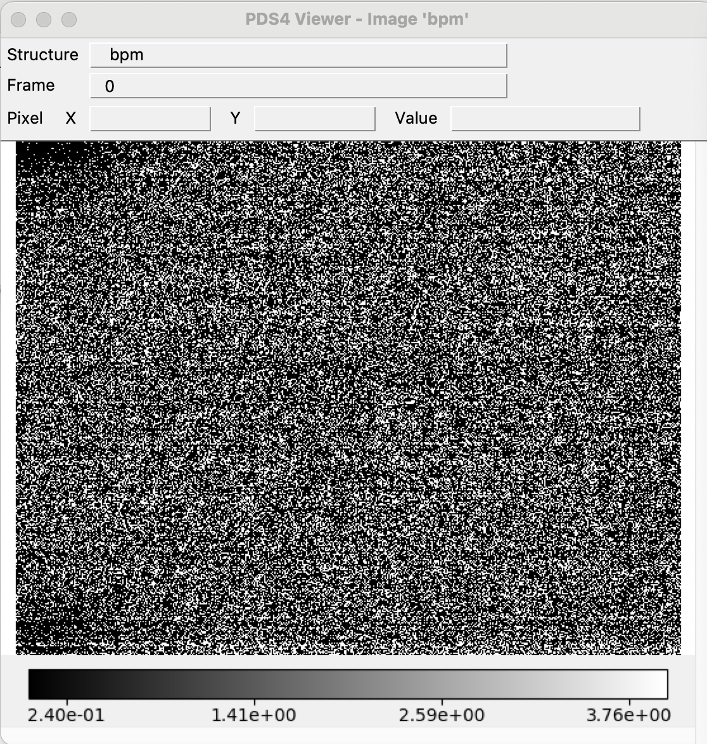
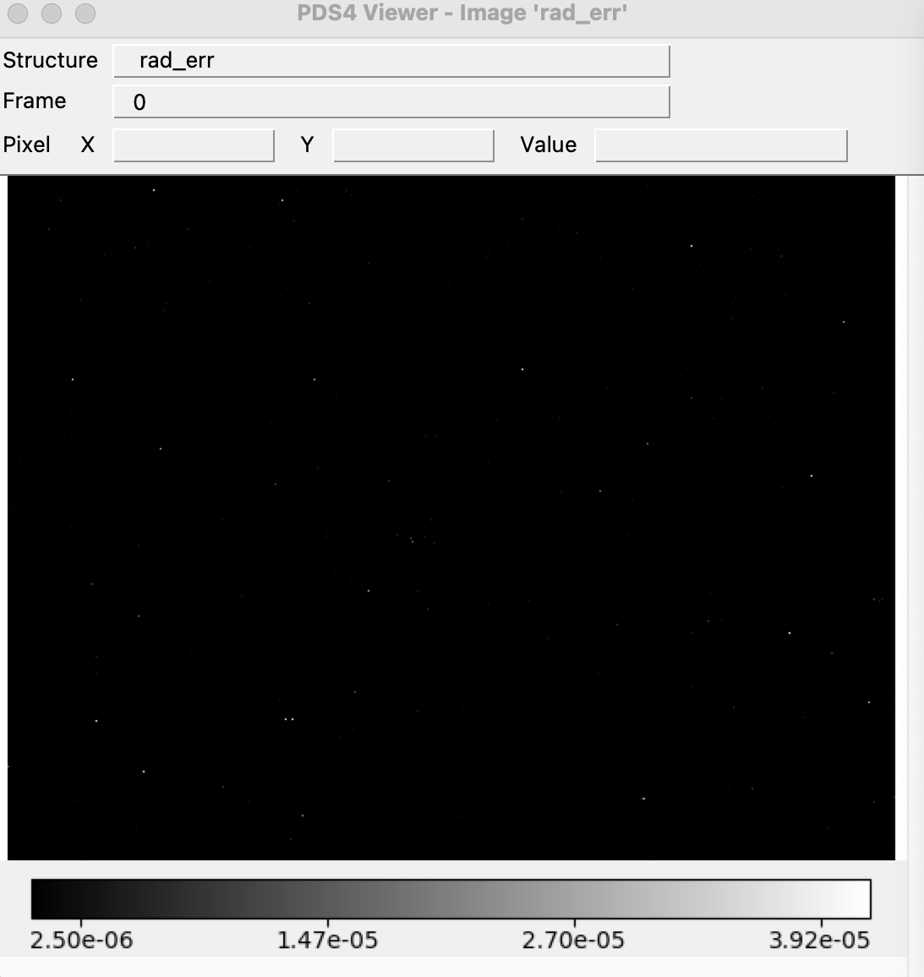
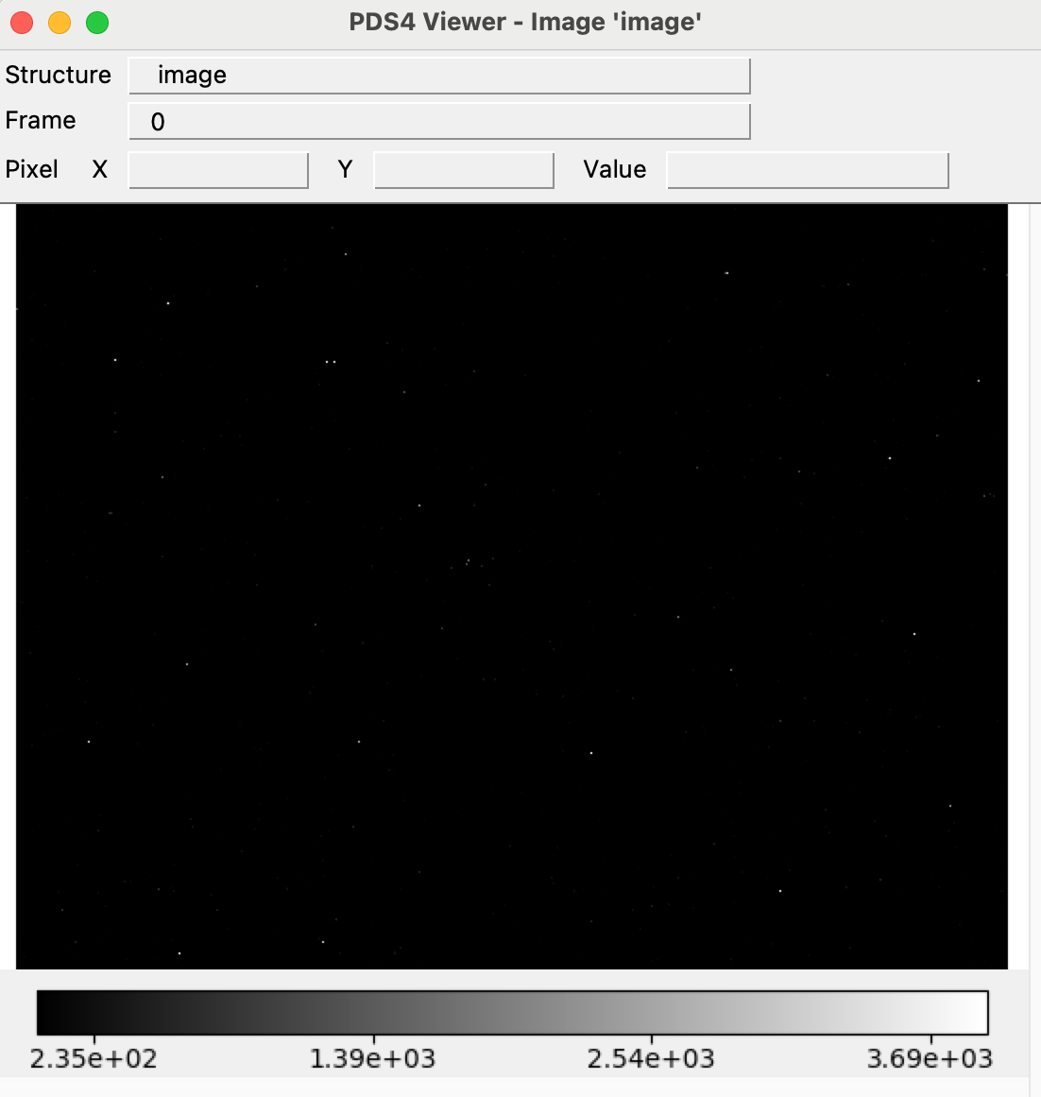
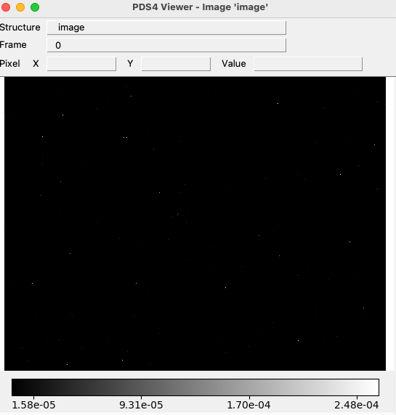
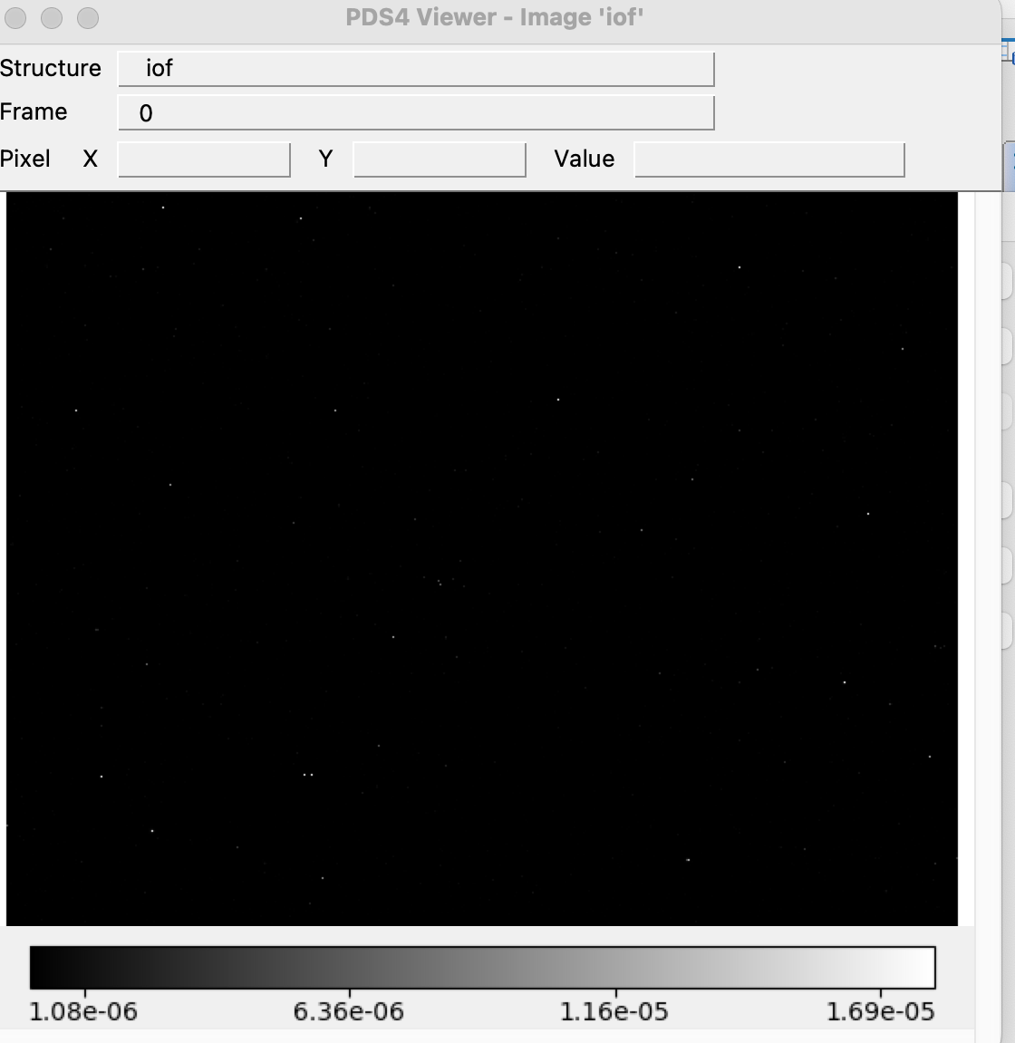
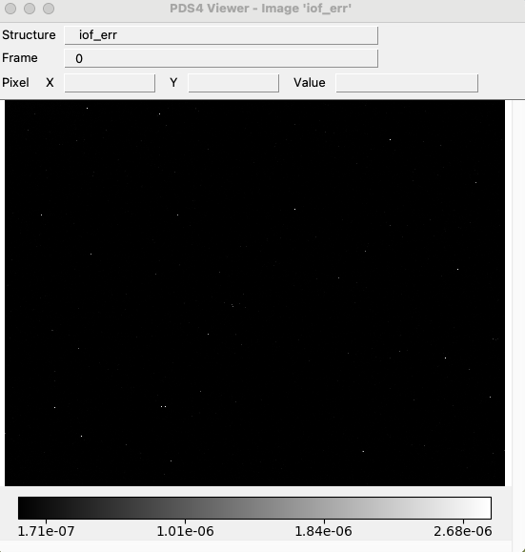
Raw & Calibrated Data - Calibration Mode
Able to open primary data and extensions with PDS4 viewer
Example tt2_0793312840_03588_eng/sci_03
Calibrated -
Extension
Calibrated - Primary
Raw
Raw Primary

Slide 13
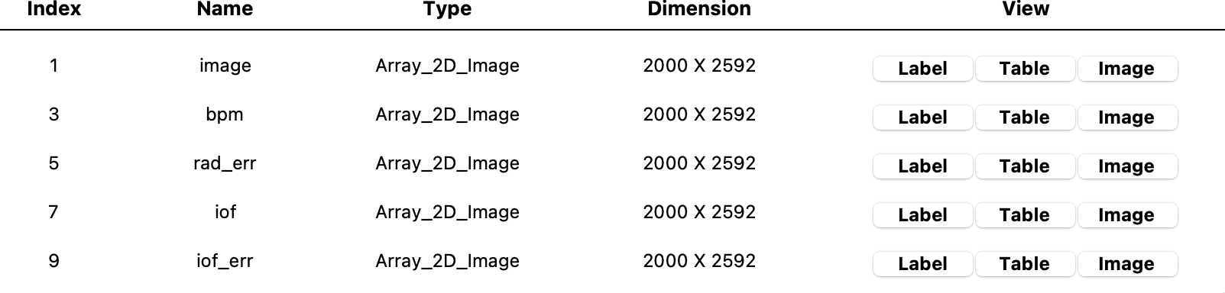
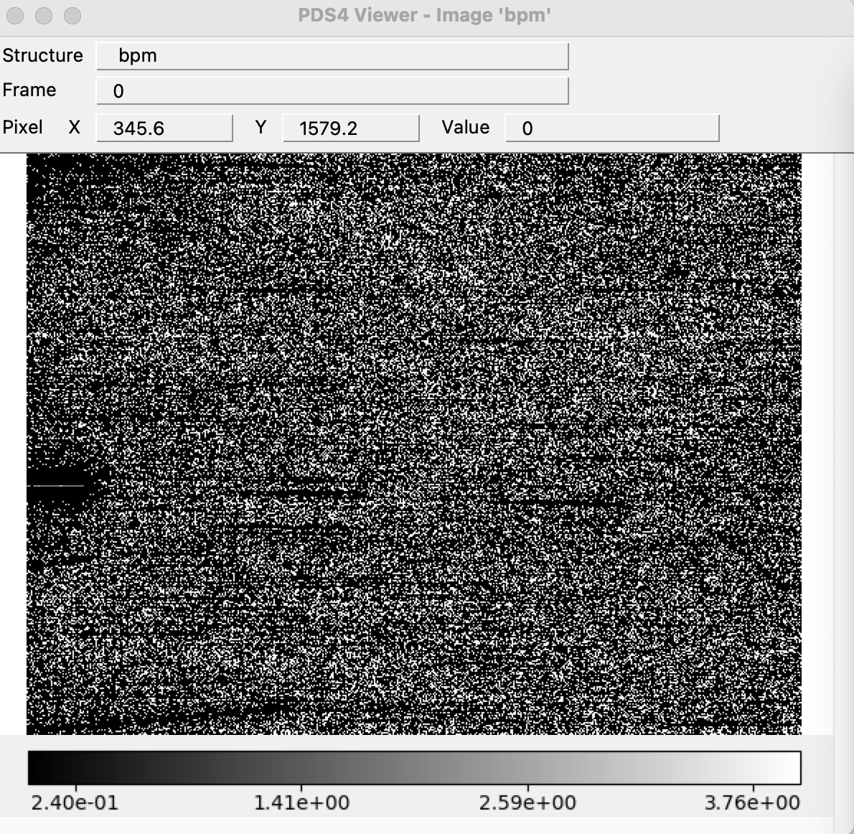
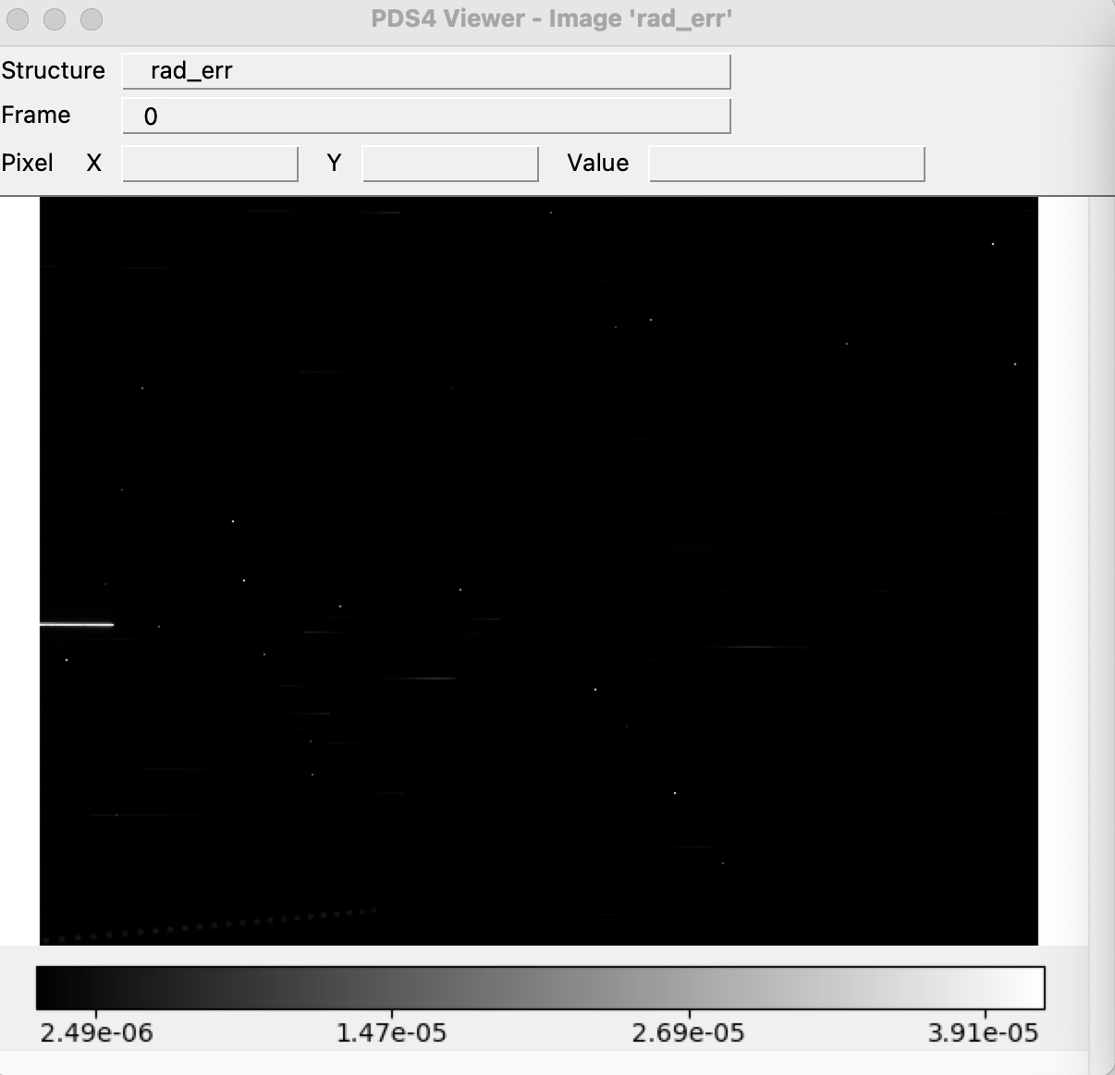
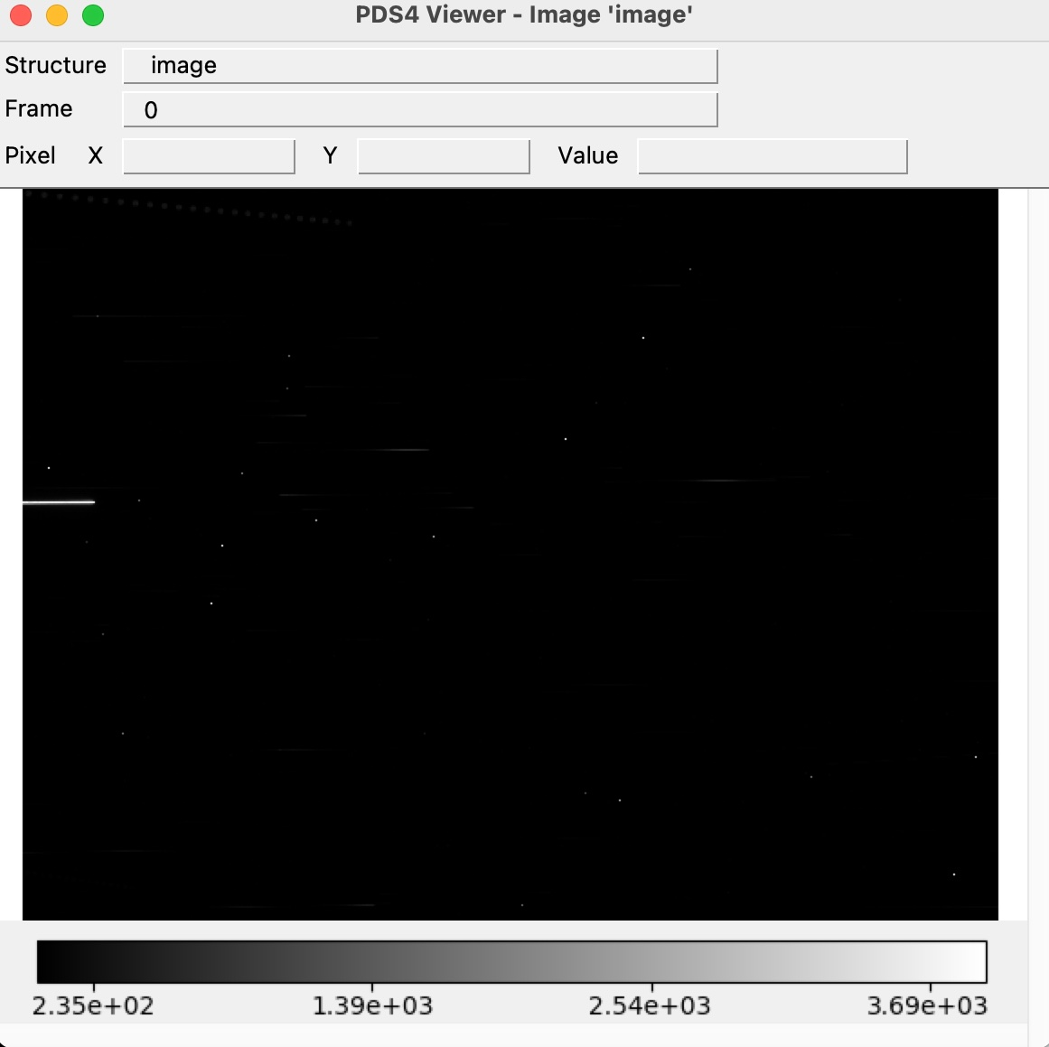
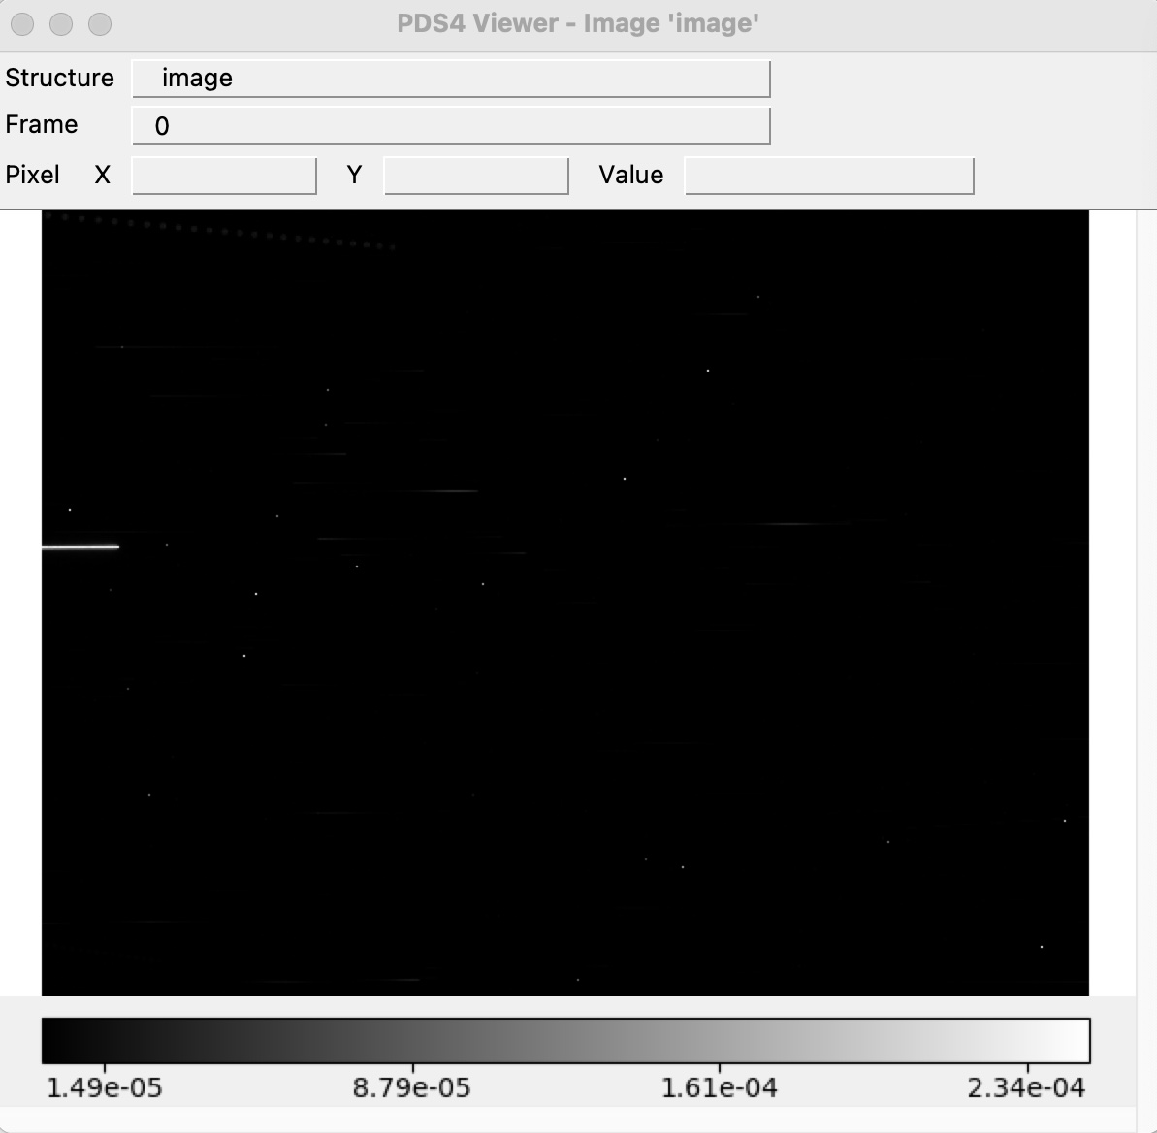
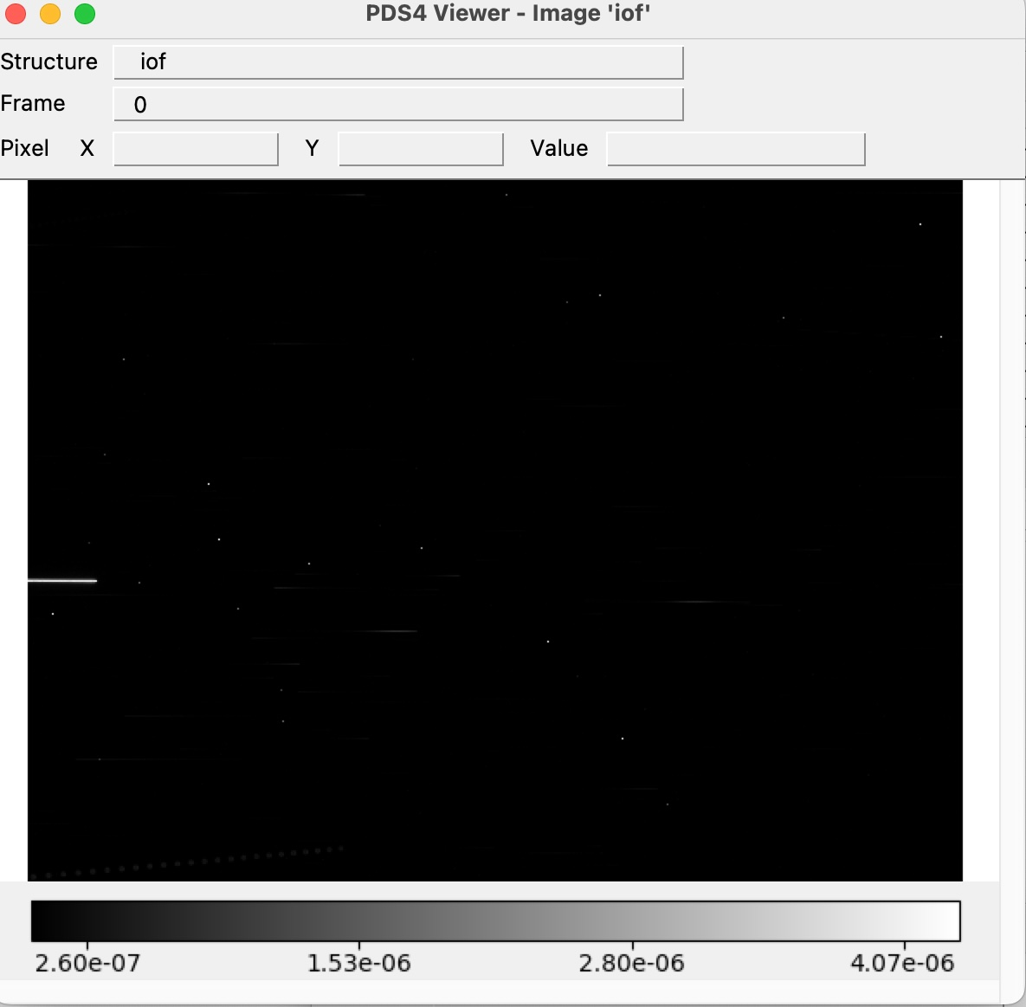

Raw & Calibrated Data – Test Image data
Able to open primary data and extensions with PDS4 viewer
Example tt1_0798446013_29460_eng/sci_02
Calibrated -
Extension
Calibrated - Primary
Raw Primary

Slide 14
Document and Calibration Collection
No version 2.0 of the document collection – Are you still fixing the errors from the previous review?
No Version 2.0 on the calibration collection – Are you still fixing the errors from the previous review?
Verify that the LIDVID for the calibration files in the data calibrated files are valid
Didn’t try to reproduce the calibrated images from the raw images because there is no new calibrations files
Can be certified

