Slide 1
The McDonald Observatory High Spectral Resolving Power Observations of Comets
urn:nasa:pds:gbo-mcdonald:comet_echelle_survey
PDS-SBN Data Archive Review
Lori Feaga
10/15/2026

Slide 2
Generalities
This is a large collection of high resolution visible spectral data of 24 periodic comets and 38 Oort cloud comets, spanning 3 decades of observations made with the McDonald Observatory Harlan J Smith 2.7 m telescope’s Tull Coudé Spectrograph. These data are reduced and are of interest to the community.
Overall, the data collection is complete and the data and ancillary files can be read via their PDS4 xml labels.
There are numerous typos, errors, and points of clarification that are laid out in this presentation and the accompanying document. Generally speaking, the liens need to be addressed before archiving, but do not prevent the data collection from being certified.

Slide 3
File: collection.xml
<Citation_Information>
  Suggest adding a <Funding_Acknowledgement> to this top-level label since you note funding sources in survey.pdf. Those are not easily accessible for NASA statistics searches if not in a label.
<Context_Area>
<Time_Coordinates>
<start_date_time>1995-10-03T11:37:30Z</start_date_time>
<stop_date_time>1995-10-04T11:42:21Z</stop_date_time>
</Time_Coordinates>
  Should be <stop_date_time>2024-11-01T03:35:50.350Z</stop_date_time>
    Taken from the stop time of the last data file collected, stars HR 8634, corresponding to the 01 Nov 2024 night of observing C/2023A3 (Tsuchinshan-ATLAS)
    <Primary_Result_Summary>
    <purpose>Science</purpose>
    <processing_level>Derived</processing_level>
    <Science_Facets>
  Suggest adding a facet for Small Bodies Gas Study like this:
    <Science_Facets>
    <discipline_name>Small Bodies</discipline_name>
    <facet1>Gas Study</facet1>
    </Science_Facets>

Slide 4
File: collection.xml
<Context_Area> con’t
<Observing_System>
<Observing_System_Component>
<name>McDonald Observatory</name>
<type>Host</type>
Type should be Facility or Observatory not Host? Host generally used in spacecraft contexts.
<Observing_System_Component>
<name>2.7m Telescope</name>
<type>Telescope</type>
<Internal_Reference>
<lid_reference>urn:nasa:pds:context:telescope:mcdonald.smith2m7</lid_reference>
<reference_type>is_telescope</reference_type>
</Internal_Reference>
</Observing_System_Component>
LID should be urn:nasa:pds:context:telescope:mcdonald.harlanjsmith_2m7

Slide 5
File: collection.xml
<Context_Area> con’t
<Observing_System_Component>
<name>Tull Coudé Spectrograph</name>
<type>Instrument</type>
<Internal_Reference>
<lid_reference>urn:nasa:pds:context:instrument:mcdonald.harlanjsmith_2m7.tull_coude_spectrograph
</lid_reference>
<reference_type>is_telescope</reference_type>
</Internal_Reference>
</Observing_System_Component>
reference_type should be: is_instrument
SBN/Cochran needs to work together to create the Tull Coudé Spectrograph context object

Slide 6
Files: survey.pdf/.xml
PDS4 is different from PDS3. The file directory structure is not a defining feature of PDS4. The file is not incorrect in describing the organization of how the data have been delivered, but a user accessing the data products from the future PDS4 database and search tools will not see the directory structure. So, make sure that relationships between files that are of importance are made via LID references. I have made suggestions on edits to survey.pdf in the accompanying review document.
Suggest capitalizing coudé in 1st paragraph: McDonald Observatory Tull Coudé Spectrograph
The filename is survey.pdf, although in section 2 it is referred to as “Survey_overview.pdf”. Please correct.
In collection.xml and survey.xml, suggest creating an internal reference to log, starlist, and weather, which will otherwise be harder to associate with the data collection once in the PDS4 database. Use collection.xml example for referencing survey.pdf/xml in a <Reference_List> <Internal_Reference> block.

Slide 7
Files: log.pdf/.xml & weather.pdf/.xml
There are some dates that show up in log.pdf but are not present in weather.pdf and vice versa. The full list of needed corrections is given in the accompanying document.
There are also some typos to be fixed. See accompanying document.

Slide 8
Files: starlist.pdf/.xml
There are several flux standards or hot stars with data files that are not listed as such in Tables 1 & 2. Should they be there? Is the list supposed to be inclusive of all observations? The list of missing stars is included in the accompanying review document.

Slide 9
Files: survey, log, starlist, and weather.xml
It is good practice to include a Modification_History block in the Identification_Area for all files so that changes can be identified
Suggest adding to all document.xml files listed at the top of the slide a modification history like so:
<Modification_History>
<Modification_Detail>
<modification_date>2026-10-15</modification_date>
<version_id>1.0</version_id>
<description>Initial version</description>
</Modification_Detail>
</Modification_History>

Slide 10
All data .xml files
Suggest adding RA, DEC, airmass, and JD to xml files from FITS headers.
Suggest adding a facet for Small Bodies Gas Study like this:
    <Science_Facets>
    <wavelength_range>Visible</wavelength_range>
    <wavelength_range>Near Infrared</wavelength_range>
    <domain>Atmosphere</domain>
    <discipline_name>Spectroscopy</discipline_name>
    <facet1>Spectral Image</facet1>
    <discipline_name>Small Bodies</discipline_name>
    <facet1>Gas Study</facet1>
    </Science_Facets>

Slide 11
Data .xml files cont’d
<Observing_System>
<Observing_System_Component>
<name>McDonald Observatory</name>
<type>Host</type> Observatory
<Internal_Reference>
<lid_reference>urn:nasa:pds:context:facility:observatory.mcdonald</lid_reference>
<reference_type>is_facility</reference_type>
</Internal_Reference>
</Observing_System_Component>
<Observing_System_Component>
<name>2.7m Telescope</name>
<type>Telescope</type>
<Internal_Reference>
<lid_reference>urn:nasa:pds:context:telescope:mcdonald.smith2m7</lid_reference> mcdonald.harlanjsmith_2m7
<reference_type>is_telescope</reference_type>
</Internal_Reference>
</Observing_System_Component>
<Observing_System_Component>
<name>Tull Coudé Spectrograph</name>
<type>Instrument</type>
<Internal_Reference>
<lid_reference>urn:nasa:pds:context:instrument:mcdonald.harlanjsmith_2m7.tull_coude_spectrograph</lid_reference>
<reference_type>is_telescope</reference_type> is_instrument
</Internal_Reference>
</Observing_System_Component>
</Observing_System>

Slide 12
Data files explored
Data files could be opened and displayed with PDS4 Viewer
Made some basic comparisons between data files I accessed and plots included in the documentation with the collection and data previously archived with PDS (e.g., deVico)
No problems with data found

Slide 13
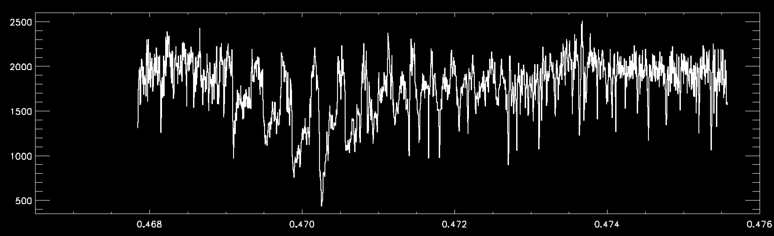
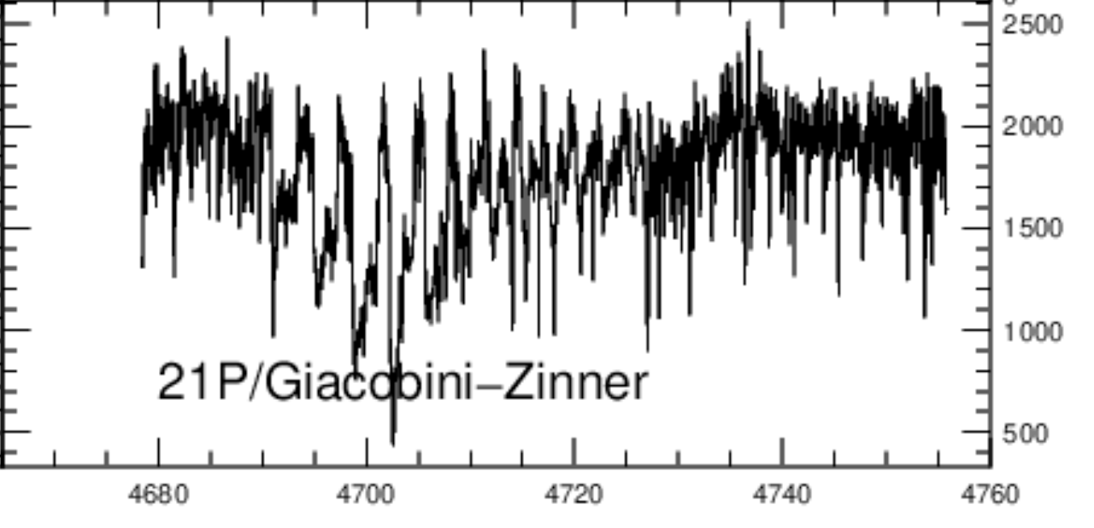
Plotting 21P_Giacobini-Zinner/gz0003.fits compared to survey.pdf Fig. 2 (‘picket fence’)
Wavelength (microns)

Slide 14
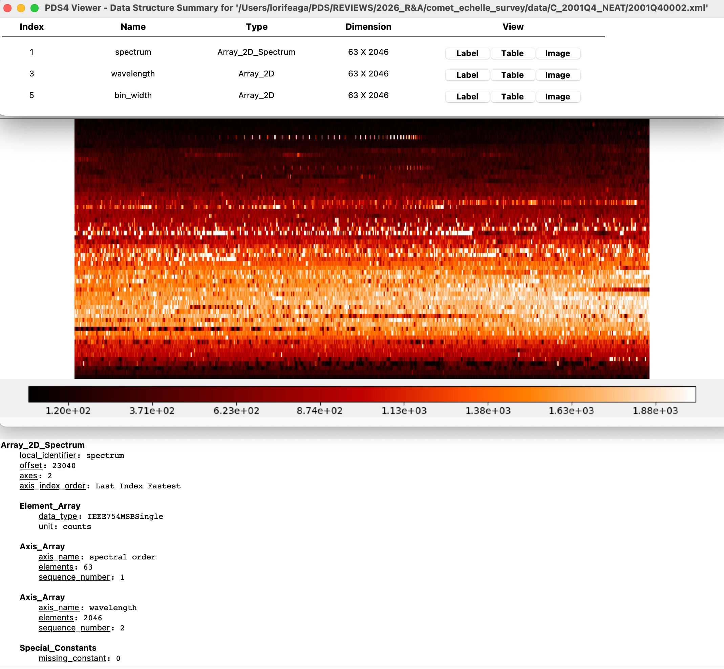
C_2001Q4_NEAT: 2001Q40002.xml + .fits
Opening file with PDS4 Viewer

Slide 15
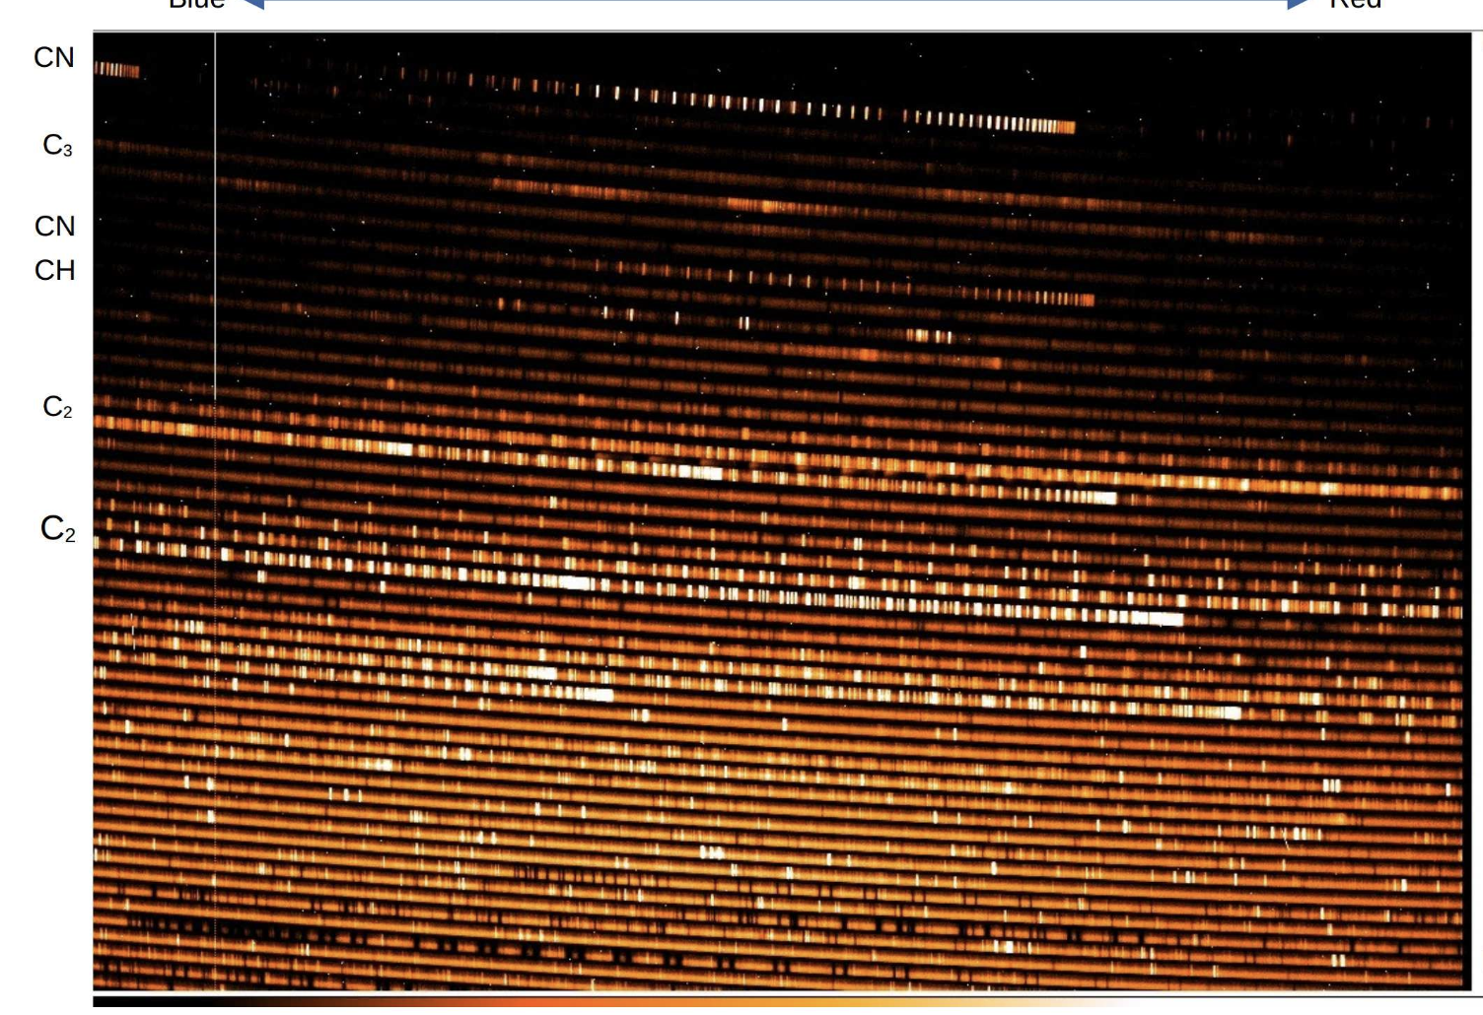
C_2001Q4_NEAT: 2001Q40002.xml + .fits
CN
C₃
CN
CH
C₂
C₂
Opening file with PDS4 Viewer
Compared to Fig. 1 (example comet spectrum) in documentation

Slide 16
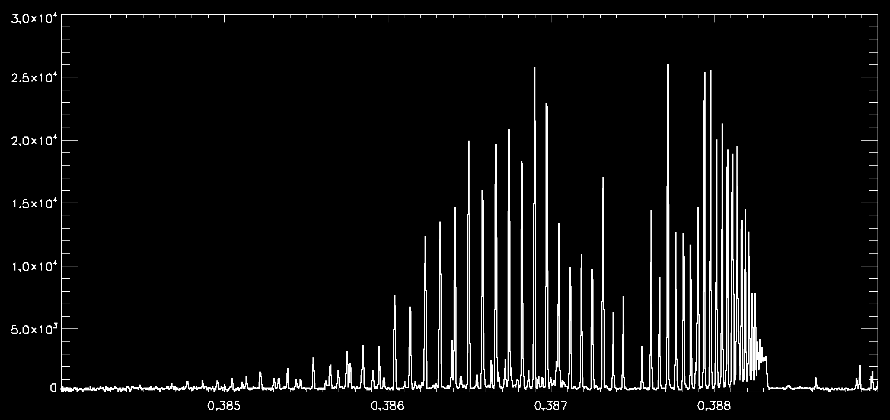
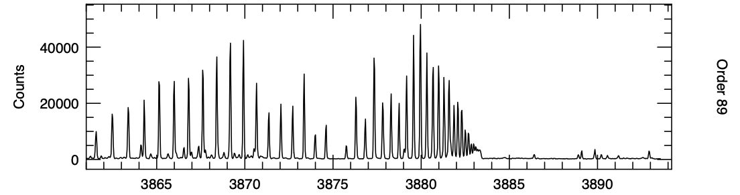
122P_deVico: dev0002.fits
Echelle survey
deVico Atlas
Comparison between data and deVico Atlas previously archived in PDS-SBN

Slide 17
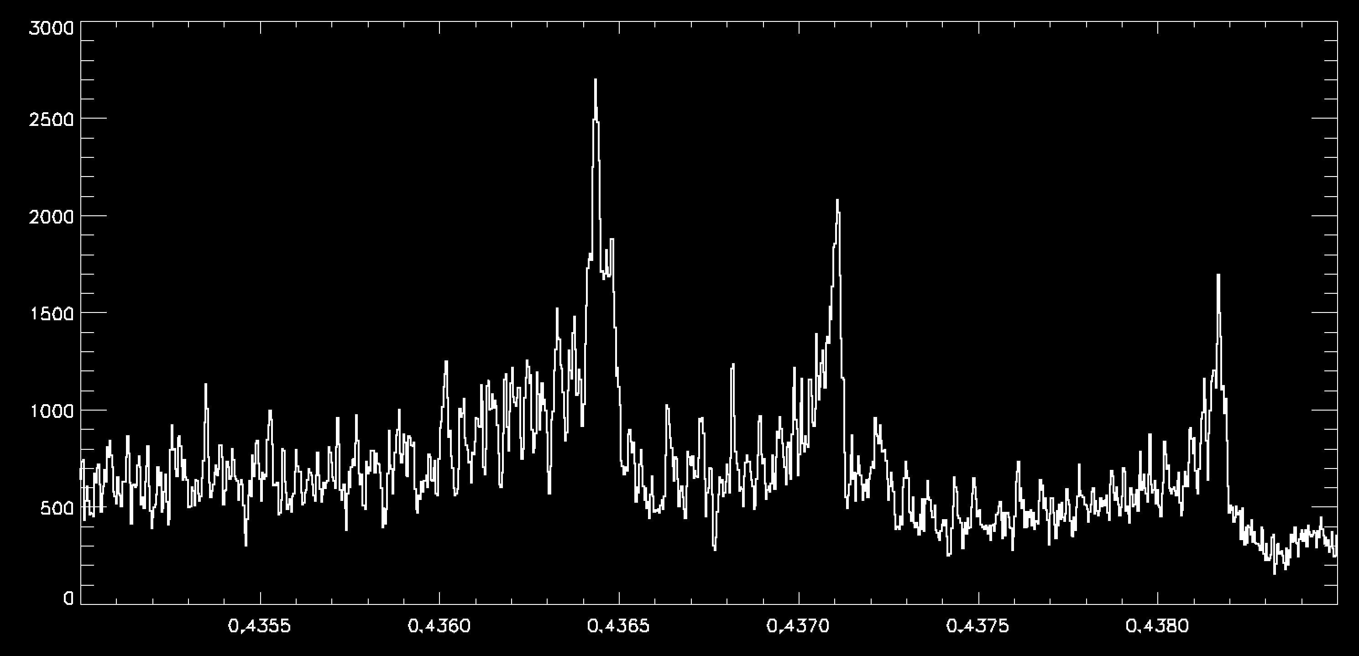
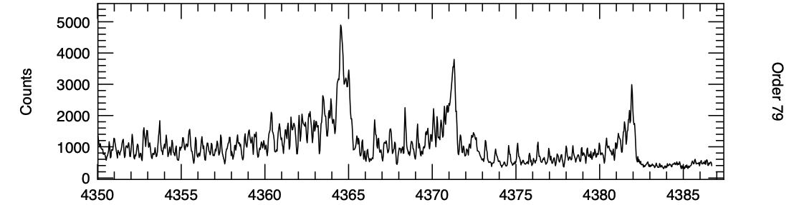
122P_deVico: dev0002.fits
Echelle survey
deVico Atlas

Slide 18
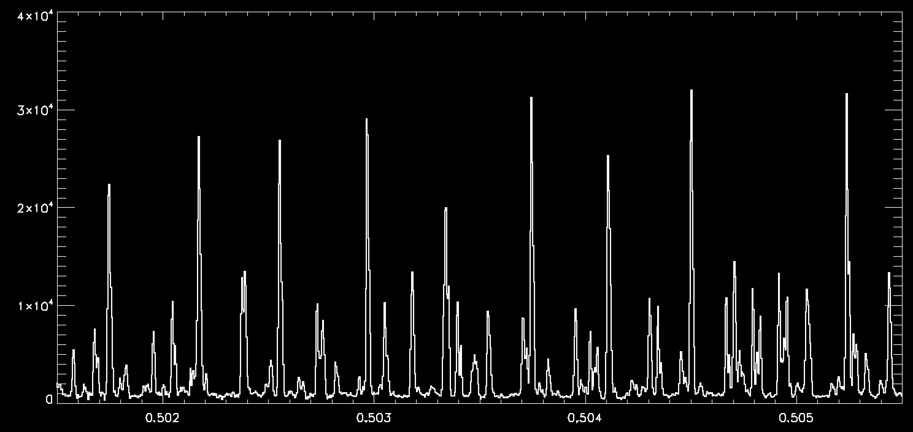
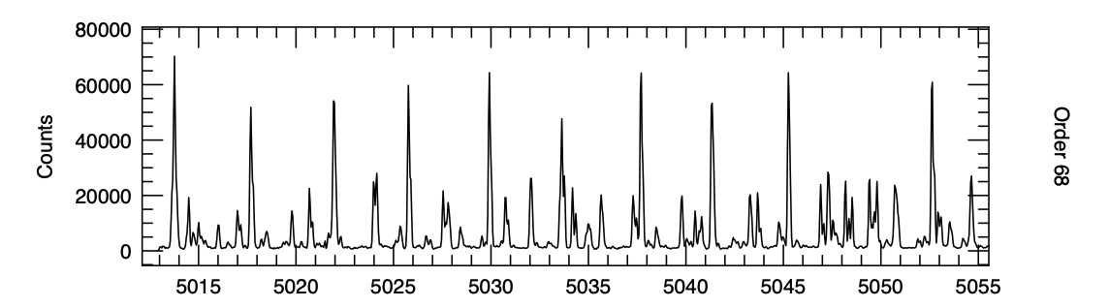
122P_deVico: dev0002.fits
Echelle survey
deVico Atlas

Slide 19
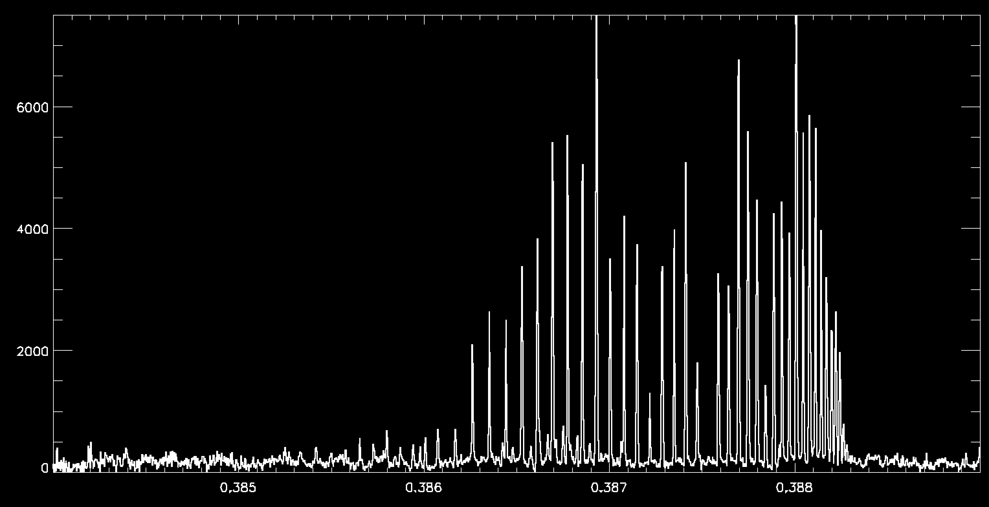
C/2013 US10 (Catalina)
CN

Slide 20
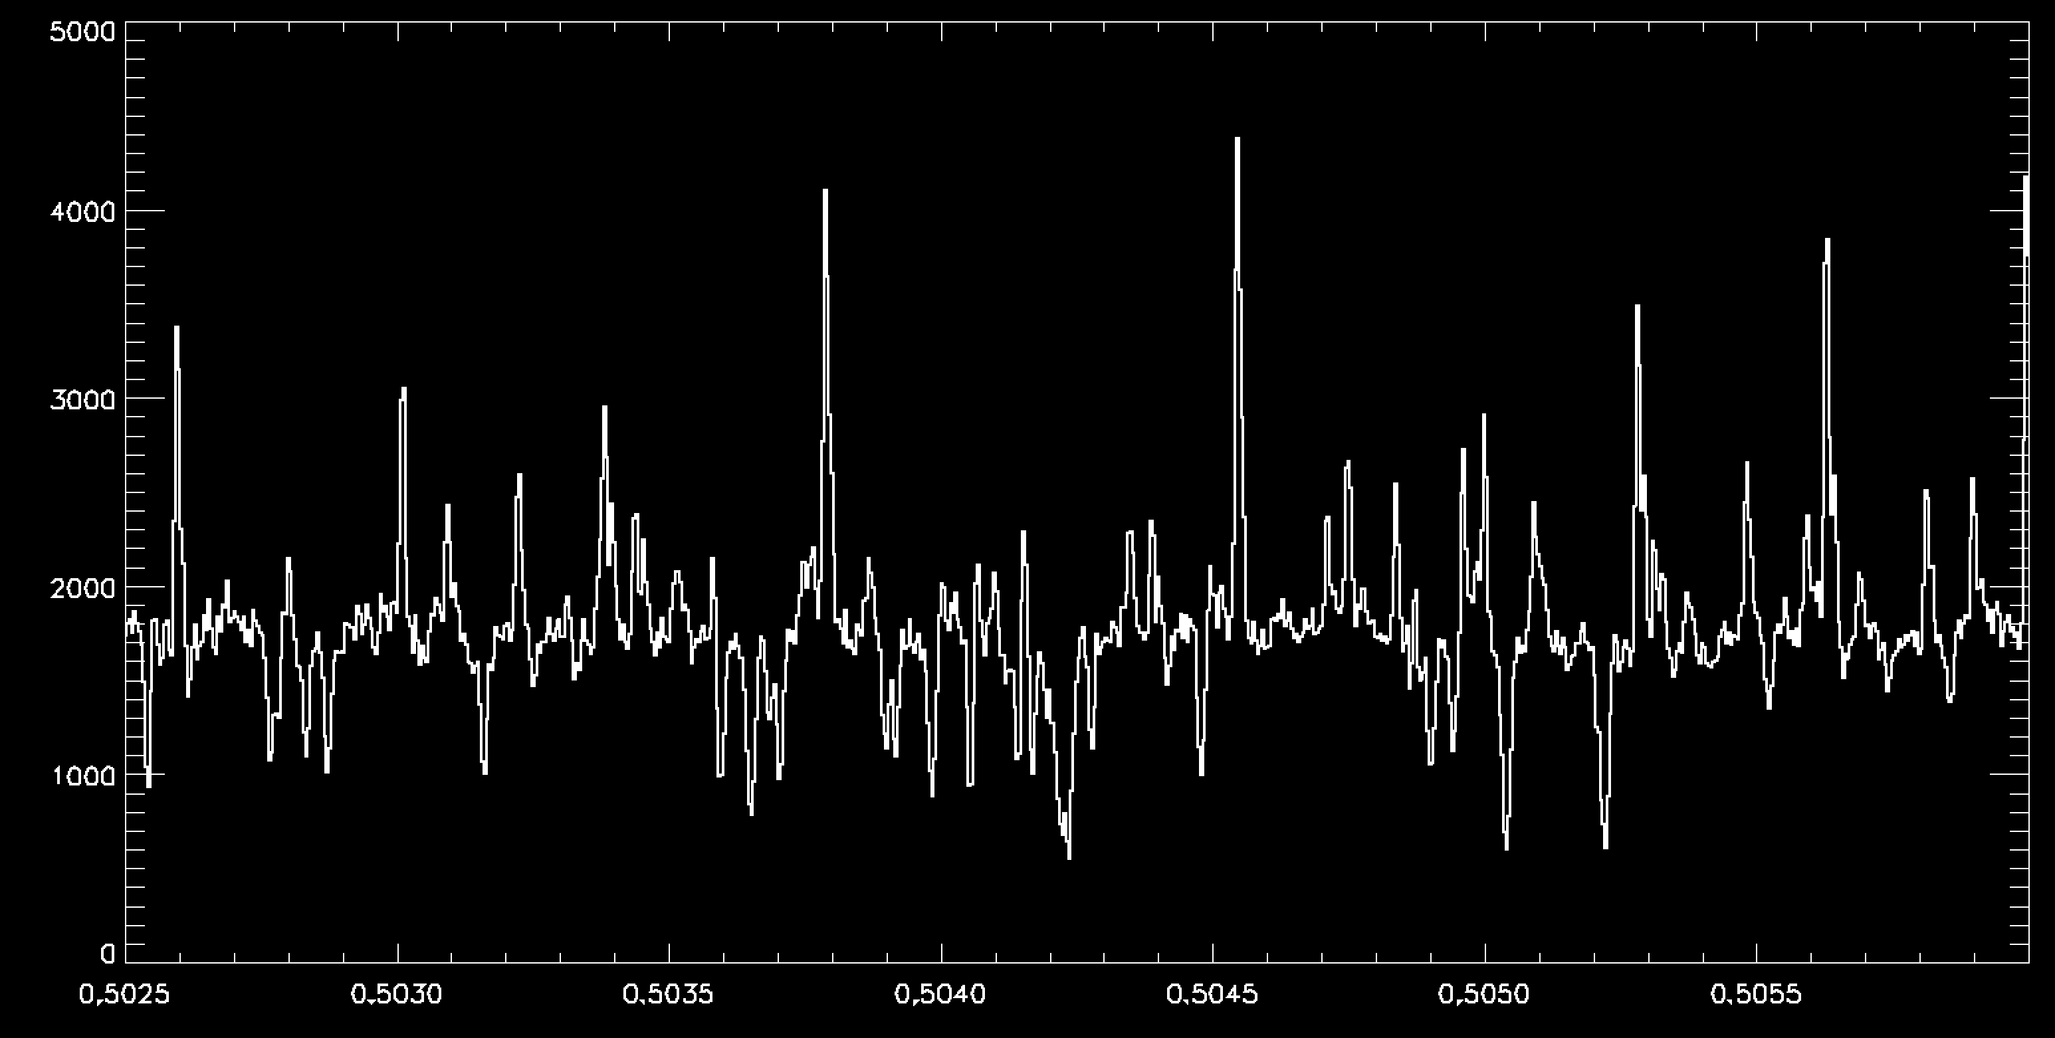
C/2013 US10 (Catalina)
C₂

Slide 21
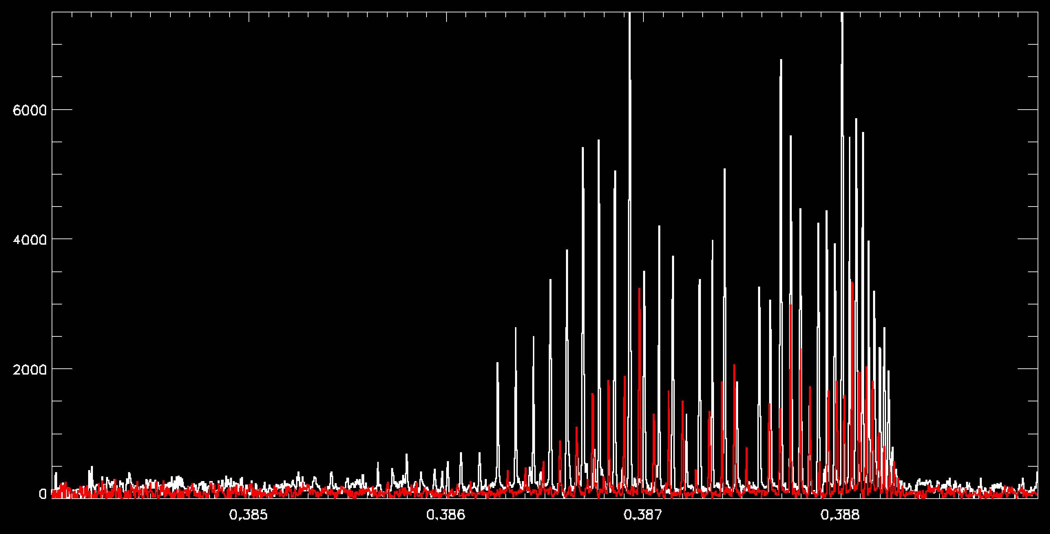
C/2013 US10 (Catalina)
CN
21 Jan 2016: 1.44 au, 10.4 km/s
16 Feb 2016: 1.79 au, 49.5 km/s

Slide 22
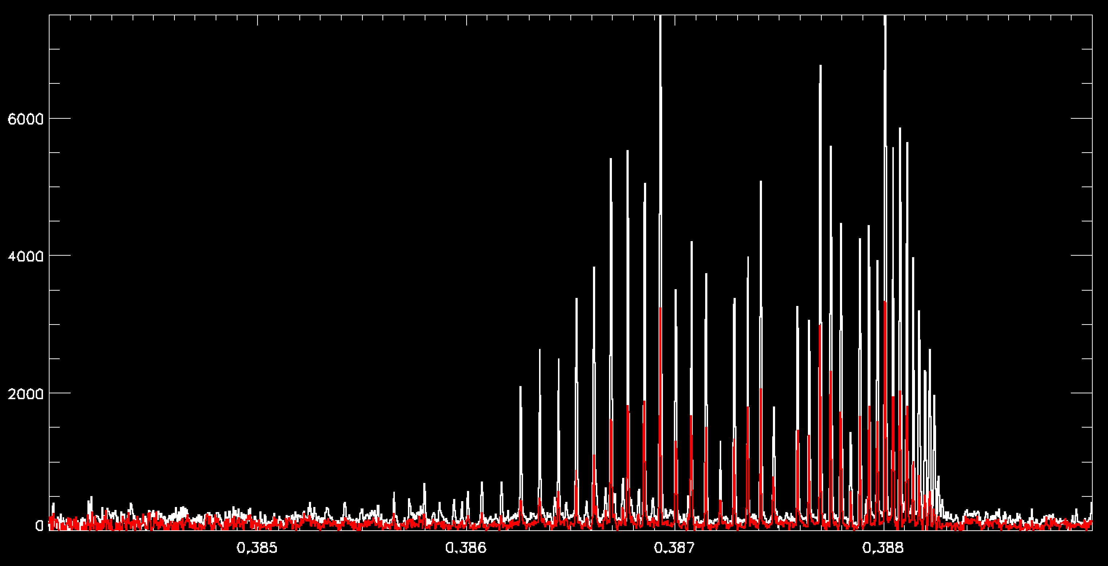
C/2013 US10 (Catalina)
CN
21 Jan 2016: 1.44 au, 10.4 km/s
16 Feb 2016: 1.79 au, 49.5 km/s , 0.5 Å shift

Slide 23
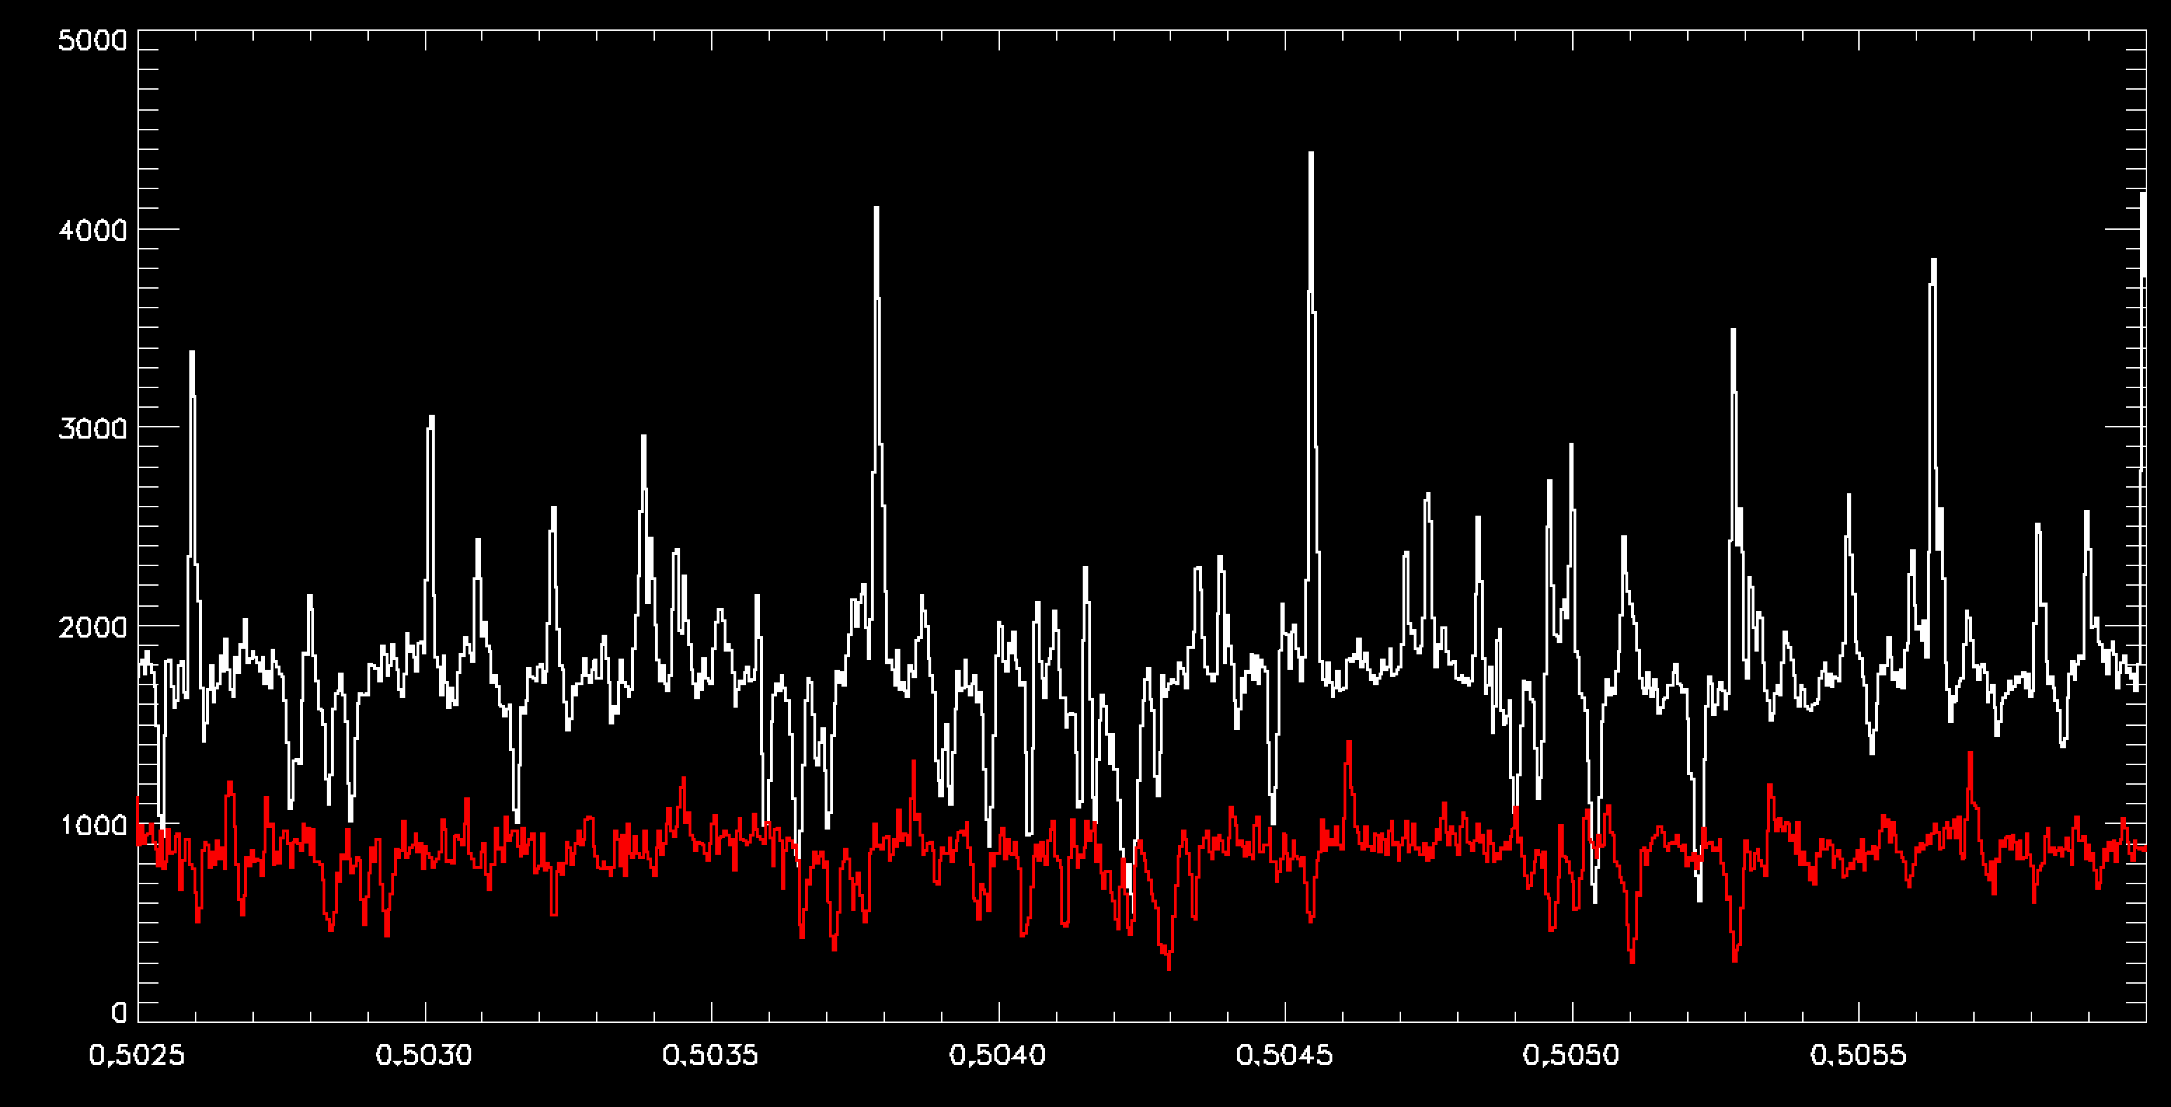
C/2013 US10 (Catalina)
C₂
21 Jan 2016: 1.44 au, 10.4 km/s
16 Feb 2016: 1.79 au, 49.5 km/s

Slide 24
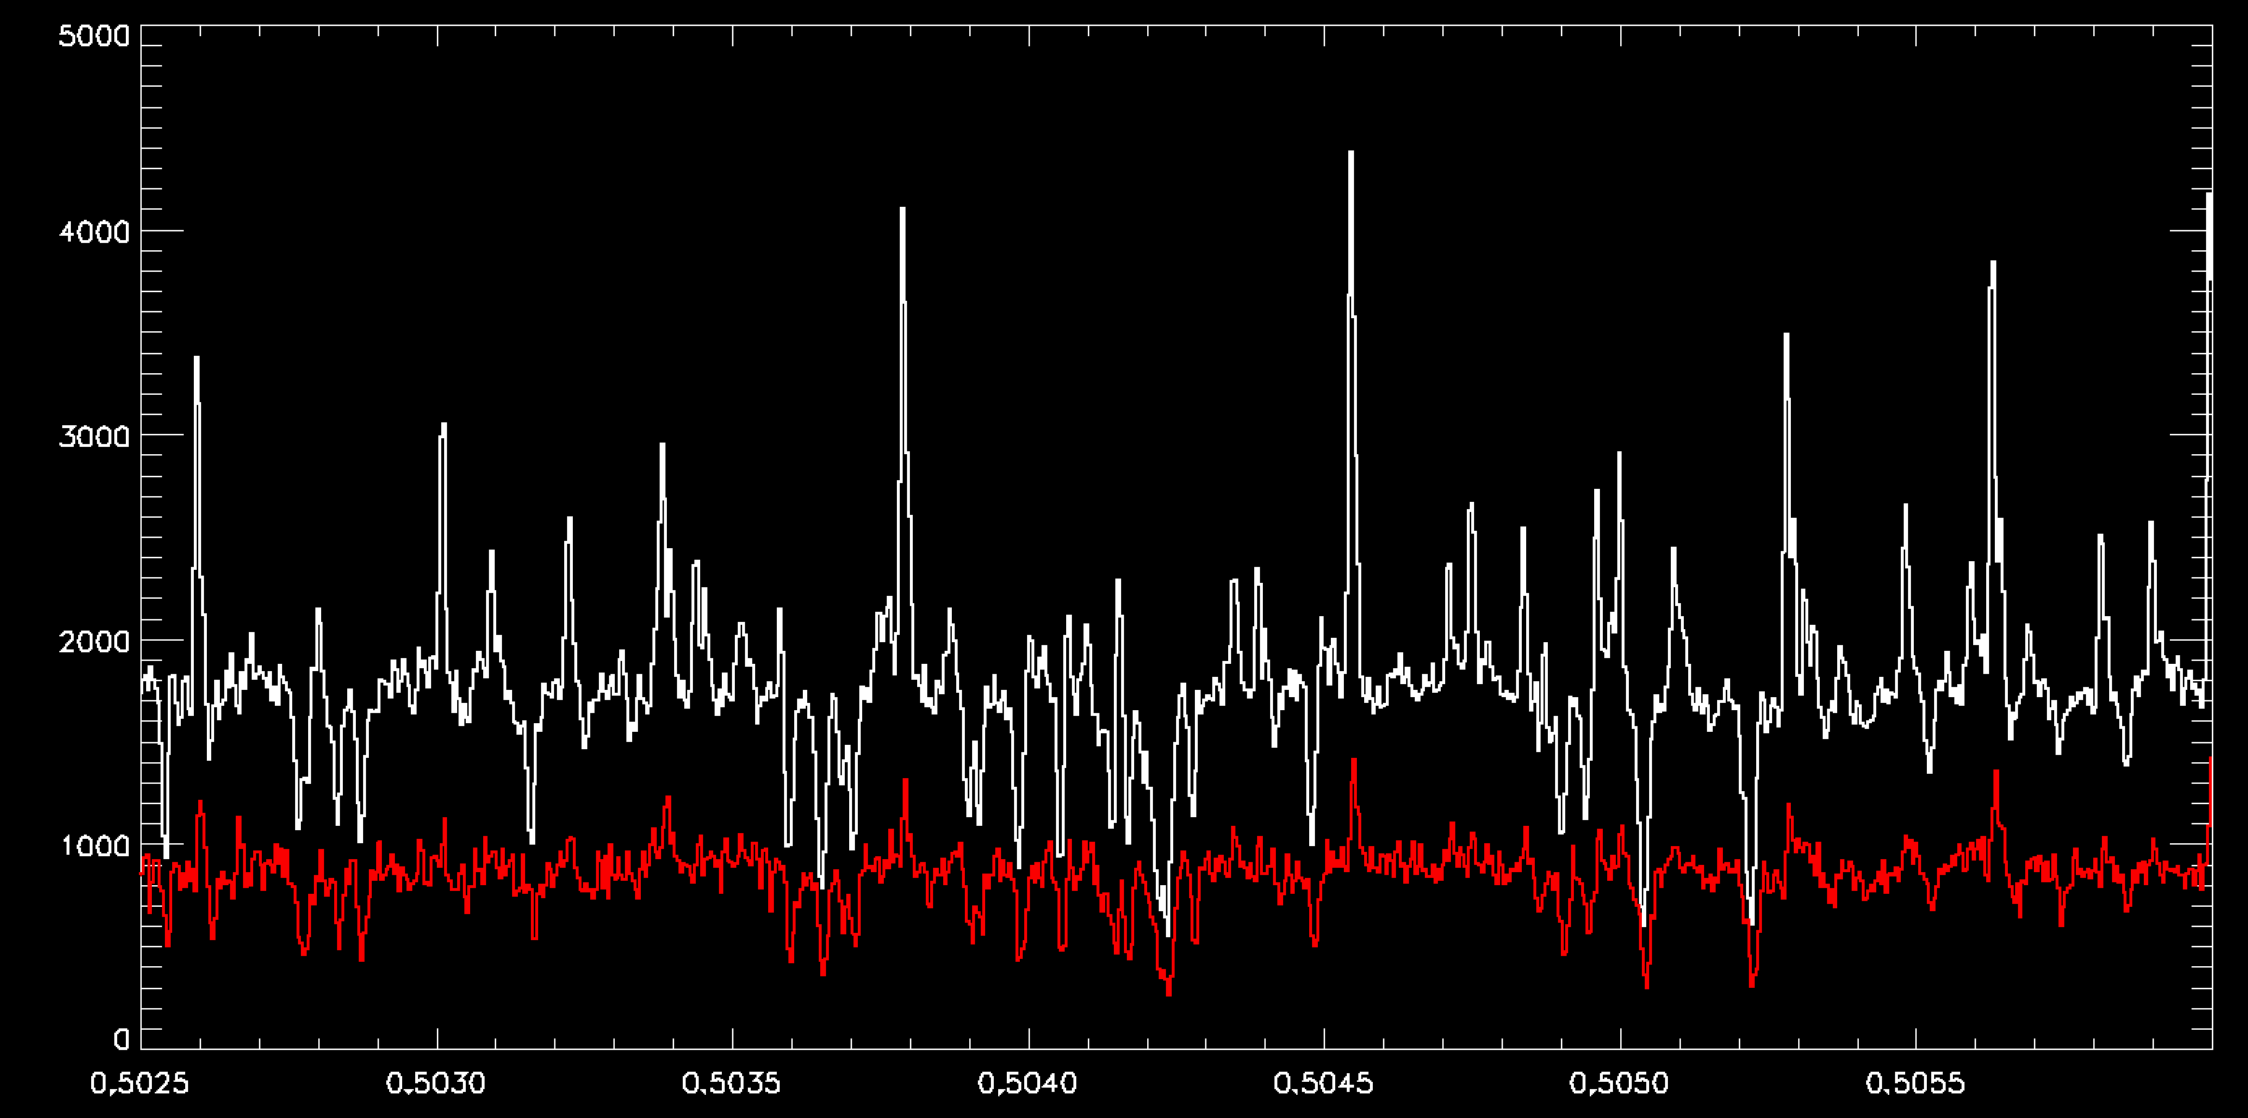
C/2013 US10 (Catalina)
C₂
21 Jan 2016: 1.44 au, 10.4 km/s
16 Feb 2016: 1.79 au, 49.5 km/s, 0.6 Å shift

Slide 25
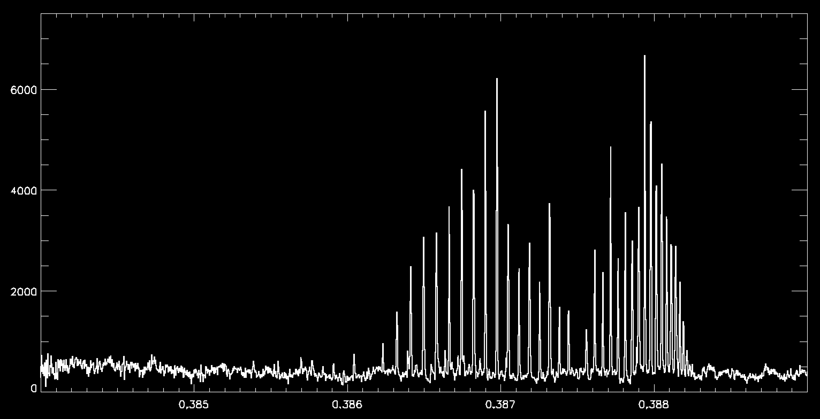
C/2015 V2 (Johnson)
CN

Slide 26
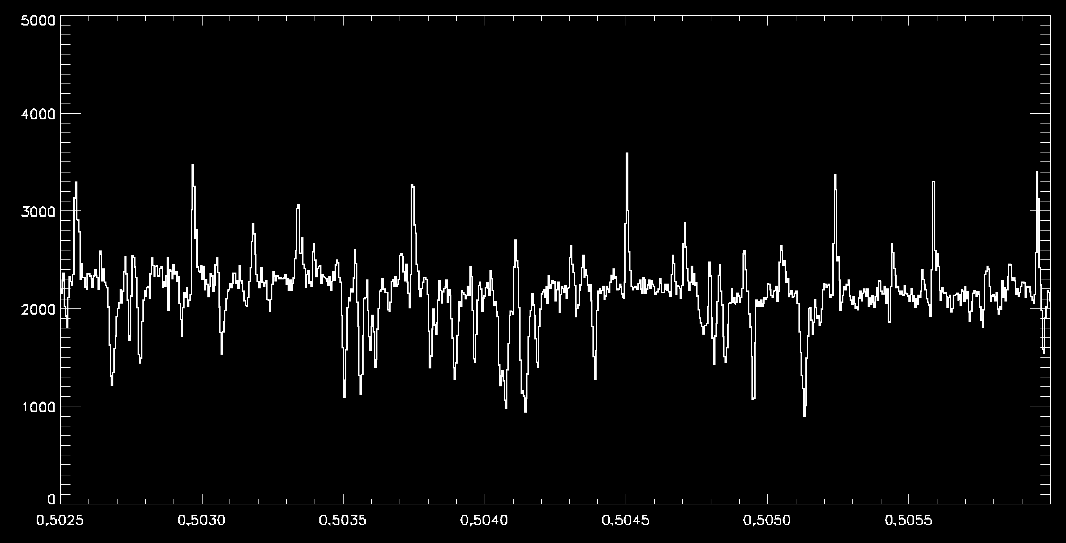
C/2015 V2 (Johnson)
C₂

Slide 27
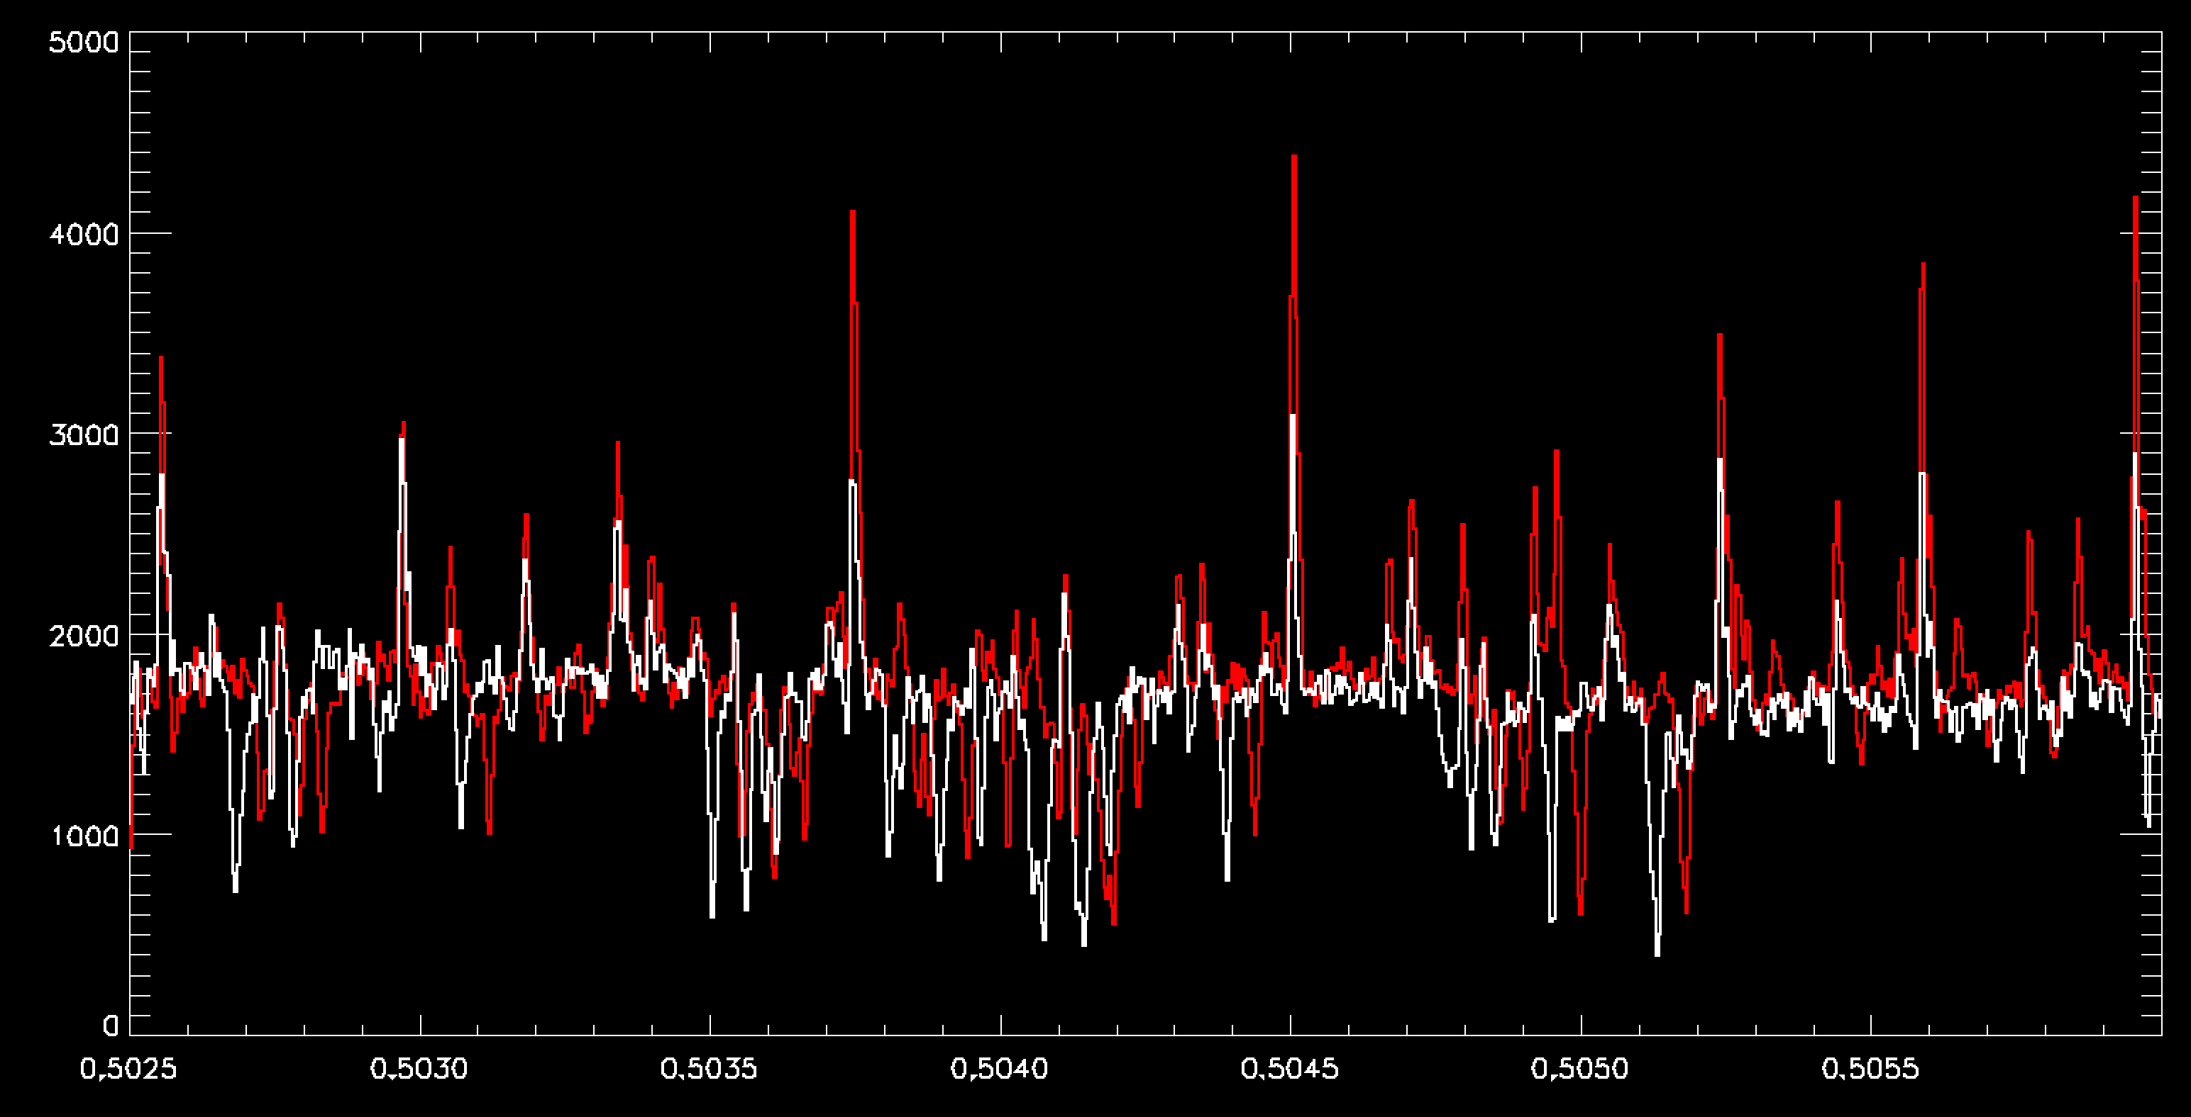
C/2013 US10 (Catalina) vs. C/2015 V2 (Johnson)
C₂
Johnson
Catalina

Slide 28
Final thoughts
To the data submitter: Please make sure to use this slide deck and the Word document (more details included) to find all suggested corrections/edits to the documentation.
To the PDS: I believe that this data collection can be certified now, acknowledging the necessary documentation liens prior to final archiving unless something major is brought up by the primary reviewer and discussed during the review that deems the collection uncertifiable and warrants a delta review.

