Slide 1
Comet Echelle Survey PDS Review
Adam McKay

Slide 2
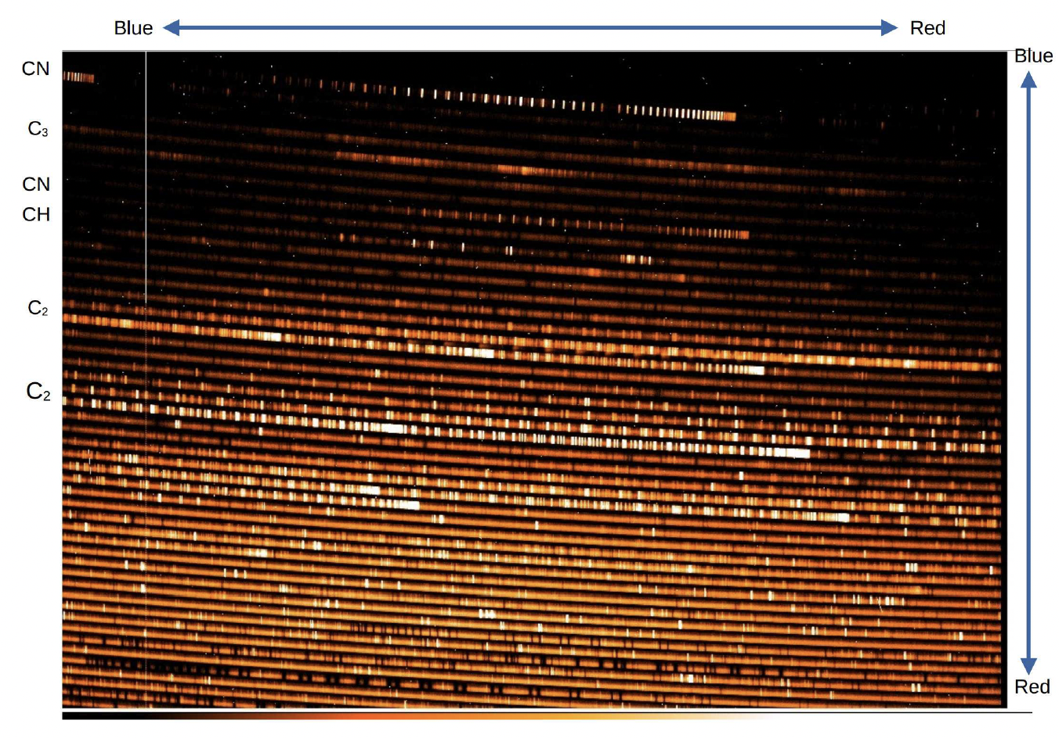
Coude Overview
Tull Coude spectrograph on the 2.7-meter Harlan J. Smith Telescope at McDonald Observatory
High resolving power (R=60,000) spectra of comets in the optical/NIR
3700-10,100 Angstroms, interorder gaps redward of 5700 Angstroms
Almost 30 years of data (1995-2024) of 62 comets
Data is reduced, can be read by various programs

Slide 3
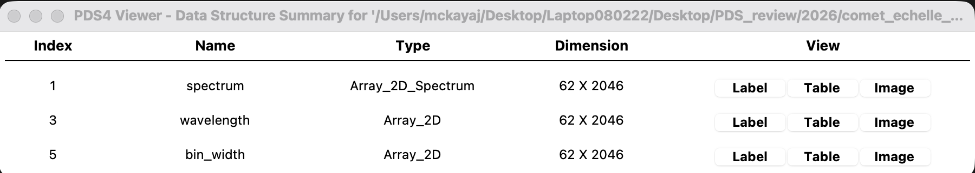
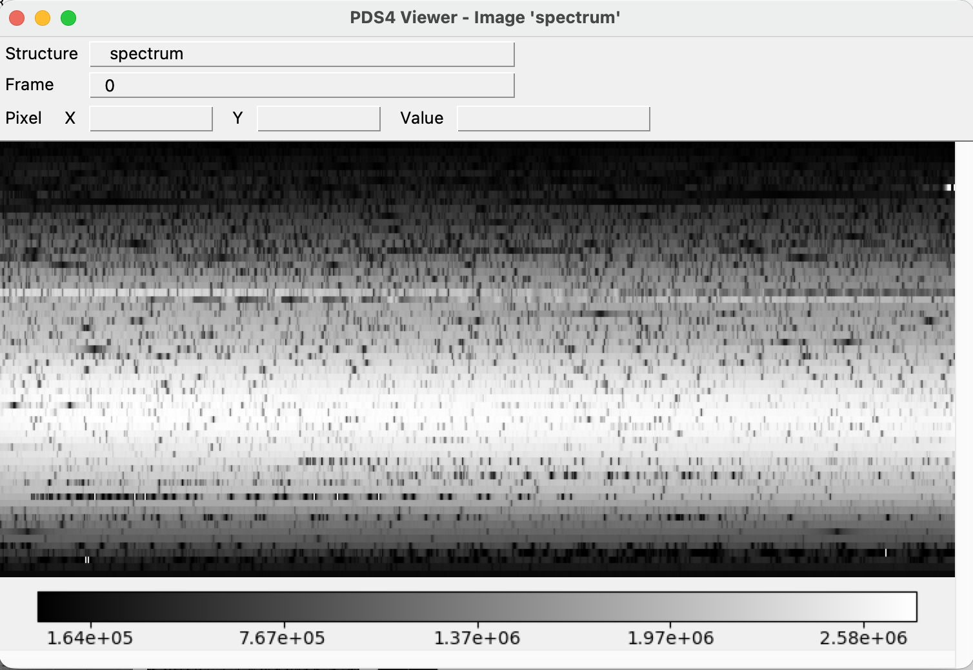
Viewing Data
Able to view data in PDS 4 Viewer and DS9
XML files and FITS headers seem to be in good shape
Extensions reported to be present in documentation are actually present in the files and can be accessed

Slide 4
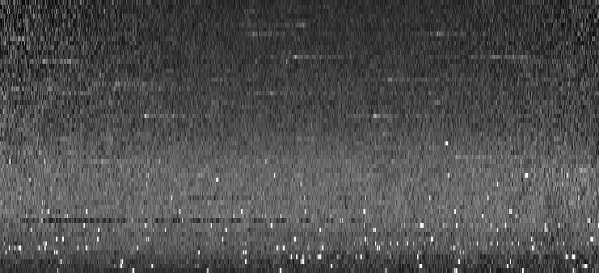
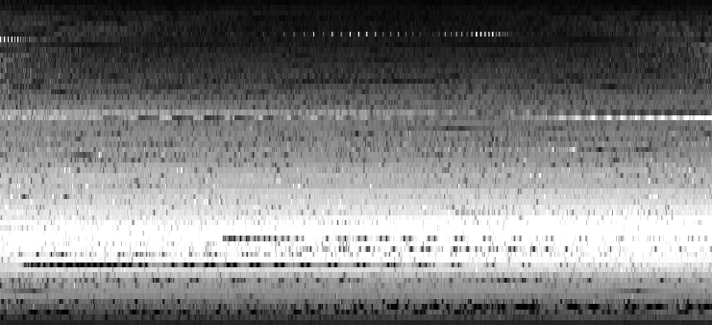
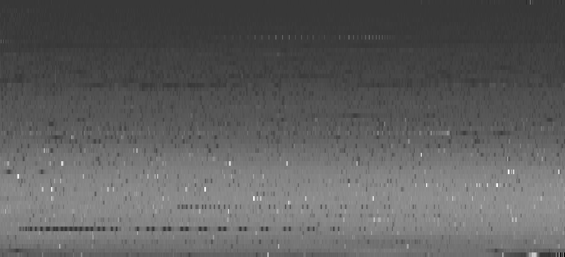
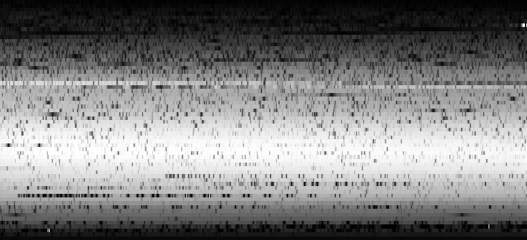
Example Data
C/2016 R2 (PanSTARRS)
C/2023 A3 (Tsuchinshan-ATLAS)
46P/Wirtanen
Solar Port

Slide 5
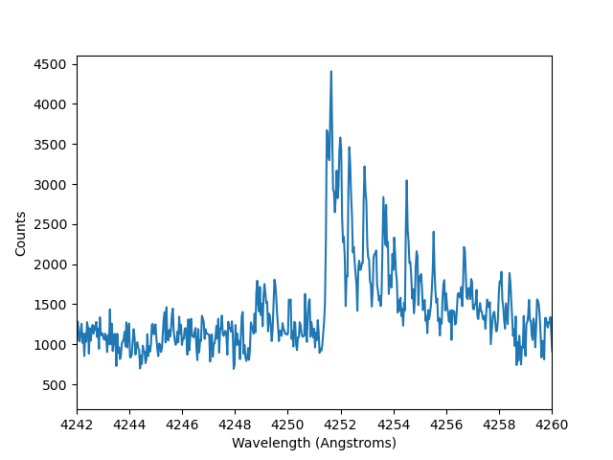
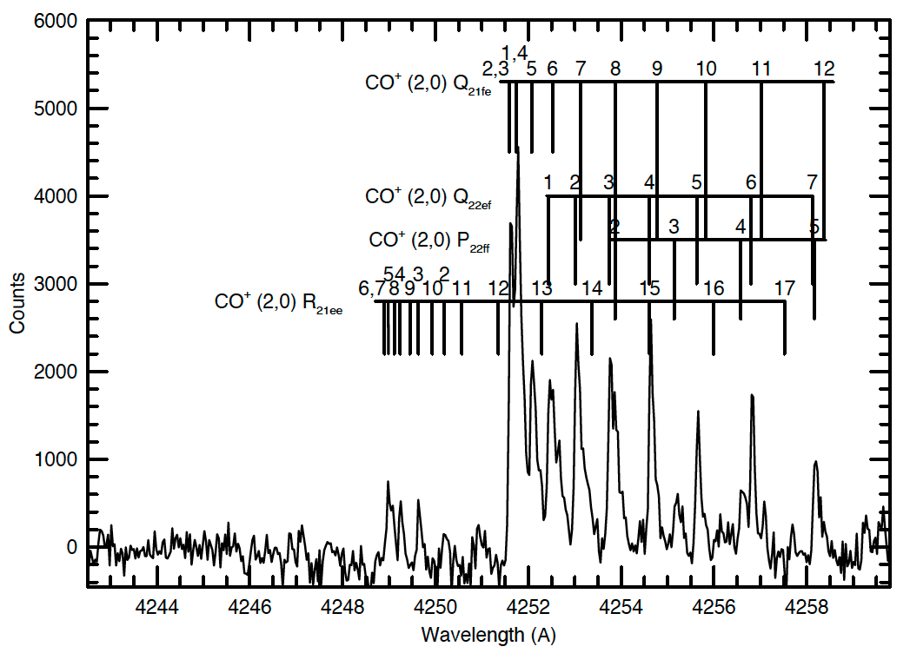
Plotting Data-CO⁺ in C/2016 R2 (PanSTARRS)
From PDS Data Set
Cochran and McKay 2018

Slide 6
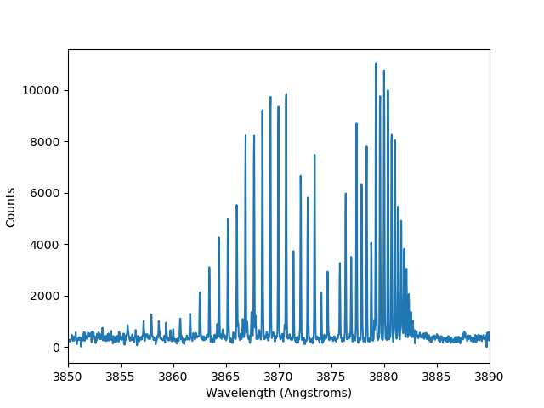
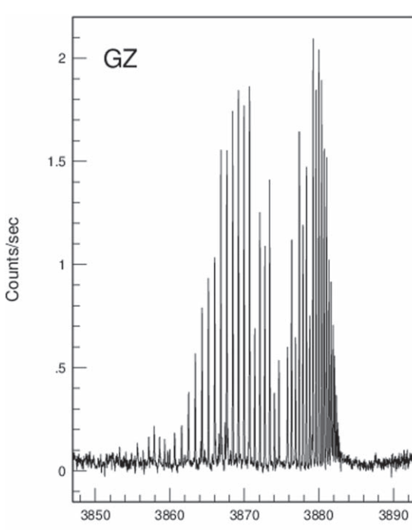
Plotting Data-CN in 21P/Giacobini-Zinner
From PDS Data Set
Cochran et al. 2020

Slide 7
Documentation
Includes documentation that is generally in good order, a few typos and corrections/clarifications needed
Survey.pdf
Missing indent on first paragraph of each section, probably a LaTeX thing
In line 2 I believe coude should be capitalized since it is in the name of the instrument
Filename is just survey.pdf, but is referred to as survey_overview.pdf in the document
Should ”V” in V sin i be capitalized (I also think it should be all one word, like vsini)?
In data reduction, should note user will also need to account for heliocentric velocity of comet when subtracting solar continuum, since reflected solar spectrum reflects both the heliocentric and geocentric velocity. For cases where the solar standard is not the solar port, the user will need the radial velocity of the star to properly align the spectra
Document mentions some spectra had cosmic rays removed by hand and user should be cautious of those, but there is no indication of which spectra these are
Add clarification of difference between exposure time and dark time in the headers?
Log.pdf
I think there should be a footnote stating what the geometry variables represent (heliocentric distance and velocity, geocentric distance and velocity)
Starlist.pdf
109 Vir should be 108 Vir, Like in survey.pdf, think v sin i should be written as “vsini”.

Slide 8
Conclusions
Data is certifiable
Some fixes to documentation needed

